Slide 1
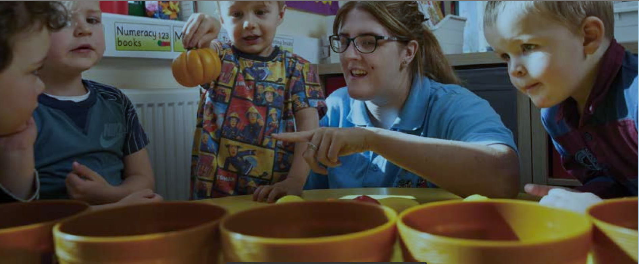
Unit 216 Exam Walk-through
Level 2 Children’s Care, Play, Learning and Development: Practice and Theory

Slide 2
Resources

Slide 3
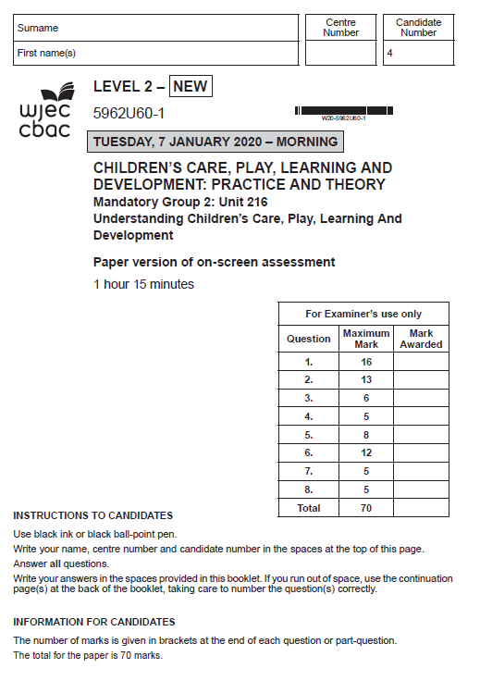
Unit 216 – Understanding Children’s Care, Play, Learning and Development
Theory - External Exam
• This exam is available to sit in January and May/June each
year
• Results for the January exam are available in March
• Results for the May/June exam are available in August
• There is the opportunity to re-sit this exam, but only in January
or May/June
• This exam is worth 10% of the qualification
• 75-minute written exam
• A maximum of 70 marks available
• Mixture of short and extended answer questions
• Graded: Pass/Fail
The exam is available in paper format or on-screen – this depends on what your centre chooses when entering their candidates
If you are completing the paper exam you will need to use black-ink pens. You may also take highlighter pens into the exam.

Slide 4
What you should have in front of you:
A copy of the exam paper
A pen, pencil
A highlighter pen
A watch
Post-it notes

Slide 5
General points on exam technique
Read through the whole question before starting to answer. This will help you understand what is required of you.
Use a highlighter to pick out key words.
Look at the command words and the number of marks available for each question, they will help you decide how much detail is needed.
If a word is bold it is important.
Keep your exam paper open at the double page spread, do not fold it in half.
Read your answers to check they make sense.

Slide 6
Command Verbs

Slide 7
What should I do first?
Make sure to put your name, candidate number and centre number on the Question paper
Carefully read the front cover of the exam paper.
INSTRUCTIONS TO CANDIDATES
Use black ink or black ball-point pen.
Write your name, centre number and candidate number in the spaces at the top of the front page of the exam paper.
Answer all questions.
Write your answers in the spaces provided in this booklet. If you run out of space, use the continuation page(s) at the back of the booklet, taking care to number the question(s) correctly.
INFORMATION FOR CANDIDATES
The number of marks is given in brackets at the end of each question or part-question.
The total for the paper is 70 marks.

Slide 8
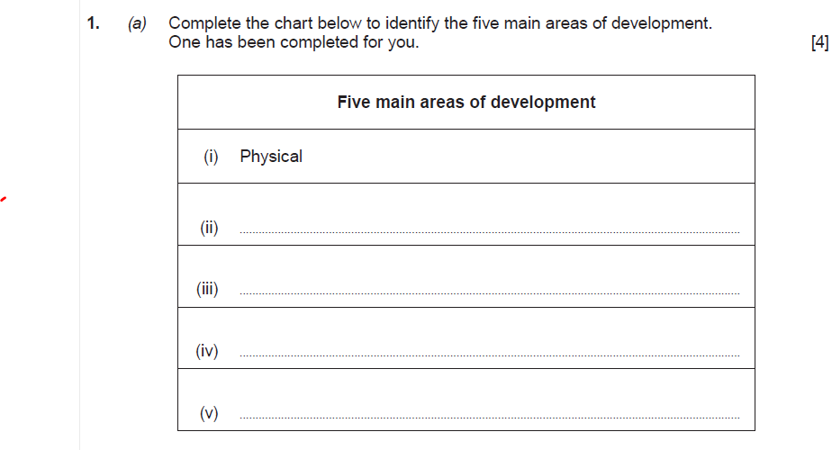
Question 1 (a)

Slide 9
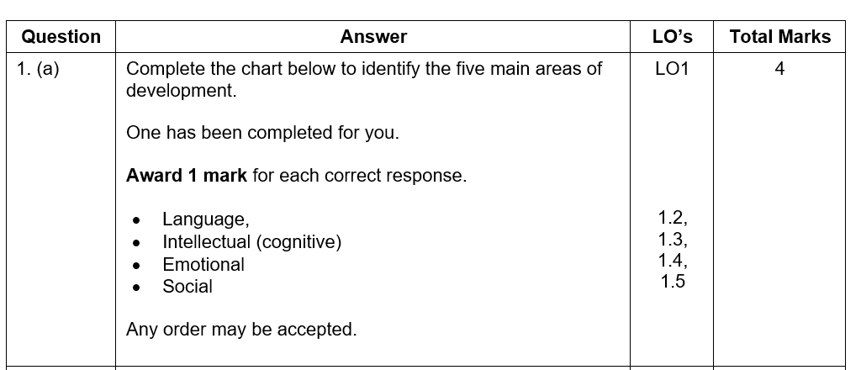
Question 1 (a)

Slide 10
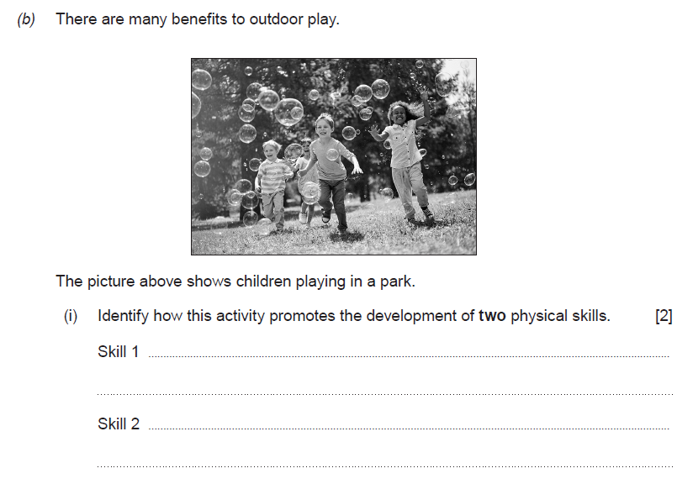
Question 1 (b) (i)

Slide 11
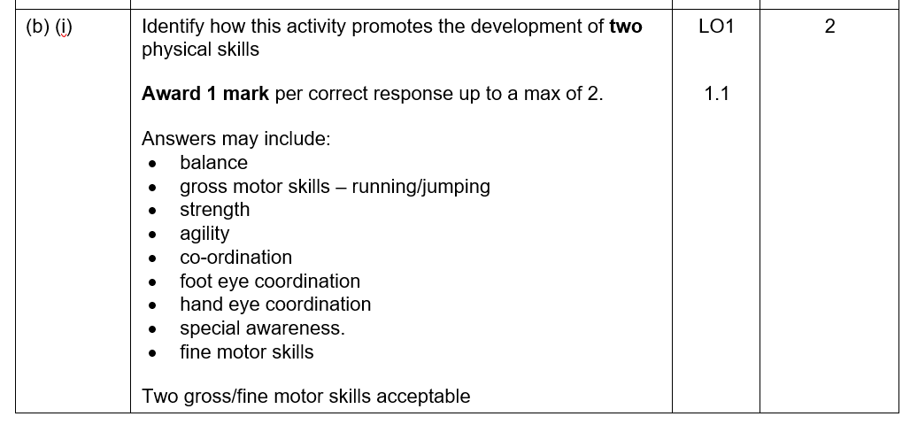
Question 1 (b) (i)

Slide 12
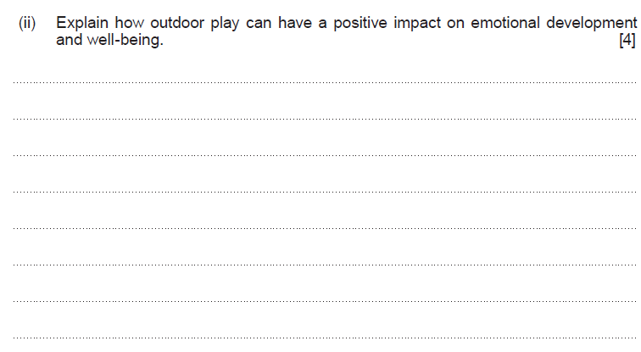
Question 1 (b) (ii)

Slide 13
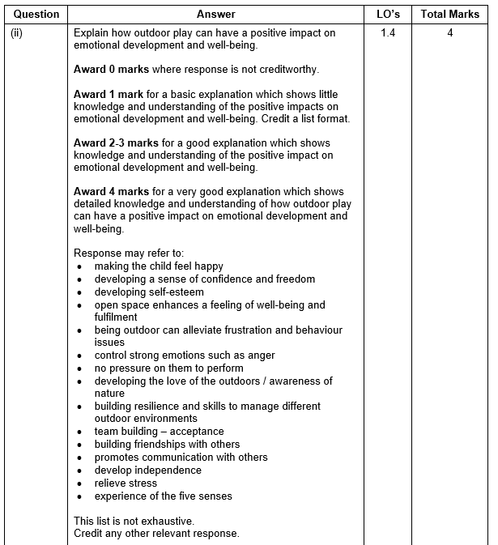
Question 1 (b) (ii)

Slide 14
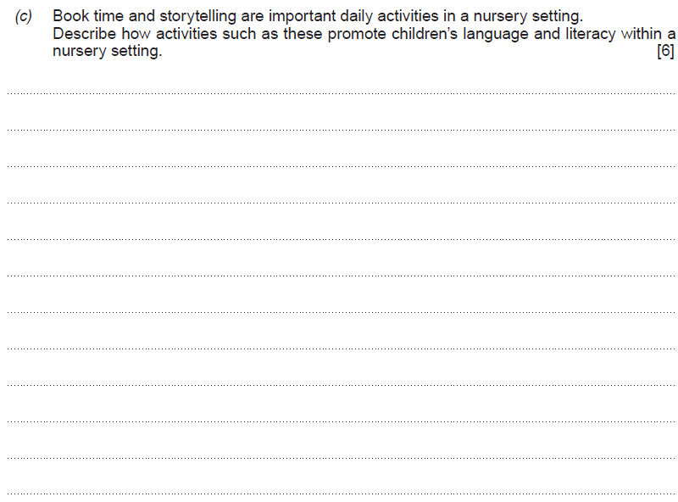
Question 1 (c)

Slide 15
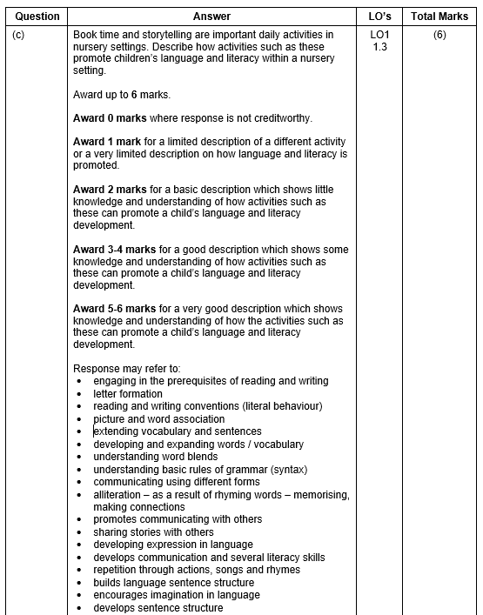
Question 1

Slide 16
Question 2 (a)

Slide 17
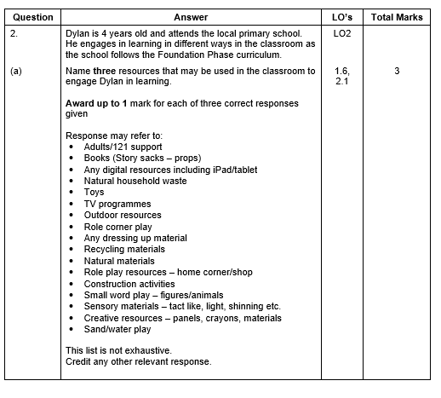
Question 2 (a)

Slide 18
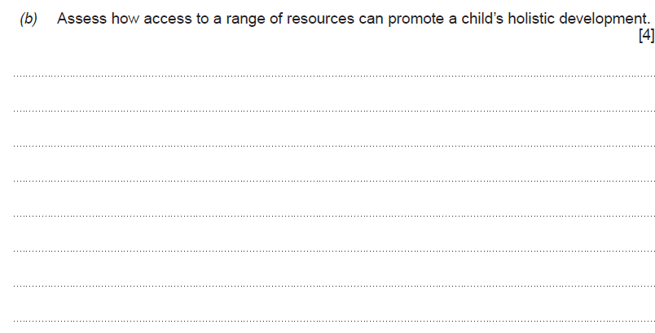
Question 2 (b)

Slide 19
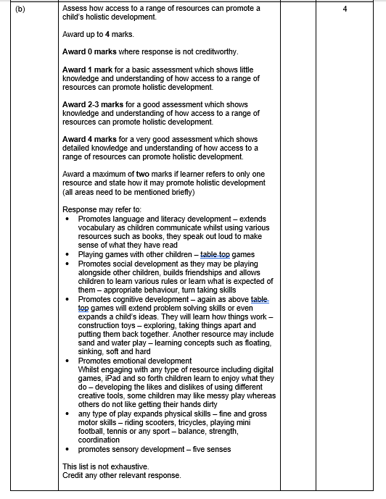
Question 2 (b)

Slide 20
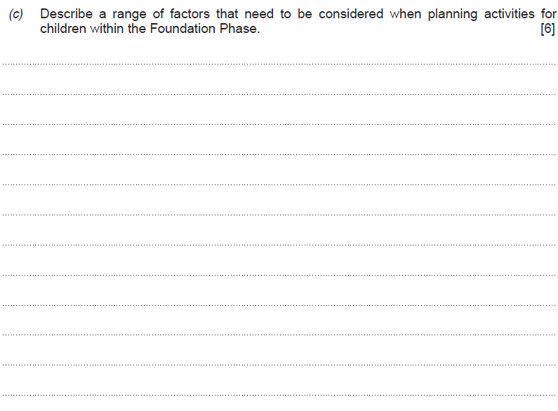
Question 2 (c)

Slide 21
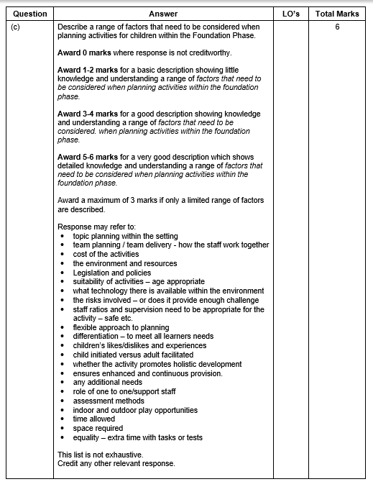
Question 2 (c)

Slide 22
Question 3

Slide 23
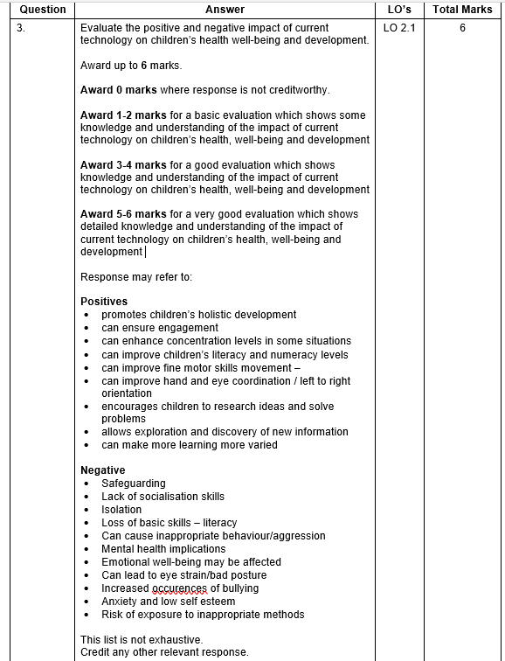
Question 3

Slide 24
Question 4 (a)

Slide 25
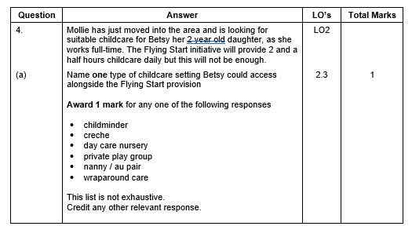
Question 4 (a)

Slide 26
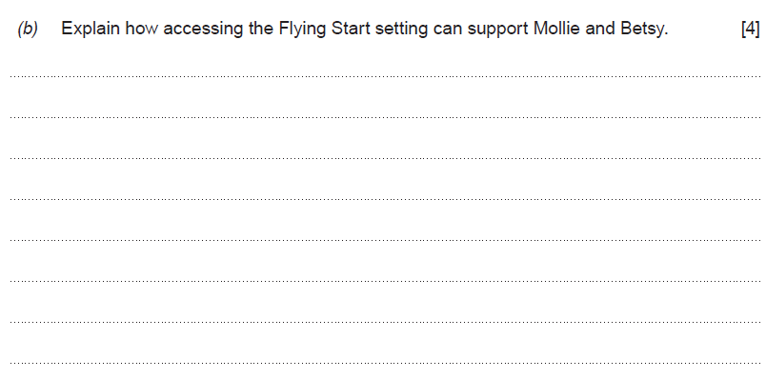
Question 4 (b)

Slide 27
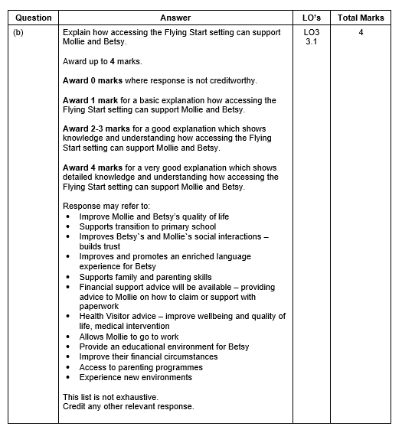
Question 4 (b)

Slide 28
Question 5 (a)

Slide 29
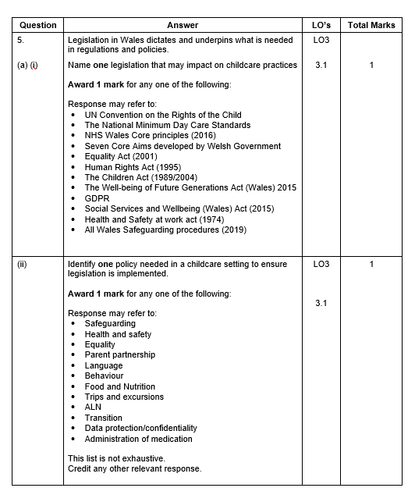
Question 5 (a)

Slide 30
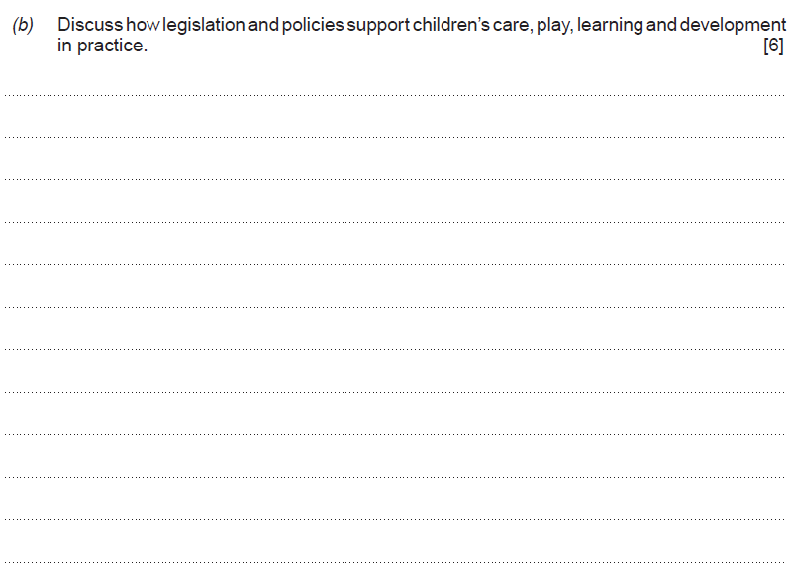
Question 5 (b)

Slide 31
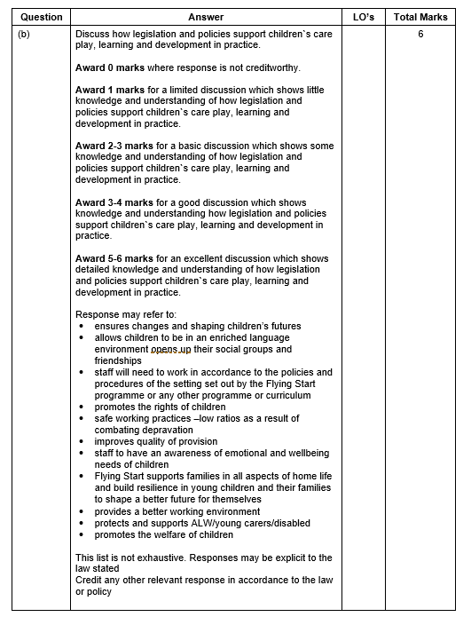
Question 5 (b)

Slide 32
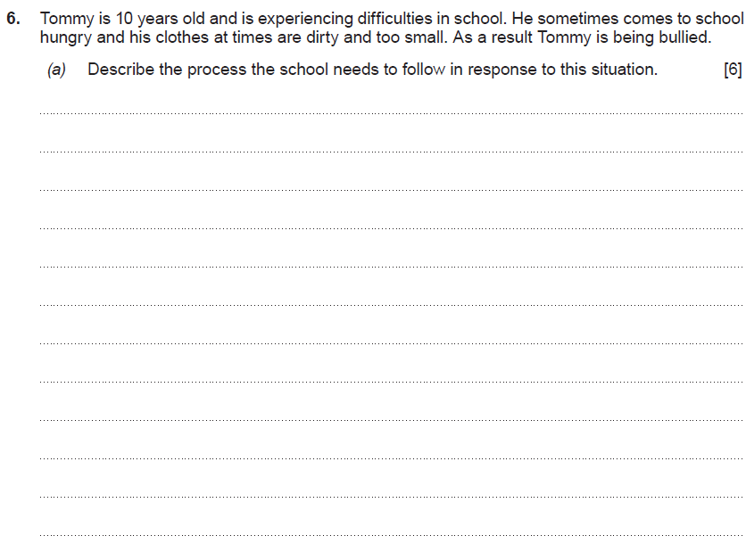
Question 6 (a)

Slide 33
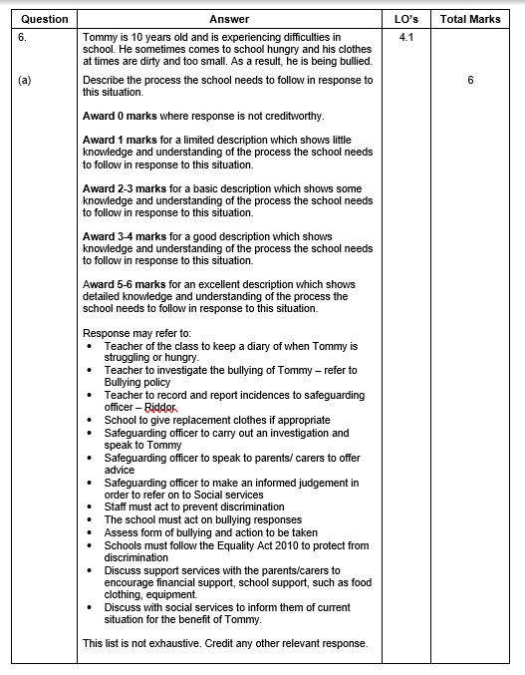
Question 6 (a)

Slide 34
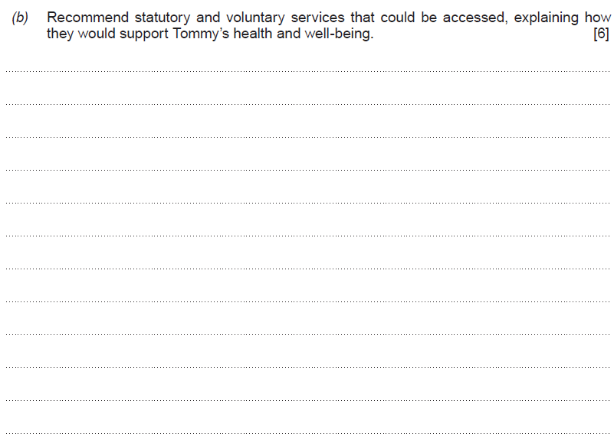
Question 6 (b)

Slide 35
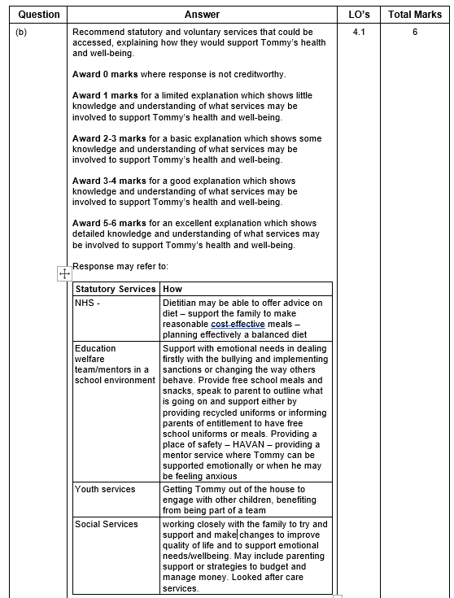
Question 6 (b)

Slide 36
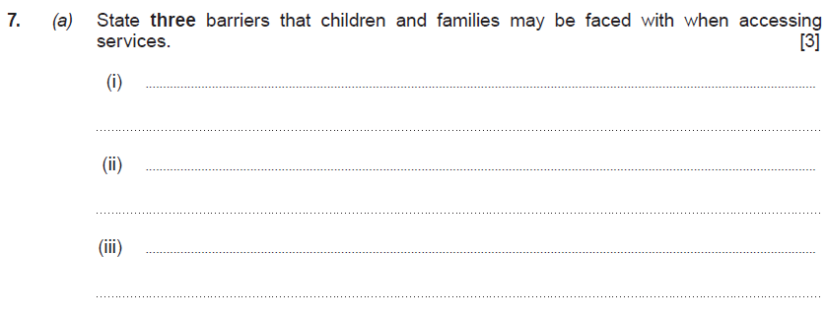
Question 7 (a)

Slide 37
Question 7 (a)

Slide 38
Question 7 (b)

Slide 39
Question 7 (b)

Slide 40
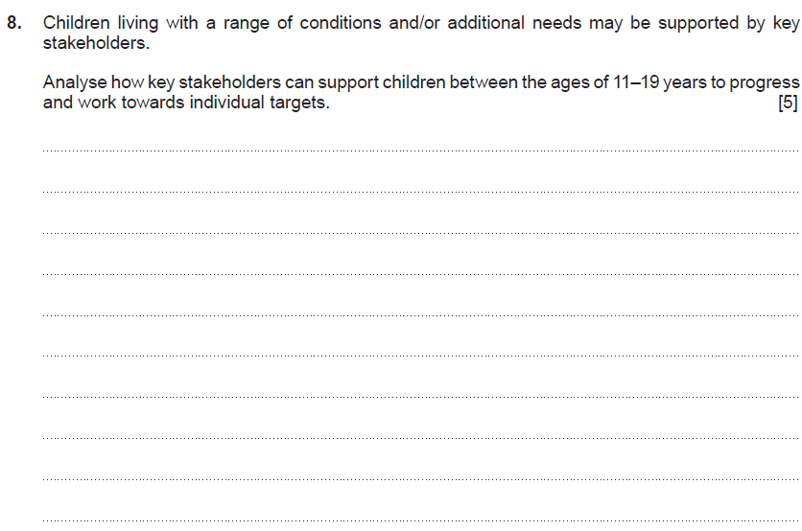
Question 8

Slide 41
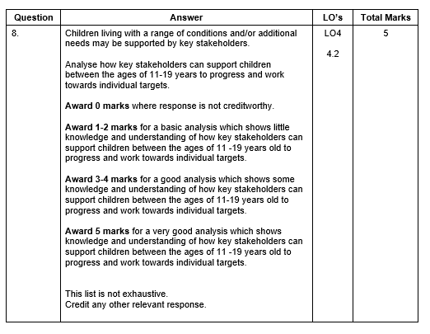
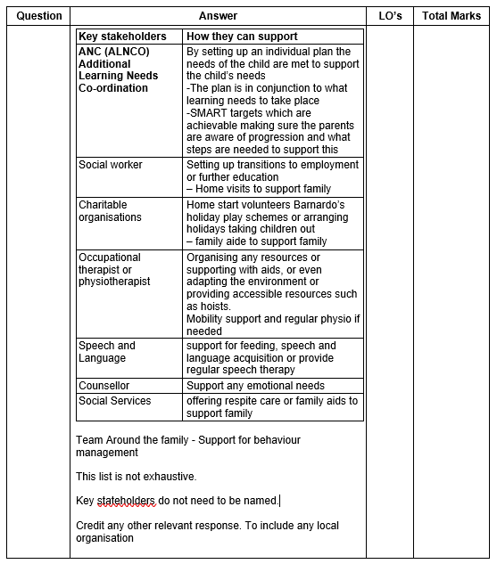
Question 8

Slide 42
Online examination review (OER)

Slide 43
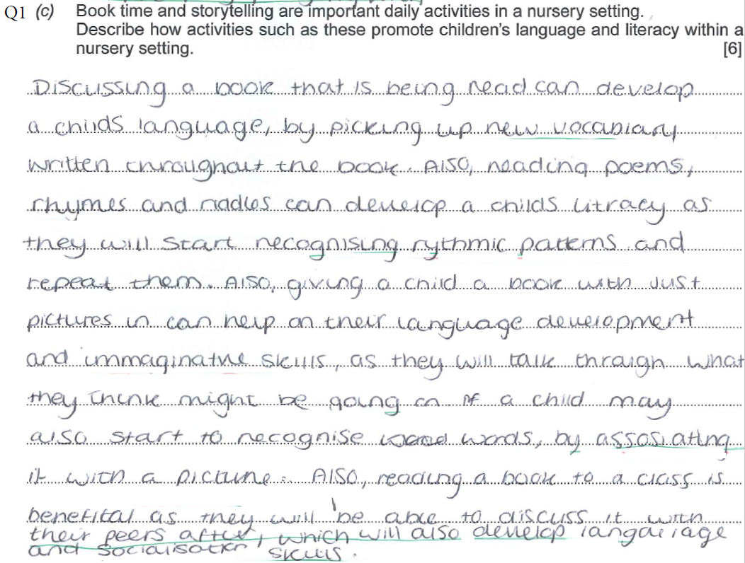
58 mark paper
Q1c A very descriptive answer. The learner has included evidence of having a very clear understanding of how such activities promote language and literacy.
The learner picks up on the development on new vocabulary from reading the book and exemplifies reading styles and rhythmic patterns – conventions of reading. The learner includes an understanding of how imaginative skills can be promoted as a result. At this age young children talk out loud to problem solve – and this has been included. The learner emphasises the fact reading will promote the recognition of words and make associations to pictures. The learner also embarks on the promotion of socialisation – a mature response.
6 marks awarded

Slide 44
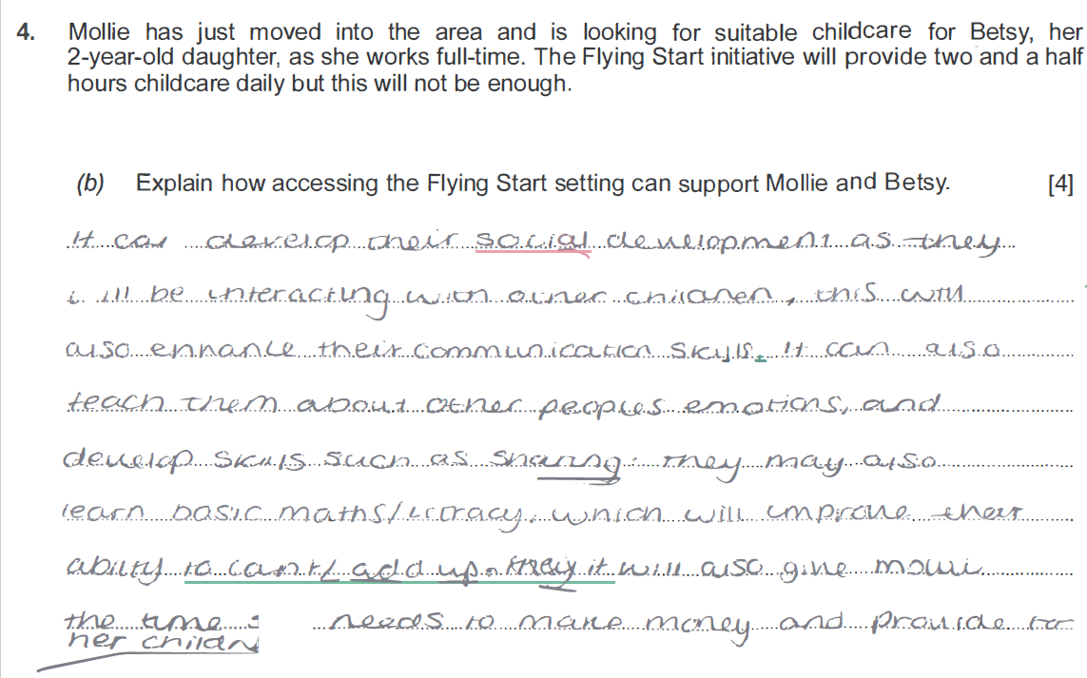
58 mark paper
Q4b The learner has included a comprehensive explanation by referring to what the Flying Start programme entails. The learner has spoken about enhancing language, communication and social skills by being with others. The learner also shows a clear understanding of the support for working parents. To gain full marks the learner would need to consider more elements of the programme for example set up in deprived areas, is a free service and is supported by the health visiting service.
3 marks awarded

Slide 45
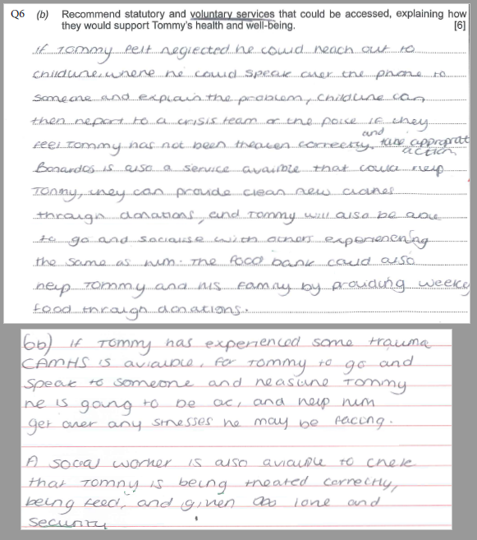
58 mark paper
6b Within the answer the learner has included recommendations to how various voluntary services operate and has given a rational explanation to why they would use the service.
The learner has a clear understanding of the command verbs and this is evident within the content. The learner relates to making assumptions correctly and covers areas of abuse and neglect. The recommendations are worthy of what the services are there for. The learner looks at how food banks operate. To gain higher marks a suggestion maybe to include more of a rationale for services in order to outline exactly the outcomes for Tommy.
5 marks awarded

Slide 46
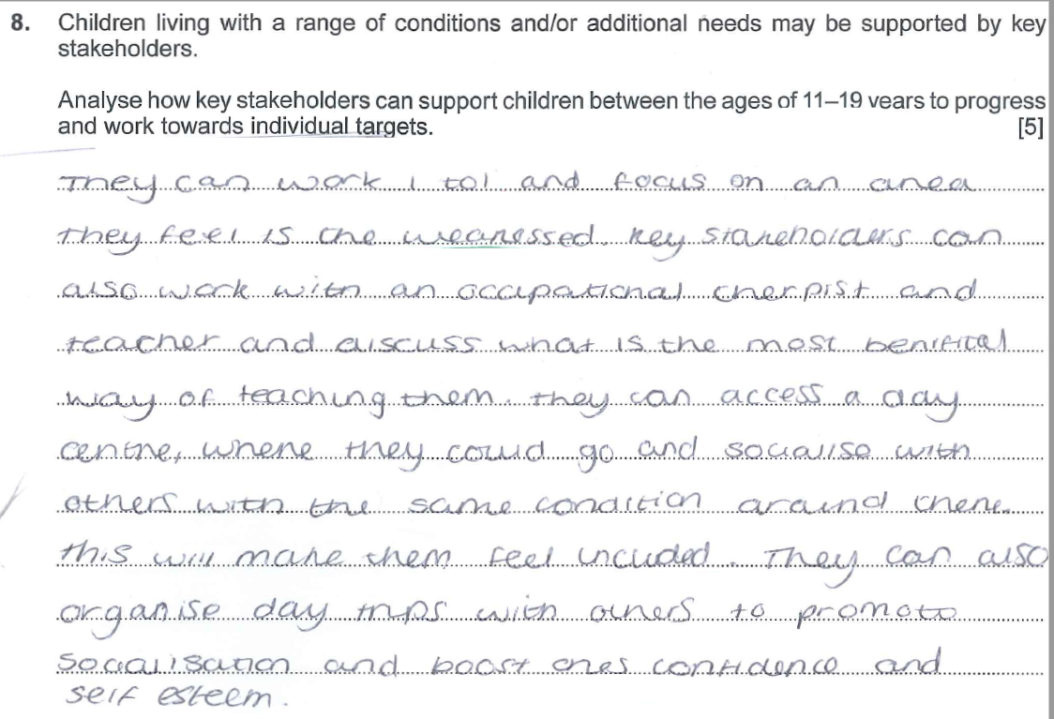
58 mark paper
Q8 A brief analysis has been included- A suggestion may include a consideration of the command verbs carefully in order to answer the question fully. The learner has included an outline (not an analysis) on how to support. The learner has briefly included and mentioned various stakeholders and understands the concepts of what services do. To gain full marks more of an analysis (relook at command verbs) is needed therefore reaching outcomes on how the service supports and works towards targets would be an advantage.
3 marks awarded

Slide 47
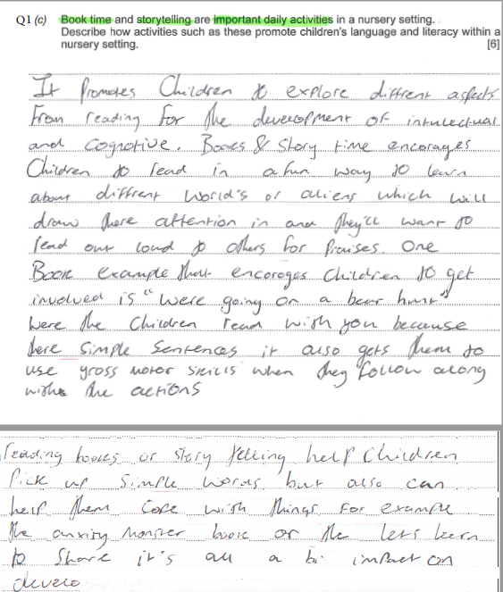
50 mark script
Q1c Looks at and includes various areas of development including cognitive. Learner has addressed how books encourage reading in a fun way. Learner gives examples of Worlds of Aliens and how it may support development and another example – going on a bear hunt. Both being good examples and how other areas of development such as fine motor skills can be promoted. To gain full marks maybe more depth within the answers is needed – therefore more understanding of how the activities may support development or language and literacy in particular.
5 marks awarded

Slide 48
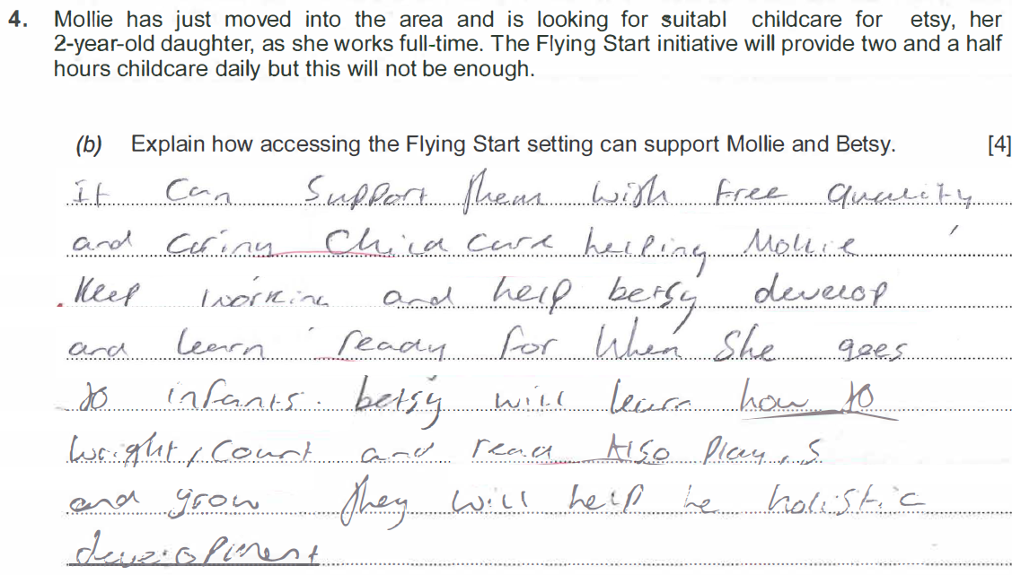
50 mark script
Q4b Full marks gained as a result of providing a good explanation on how the Flying Start programme engages children. Learner not only identifies but provides evidence of what the programme entails for example free quality care and support for working families. The learner has also established the importance of preparation for school in particular infant class. The answer includes reference to the learning process and how it supports holistic development. To further the answer it may be suggested a little is included with regards to the support of the health visiting service.
4 marks awarded

Slide 49
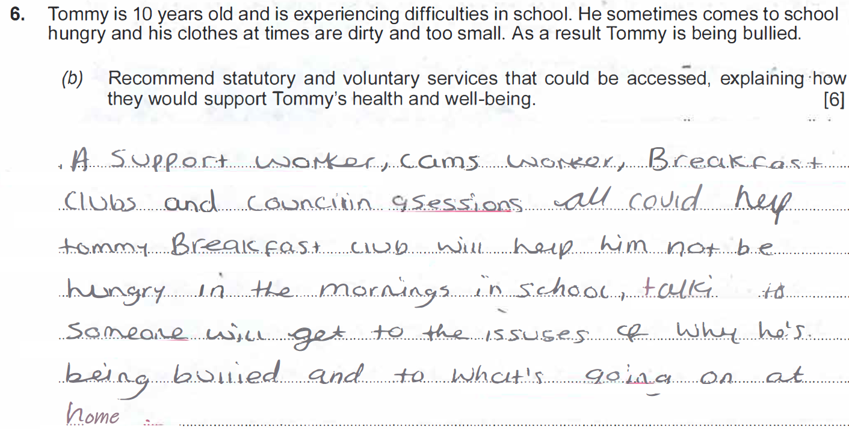
40 mark script
Q6b There has been a mention of the bullying policy and addressing Tommy personally but no evidence of the safeguarding process at this stage. Also, the learner has just questioned that the teacher will look closely to why, rather than carry out again as suggested safeguarding procedures. The answer needs to relate to the processes of what staff should do in this type of case – for example – refer concerns to safeguarding office, speak to parents, log, report, record and carry out an investigation, ask Tommy what has been happening etc. responses need to be more specific rather than generalised.
3 marks awarded

Slide 50
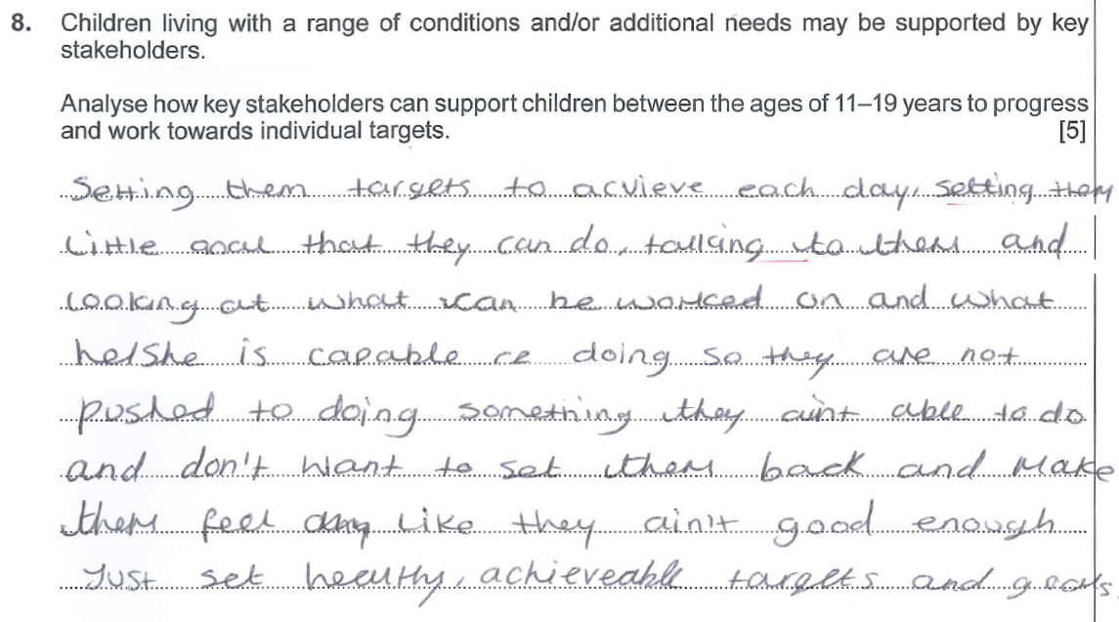
40 mark script
Q8 – No analysis shown in relation to answer. Generally, a brief explanation – learner needs to understand the command verbs in order to answer question. No mention of stakeholders in or out of practice and no support identified was a reason. To gain better marks the answer would need to state how the support is given and what would be the outcomes of the individual reaching certain targets. A very basic answer with no analytical skills used.
1 mark awarded

Slide 51
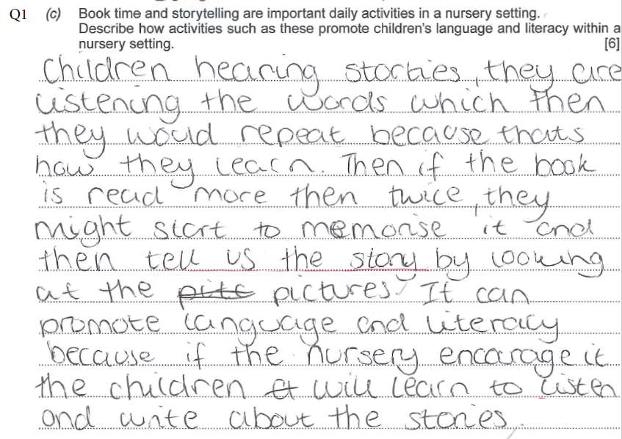
32 mark script
Q1c The answer is basic and refers only to listening and repeating. The learner considers memory or recall as a result of listening to a story there is no mention of how literacy can be developed. The learner has not considered how the activity can promote skills holistically. The next section is rather repetitive and again only outlines listening - the answer needs to reflect on how language and literacy is promoted whilst children engage in such sessions.
2 marks awarded

Slide 52
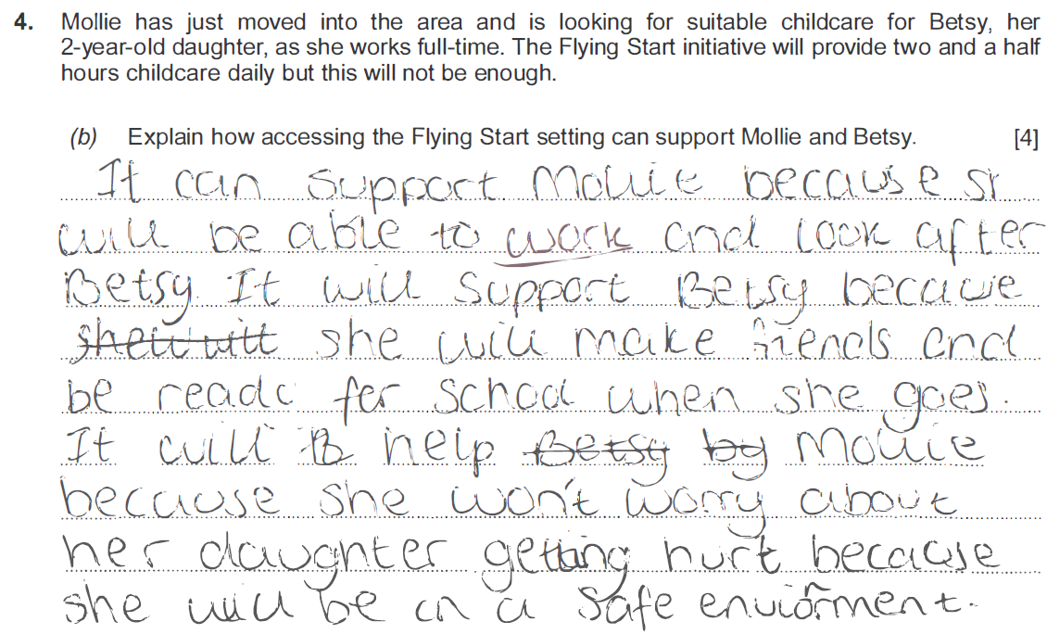
32 mark script
Q4b Good explanation included with valid points. The learner understands what the Flying Start programme covers. For example – providing a service to allow parents to go to work and allows children to gain valuable skills preparing them for school. To gain the full marks learners need to refer to the health visiting service and language promotion which are fundamental elements within the programme.
3 marks awarded

Slide 53
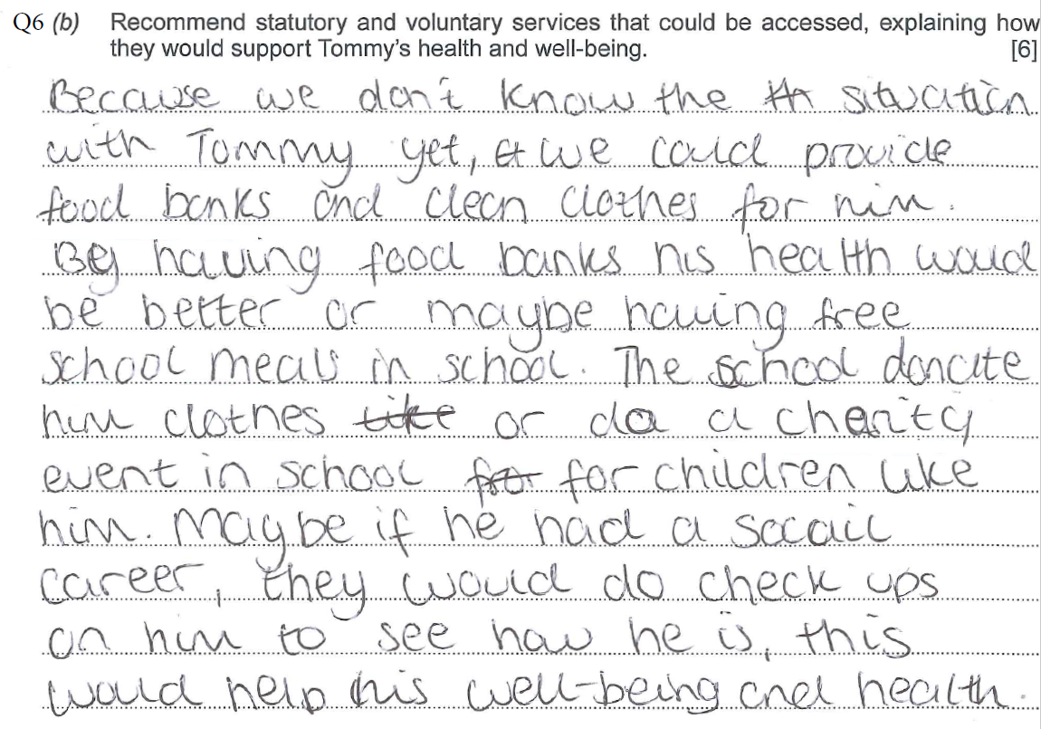
32 mark script
Q6b The learner has included relevant recommendations to include the need of food banks and clean clothes. Free school meals again support health. The second aspect does not however make sense therefore marks are lost. To gain full marks it would be suggested other services are considered such as Barnados, NSPCC and how these can support Tommy’s health and wellbeing overall. The NSPCC would also be able to support the family and educate them on a better way of life.
3 marks awarded

Slide 54
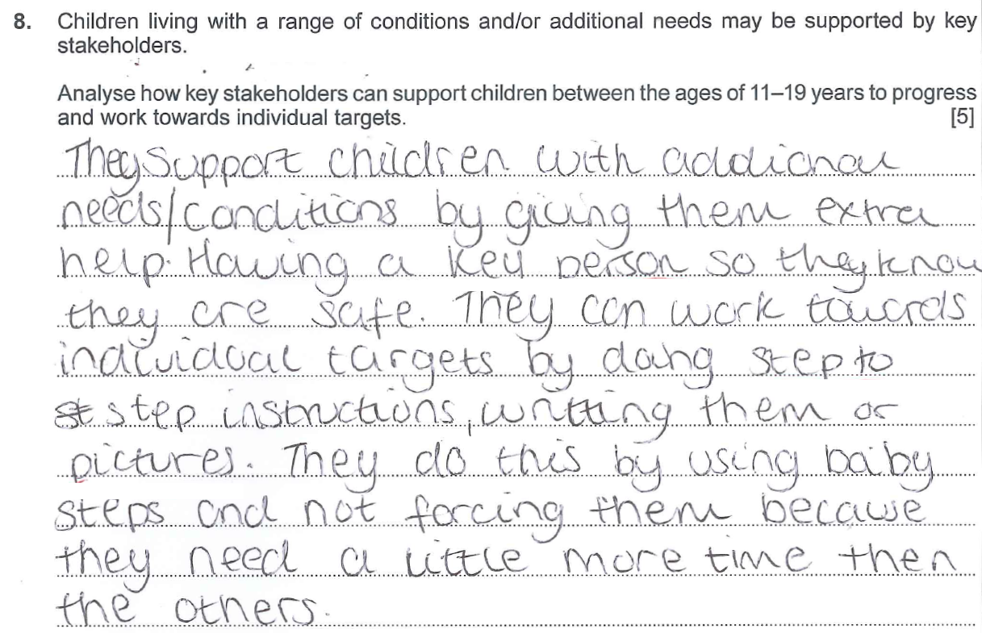
32 mark script
Q8 – The question is answered with ‘they’ rather than introducing or showing an awareness of who the stakeholders maybe and how different services may support learners with additional learning needs. The mark awarded considers the steps included – but are brief outlines rather than descriptive. To award higher marks the learner would need to have a clear understanding of who may be involved such as ALNCO and/or other various professionals and how they support individuals to enable progression, for example, annual reviews, target setting, regular contact to work in collaboration to work towards reaching goals.
2 marks awarded

Slide 55
Summary
For online scripts – there is much more description within higher grades.
The answers within higher grades include evidence of own experience and what has been learnt in class.
Evidence within scripts show a clear understanding of the command verbs and sector vocabulary.
Answers within lower grades are basic and include only brief explanations, or limited understanding of what is needed within questions.

Slide 56
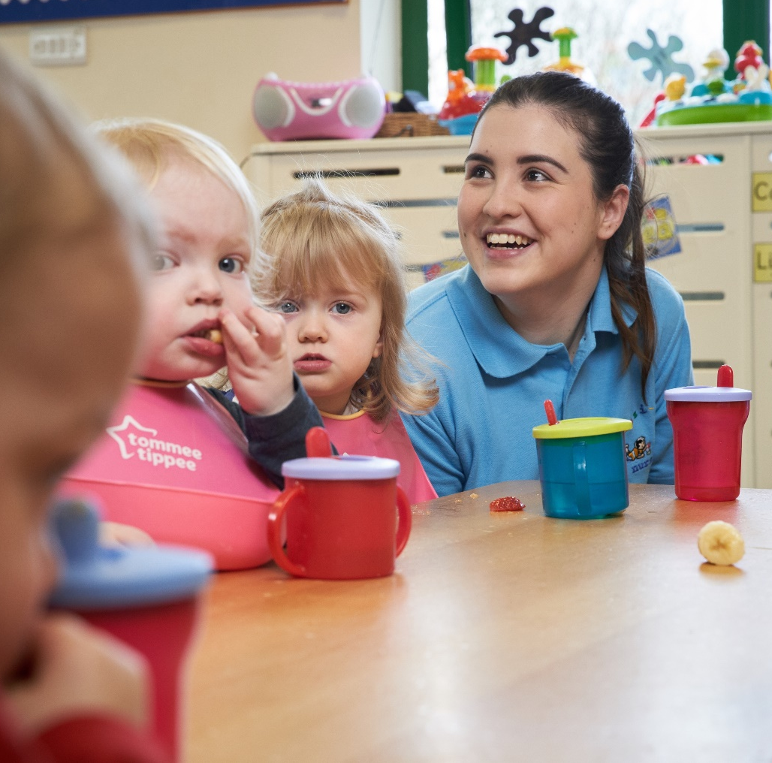
Diolch
Thank you

