Slide 1
Exam Walk-Through
GCE Health and Social Care, and Childcare
Unit 1 – Promoting health and well-being (2570U1)
Notes:
Hello and welcome to the EWT for GCE HSCCC Unit 1 for first assessment in 2021.
I am Karen Bushell, Subject Officer for this qualification.

Slide 2
What you should have in front of you:
A copy of the exam paper
An answer booklet/lined paper
Any additional resource material
A pen, pencil and ruler
A highlighter
A watch
Post-it notes

Slide 3
What this exam paper is all about:
This paper is Unit 1
It is testing ‘Promoting health and well-being’
The paper is made up of 7 questions
The exam lasts 2 hours

Slide 4
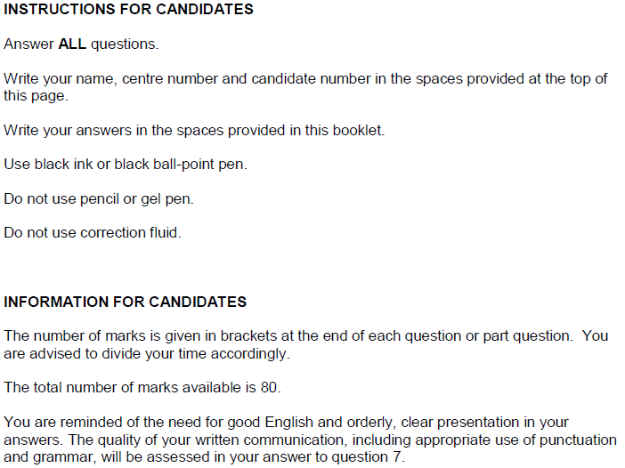
What should I do first?
1. Read the front cover of the exam paper.
2. Make sure your name and candidate number are on your answer booklet.
Notes:
You will see that as you go through the paper there are suggested timings for you to attempt each question – this is only provided as a guide for the purposes of this activity.

Slide 5
General points on exam technique
Read through the whole question before starting to answer. This will help you understand what is required of you.
Use a highlighter to pick out key words.
Look at the command words and the number of marks available for each question, they will help you decide how much detail is needed.
If a word is bold, it is important.
Keep your exam paper open at the double page spread, do not fold it in half.
Read your answers to check they make sense.

Slide 6
How do I tackle Question 1?
This is the first question in the paper.
Highlight the key issues in the question
Mnemonics or memory aids?
Underline the command
Identify the AO
Marks available?
Notes:
This is the first question in the paper – read it and re-read it!
Use your highlighter to underline the key issues in the question – i.e. The Social Services and Well-being Act (Wales) 2014
Write down any mnemonics or memory aids you may have for the SSWB Act in preparation
Underline the command verb, in this case: Describe
As describe is an AO1 command verb, there are only AO1 marks available for this question, therefore remember that there is no need to e.g. explain, compare or evaluate.
Highlight the number of marks available for this question: 8 marks

Slide 7
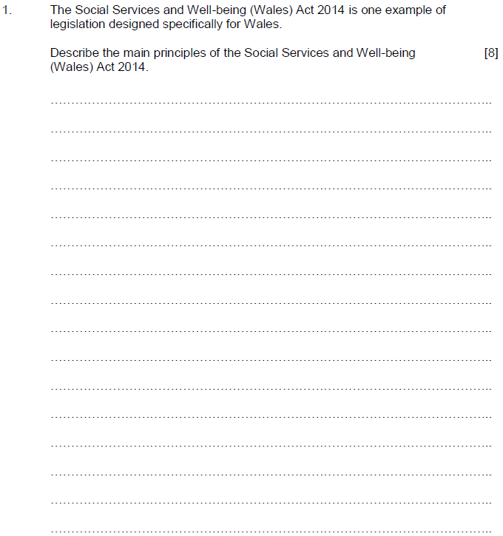
Question 1, AO1
10:00
Start the clock!
Try and answer this question in 10 minutes.
Use the space provided to respond – be guided by the number of marks and space available. (Remember you can always use the continuation page if needed)
Notes:
How did you get on?
Underline the command verb and the main parts of the question – in this case DESCRIBE and the SSWB Act 2014. To describe something you need to: Provide characteristics/main features or a brief account.
Remember that this is the first question, it is exclusively AO1, so plan your time and ensure you don’t write too much or attempt to give analysis or explanation.
To reach into the top mark band for this question the examiners are looking for responses that show excellent knowledge and understanding of the SSWB Act, and also show a confident grasp of the key concepts i.e. a focus on people who need care and support, empowerment, co-production and partnerships.
Remember that this is an AO1 Question – no need to explain, analyse or evaluate – you will not get any extra marks!

Slide 8
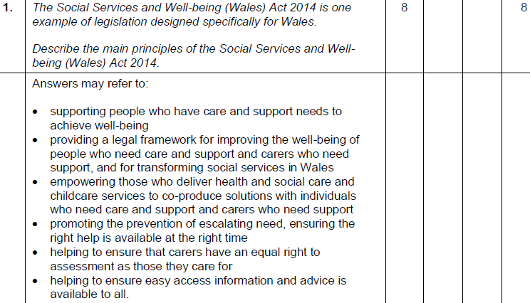
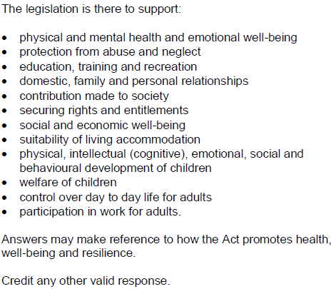
Question 1 AO1 mark scheme
Notes:
The mark scheme gives detailed examples of what the examiner would expect to see a candidate write in the examination.
Not everything detailed here has to be in a good answer, it is how the candidate responds to the demands of the question that is more important.
‘Credit any other valid response’ is always included to ensure that any answers that a candidate comes up with that hasn’t been included can be credited too.

Slide 9
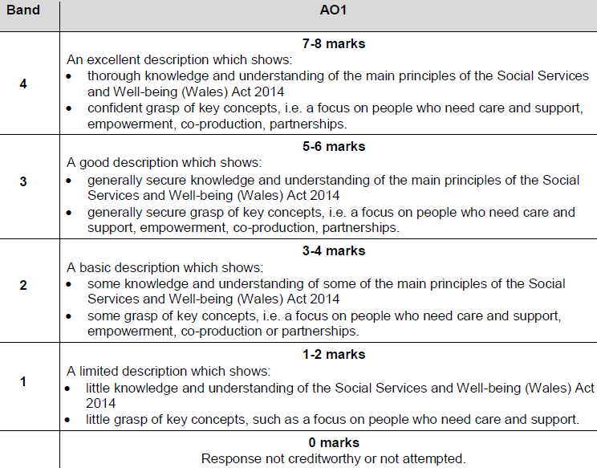
Question 1 AO1 mark scheme bands
Notes:
The bands show you what is expected of you to achieve the marks available.

Slide 10
How do I tackle Question 2?
This question has multiple parts – make sure that you complete them all. They are all linked to the first stem of the question.
Highlight the key issues in the question
Mnemonics or memory aids?
Underline the command
Identify the AO
Marks available?
Notes:
Use your highlighter to underline the key issues in the question – i.e. Well-being and The Social Services and Well-being Act (Wales) 2014
Write down any mnemonics or memory aids you may have for the SSWB Act in preparation
Underline the command verb, in this case: Outline this means to: set out the main points/provide a brief description or main characteristics
As describe is an AO1 command verb, there are only AO1 marks available for this question, therefore remember that there is no need to e.g. explain, compare or evaluate
Highlight the number of marks available for this question: 6 marks

Slide 11
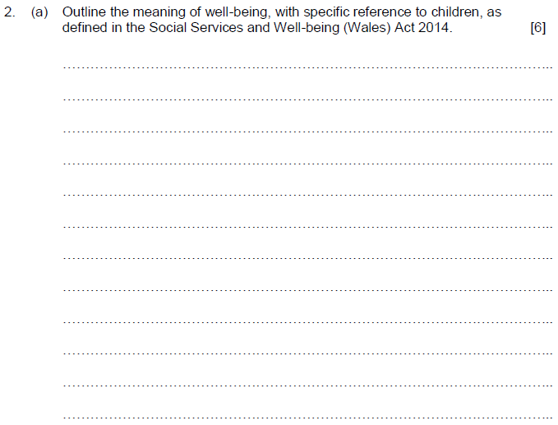
Question 2 (a), AO1
8:00
Start the clock!
Try and answer this question in 8 minutes.
Use the space provided to respond – be guided by the number of marks and space available. (Remember you can always use the continuation page if needed)
Notes:
How did you get on?
AO1 marks only for this question, so there is no expectation of any explanation or analysis.
Don’t waste time doing this, as you will not get awarded marks for this!
Use the space provided and don’t spend too much time on these lower tariff questions - remember this is just the start of the paper. Plan your time.
To achieve the full 6 marks, the examiner is expecting to see a very good outline of the meaning of well-being, showing thorough knowledge and understanding of the SSWB Act 2014.
The examiner also expects to see specific reference to well-being in children.

Slide 12
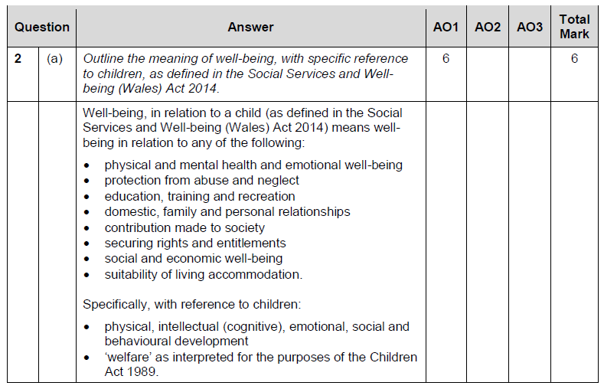
Question 2 (a) AO1 mark scheme
Notes:
Briefly summarise the slide – as discussed earlier.

Slide 13
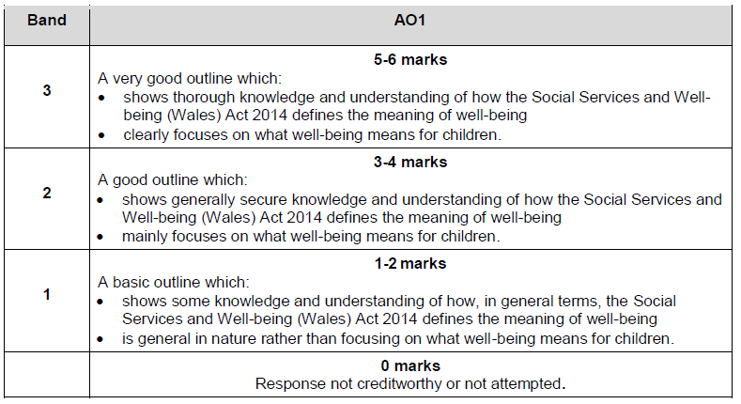
Question 2 (a) AO1 mark scheme bands
Notes:
The mark bands give exact detail of what the examiners expect to see for each of the bands – where does your answer fit?

Slide 14
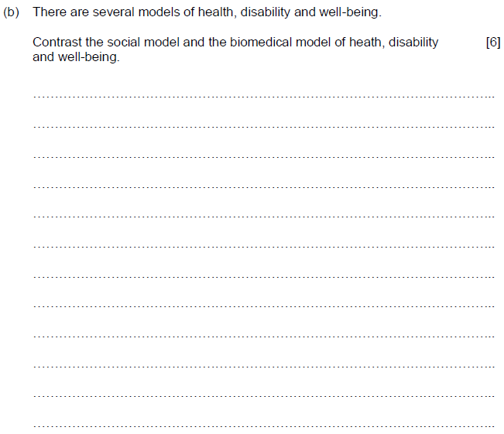
Question 2 (b), AO3
8:00
Start the clock!
Try and answer this question in 8 minutes.
Use the space provided to respond – be guided by the number of marks and space available. (Remember you can always use the continuation page if needed)
Notes:
This question makes direct reference to both the social and biological models of health, disability and well-being.
The command verb here is contrast – this is exclusively AO3.
The focus should be on differences not similarities of the two models.
This 6 mark question expects you to contrast these two models – include examples if you can.
The examiner would expect to see a range of features of both models, clearly illustrating the main differences.
To achieve into the top mark band the examiner would expect to see detailed consideration of the way that the two models contrast.
Focus on the differences rather than the similarities – include examples if you can. i.e. The Biomedical model emphasises treating individuals separately from their lifestyle/ living conditions, concentrating on the disease, illness or disability and returning the individual to their pre-ill state. Reasons for illness are not at the centre of the biomedical model whilst the social model addresses broader issues around health, using a ‘community approach’ to prevent illness. The social model goes beyond life-style and behaviour and promotes the need for social change.

Slide 15
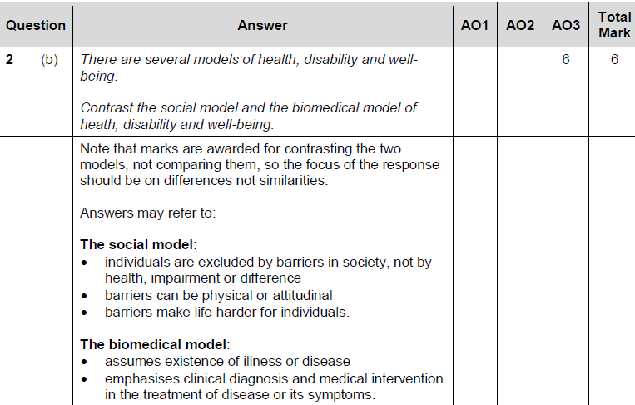
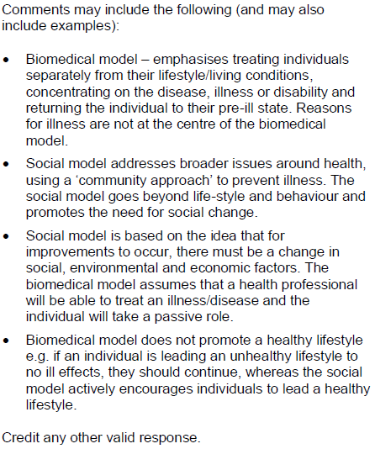
Question 2 (b) AO3 mark scheme
Notes:
The mark scheme details examples of what your answer may include - this is not a comprehensive list.

Slide 16
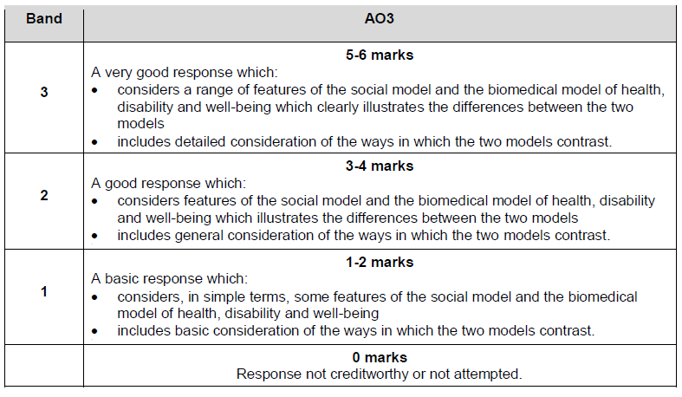
Question 2 (b) AO3 mark scheme bands
Notes:
The mark bands give exact detail of what the examiners expect to see for each of the bands – where does your answer fit?

Slide 17
How do I tackle Question 3?
Highlight the key issues in the question
Mnemonics or memory aids?
Underline the command
Identify the AO
Marks available?
Notes:
Use your highlighter to underline the key issues in the question – i.e. HOW preventative measures may be supported by local and national strategies and lifestyle choices.
Write down any mnemonics or memory aids you may have for local and national strategies and lifestyle choices.
Underline the command verb, in this case: Consider
As consider is an AO3 command verb, there are only AO3 marks available for this question.
Highlight the number of marks available for this question: 10 marks – use the space provided as a guide for how much to write.

Slide 18
Question 3, AO3
12:00
Start the clock!
Try and answer this question in 12 minutes.
Use the space provided to respond – be guided by the number of marks and space available. (Remember you can always use the continuation page if needed)
Notes:
This is a high tariff question (the highest is 14 on this paper) – so take your time to read the question and ensure that each of the specific bits are addressed.
Use your highlighter to make sure you don’t miss anything….
Use examples to help you in this question – you will have learnt lots of examples of local and national strategies and life-style choices – remember to not just list them – address the demands of the question.
An example of a preventative measure is given to you in the rider - this is to helps you!
The question expects you to make judgements about how preventative measures may be supported by local and national strategies and lifestyle choices – you will not achieve into the top mark band if you miss one of these out.
The examiner also expects to see you give some detail on how the strategies and choices contribute to the impact of the preventative measures.

Slide 19
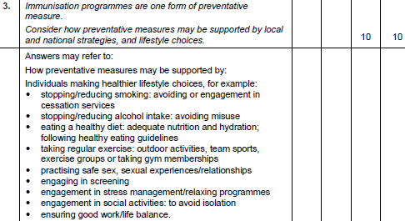
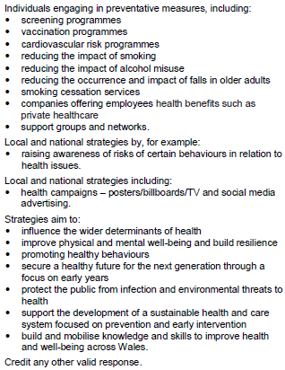
Question 3 AO3 mark scheme
Notes:
The mark scheme details examples of what your answer may include - this is not a comprehensive list.

Slide 20
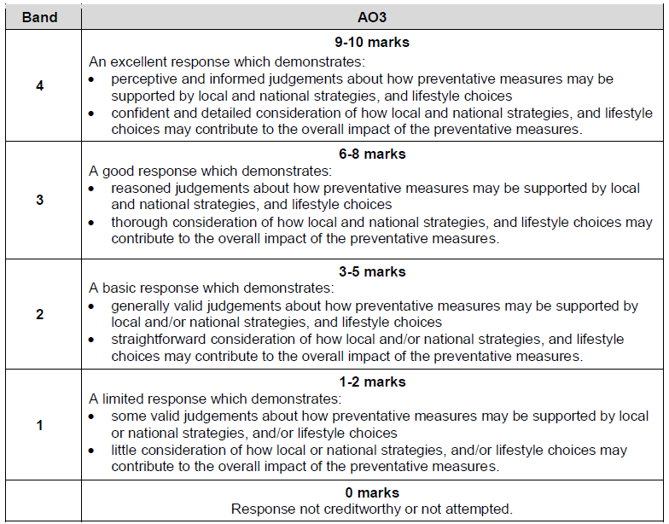
Question 3 AO3 mark scheme bands
Notes:
The mark bands give exact detail of what the examiners expect to see for each of the bands – where does your answer fit?

Slide 21
How do I tackle Question 4?
Highlight the key issues in the question
Mnemonics or memory aids?
Underline the command
Identify the AO
Marks available?
Notes:
Use your highlighter to underline the key issues in the question – i.e. The role of Flying Start in improving the health, and well-being and resilience of children in Wales.
Write down any mnemonics or memory aids you may have for Flying Start.
Underline the command verb, in this case: Explain to explain you need to: Provide details and reasons for how and why something is the way it is…
As explain is an AO2 command verb, there are only AO2 marks available for this question.
Highlight the number of marks available for this question: 8 marks – use the space provided as a guide for how much to write.

Slide 22
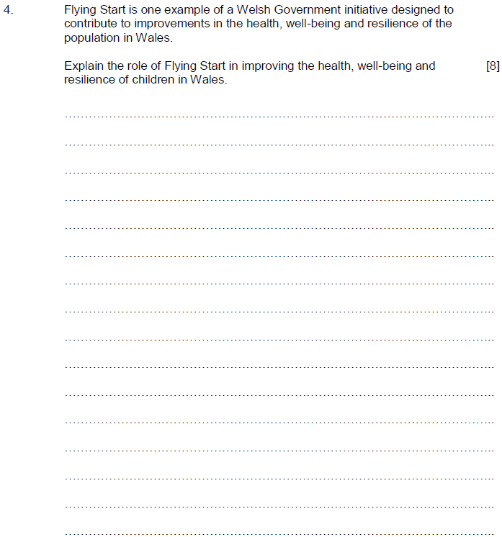
Question 4, AO2
10:00
Start the clock!
Try and answer this question in 10 minutes.
Use the space provided to respond – be guided by the number of marks and space available. (Remember you can always use the continuation page if needed)
Notes:
The rider is there to help you and give you some context – read it!
The command verb ‘explain’ is AO2 only – therefore no analysis or evaluation is required for this question.
Don’t just write everything you know about Flying Start! Make sure you address the demands of the question!
To achieve into the higher mark bands the examiner is expecting to see detailed knowledge and understanding of the role of Flying Start in improving the health, well-being and resilience of children in Wales.
In addition, they would expect to see a confident grasp of a range of ways Flying Start can contribute to the improvement of children’s health, well-being and resilience.
Use examples from Flying Start to illustrate your answer – make sure you don’t just list them – put them into the context of the question.

Slide 23
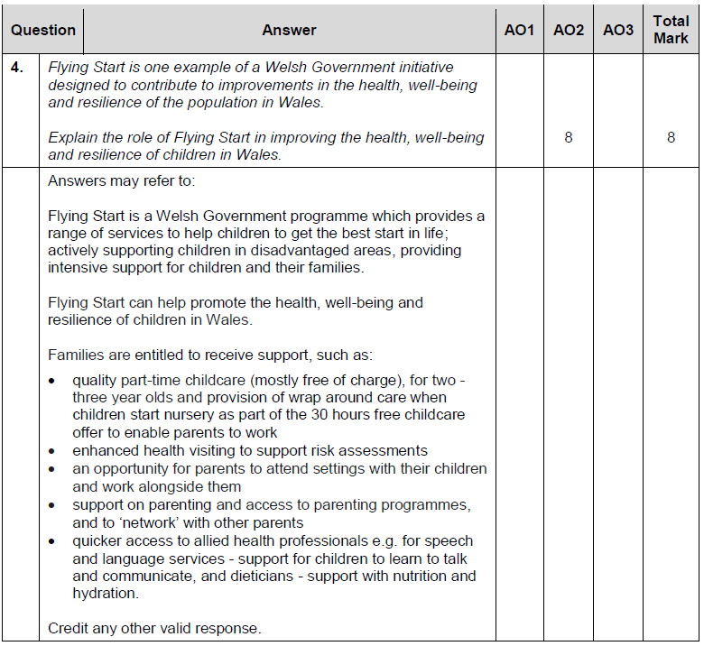
Question 4 AO2 mark scheme
Notes:
Examples of support are detailed in the mark scheme – the examiner would expect the better candidate to have listed some of these – but not all!

Slide 24
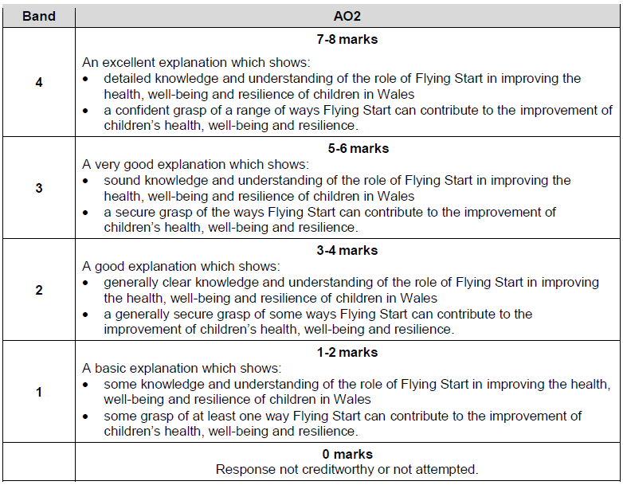
Question 4 AO2 mark scheme bands
Notes:
The mark bands give exact detail of what the examiners expect to see for each of the bands – where does your answer fit?

Slide 25
How do I tackle Question 5?
This question has multiple parts – make sure that you complete them all. They are all linked to the first stem of the question.
Highlight the key issues in the question
Mnemonics or memory aids?
Underline the command
Identify the AO
Marks available?
Notes:
Use your highlighter to underline the key issues in the question – i.e. For i) DESCRIBE two OTHER approaches to health, well-being and resilience GIVING AN EXAMPLE OF EACH and for ii) OUTLINE current trends and patterns of health, well-being and resilience of the population of Wales support the need for health, and well-being campaigns.
Write down any mnemonics or memory aids you may have for both questions.
Underline the command verb, in this case: Describe and Outline – to describe is to: Provide characteristics/main features or a brief account, and to outline is to: Set out the main points/provide a brief description or main characteristics.
As describe and outline are both AO1 command verbs, there are only AO1 marks available for both questions.
Highlight the number of marks available for this question: 6 marks each – use the space provided as a guide for how much to write. They have equal weighting, so try to not write too much for one.

Slide 26
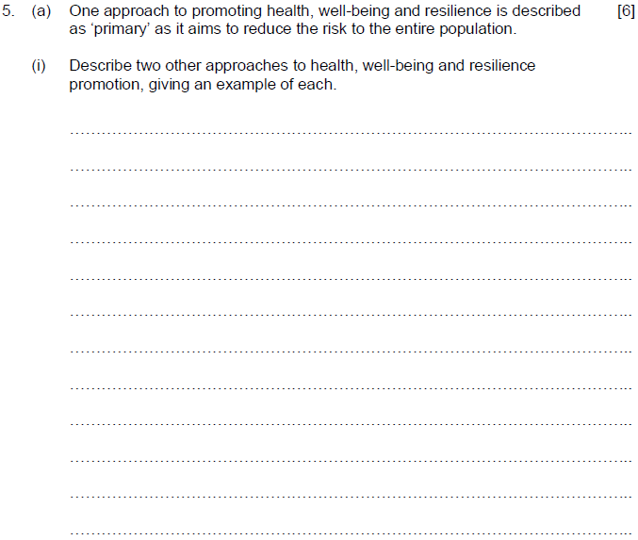
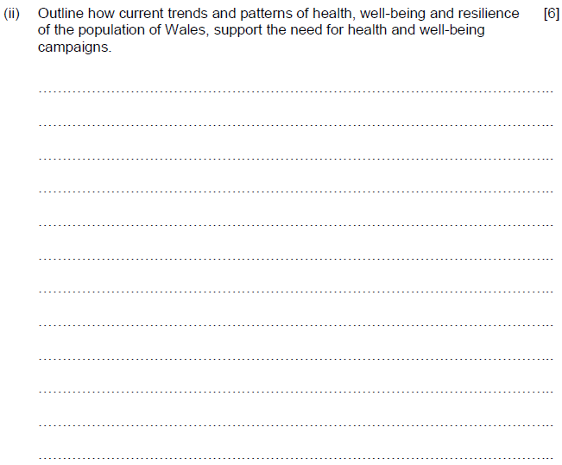
Question 5 (a), AO1
12:00
Start the clock!
Try and answer these questions in 12 minutes.
This question is split into two 3 mark questions – you have to include an example to achieve into the top mark band.
This is an AO1 question only – do not waste time analysing or evaluating – you won’t get any additional marks!
Notes:
Is basically split into two 3 mark questions are you are asked to describe two other approaches, and give an example of each.
If you describe the approach but to not include an example you can only achieve a maximum of 2 marks (4 marks in total for the question).
Answers would be making reference to secondary and tertiary approaches – with appropriate examples.
ii) To achieve into the top mark band for this question, the examiner would expect to see through knowledge and understanding of current trends and patterns of health, well-being and resilience of the population of Wales – with clear examples of how a range of current trends and patterns support the need for relevant health and well-being campaigns. You will have learnt a lot of these – try and be selective and chose examples that you can clearly illustrate.

Slide 27
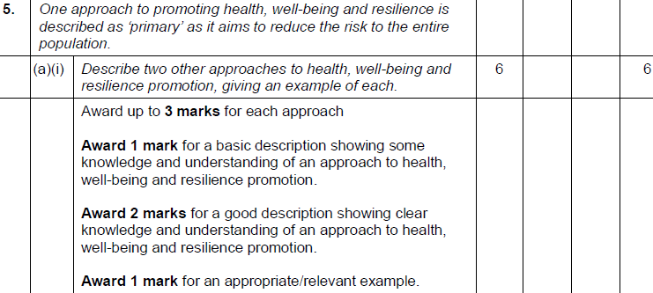
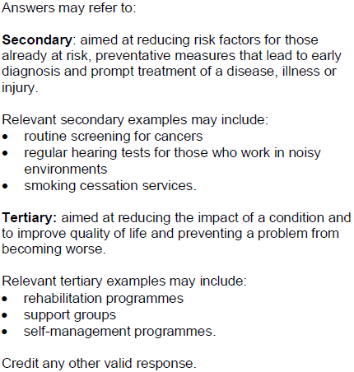
Question 5 (a) (i) AO1 mark scheme
Notes:
Additional detail of the examples of secondary and tertiary are detailed in the mark scheme for your reference. Not all of this has to be included for top marks.

Slide 28
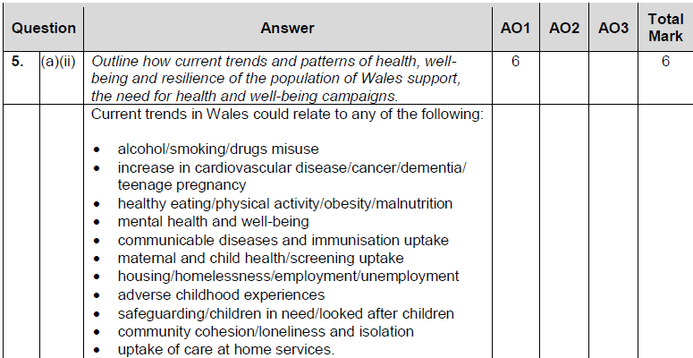
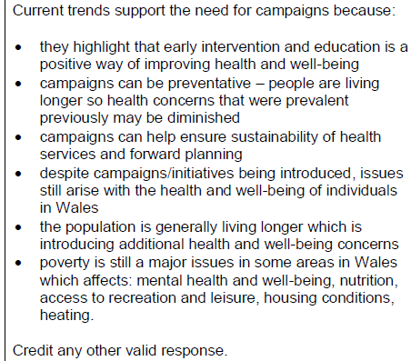
Question 5 (a) (ii) AO1 mark scheme
Notes:
There are loads of examples of current trends including in the mark scheme that you would have learnt about - try and be selective and choose one that you can clearly illustrate and understand.

Slide 29
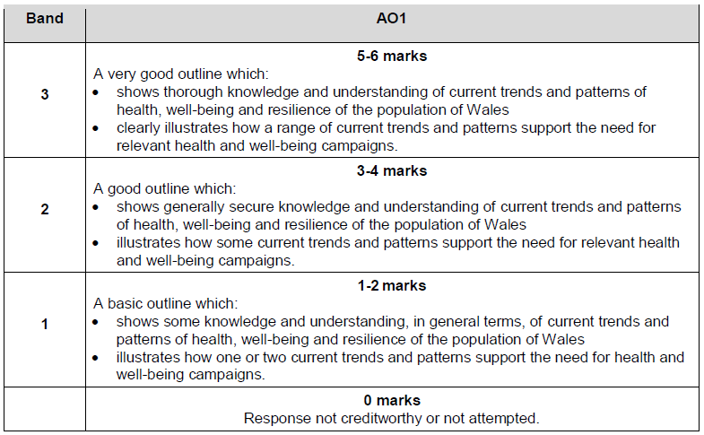
Question 5 (a) AO1 mark scheme bands
Notes:
The mark bands give exact detail of what the examiners expect to see for each of the bands – where does your answer fit?

Slide 30
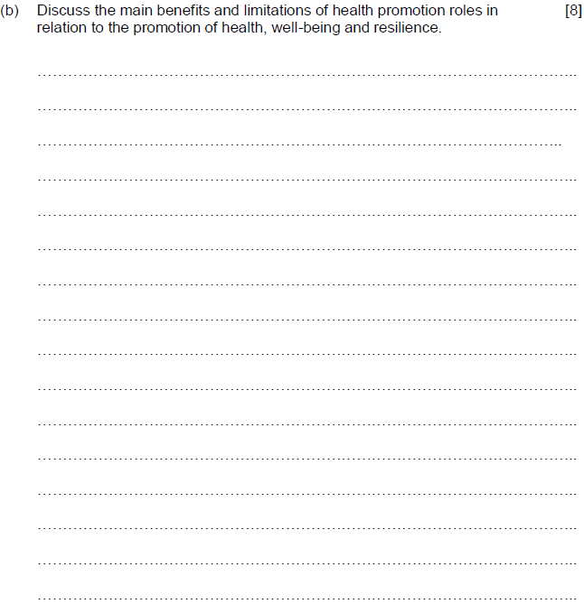
Question 5 (b), AO3
10:00
Start the clock!
Try and answer this question in 10 minutes.
Use the space provided to respond – be guided by the number of marks and space available. (Remember you can always use the continuation page if needed)
Notes:
Highlight the command verb, DISCUSS. This is an AO3 command.
This question asks for both the benefits and limitations of health promotion roles – you have to address both to achieve into the top mark band.
The examiner expects perceptive and informed judgements about a range of benefits and limitations of health promotion roles to achieve into the top mark band – this will need to include examples.
The examiner also expects to see detail about the possible contribution of key health and social care and childcare practitioners to the promotion of individuals’ health, well-being and resilience
Both the benefits and limitations of health promotion roles have to be addressed to achieve into the top mark band in addition to the contribution of KEY health and social care and childcare practitioners.

Slide 31
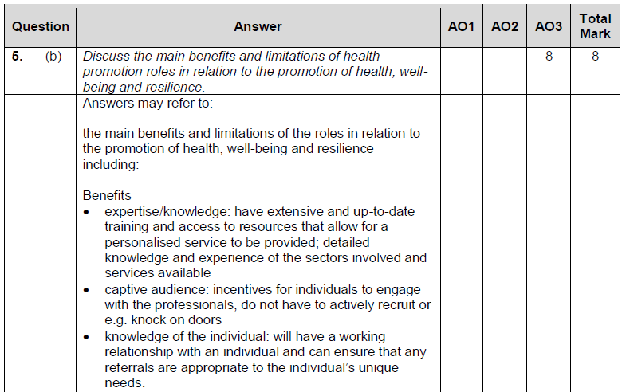
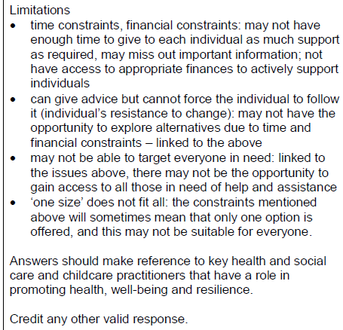
Question 5 (b) AO3 mark scheme
Notes:
Detailed examples of the main benefits and limitations of the roles in relation to the promotion of health, well-being and resilience are listed within the mark scheme - these are not exhaustive.
Answers should make reference to key health and social care and childcare practitioners – give examples where you can!

Slide 32
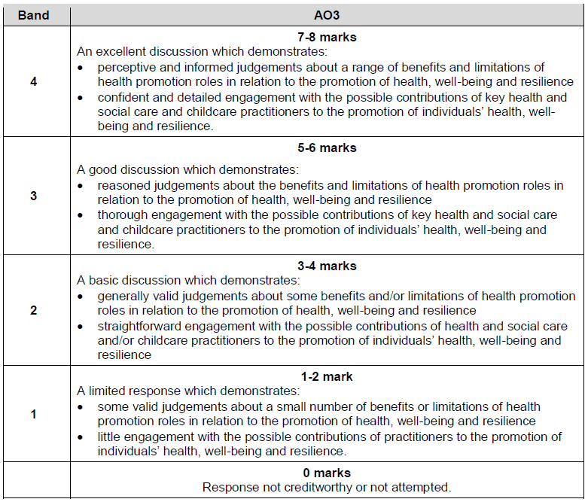
Question 5 (b) AO3 mark scheme bands
Notes:
The mark bands give exact detail of what the examiners expect to see for each of the bands – where does your answer fit?

Slide 33
How do I tackle Question 6?
Highlight the key issues in the question
Mnemonics or memory aids?
Underline the command
Identify the AO
Marks available?
Notes:
Use your highlighter to underline the key issues in the question – i.e. TWO other modifiable risk factors
Write down any mnemonics or memory aids you may have for
Underline the command verb, in this case: Explain – to provide details and reasons for how and why something is the way it is…
As explain is an AO2 command verb, there are only AO2 marks available for this question.
Highlight the number of marks available for this question: 8 marks each – use the space provided as a guide for how much to write.

Slide 34
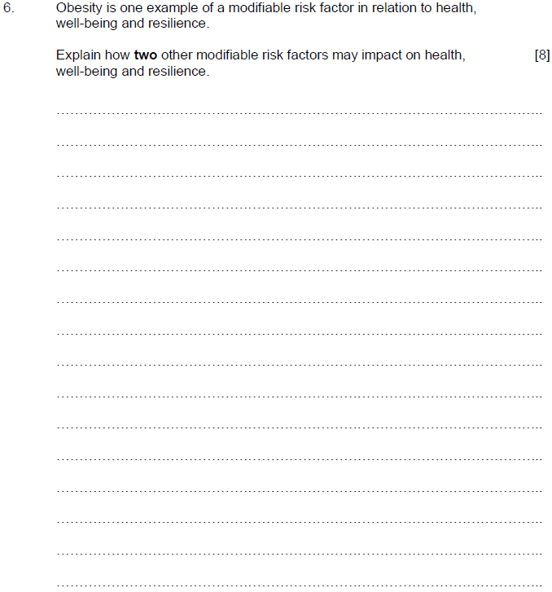
Question 6, AO2
10:00
Start the clock!
Try and answer this question in 10 minutes.
Use the space provided to respond – be guided by the number of marks and space available. (Remember you can always use the continuation page if needed)
Notes:
The rider is there to help you – giving an example.
Make sure that you do not use obesity in your answer! And make sure you use two different examples in your response.
This is an A02 question only – do not attempt to analyse or evaluate as you won’t receive any additional marks!
The examiner expects to see evidence of detailed knowledge and understanding of two modifiable risk factors and the potential impact of each on health, well-being and resilience to achieve into the top mark band.
The examiner would also expect to see evidence of a range of ways in which each modifiable risk factor you have identified could impact on an individual’s health, well-being and resilience.

Slide 35
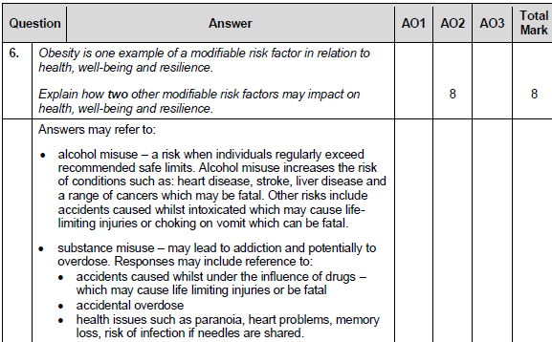
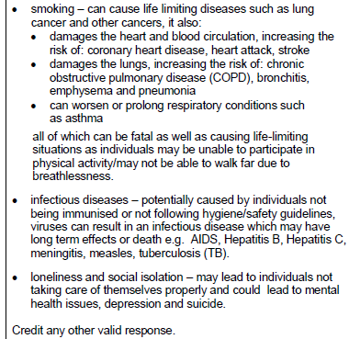
Question 6 AO2 mark scheme
Notes:
The mark scheme gives detail on a variety of modifiable risk factors as listed in the specification - only two have to be included (it may be that one that is not listed here is provided and this may be appropriate).
Each of the examples is explained and this is they key to achieving top marks in this question – more than a list or bullet points is needed to achieve into the top band.
If only one is addressed, you are also limited to the number of marks that can be achieved – attempt two even if you do not know them in depth, it is likely that you will pick up more marks this way rather than writing all that you know about one.

Slide 36
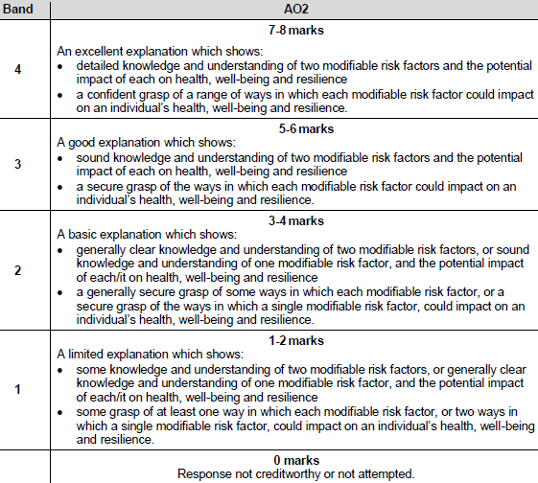
Question 6 AO2 mark scheme bands
Notes:
The mark bands give exact detail of what the examiners expect to see for each of the bands – where does your answer fit?

Slide 37
How do I tackle Question 7?
Highlight the key issues in the question
Mnemonics or memory aids?
Underline the command
Identify the AO
Marks available?
Notes:
Use your highlighter to underline the key issues in the question – i.e. There are TWO commands in this question and two main issues – the main features of HOLISTIC CONCEPTS and HOW social and economic determinants contribute to inequalities in outcome focused care.
Write down any mnemonics or memory aids you may have for holistic concepts of health and well-being and inequalities in outcome focused care.
Underline the command verbs, in this case there are TWO – this is the only time in this paper that this happens: DESCRIBE AND CONSIDER
Describe is an AO1 command verb and consider is an AO3 command. To describe you need to: Provide characteristics/main features or a brief account, and to consider you must: Review and respond to given information
Highlight the number of marks available for this question: 14 marks in total – the highest tariff question in this paper – use the space provided as a guide for how much to write.

Slide 38
Question 7, AO1/AO3
16:00
Start the clock!
Try and answer this question in 16 minutes.
Use the space provided to respond – be guided by the number of marks and space available. (Remember you can always use the continuation page if needed)
Notes:
This is the highest tariff question on the paper.
The question has two command verbs so you need to ensure that you address both in your response.
The first command ‘Describe’ has 6 marks attached to it – the examiner expects you to show detailed knowledge and understanding of the holistic concepts of health and well-being. You are not expected to analyse or evaluate the holistic concepts in any way.
The second command ‘Consider’ has 8 marks attached to it – the examiner expects to see perceptive and informed judgements about how a range of social and economic determinants may contribute to inequalities in outcome focused care – to achieve into the top band they also expect to see a confident and detailed response of the impact of social and economic determinants and their potential impact on care provision.
Plan your response – create a short plan in the margin or on a page at the back of the paper - make sure you don’t miss out on any of the pertinent points and tick them off as you do them – there is a lot to cover in this question!

Slide 39
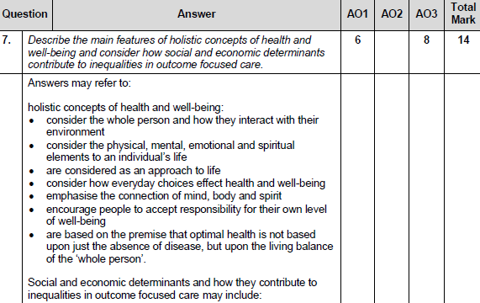
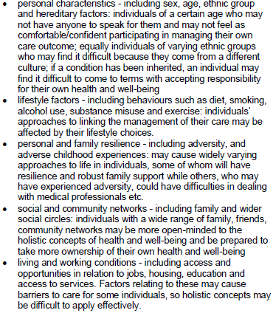
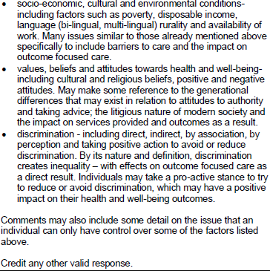
Question 7 AO1/AO3 mark scheme
Notes:
There is lots of detail in the mark scheme about the way the examiner expects you to address the question – this includes a detailed description of the holistic concepts of health and well-being and then examples of social and economic determinants and how they contribute to inequalities in outcome focused care.
Not all of these points have to be addressed to achieve into the top mark bands.

Slide 40
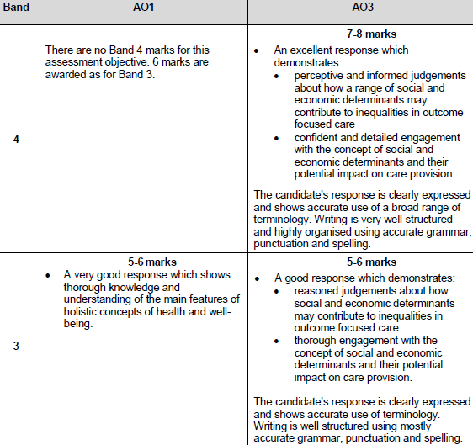
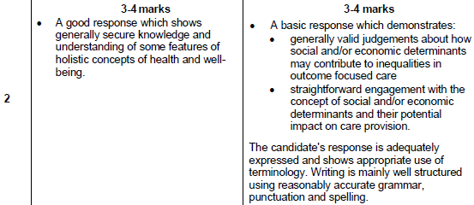
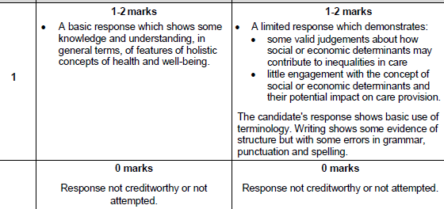
Question 7 AO1/AO3 mark scheme bands
Notes:
Note that there is no band 4 for AO1 as only 6 marks are available.
Quality of written communication is assessed in this question too – the mark scheme gives details in the AO3 bands and to achieve into the top bands it is expected that the responses are clearly expressed and how accurate use of a broad range of terminology. The response should be well structured and highly organised with accurate grammar punctuation and spelling.

Slide 41
How did you do?
As the first assessment for this unit is summer 2021, raw mark grade boundaries are not available.
The Uniform Mark Scale (UMS) is used as a device for reporting, recording and aggregating your unit assessment outcomes. The UMS is used so that you and others who achieve the same standard will have the same uniform mark, irrespective of when you take the unit. The maximum uniform mark for any unit depends on that unit’s weighting in the specification.
Uniform marks for this unit correspond to unit grades as follows:
Notes:
As there are no previous examinations from which to give you an indication of how you would have achieved, it is best to be guided by the UMS scale as detailed in this slide.

Slide 42
Any questions?
Do you have any further questions about this exam?
If so, write them on a post-it note and stick it to the front of your paper to give to your teacher.
Notes:
Read slide.

