Slide 1
Level 3 Health and Social Care: Principles and Contexts
Unit 2: Factors affecting individuals’ growth and development across the lifespan and how this
impacts on outcomes, care and support needs..
Online Exam Review
(January 2024)

Slide 2
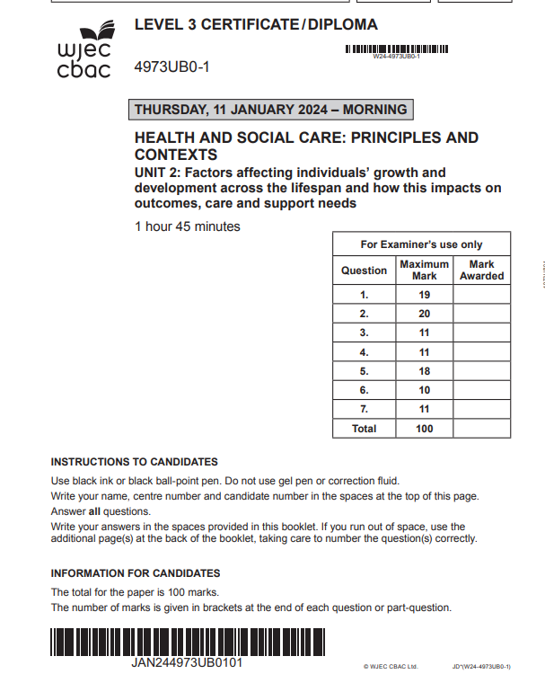
Unit 2: Factors affecting individuals’ growth and development across the lifespan and how this impacts on outcomes, care and support needs.
.
Online examination review (OER)

Slide 3
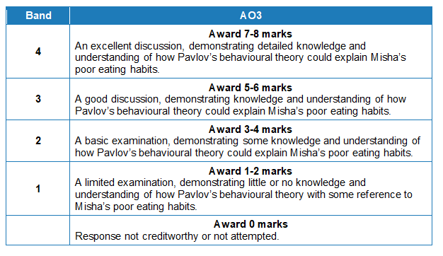
Question 2: Misha has been diagnosed with high blood cholesterol and obesity. Misha now recognises that her poor eating habits have contributed to her high blood cholesterol and obesity.
Question 2 (b) Discuss how Pavlov’s behavioural theory could explain Misha’s poor eating habits. [8 marks]

Slide 4
Question 2 (b) Candidate answer

Slide 5
Question 2 (b) Candidate answer with examiner’s comments
This candidate has demonstrated good knowledge and understanding of Pavlov’s behavioural theory and attempted to apply it to explain Misha’s poor eating habits. The candidate has used key concepts within their answer.
For the candidate to improve their answer, some further knowledge of Pavlov’s experiment, the use of the term ‘classical conditioning’ and further discussion into why Misha may have poor eating habits would have been useful, for example, the conditioned stimulus could have been the television and hot drink, and this could have been linked to the unconditioned stimulus, for example, watching the television with a packet of biscuits and drinking a hot drink with a biscuit.
6 marks awarded.

Slide 6
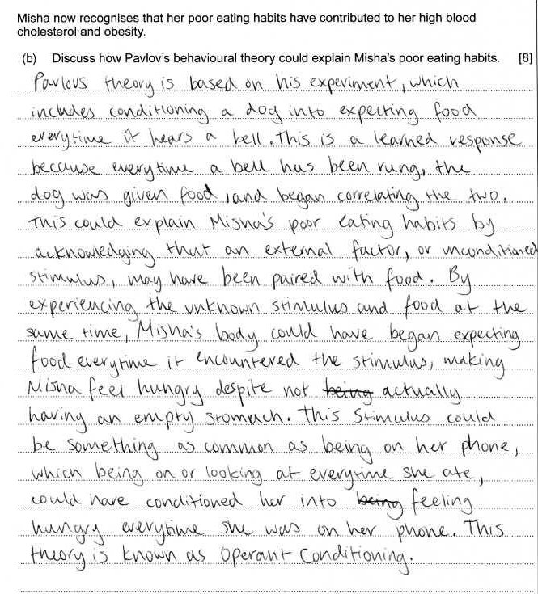
Question 2 (b) Candidate answer

Slide 7
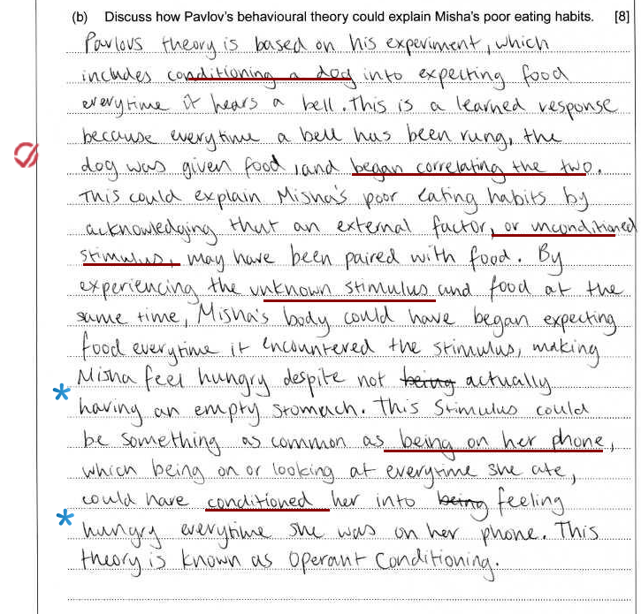
Question 2 (b) Candidate answer with examiner’s comments
This candidate demonstrated an excellent discussion, considering different ideas within Pavlov’s theory and applying them well to the scenario when explaining Misha’s poor eating habits.
The candidate’s answer started well with discussion of Pavlov’s experiment and used a wide range of terms such as unconditional stimulus, correlating, unknown stimulus, and conditioned.
The candidate then applied knowledge to why Misha may have poor eating habits. It was a pity that, at the end, the candidate used the wrong term which should have been ‘classical conditioning,’ as operant conditioning is linked to Skinner.
A very good answer!
7 marks awarded.

Slide 8
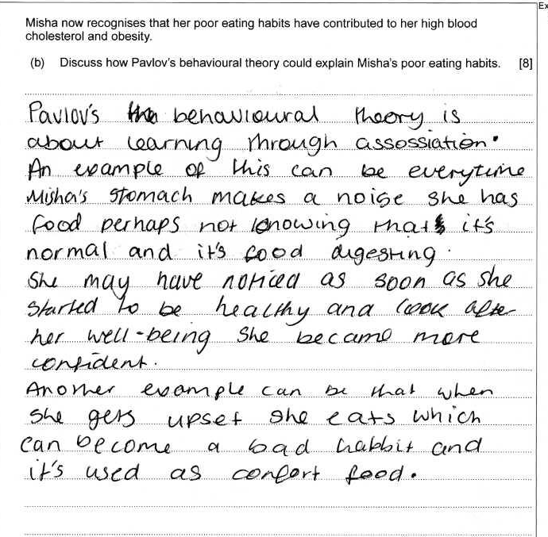
Question 2 (b) Candidate answer

Slide 9
Question 2 (b) Candidate answer with examiner’s comments
This candidate demonstrated knowledge and understanding of how Pavlov’s behavioural theory may explain Misha’s poor eating habits.
The candidate answer started well by making clear what Pavlov’s theory was about ‘learning through association.’
The candidate then applied this knowledge to why Misha may have poor eating habits. Two clear discussion points were made linking to ‘learning through association.’
For the candidate to improve their answer further, they could have written about the term ‘classical conditioning’ and made further use of key concepts such as: conditioned stimuli (eating when hearing stomach made noise) and unconditional stimulus, (conditioned response). The candidate could have also discussed Pavlov’s experiment to enable some context behind the reasons.
Candidate was awarded 5 marks.
A very good description!
7 marks awarded.

Slide 10
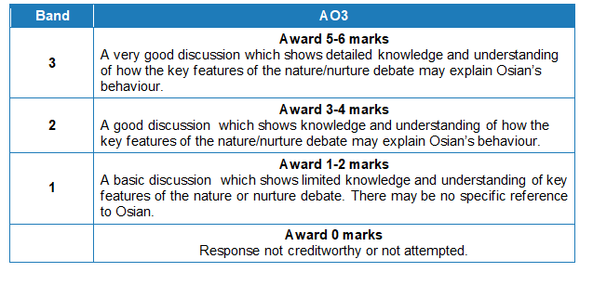
Question 5 (a)
Osian is 17 years old and has joined a youth gang that has been linked to local crimes.
Discuss how the key features of the nature/nurture debate may explain Osian’s behaviour.
[6 marks]

Slide 11
Question 5 (a) Candidate answer

Slide 12
Question 5 (a) Candidate answer with examiner’s comments
This candidate showed knowledge and understanding of key features of the nature and nurture debate and how this may explain Osian’s current lifestyle choices.
The candidate did give an incorrect definition of nature by linking this to the environment, however we positively mark and do not mark down incorrect responses. The candidate did make clear that nature was due to genetics and did well to state that nurture was due to observation and imitation. They went on to discuss how this may link to Osian’s current lifestyle. It was pleasing to see some concepts used such as genetic heritage, role models and imitate.
For the candidate to improve their answer, they could have brought in psychological models to fully meet the command word of ‘discuss’ which is examining an issue in detail considering different ideas.
4 marks awarded.

Slide 13
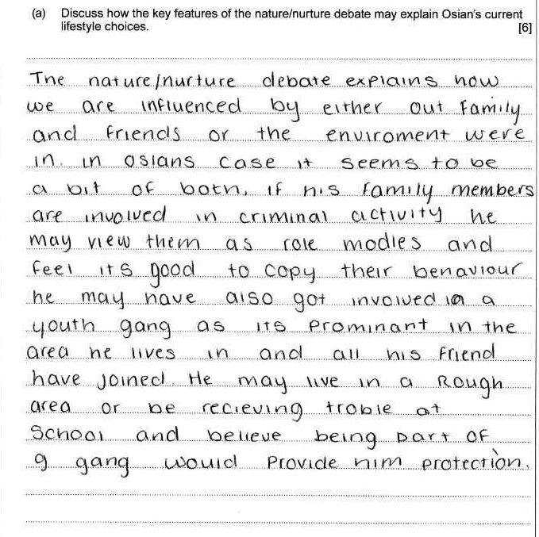
Question 5 (a) Candidate answer

Slide 14
Question (5a) Candidate answer with examiner’s comments
This candidate showed basic knowledge and understanding of key features of the nature and nurture debate, their answer is limited in scope.
The candidate did show knowledge of features of the nurture debate, for example, that it is influenced by family/friends/environment, however, there were no clear features of the nature argument discussed. The candidate did give some discussion of why nurture may explain Osian’s current lifestyle choice; however, it was not clear if the candidate was aware that this linked to nurture as the answer was not structured effectively. The candidate did well to use the term ‘role models.’
For the candidate to improve, they needed to explore psychological models to back up their answer and should bring in the nurture side of the debate, discussing how this could explain Osian’s current behaviour. The candidate could have added to the 2nd sentence “influenced by either our family genes or the environment.” Using the word ‘genes’ would have demonstrated knowledge of the nature element of the debate.
2 marks awarded.

Slide 15
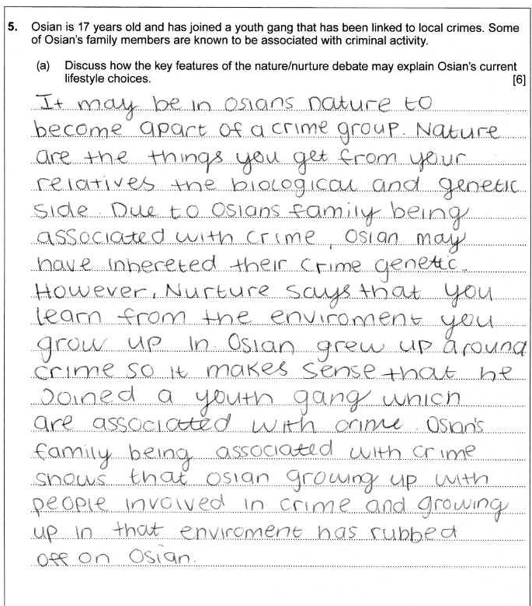
Question 5 (a) Candidate answer

Slide 16
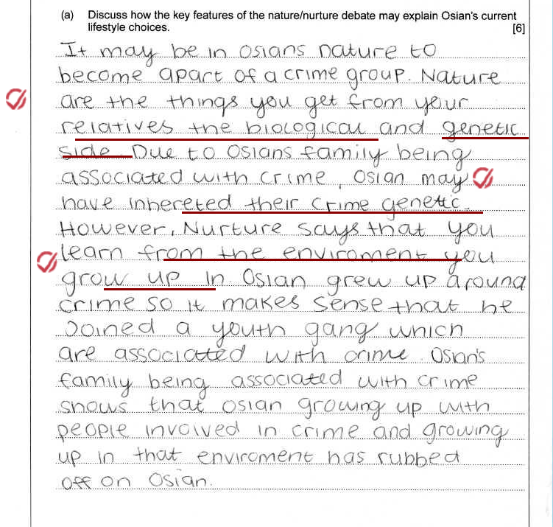
Question 5 (a) Candidate answer with examiner’s comments
This candidate showed good knowledge and understanding of key features of the nature and nurture debate, and it was pleasing to see two clear definitions of both nature and nurture.
The candidate did expand upon why nature could explain Osian’s current lifestyle choices discussing the fact that he may have inherited the crime genetic (this seemed to be a typing error and should have read ‘crime gene’.)
However, the discussion on nurture was generalised, for example, the candidate said it made sense that he ‘joined a gang’ and this ‘rubbed off on Osian’, the command word is ‘discuss’ so it is important to examine an issue in detail and this was lacking in this part of the answer. The candidate could have improved this section by making clear why Osian’s environment could explain his current lifestyle choices, for example, discussing the fact that Osian was living without any positive role models or may have been peer pressured from members of the gang.
For the candidate to improve their answer further, they needed to discuss the nature argument in more detail as stated above and brought in psychological models to fully meet the command word of ‘discuss’ which is examining an issue in detail considering different ideas.
3 marks awarded.

Slide 17
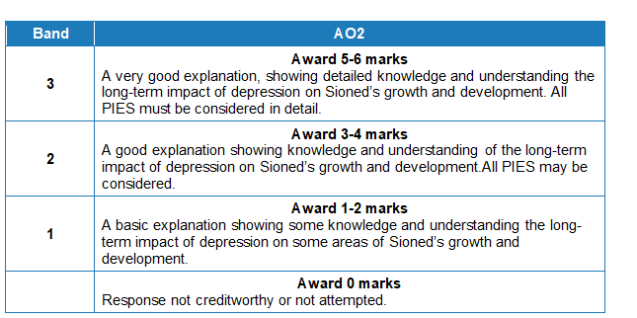
Question 7 (a)
Sioned is 35 years old and has lived with a long-term severe skin condition (eczema) all her life. It has caused her to experience episodes of depression over the last ten years.
Explain the long-term impact of depression on Sioned’s growth and development.
6 marks.

Slide 18
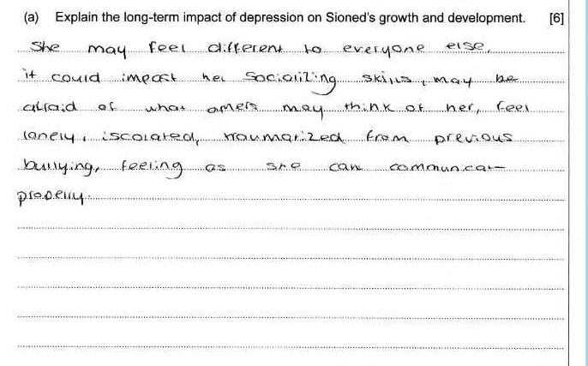
Question 7 (a) Candidate’s answer

Slide 19
Question 7 (a) Candidate answer with examiner’s comments
This candidate showed some knowledge and understanding of the impact of depression on Sioned’s growth and development.
The candidate did explain the impact on Sioned’s social development, being isolated and lonely. Bullying was not in the stem of this question and reasoning behind this answer was not explained by the candidate.
For the candidate to improve their answer, they could have brought in other aspects of development such as physical, intellectual and emotional aspects of living with depression and the potential long-term impact this could have had on Sioned.
2 marks awarded.

Slide 20
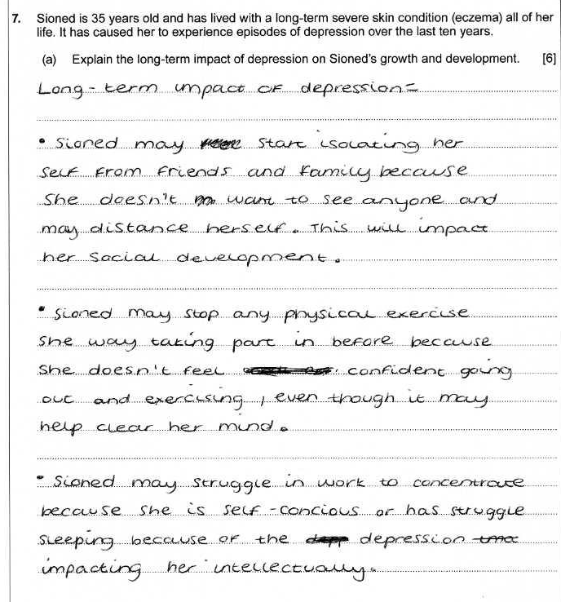
Question 7 (a) Candidate answer

Slide 21
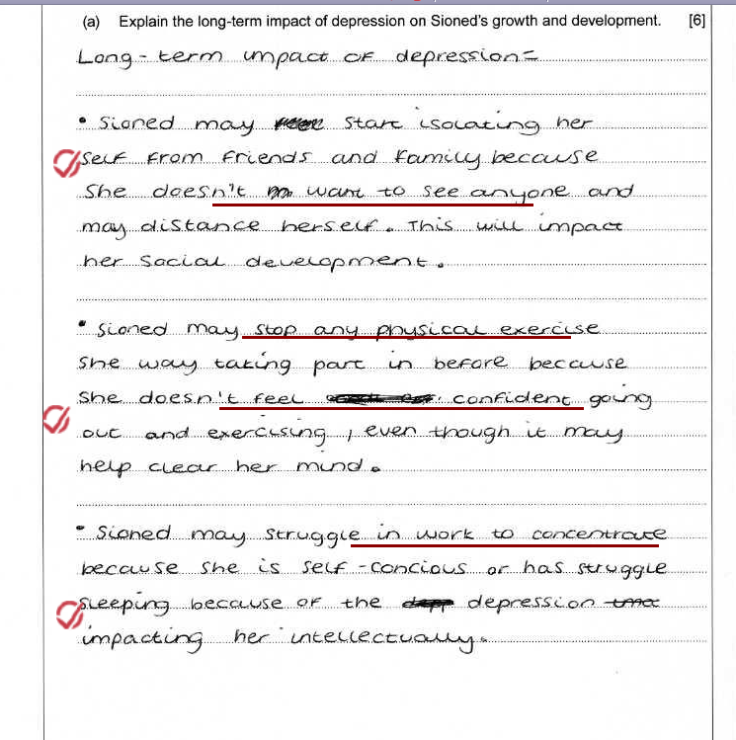
Question 7 (a) Candidate answer with examiner’s comments
This candidate showed some knowledge and understanding of the long-term impact of depression on Sioned’s growth and development through the wide-ranging nature of their response.
The candidate explained the impact on Sioned’s social development, isolating herself from friends; physical development, stopping physical exercise; and intellectual development, struggling to concentrate in work. It was evident that the candidate was aware of the impact of depression, however the answer lacked a detailed explanation of the long-term impact.
For the candidate to improve their answer, they could develop their responses by explaining social isolation and the long-term impact of stopping physical exercise such as increased risk of putting on weight leading to obesity. The candidate could also have considered the long-term impact of not being able to concentrate, for example, the impact on her work leading to losing her job and resulting in loss of future income.
3 marks awarded.

Slide 22
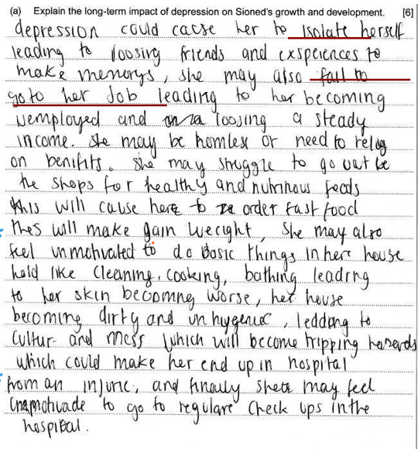
Question 7 (a) Candidate answer

Slide 23
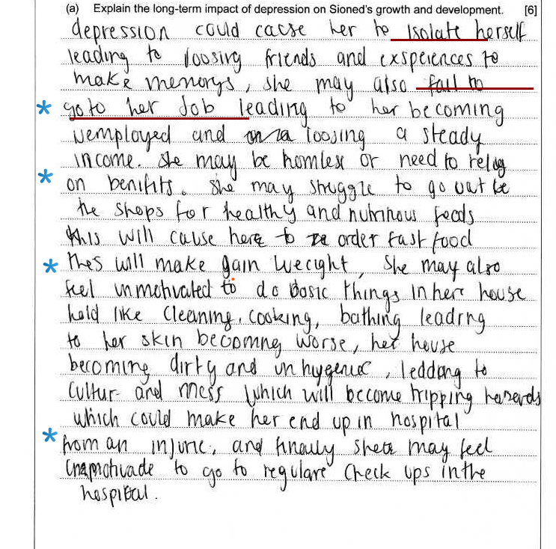
Question 7 (a) Candidate answer with examiner’s comments
This candidate demonstrated detailed knowledge and understanding of the long-term impact of depression on Sioned’s growth and development.
The candidate developed several points including long-term physical, intellectual and social impacts of depression. It was pleasing to see clear explanations of the impact on depression focusing on how this could affect Sioned’s growth and development.
The candidate could have made some reference to emotional development to reach the top of the band and could have given a named condition that could be linked to gaining weight, for example, obesity.
The section about her job could have been more clearly linked to intellectual development when discussing her lack of focus, however, there were detailed points made throughout the answer.
5 marks awarded.

