Slide 1
CCPLD Level 3: Practice and Theory
Unit 330
Spring Network 2024

Slide 2
This event is supported and facilitated by representatives and subject specialists from WJEC and City and Guilds.
WJEC
Amy Allen-Thomas
Subject Officer – Children’s, Care, Play, Learning and Development
Level 2 CCPLD: Core
Level 2 CCPLD: Practice and Theory
Level 3 CCPLD: Practice and Theory
WJEC
Lianne Haymer
Principal Examiner – Children’s, Care, Play, Learning and Development
Level 3 CCPLD: Practice and Theory
City & Guilds and WJEC continue to work collaboratively and in partnership with the following organisations who will also be contributing to this event:
Qualifications Wales
Social Care Wales
Health Education and Improvement Wales

Slide 3
Audio Recording
The presenter is required to make an audio recording of this event. This is a control designed to ensure that WJEC is able to demonstrate compliance with regulatory Conditions of Recognition; specifically, conditions relating to the confidentiality of assessment materials.
The recording will be made available to the qualifications regulator if required, but it will not be shared with any other third parties. The recording will be stored securely by WJEC for a period of three years and then permanently destroyed.
Please note that delegates are NOT PERMITTED to make an audio or video recording of any aspect of this event.

Slide 4
Using Teams
During this Teams session, it would be beneficial to all if the following protocols are adhered to:
Microphones to be muted when not speaking
Use the ‘raise your hand’ feature to ask a question or use the chat function
Activate your camera if you wish to do so
Technical problems:
If you experience technical problems with your sound or your web camera, this is often out of our control, but in the first instance we advise you leave and re-join the meeting or contact your own IT support.

Slide 5
Event Materials
This PPT presentation will be sent to the email address(es) you provided on registration.

Slide 6
Aim and objectives
The online session will provide participants with an opportunity to:
Listen to high level Principal Examiner feedback on Unit 330 from January 2024 examination.
Read and digest candidates responses before the session and propose awarded marks in line with mark scheme in preparation.
Participate in discussion for each marked response.
Gather hints and tips on the marking process to embed in delivery and assessment at centre level.
Question and answer opportunities with the technical adviser and subject specialists
New Mailbox for WJEC CCPLD Qualifications
CCPLD@wjec.co.uk

Slide 7
Entries January 2024
Paper
Onscreen
Paper
 | Paper | Onscreen
Number of entries | 165 | 141
Mean mark | 47.3 | 51.6
PASS | 37
MERIT | 51
DISTINCTION | 66

Slide 8
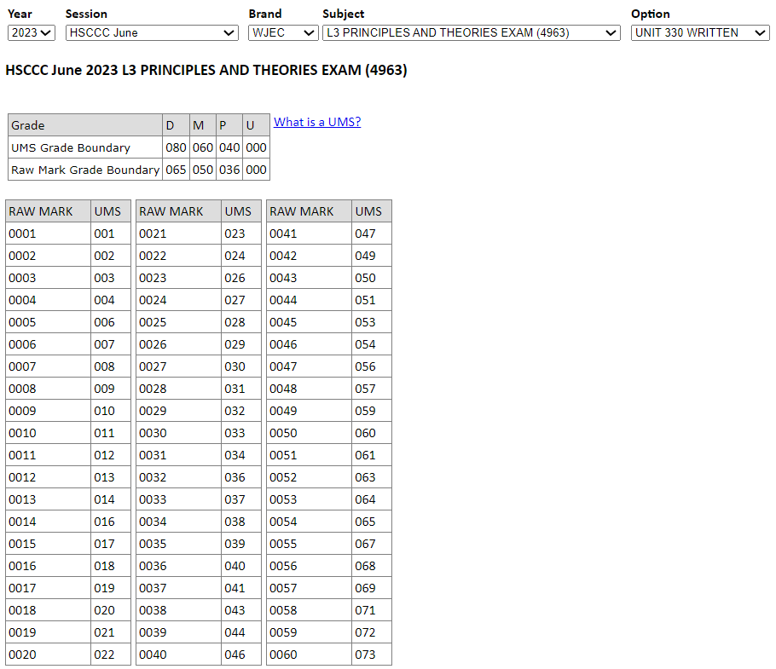
UMS calculator
https://www.wjecservices.co.uk/MarkToUMS/default.aspx
Unit 330 and 331 UMS combined grade

Slide 9
Unit 330 – Winter 2024
Support Pack

Slide 10
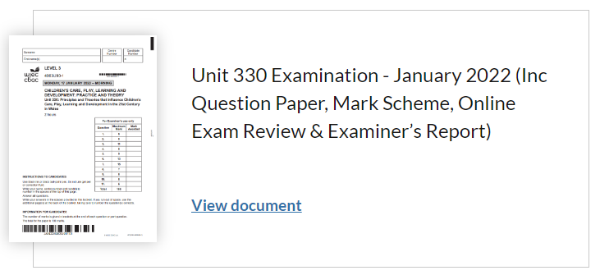
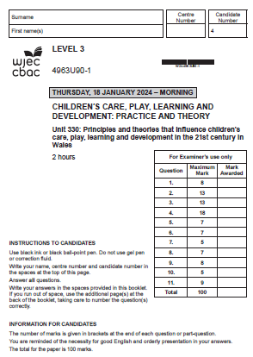
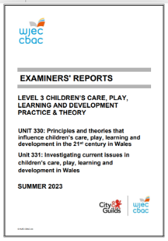
Level 3 Children's Care, Play, Learning and Development: Practice and Theory (healthandcarelearning.wales)
Summer 2023

Slide 11
Principal Examiner Feedback
Unit 330 – January 2024

Slide 12
High level feedback
The examination was completed on-line and through paper copies.
The questions proved to be accessible to the majority of candidates and timing of the paper was gauged well as candidates responded well and with detail to all questions provided.
Responses were generally clear and examiners were able to understand text, some learners wrote in very large writing and they ran out of space quickly although more often than not, they made use of additional sheets to complete their response.
Responses were enhanced by the opportunity to complete online through clarity and expanded space for their responses, many learners benefit through being able to type rather than write their answers, to amend and correct as they respond.
All questions were attempted and no question proved to be more challenging than what has been used in any other paper for this unit.
The candidate answers varied in the detail provided in their responses and the command verbs were acknowledged with successful navigation of writing skills to ensure the highest marks can be achieved, this is especially significant in the higher assessment outcome when referring to specific question types.
Very few candidates responded with bullet points where the response required an explain or a discuss, which was very positive to see.

Slide 13
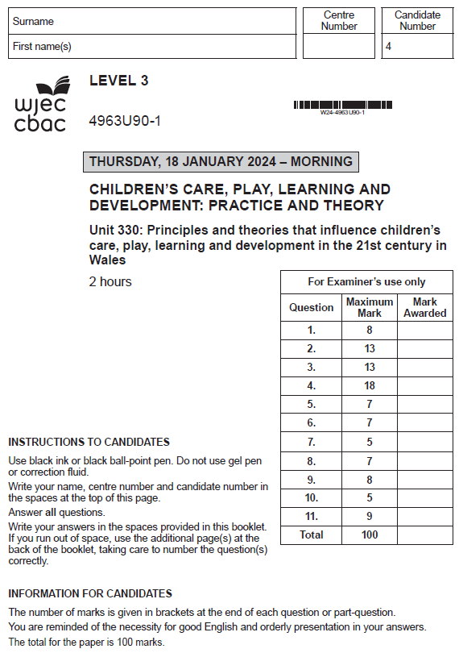
Unit 330: Principles and Theories that Influence Children’s Care, Play, Learning and Development in the 21st Century in Wales

Slide 14
Question 2(b) and mark scheme
Command Verb: Describe
Provide characteristics/main features or a brief account
Response may refer to:
ACEs is an acronym to describe a broad range of Adverse Childhood Experiences
Children or young people have been exposed to negative / stressful / traumatic experiences
A traumatic experience / event
Long lasting impact
An event or experience causing mental and emotional trauma
Causing toxic stress to the developing mind of a child
Affecting the child’s well-being
Negative experiences and events can have a long-lasting effect on people's lives
These experiences can include:
Physical abuse
Sexual abuse
Emotional abuse
Neglect / physical or emotional
Mental illness
Incarcerated relative / family member or close contact being detained in prison Violence against a family member
Domestic abuse
Household Substance misuse
Household dysfunction
Parental separation / divorce
Community violence
Homelessness
Growing up in a household where adults are experiencing mental health issues / harmful alcohol / drug use
This list is not exhaustive.
Credit any other relevant response.
Award up to 6 marks.
Award 0 marks for a description that is not creditworthy.
Award 1-2 marks for a limited description which shows little knowledge and understanding of the meaning of the term Adverse Childhood Experiences (ACEs).
Award 3-4 marks for a good description which shows some knowledge and understanding of the meaning of the term Adverse Childhood Experiences (ACEs).
Award 5-6 marks for a very good description which shows sound knowledge and understanding of the meaning of the term Adverse Childhood Experiences (ACEs).

Slide 15
Question 2(b) Candidate’s answer with Examiner’s comments
Adverse childhood experiences are experinces children in adolesence go though caused by anoyne but mostly someone within the childs family or care circle,this can exist of any types of abuse such as,sexual abuse,physical abuse,emotional abuse,domestic abuse, domestic violence, neglect. If a child experinces any types of these adverse childhood experiencs it could affect them in ways such as not being able to form bonds/friendships meaning they could feel more lonley,a child may develope anxiey,depression or eating disorders,a child may isolate themselfs from others.A child could develop ALN such as a selective mute.A childs future may be affects by adverse childhood experinces as of not being able to attend school as of not feeling safe or not being able to concentrate worrying about things at home a child may have low self - confidence and steem.Adverse childhood experiences affect all children differenrlty by affect them hugly from adolesnece al the way through theri life as it can be traumatic.
Principal examiner feedback​
​
This response provided a clear and focused description of Adverse Childhood Experiences(ACEs) and its meaning. This response is an example of a very good answer with a good level of knowledge and understanding shown. There is reference to key areas identified within the mark scheme, and the response addresses the descriptive meaning of ACEs, with an understanding of the types of trauma or abuse that the experiences may entail, and also a description of the meaning and it’s effect on children now and in the future.
Exam preparation tip
Further explanation of the points raised within the response could have improved the candidate mark awarded.
Marks awarded 5/6

Slide 16
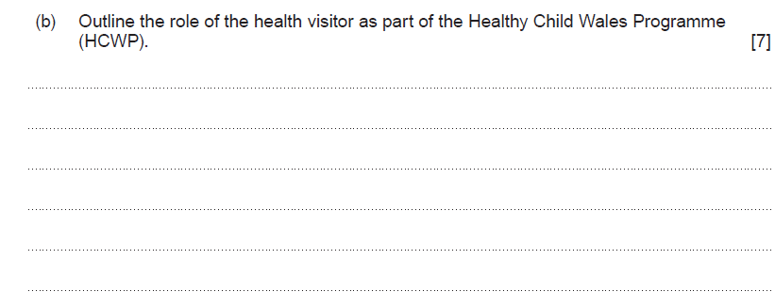
Question 3(b) and mark scheme
Command Verb: Outline
Set out the main points/provide a brief
description or main characteristics
Response may refer to:
The health visiting services provides a professional assessment of family resilience
Health visitors assess the development of the child
Provides consideration to the whole setting / environment / wider influences such as social /economic / environmental factors
The health visitor assesses whether the child and / or family need additional support / address areas of concern
The Welsh health visiting service work in partnership to develop a fully validated all Wales Health Visiting Family Resilience Assessment Instrument Tool (FRAIT) e.g. identify additional needs / identify potential safeguarding concerns / interventions to review and evaluate progress
Work with families to support the universal screening contacts e.g. screening / immunisation / monitoring and supporting child development
Health visitors providing a targeted visiting service e.g. for a mother expecting her first baby / support for learning difficulties / safeguarding concerns / emotional / mental health issues / concerns in pregnancy / medical conditions of unborn child
Growth / development assessments
Weaning and baby advice
Family resilience assessment
Maternal mental health assessment
Multiple pregnancy support
Parental expectations and preparation for parenthood discussed / assessed
Level of intervention determined to support the family
Support family on health and health behaviours / key health promotion
Promote secure attachment and bonding between parent / carer and their baby
Health visitors discuss expected developmental milestones / support management of baby’s well-being / management of minor illness’s / prevention of accidents
Health visitors support the family / carers in key health messages e.g. breastfeeding / dental health /healthy start vitamins / healthy nutrition and promoting baby development.
Health visitors discuss and support key public health priorities will be met by the provision of support and advice on various key areas, including: dietary advice / smoking cessation / dental health / play / vision / childhood immunisation programme / preparation of school readiness and promotion of safety in the home and the community
This list is not exhaustive. Credit any other relevant response.
Award up to 7 marks.
Award 0 marks for an outline that is not creditworthy.
Award 1-2 marks for a limited outline which shows little knowledge and understanding of the role of the health visitor as part of the Healthy Child Wales Programme (HCWP)
Award 3-4 marks for a good outline which shows some knowledge and understanding of the role of the health visitor as part of the Healthy Child Wales Programme (HCWP)
Award 5-7 marks for a very good outline which shows sound knowledge and understanding of the role of the health visitor as part of the Healthy Child Wales Programme (HCWP)

Slide 17
Question 3(b) Candidate’s answer with Examiner’s comments
Principal examiner feedback​
​
This set of questions provided an opportunity to expand further on the knowledge gained of health care provision in Wales, with a focus on the Healthy Child Wales Programme. This question - 3(b) required the candidate to provide an outline of the role of the health visitor. This question provided a range of firm responses and was generally highly awarded through providing sound knowledge and understanding of the day-to-day role and responsibilities with a health visitors role.
Exam preparation tip
This candidate provided a good outline and responded with a range of focused areas specific to the role of the health visitor, although more detail within the response could have supported the expression of a very good understanding.
Marks awarded 3/7
The role of a health visitor is to be support to the parent and baby until usually the age of 2 years of age . They will keep track on the childs head circrumfance, weight and height to ensure that the child is physically growing healthily they will also take not of their sleeping patterens and the amount of feeds the child is recvivng and the space inbertween them to ensure that they are developing. They are their to answer and support the parent and give advice on things such as breast feeding they will also refer the parent or baby to a specialist if they feel it is appropiate such as a dietition or a GP. They will spot things early on if the child isnt taking the milk and the resoning such as being dairy free and knowing what subbsitities that would be appropiate.

Slide 18
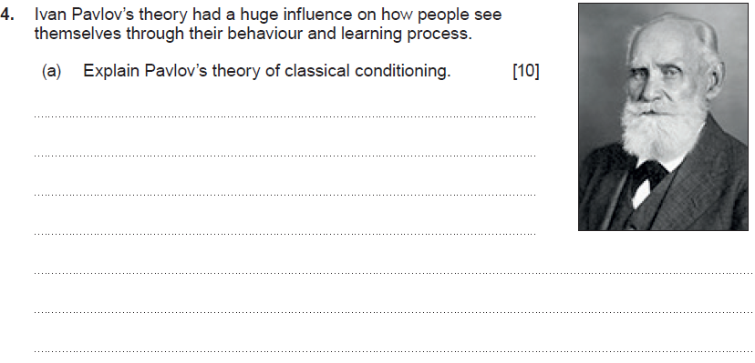
Question 4(a) and mark scheme
Command Verb: Explain
Provide details and reasons for how and why something is the way it is
Response may refer to:
Classical conditioning is an automatic conditioned response when paired with a specific stimulus
Pavlov’s experiment was on based on canine digestion / the digestion of dogs
The experiment demonstrated the existence of classical conditioning with the association of a bell sound with food
Pavlov introduced two stimuli / the bell and the food
Pavlov’s experiment was based on the dogs associating the sound of the bell with food
The dogs were conditioned to salivate for food by the sound of the bell without the presence of food
Pavlov showed that an initially neutral stimuli can provoke a new response through its association
Pavlov began ringing a bell and then presenting the food so they’d associate the sound with food.
Pavlov found that over time dogs were salivating not only when their food was presented to them, but when the people who fed them arrived.
Pavlov’s theory that the dogs were salivating because they were associating the people with being fed.
The dogs learned to associate the bell ringing with food
Subjecting the dogs to the stimuli provoked a reaction in them
The bell ringing caused their mouths to salivate whenever the bell rang / not just when they encountered the food.
Classical conditioning consists of associating an initially neutral stimulus with a meaningful stimulus
Pavlov’s theory supports the ability to associate stimuli in many daily situations
Classical conditioning can be divided into stimuli / unconditioned and conditioned stimuli
Classical conditioning can be divided into responses / unconditioned and conditioned responses
The is a relationship between stimuli and responses
Pavlov’s experiment shows:
The unconditioned stimulus was the food
The unconditioned response was the salivation of the dogs when seeing the food
The conditioned stimulus was the sound of the bell
The conditioned response was the dogs salivating when hearing the sound of the bell
This list is not exhaustive.
Credit any other relevant response.
Award up to 10 marks.
Award 0 marks for an explanation that is not creditworthy.
Award 1-2 marks for a limited explanation which shows little knowledge and understanding of Pavlov’s theory of classical conditioning
Award 3-4 marks for a good explanation which shows some knowledge and understanding of Pavlov’s theory of classical conditioning
Award 5-7 marks for a very good explanation which shows sound knowledge and understanding of Pavlov’s theory of classical conditioning
Award 8-10 marks for an excellent explanation which shows detailed knowledge and understanding of Pavlov’s theory of classical conditioning

Slide 19
Question 4(a) Candidate’s answer with Examiner’s comments
Pavlovs Theory of Classic conditoning is that a persons behaviour can be contioned. Pavlovs study was based on a dog and their time for dinner. Pavlovs dog would salvate when they would be given their dinner. To conditon the dog to be able to know when they were about to be given their dinner Pavlov introduced a bell and would ring the bell before he would give the dog its dinner over time the stimili which was the dog salvating. The dog would beging to salvate before he saw the food just from when Pavlov would ring the bell to show that behaviour can be conditoned.
This is shown and used in settings as if a child has seen that if they sit smarlty on the carpet they will recive a sticker they have been conditoned to know this meaning they will more likely to sit smarlty knowing they will get a sticker because of this it also relates to a child having vicarious reinforcement seeing somone else do it. Positive reinforcement and negative reinforcemnt the positive reinforcment being the sticker for sitting smartly and the negative reinforement not getting the sticker for not sitting smartly. The childrened will be conditoned to know that when they take their coats of they are top sit smartly on the carpet.
Principal examiner feedback​
​
This response provides a very good understanding of Pavlov’s theory of classical conditioning. The response is clear in it’s understanding of the experiment undertaken by Pavlov which involved conditioning the behaviour of a dog based on a direct stimulus. This response was highly awarded for its clarity and explanation.
Exam preparation tip
Further detail within the explanation relating to the experiment and the understanding of conditioning responses with appropriate classical conditioning terminology could have enhanced the marks awarded. Overall, a very good response providing sound knowledge. Marks awarded 7/10

Slide 20
Question 4(b) and mark scheme
Command Verb: Suggest
Put forward an idea, reason or course of action
Response may refer to:
Encourage positive / respectful relationships
Use activities to develop interpersonal skills
Help develop reasoning skills / problem solving skills
Help children to develop emotional intelligence
Help children to understand / make sense of their feelings / emotions
Create a positive behaviour policy
Defining boundaries
Develop a respect for rules
Create an understanding of acceptable / expected behaviours
Create awareness / co-operation of behaviour expectations
Engage parents / carers in understanding the expectations of behaviours
Regular / positive / genuine use of praise and encouragement
Create simple / easy to follow rules / boundaries
Provide specific / timely feedback to encourage understanding
Give attention to positive behaviours
Reward positive behaviour e.g. stickers, certificates, charts
Create a quiet area to relax/calm down/ to provide thinking space/reduce overwhelming feelings or emotions
Provide a consistent and fair environment
This list is not exhaustive.
Credit any other relevant response.
Award up to 8 marks.
Award 0 marks for a suggestion that is not creditworthy.
Award 1-2 marks for a limited suggestion which shows little knowledge and understanding of ways in which childcare workers can support positive behaviour in the early years setting
Award 3-4 marks for a good suggestion which shows some knowledge and understanding of ways in which childcare workers can support positive behaviour in the early years setting
Award 5-6 marks for a very good suggestion which shows sound knowledge and understanding of ways in which childcare workers can support positive behaviour in the early years setting
Award 7-8 marks for an excellent suggestion which shows detailed knowledge and understanding of ways in which childcare workers can support positive behaviour in the early years setting

Slide 21
Question 4(b) Candidate’s answer with Examiner’s comments
They can use positive reinforcement by using a stickers or a traffic light name system or verbal positive reinforcement meaning thst is a child is showing positive beahiour they will recive positive reinforcement verbally such as ''Well Done '' this will make the child to want to contiune this behaviour to have more positive reinforcement. Negative reinforcement can also be used if negative behaviour is being shown the child will loose 5 minutes of their break this is will make the child not want to repate the negative behaviour because they missed their break. Social learning would also support positive behaviour in a early years setting seeing the members of staff speak to eachother polielty using their pleases and thank yous the children will observe this and by the members of staff being positive role models the children will socially learn from this and will copy this behaviour this can also happen with hte younger children in the school seeing their older peers as positive rolemodles and repeating their behaviours as a example in placement the older children of the school line up calmly for their dinner and the younger children have recongised this and are now wanting to do the same bacuse of this the younger children in my setting also standf calmly and in line when waiting for their dinner. Vicarious reinforcemnt would also support positive behaviour if a child sees their peer presenting postiive behaviour and reciving a positive reinforcement they will also present postivie behiour becuase they too want the postivie reinforcement.
Principal examiner feedback​
​This set of questions provided an opportunity to expand further on the knowledge gained of Pavlov’s theory of classical conditioning, with a focus on the influences his theory has had in practice. This question - 4(b) required the candidate to suggest ways childcare worker can support positive behaviour in early years settings.
Exam preparation tip
This response provided a range of suggestions which were clear and detailed and is a highly awarded excellent response.
Discussion relating directly to Pavlov’s theory of classical conditioning could have enhanced the mark awarded.
Marks awarded 7/8

Slide 22
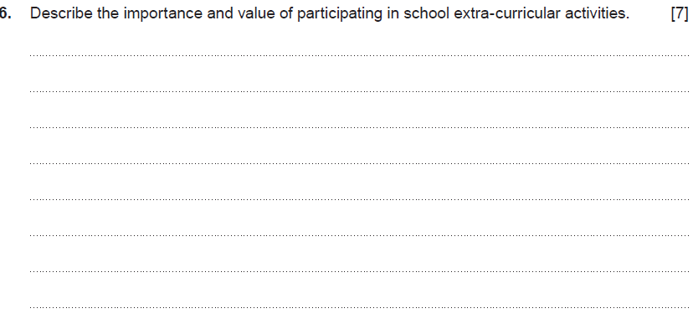
Question 6 and mark scheme
Command Verb: Describe
Provide characteristics/main features or a brief account
Response may refer to:
Improved academic performance / learning
Positive learning experiences
Help to explore personal interests
Help to create a broader perspective
Gain higher self-esteem
Provide greater social opportunities
Improve social development
Improve communication skills
Provide productive opportunities for learning
Feeling of worthiness
Help to grow self-confidence
Greater self-worth and value
Develops teamwork
Develops problem solving skills
Greater commitment
Learn the importance of sharing time / giving up personal time / caring for others / supporting others / helping others
Create a sense of belonging / connection with others
Being part of a team / group / club etc
Improves time management
Learn new skills
Develop ideas of career choices
Increase independence
Increase motivation
Help with meeting new people
Experience different environments
Take on new challenges
Develop skills to support learning in the classroom
Learn skills to support with understanding the world of work
Character building / development
Learn about personal strengths and weaknesses
Develop leadership skills
Develop resilience
Develop greater self-awareness
This list is not exhaustive. Credit any other relevant response.
Award up to 7 marks.
Award 0 marks for a description that is not creditworthy.
Award 1-2 marks for a limited description which shows little knowledge and understanding of the importance and value of participating in school extra-curricular activities.
Award 3-4 marks for a good description which shows some knowledge and understanding of the importance and value of participating in school extra-curricular activities
Award 5-6 marks for a very good description which shows sound knowledge and understanding of the importance and value of participating in school extra-curricular activities
Award 7 marks for an excellent description which shows detailed knowledge and understanding of the importance and value of participating in school extra-curricular activities

Slide 23
Question 6 Candidate’s answer with Examiner’s comments
Extra curriculm activitys are vitally important for childrens growth hollistically for example socialy a child can develop from extra curricular activtiys as it will support them in creating new bonds with child who have simular intrests,extra curricular activitys support a childs physical development by keeping htem fit and healthy but in a fun way.Extra curricular activitys could also support a childs language development by they may learn new words or even a new language,intellectually a child may develope as extra curricular activitys can involve promblem solving and thinking outside the box,extra curricualr activitys alow children to develop creativly as they can create pictures find new ways to express themselfs.Extra curricular activitys support emtional development as a child can explore their feeling and if they enjoy activitys and if they dont enjoy some activitys but it can also help them to find new ways to express their feelings.Extra curricular activitys help a child develope spirtualy ad morally as a child may have to be considerate to peoples needs and religions also a child may have to take turns and be patient.
Principal examiner feedback​
​
This response provided candidates with the opportunity to express their understanding and knowledge of the importance and value of participating in school extra-curricular activities. This candidate provided a clear description of a range of holistic areas that can be developed through extra-curricular activities and provided a good structure to the response.
Exam preparation tip
Further enhancement of marks awarded could have been developed with greater depth to each area described as some areas were a little brief, to provide a greater understanding of the value and importance of the activities described.
Marks awarded 5/7

Slide 24
Question 8 and mark scheme
Command Verb: Reflect
Evaluate and/or consider
Award up to 7 marks.
Award 0 marks for a reflection that is not creditworthy.
Award 1-2 marks for a limited reflection which shows little knowledge and understanding of the various reasons that may impact on a child’s attendance at school.
Award 3-4 marks for a good reflection which shows some knowledge and understanding of the various reasons that may impact on a child’s attendance at school.
Award 5-7 marks for a very good reflection which shows sound knowledge and understanding of the various reasons that may impact on a child’s attendance at school.
Response may refer to:
Holidays during term time
Travel issues
Financial concerns
Truanting
Behaviour issues
Lack of parental boundaries
Young carers or responsibility for siblings
Parents commitment to working hours
Poor time management
Experiencing personal/family transition
Health condition
Adverse childhood experiences (ACEs)
Bullying or friendship issues
Anxiety and mental health
Cultural or religious expectations
This list is not exhaustive.
Credit any other relevant response.

Slide 25
Question 8 Candidate’s answer with Examiner’s comments
A childs attendance at school may be impacted as of finance difficulies for example if a child lives far out from a school and the caregiver cant afford a car or bus they then become unable to attend school,health conditions may affect a childs attendance as if the child is continusly sick the child cannot attend school,neglect could be a reason if a parent does not care about the child they will not bring the child to school , bullying could affect a child attendance if they child is scared to attend school they could be alowed to stay home,parents taking children on holiday during school times may affect a childs attendace, another reason could be hospital or doctors appointments again if the child has health conditons they may not be able to attend school, or if the child is a young carer they are unable to attend shcool because they have to care for family memebers.
Principal examiner feedback
​
This response provided a very good reflection of the reasons that may impact on a child’s attendance. This candidate reflected on reasons such as financial and travel difficulties,​ health and illness concerns and the impact of bullying on attendance.
Exam preparation tip
This response could have been expanded on further with a clearer reflection of the areas discussed to show a higher level of knowledge and understanding of the factors that impact children’s attendance.
Marks awarded 5/7

Slide 26
Question 11 and mark scheme
Command Verb: Examine
Inspect thoroughly, in detail and draw a conclusion
Response may refer to:
CIW are an independent regulator of social care and childcare in Wales
CIW register / inspect / take action to improve the quality and safety of services
Specialist CIW teams are in place to ensure that only services that meet all of the regulatory requirements are registered to care for children
Ensure registered services understand their responsibility to provide safe and good quality care
The CIW team will take action if services don’t provide safe care
Improves the well-being of the people of Wales.
CIW regulate children’s services e.g. care homes for children / fostering services / adoption services / advocacy services and secure accommodation services
Regulate childcare and play services e.g. child minders / crèches / full day care / sessional day care / out of school care / open access play provision
CIW inspect services registered to check that they provide safe care
CIW provide a caring approach
CIW provide a fair / consistent / impartial and inclusive service
Ensure integrity / honesty and a trustworthy service
Professional - are skilled, knowledgeable and innovative
CIW carry out functions on behalf of Welsh Ministers
CIW provide assurance on the quality and safety of services for children
CIW decide who can provide services for children
Inspect / evaluate the well-being of individuals receiving care and the extent which outcomes are being achieved
Inspect quality of care and support e.g. qualified staff / knowledgeable / skilled / motivated and supporting children to achieve the best possible outcomes
Inspect / evaluate the physical environment are safe / clean / accessible / comfortable / welcoming / well-maintained / stimulating, and suitably equipped and furnished
CIW inspect and drive improvement of regulated services / local authority social services
Ensure that people using services are supported to achieve the best possible outcomes / are not placed at risk or do not experience harm
Make referrals of safeguard concerns
Undertake national reviews of social care services
Take action to ensure services meet legislative and regulatory requirements
Respond to concerns raised about social care and childcare services
Aim to improve care by encouraging and promoting improvements in the safety and quality of social care services
Take action to ensure services meet legislative and regulatory requirements
Follow-up on concerns raised about regulated services.
Enforce penalties where shortfall are identified / end services
This list is not exhaustive. Credit any other relevant response.
Award up to 9 marks.
Award 0 marks for an examination that is not creditworthy.
Award 1-2 marks for a limited examination which shows little knowledge and understanding of the positive impact of Care Inspectorate Wales (CIW) when regulating children’s care, play and learning services
Award 3-4 marks for a good examination which shows some knowledge and understanding of the positive impact of Care Inspectorate Wales (CIW) when regulating children’s care, play and learning services
Award 5-7 marks for a very good examination which shows sound knowledge and understanding of the positive impact of Care Inspectorate Wales (CIW) when regulating children’s care, play and learning services
Award 8-9 marks for an excellent examination which shows detailed knowledge and understanding of the positive impact of Care Inspectorate Wales (CIW) when regulating children’s care, play and learning services

Slide 27
Question 11 Candidate’s answer with Examiner’s comments
The Care inspectorate Wales are a positive impact on childrens care,play and learning as they make sure children are getting the best outcome from care services,as they make sure the envrionments are healthy,clean and suitable for children.They also make sure children are still learning while being cared for,The Care inspectorate wales also make sure the staff members are safe to be looking after the children to ensure their is no danger of harm,they also ensure the children are getting postive amounts of play and are that staff memebers encourage and join in with play as it is a vital step in development.The Care inspectorate Wales also check children are being fed nutritous healthy meals , having regular nappy changes are that they are cleaned well and have a good routine within a setting.Care inspctorate wales also support positive impacts by giving settings adivce on improvement so they can develop more to give the best outcome for the children.Care inspectorate wales give positive impacts as they alow parents to have trust in settings knowing their children are safe while gone.They also make sure that workers are working at the minimal standards they are allowed to or above.
Principal examiner feedback
​This response provided a clear and focused examination of the positive impact of the Care Inspectorate Wales (CIW). The candidate has addressed a range of regulatory requirements the CIW is responsible for and the positive impact that this service has for children accessing the care services that are regulated. This is an example of a very good examination and a highly awarded response.
​Exam preparation tip
Further enhancement of the level of examination provided could have been developed with greater depth to provide a firm understanding of the positive impact of regulating childcare services.
Marks awarded 7/9

Slide 28
Unit 330 - Exam
3rd June 2024 AM

Slide 29
Event Evaluation
https://www.surveymonkey.co.uk/r/WJEConline2023-24

Slide 30
Diolch
Thank you

Slide 31
Contacts:
Contact our specialist Subject Officers, Technical Adviser and administrative support team for your subject with any queries.
WJEC
Amy Allen-Thomas - Subject Officer
Tania Lucas – Subject Support Officer
E-mail: ccpld@wjec.co.uk

