Slide 1
Exam Walk-Through
Level 3 Health and Social Care: Principles and Contexts – Unit 5 4973UC/UD
Notes:
Hello.
This is a walk-through of the Level 3 Health and Social Care: Principles and Contexts – Unit 5 Sample Assessment Material.

Slide 2
What you should have in front of you:
A copy of the exam paper
A pen and pencil
A highlighter pen
A watch
Post-It notes
Notes:
In front of you, you should have:
A copy of the exam paper
A pen and pencil
A highlighter pen, which will help you identify key points in the question
A watch to help you keep an eye on the time
And Post-It notes – in case you need to write down any queries to ask your teacher - or in case you want to make any notes or jot down questions to ask your teacher

Slide 3
What this exam paper is all about:
This paper is 1 hour, 45 minutes long.
It is testing your knowledge of health and social care principles and contexts.
The paper is made up of five questions.
The question types vary.
The paper will assess AO1, AO2 and AO3.
The total mark for this paper is 100.
All question papers for Health and Social Care: Principles and Contexts have the same layout as this one.
Notes:
This exam paper is from the SAMs.
It is testing the content you will have been taught for Level 3 Health and Social Care: Principles and Contexts.
The exam is 1 hour and 45 minutes long.
The paper is made up of 5 questions.
The question types vary.
The paper will assess AO1, AO2 and AO3.
The total mark for this paper is 100.

Slide 4
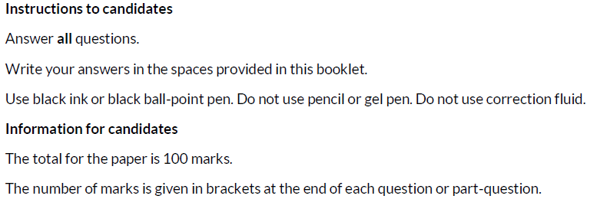
What should I do first?
1. Read the front cover of the exam paper.
2. Make sure your name and candidate number are on your answer booklet.
Notes:
First of all, read the instructions on the front cover of the exam paper.
Read the Instructions to Candidates section and the Information for Candidates section.
Write your name and candidate number in the correct section of the booklet.

Slide 5
General points on exam technique
Read through the whole question before starting to answer. This will help you understand what is required of you.
Use a highlighter to pick out key words.
Look at the command words and the number of marks available for each question, they will help you decide how much detail is needed.
If a word is bold, it is important.
Keep your exam paper open at the double page spread, do not fold it in half.
Read your answers to check they make sense.
Notes:
Read the slide.

Slide 6
How do I tackle the questions in this paper?
Skills being tested:
AO1 – demonstrate knowledge and understanding of a range of key concepts, values and issues that are relevant to health and social care
AO2 – apply knowledge and understanding of health and social care principles and contexts
AO3 – analyse and evaluate health and social care theories and practice to demonstrate understanding, reflect on how they can influence practice, making reasoned judgements and drawing conclusions
Approach:
Read each part of every question, e.g. question 1 (a), (b), (c) and (d).
Highlight key words/command verbs.
Check the number of marks for each part of the question so you spend your time appropriately.
Think carefully about your answer – are you responding to the command verb? – these are key.
Make a plan if you have time.
Remember the number of lines available indicates the length of the required response.
Avoid using bullet points.
Notes:
All the questions in this paper follow the same format.
They assess all three assessment objectives and you should follow the same approach for each question part/sub-section.

Slide 7
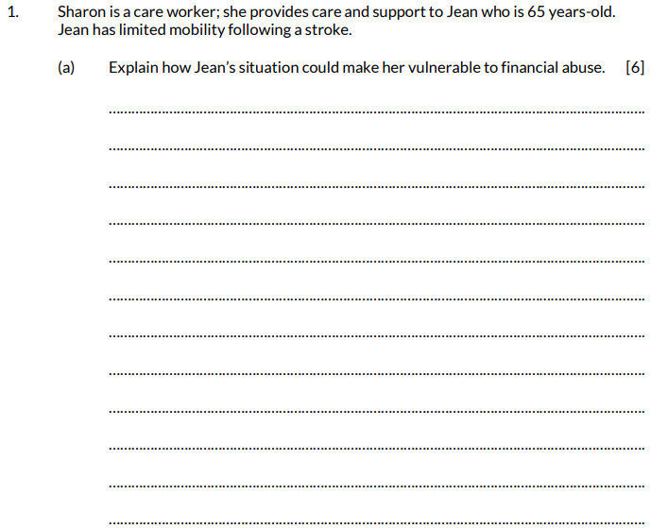
Question 1 (a), AO2
The information given at the start of some questions in the paper is called the rider. This sets the scene and gives you key information that will help you to formulate your answer.
The command word here is ‘Explain’ – provide details and reasons for how and why something is the way it is.
Notes:
Question 1 has a short rider to set the scene for the question.
Read the question.
The command verb Explain is key; you need to give an extended response as indicated by the number of lines, make sure you focus on the question and stick to financial abuse.

Slide 8
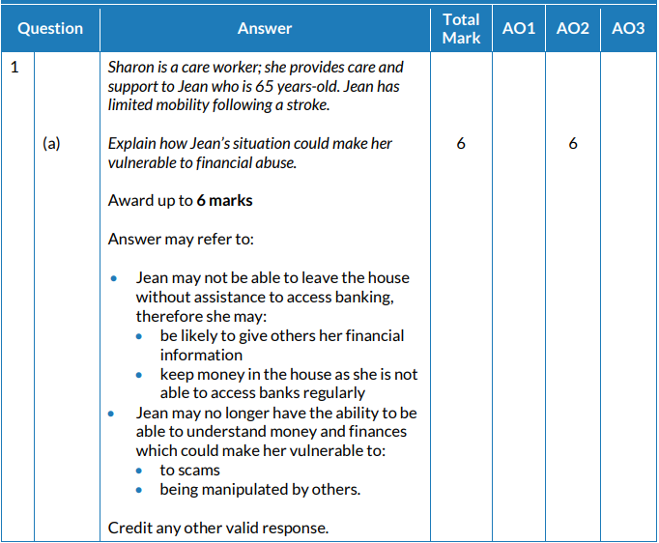
Question 1 (a) AO2 mark scheme
In order to access the full range of marks your response needs to refer to Jean. Look at the answers you have given and underline what you have covered from the mark scheme.
This means we can always give a mark to a response that is not on the list but is correct – check with your teacher if you are not sure.
Notes:
In order to access the full range of marks, your response needs to refer to Jean – look at the answers you have given and underline what you have covered from the mark scheme.

Slide 9
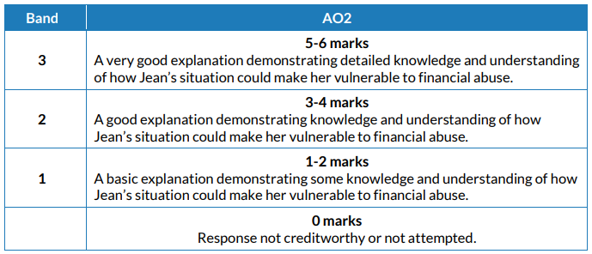
Question 1 (a) AO2 mark bands
This is a banded mark scheme – so you need to make a judgement on your response before awarding a mark.
Look at how many points you have underlined and make a judgement.
Notes:
This is a banded mark scheme – so you need to make a judgement on your response before awarding a mark.
Look at how many points you have underlined and make a judgement.
Award yourself a mark between 0 - 6 marks.

Slide 10
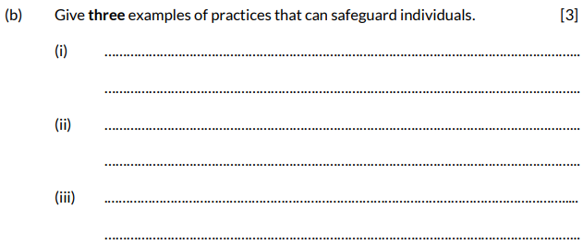
Question 1 (b), AO1
The command word here is ‘Give’ – provide, name.
Read the question carefully. Here, you are being asked for three examples in your answer.
Take care not to repeat yourself.
Notes:
Read the question.
The command word here is ‘Give’ – which means provide, name.
Remember to read the question carefully. Here, you are being asked for three examples in your answer.
Take care not to repeat yourself.

Slide 11
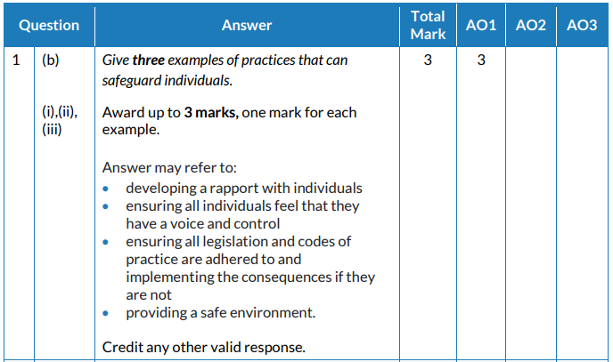
Question 1 (b) AO1 mark scheme
Look at your answers and underline anything in your answer that is in these lists and give yourself a mark as appropriate.
This means we can always give a mark to a response that is not on the list but is correct – check with your teacher if you are not sure.
Notes:
As you did for the previous question, look at your answers and give 1 mark for each correct example you have stated, either from the list or any other valid response that you may have given.

Slide 12
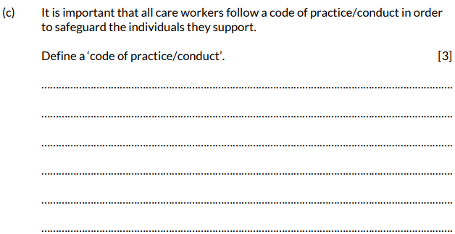
Question 1 (c), AO1
The command word here is ‘Define’ – give the exact meaning.
It is, however, 3 marks so try to give as much detail as possible.
Notes:
Read the question.
The command word here is ‘Define’ – which means give the exact meaning.
It is, however, 3 marks so try to give as much detail as possible.

Slide 13
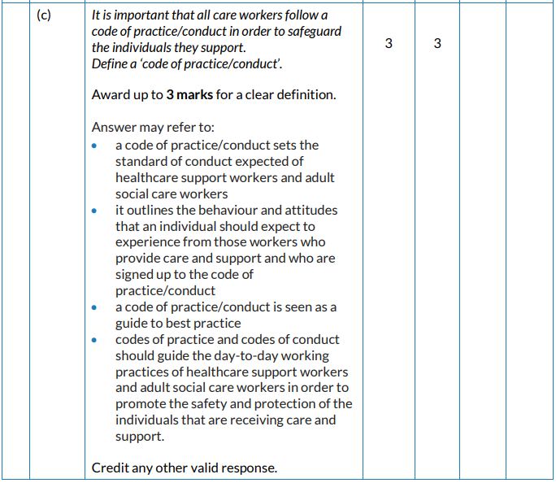
Question 1 (c) AO1 mark scheme
What we are looking for here is evidence that you can give a detailed definition.
Award yourself:
1 mark for a very basic definition
2 marks for a satisfactory definition
3 marks for a sound, detailed definition – again, your teacher will be able to advise
Notes:
Again, underline the correct responses you have given within your definition.
Award yourself:
1 mark for a very basic definition
2 marks for a satisfactory definition
3 marks for a sound, detailed definition – again your teacher will be able to advise

Slide 14
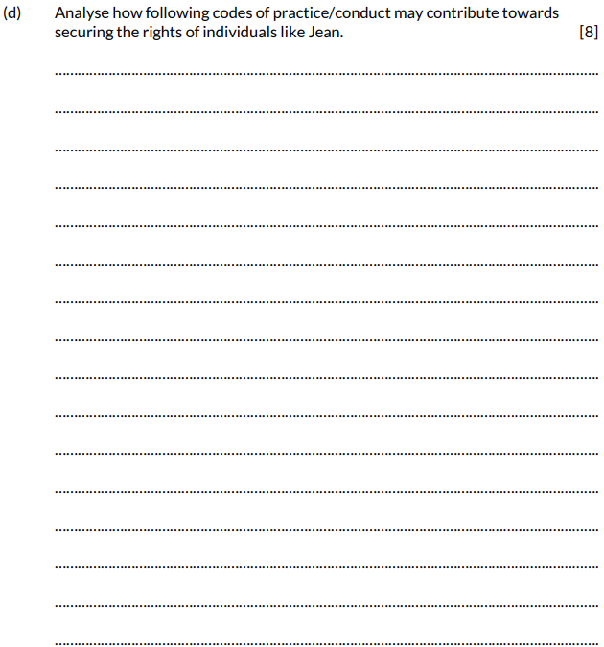
Question 1 (d), AO1 and AO3
The command word here is ‘Analyse’ – examine an issue in detail/how parts relate to whole, to explain and interpret.
Strengths – positives
Weaknesses – negatives
8 marks is a lot of marks so remember to plan your response carefully and include as much detail as possible. Do not write in bullets points.
Notes:
Read the question.
The command word here is ‘Analyse’ – which means examine an issue in detail/how parts relate to whole, to explain and interpret.
Strengths – positives
Weaknesses – negatives
8 marks is a lot of marks so remember to plan your response carefully and include as much detail as possible. Do not write in bullets points.

Slide 15
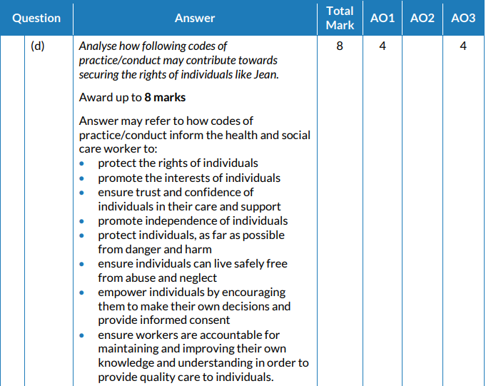
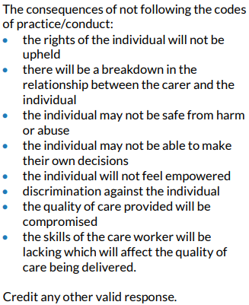
Question 1 (d), AO1 and AO3 mark scheme
You are looking at demonstrating two skills in this response.
Look at your answers and underline anything in your answer that is in these lists or anything else you feel is appropriate and deserves a mark under “Credit any other … ”
Notes:
Look at your answers and underline anything in your answer that is in these lists or anything else you feel is appropriate and deserves a mark under “Credit any other … ”
You are looking at demonstrating two skills in this response – as the marks are split across two assessment objectives.

Slide 16
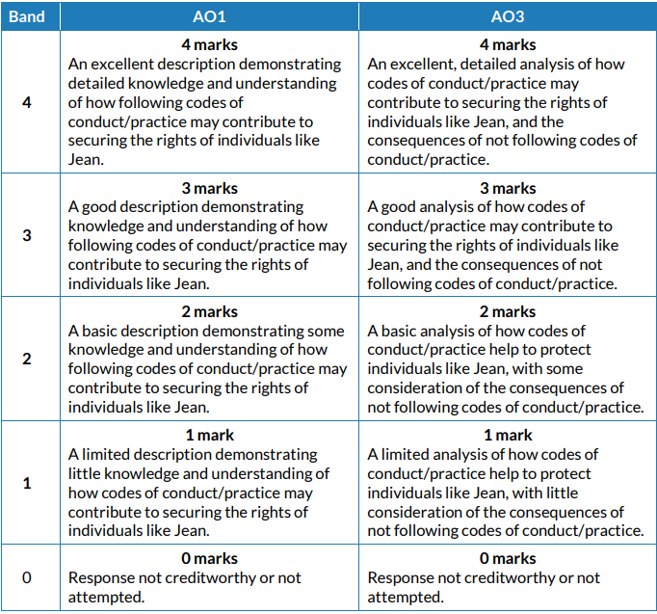
Question 1 (d), AO1 and AO3 mark bands
Look at the banded descriptors and what you have underlined and make a judgement, i.e. give yourself a mark for AO1 and AO2.
Add them together to give a total mark out of 8.
Notes:
Look at the banded descriptors and what you have underlined and make a judgement, i.e. give yourself a mark for AO1 and AO2.
Add them together to give a total mark out of 8.

Slide 17
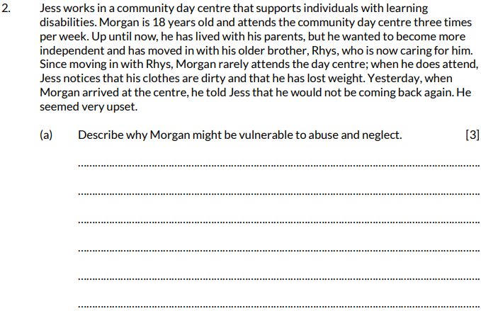
Question 2 (a), AO1
This question has a detailed rider – take care when reading it to stay focussed.
The command word here is ‘Describe’ – provide characteristics/main features or a brief account.
Notes:
Read the question.
This question has a detailed rider – take care when reading it to stay focussed.
The command word here is ‘ Describe’ – provide characteristics/main features or a brief account.

Slide 18
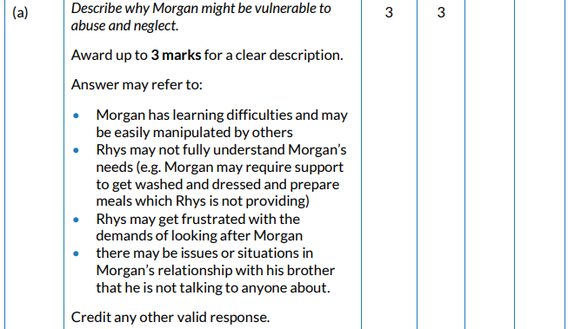
Question 2 (a) AO1 mark scheme
What we are looking for here is evidence that you can give a description and not just recall facts.
Look at your answers and underline anything that is in this list.
Award 1 mark for a basic description
2 marks for a satisfactory description and
3 marks for a good description
Notes:
What we are looking for here is evidence that you can give a description and not just recall facts.
Look at your answers and underline anything that is in this list.
Award 1 mark for a basic description
2 marks for a satisfactory description and
3 marks for a good description

Slide 19
Question 2 (b), AO1
The command word here is ‘Give’ – provide, name.
Read the question carefully. Here, you are being asked for examples in your answer.
Notes:
Read the question
The command word here is ‘Give’ – provide, name.
Read the question carefully. Here, you are being asked for examples in your answer.

Slide 20
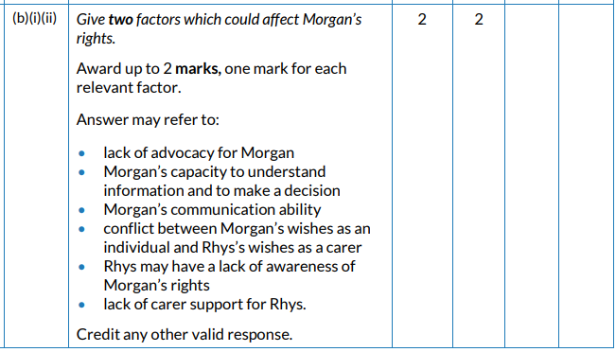
Question 2 (b) AO1 mark scheme
This mark scheme allows 1 mark per factor and, again, they can be from this list or any others you teacher confirms as correct – give yourself 0,1 or 2 marks.
Notes:
This mark scheme allows 1 mark per factor and, again, they can be from this list or any others you teacher confirms as correct – give yourself 0, 1 or 2 marks.

Slide 21
Question 2 (c), AO2
The command word here is ‘Explain’ – provide details and reasons for how and why something is the way it is.
Focus on Jess and Morgan throughout and try to give full responses.
Notes:
Read the question.
The command word here is ‘Explain’ – provide details and reasons for how and why something is the way it is.
Focus on Jess and Morgan throughout and try to give full responses.

Slide 22
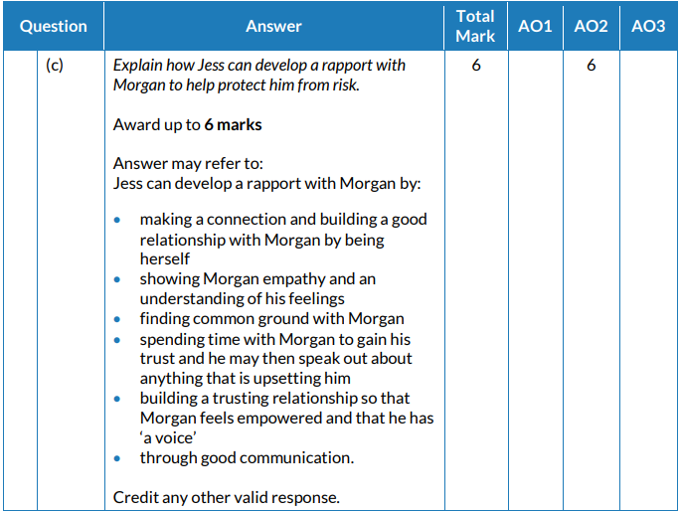
Question 2 (c) AO2 mark scheme
Look at your answers and underline anything in your answer that is in these lists or anything else you feel is appropriate and deserves a mark under “Credit any other … ”
Notes:
Look at your answers and underline anything in your answer that is in these lists or anything else you feel is appropriate and deserves a mark under “Credit any other … ”

Slide 23
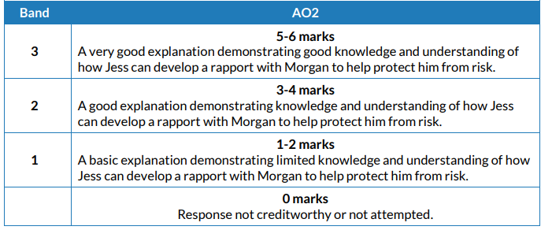
Question 2 (c) AO2 mark bands
Look at the banded descriptors and what you have underlined and make a judgement, i.e. give yourself a mark for AO2.
Notes:
Look at the banded descriptors and what you have underlined and make a judgement, i.e. give yourself a mark for AO2.

Slide 24
Question 2 (d), AO3
The command word here is ‘Discuss’ – examine an issue in detail in a structured way, taking into account different ideas.
The key word here in inclusion. Make sure you come up with realistic ideas and give examples to support your response.
You could start by stating what inclusion means to help focus your response.
Notes:
Read the question
The command word here is ‘Discuss’ – examine an issue in detail in a structured way, taking into account different ideas.
The key word here in inclusion. Make sure you come up with realistic ideas and give examples to support your response.
You could start by stating what inclusion means to help focus your response.

Slide 25
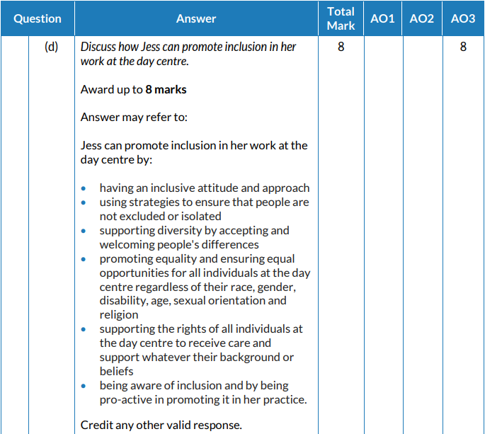
Question 2 (d) AO3 mark scheme
Look at your answers and underline anything in your answer that is in these lists or anything else you feel is appropriate and deserves a mark under “Credit any other … “
Notes:
Look at your answers and underline anything in your answer that is in these lists or anything else you feel is appropriate and deserves a mark under “Credit any other … ”

Slide 26
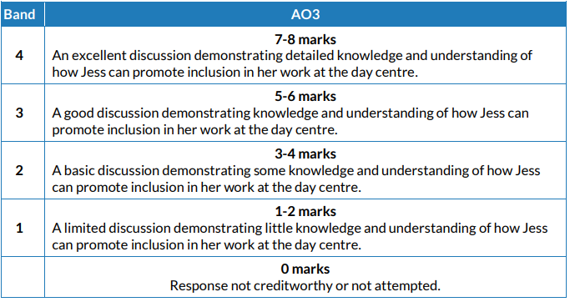
Question 2 (d) AO3 mark bands
Look at the banded descriptors and what you have underlined and make a judgement, i.e. give yourself a mark out of 8 for AO3.
Your teacher can advise if you are between bands.
Notes:
Look at the banded descriptors and what you have underlined and make a judgement, i.e. give yourself a mark for AO3.
Your teacher can advise if you are between bands.

Slide 27
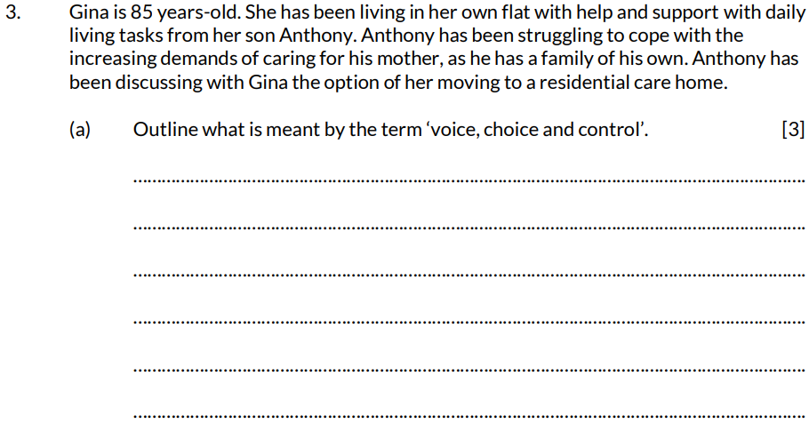
Question 3 (a), AO1
Remember: reading the rider will set the scene.
The command word here is ‘Outline’ – set out the main points/ provide a brief description or main characteristics.
Try and address all three key words.
Notes:
Read the question.
Remember: reading the rider will set the scene.
The command word here is ‘Outline’ – set out the main points/provide a brief description or main characteristics.
Try and address all three key words in the number of lines.

Slide 28
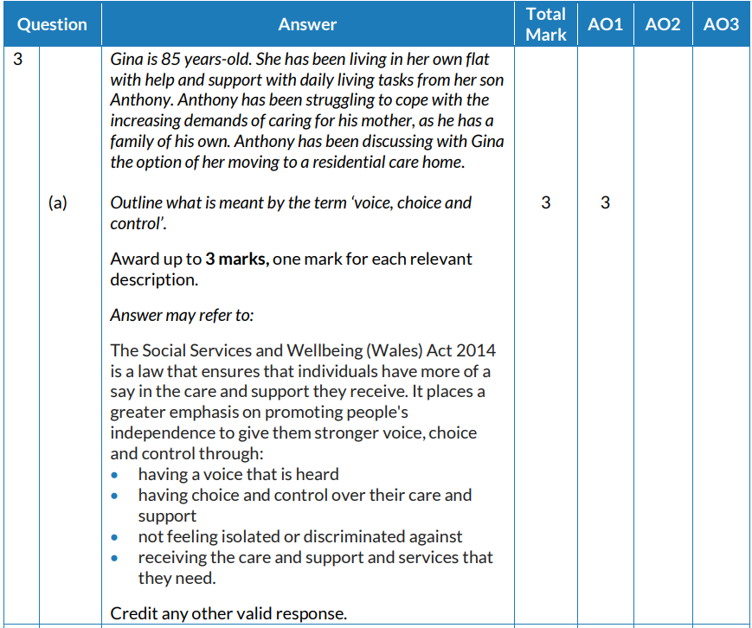
Question 3 (a) AO1 mark scheme
Look at your answers and underline anything in your answer that is in these lists or anything else you feel is appropriate and deserves a mark under “Credit any other ... ”
Award 1 mark per point.
Notes:
This one is slightly easier to mark as it’s one mark for each correct point.
Again, look at your answers and underline anything in your answer that is in these lists or anything else you feel is appropriate and deserves a mark under “Credit any other ... ”
Award 1 mark per point up to a maximum of 3 marks.

Slide 29
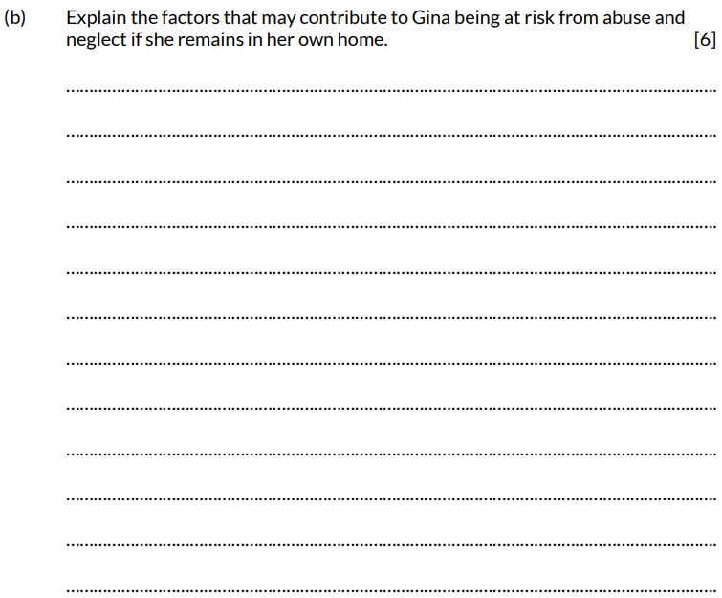
Question 3 (b), AO2
The command word here is ‘Explain’ – provide details and reasons for how and why something is the way it is.
6 marks are available here. Try to explain a number of factors –remember, it’s not a list we need, it’s extended writing.
The command word here is ‘Explain’ – provide details and reasons for how and why something is the way it is.
5 marks are available here. Do not just describe multi-agency working; provide details and reasons.
Notes:
Read the question
The command word here is ‘Explain’ – provide details and reasons for how and why something is the way it is.
6 marks are available here. Try to explain a number of factors – remember, it’s not a list we need, it’s extended writing.

Slide 30
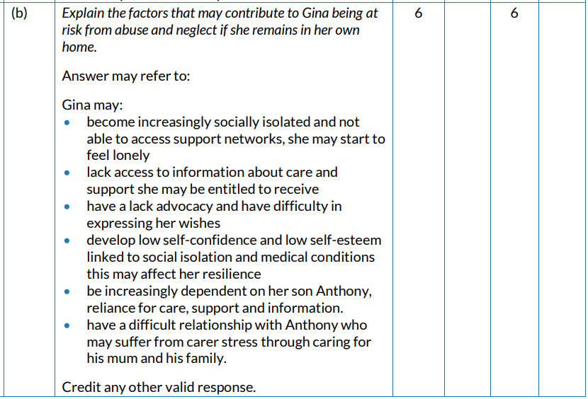
Question 3 (b) AO2 mark scheme
Look at your answers and underline anything in your answer that is in the lists or anything else you feel is appropriate and deserves a mark under “Credit any other ... ”
This will then help you award a mark as, for this type of question, it’s not 1 mark per point.
Notes:
Look at your answers and underline anything in your answer that is in the lists or anything else you feel is appropriate and deserves a mark under “Credit any other … ”
This will then help you award a mark as, for this type of question, it’s not 1 mark per point.

Slide 31
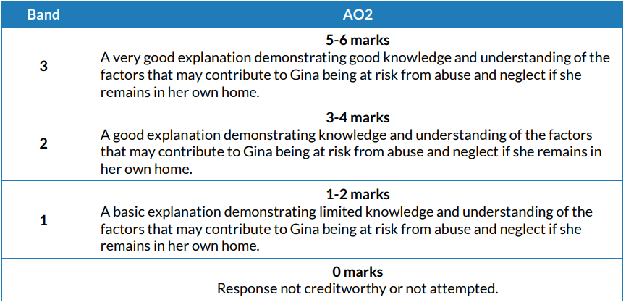
Question 3 (b) AO2 mark bands
Look at the banded descriptors and what you have underlined and make a judgement, i.e. give yourself a mark out of 6 for AO2.
Your teacher can advise if you are between bands.
Notes:
Look at the banded descriptors and what you have underlined and make a judgement, i.e. give yourself a mark out of 6 for AO2.
Your teacher can advise if you are between bands.

Slide 32
Question 3 (c), AO3
The command word here is ‘Evaluate’ – make sure you give some judgements in the response and qualify them.
8 marks are available here, so we are looking for you to apply your knowledge of how the inspectorate system works.
Notes:
Read the question
The command word here is ‘Evaluate’ – make sure you give some judgements in the response and qualify them.
8 marks are available here, so we are looking for you to apply your knowledge of how the inspectorate system works.

Slide 33
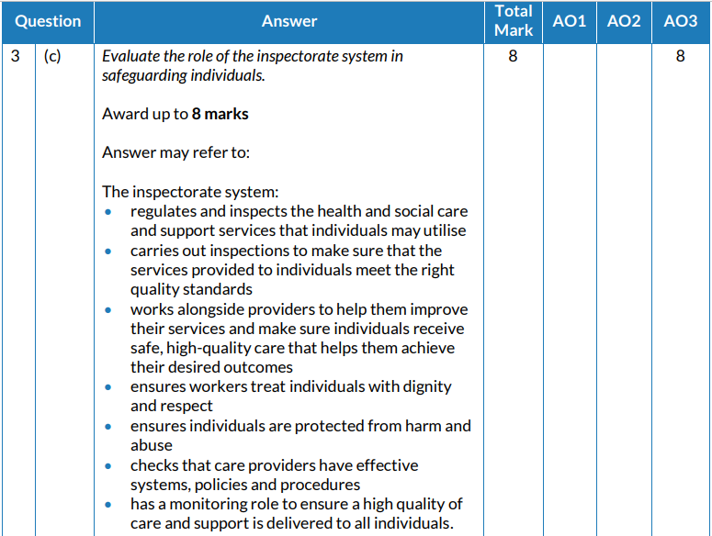
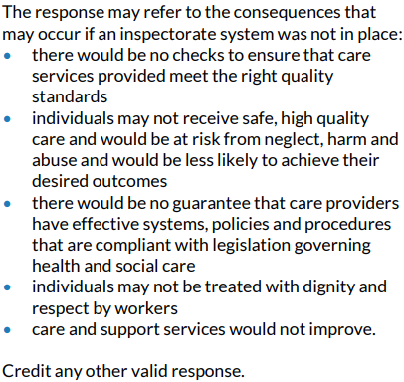
Question 3 (c) AO3 mark scheme
Look at your answers and underline anything in your answer that is in the lists or anything else you feel is appropriate and deserves a mark under “Credit any other ... ”
This will then help you award a mark as, for this type of question, it’s not 1 mark per point.
Notes:
Look at your answers and underline anything in your answer that is in the lists or anything else you feel is appropriate and deserves a mark under “Credit any other ... ”
This will then help you award a mark as, for this type of question, it’s not 1 mark per point.

Slide 34
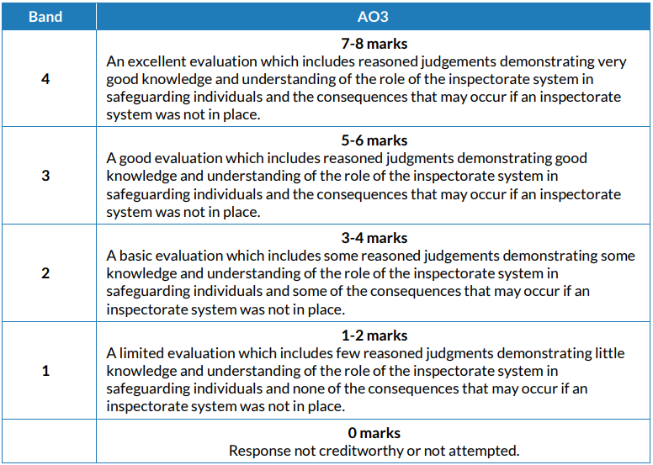
Question 3 (c) AO3 mark bands
Look at the banded descriptors and what you have underlined and make a judgement, i.e. give yourself a mark out of 8 for AO2.
Your teacher can advise if you are between bands.
Notes:
Look at the banded descriptors and what you have underlined and make a judgement, i.e. give yourself a mark out of 6 for AO2.
Your teacher can advise if you are between bands.

Slide 35
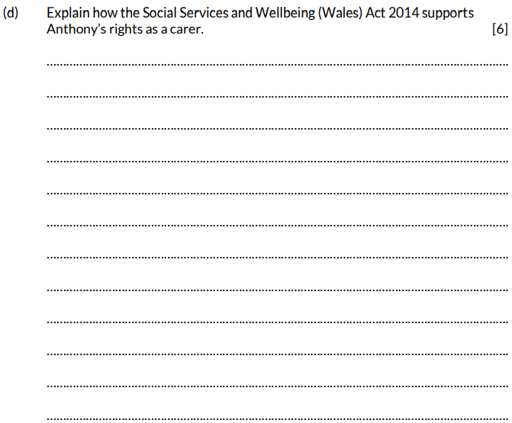
Question 3 (d), AO2
The command word here is ‘Explain’ – provide details and reasons for how and why something is the way it is.
6 marks are available here. Try to explain as fully as possible: remember, it’s not a list we need, it’s extended writing.
Notes:
Read the question.
The command word here is ‘Explain’ – provide details and reasons for how and why something is the way it is.
6 marks are available here. Try to explain a number of factors – remember, it’s not a list we need, it’s extended writing.

Slide 36
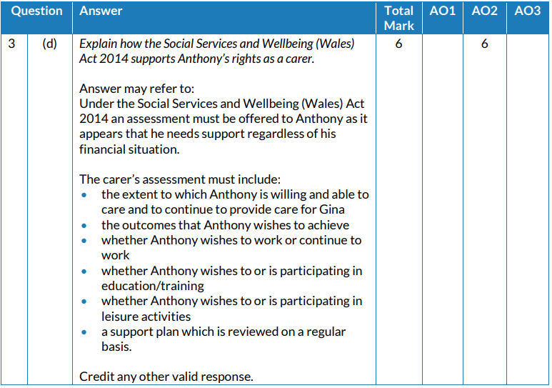
Question 3 (d) AO2 mark scheme
Look at your answers and underline anything in your answer that is in the lists or anything else you feel is appropriate and deserves a mark under “Credit any other ... ”
This will then help you award a mark as, for this type of question, it’s not 1 mark per point.
Notes:
Look at your answers and underline anything in your answer that is in the lists or anything else you feel is appropriate and deserves a mark under “Credit any other ... ”
This will then help you award a mark as, for this type of question, it’s not 1 mark per point.

Slide 37
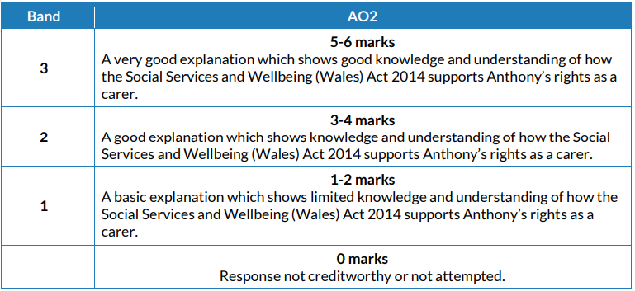
Question 3 (d) AO2 mark bands
Look at the banded descriptors and what you have underlined and make a judgement, i.e. give yourself a mark out of 6 for AO2.
Your teacher can advise if you are between bands.
Notes:
Look at the banded descriptors and what you have underlined and make a judgement, i.e. give yourself a mark out of 6 for AO2.
Your teacher can advise if you are between bands.

Slide 38
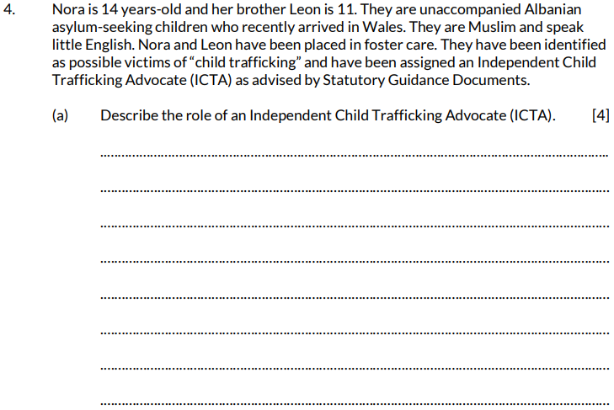
Question 4 (a), AO1
The command word here is ‘Describe’ so you need to give specific information.
4 marks are available here. Try to explain a number of duties of the ICTA – remember, it’s not a list we need, it’s extended writing.
Notes:
Read out the question.
The command word here is ‘Describe’ so you need to give specific information.
4 marks are available here. Try to explain a number of duties of the ICTA – remember, it’s not a list we need, it’s extended writing.

Slide 39
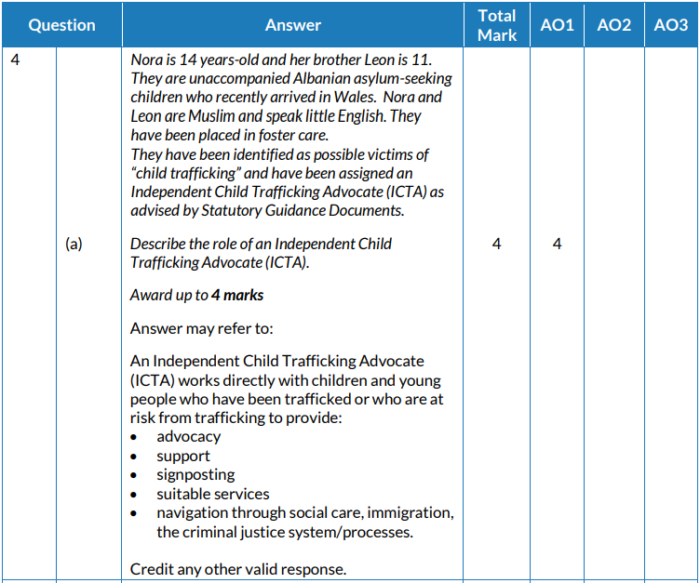
Question 4 (a) AO1 mark scheme
What we are looking for here is evidence that you can give a description and not just recall facts.
Look at your answers and underline anything that is in this list.
Award 1 mark for a basic description – e.g. may only refer to one or two points
2 marks for a satisfactory description – e.g. two or three points with some explanation
3 marks for a good description – e.g. three or four points with clear explanation
4 marks for an excellent description – e.g. would include all points listed and give lots of detail
Notes:
What we are looking for here is evidence that you can give a description and not just recall facts.
Look at your answers and underline anything that is in this list.
Award 1 mark for a basic description – e.g. may only refer to one or two points
2 marks for a satisfactory description – e.g. two or three points with some explanation
3 marks for a good description – e.g. three or four points with clear explanation
4 marks for an excellent description – e.g. would include all points listed and give lots of detail

Slide 40
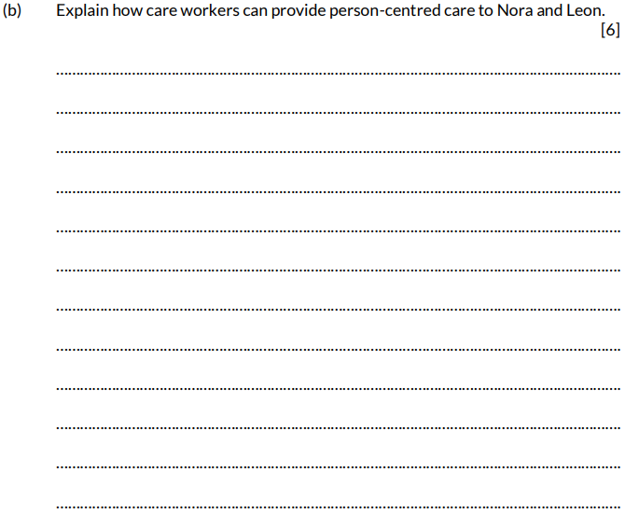
Question 4 (b), AO2
The command word here is ‘Explain’ – provide details and reasons for how and why something is the way it is.
6 marks are available here. Try and explain a number of ways the care workers can provide person centred care –remember, it’s not a list we need, it’s extended writing
Notes:
Read the question
The command word here is ‘Explain’ – provide details and reasons for how and why something is the way it is.
6 marks are available here. Try and explain a number of ways the care workers can provide person centred care – remember, it’s not a list we need, it’s extended writing.

Slide 41
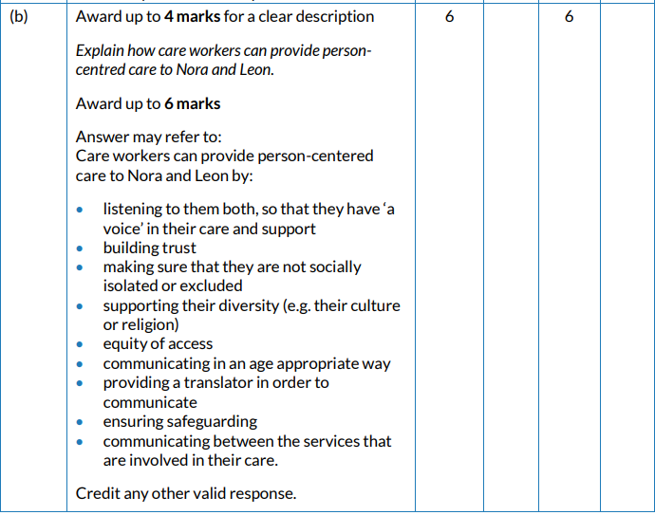
Question 4 (b) AO2 mark scheme
Look at your answers and underline anything in your answer that is in the lists or anything else you feel is appropriate and deserves a mark under “Credit any other ... ”
This will then help you award a mark as, for this type of question, it’s not 1 mark per point.
The mark bands are on the next slide to help you.
Notes:
Look at your answers and underline anything in your answer that is in the lists or anything else you feel is appropriate and deserves a mark under “Credit any other … ”
This will then help you award a mark , for this type of question, it’s not 1 mark per point. The mark bands are on the next slide to help you.

Slide 42
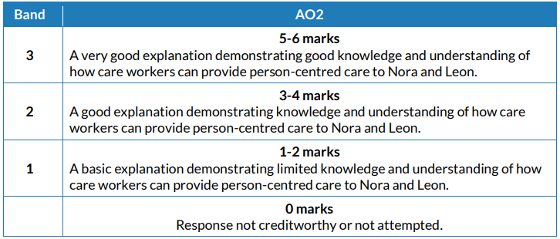
Question 4 (b) AO2 mark bands
Look at the banded descriptors and what you have underlined and make a judgement, i.e. give yourself a mark out of 6 for AO2.
Your teacher can advise if you are between bands, but also look back on the tips you’ve been given earlier.
Notes:
Look at the banded descriptors and what you have underlined and make a judgement, i.e. give yourself a mark out of 6 for AO2.
Your teacher can advise if you are between bands, but also look back on the tips you’ve been given earlier.

Slide 43
Question 4 (c), AO1 and AO3
The command word here is ‘Discuss’ so, again, we are looking for applied knowledge – refer to Nora and Leon.
8 marks are available here. Try to discuss positive and negative attitudes in your response – remember, it’s not a list we need, it’s extended writing.
Notes:
Read the question
The command word here is ‘Discuss’ so, again, we are looking for applied knowledge.
8 marks are available here. Try to discuss positive and negative attitudes in your response – remember, it’s not a list we need, it’s extended writing.

Slide 44
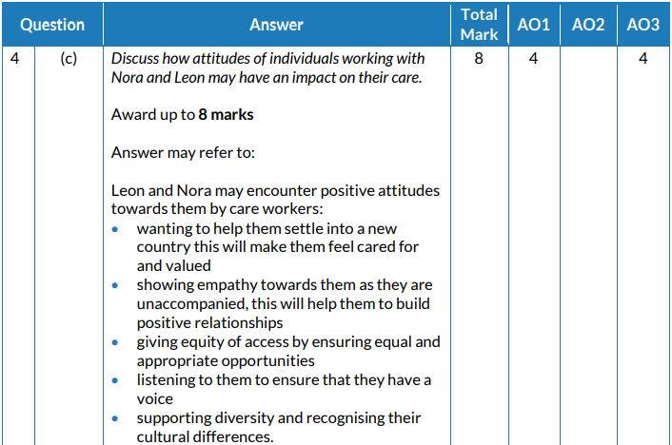
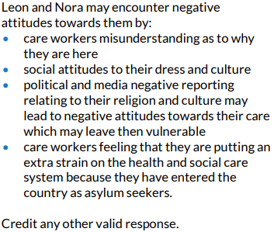
Question 4 (c) AO1 and AO3 mark scheme
Once again, look at your answers and underline anything in the lists or anything else you feel is appropriate and deserves credit (“Credit any other ... ”).
Here we are looking for recall of knowledge plus application – so marks can be given for factual statements and elaboration.
Notes:
Once again, look at your answers and underline anything in the lists or anything else you feel is appropriate and deserves credit (“Credit any other ... ”).
Here we are looking for recall of knowledge plus application – so marks can be given for factual statements and elaboration.

Slide 45
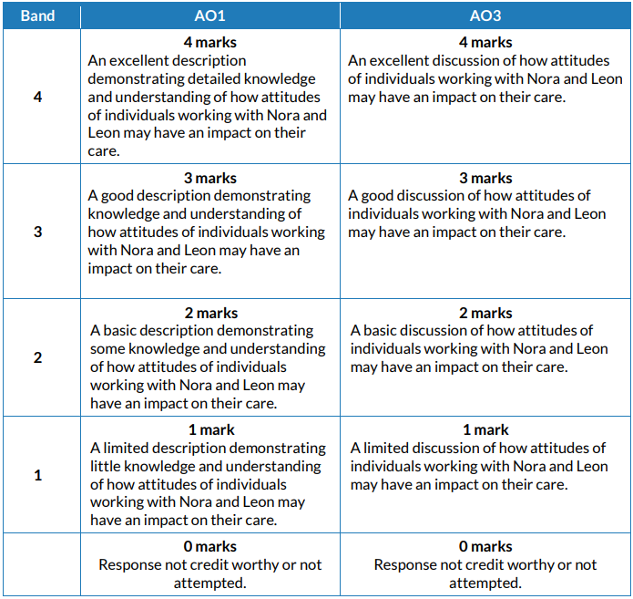
Question 4 (c) AO1 and AO3 mark bands
Look at the banded descriptors and what you have underlined and make a judgement, i.e. give yourself a mark for AO1 and AO3.
Add them together to give a total mark out of 8.
Notes:
Look at the banded descriptors and what you have underlined and make a judgement, i.e. give yourself a mark for AO1 and AO3.
Add them together to give a total mark out of 8.

Slide 46
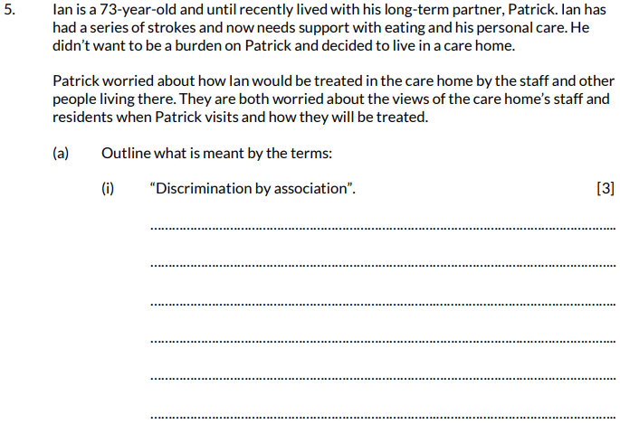
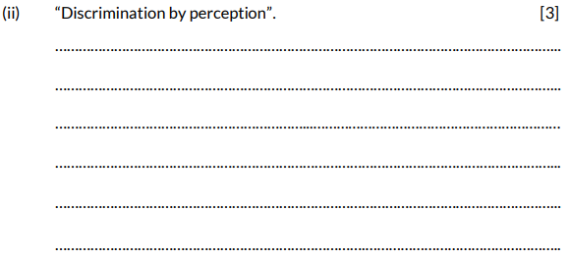
Question 5 (a), AO1
Again, the rider is intended to set the scene.
The command word here is ‘Outline’ – set out the main points/ provide a brief description or main characteristics.
Make sure the responses for (i) and (ii) are not confused.
Notes:
Read the question.
Again, the rider is intended to set the scene.
The command word here is ‘Outline’ – set out the main points/provide a brief description or main characteristics.
Make sure the responses for (i) and (ii) are not confused.

Slide 47
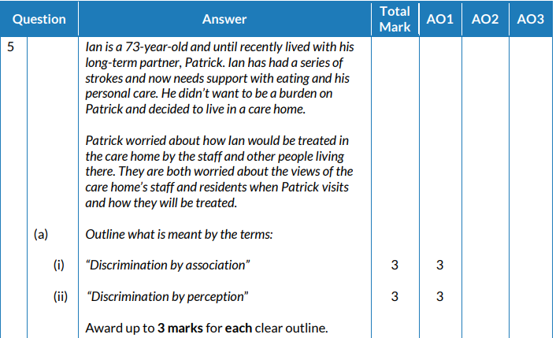
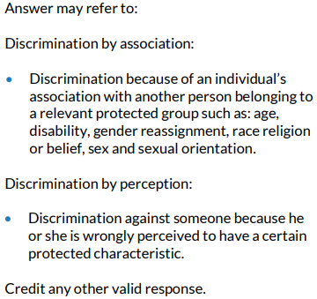
Question 5 (a) AO1 mark scheme
Look at your answers.
Remember you can award yourself up to 3 marks per outline – use the guidance below:
Award 1 mark for a basic outline
2 marks for a satisfactory outline
3 marks for a very good, clear outline – very close to the definition in the mark scheme.
Notes:
Look at your answers.
Remember you can award yourself up to 3 marks per outline – use the guidance below:
Award 1 mark for a basic outline
2 marks for a satisfactory outline
3 marks for a very good, clear outline – very close to the definition in the mark scheme.

Slide 48
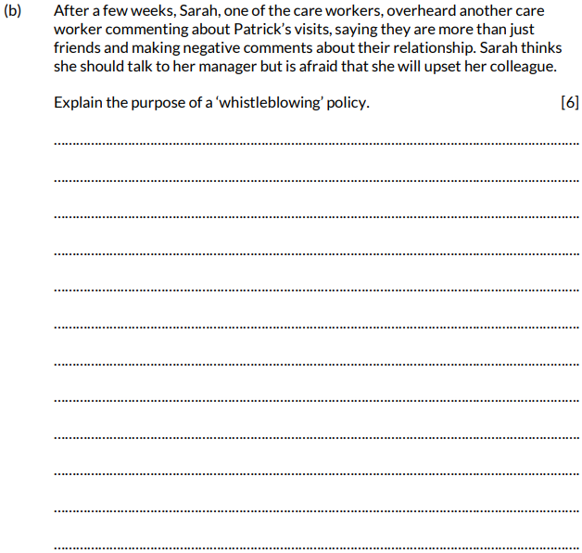
Question 5 (b), AO2
The command word here is ‘Explain’ – provide details and reasons for how and why something is the way it is.
6 marks are available here. Try and explain a number of factors – remember, it’s not a list we need, it’s extended writing.
Notes:
Read the question.
The command word here is ‘Explain’ – provide details and reasons for how and why something is the way it is.
6 marks are available here. Try and explain a number of factors – remember, it’s not a list we need, it’s extended writing.

Slide 49
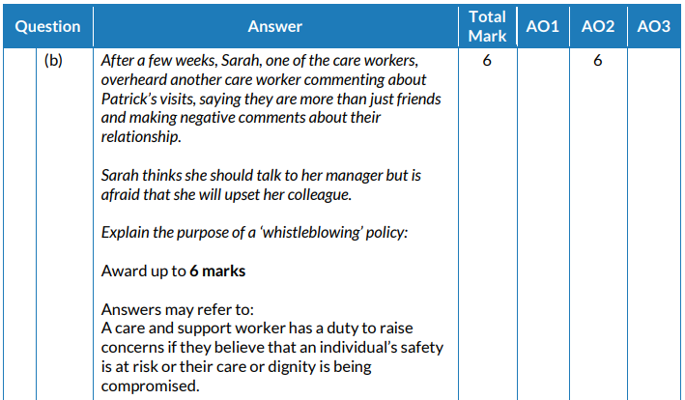
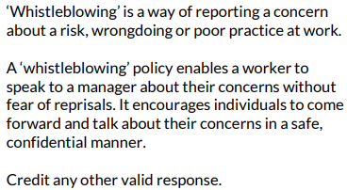
Question 5 (b) AO2 mark scheme
Look at your answers and underline anything in your answer that is in the lists or anything else you feel is appropriate and deserves a mark under “Credit any other ... ”
This will then help you award a mark as, for this type of question, it’s not 1 mark per point.
Notes:
Look at your answers and underline anything in your answer that is in the lists or anything else you feel is appropriate and deserves a mark under “Credit any other ... ”
This will then help you award a mark as, for this type of question, it’s not 1 mark per point.

Slide 50
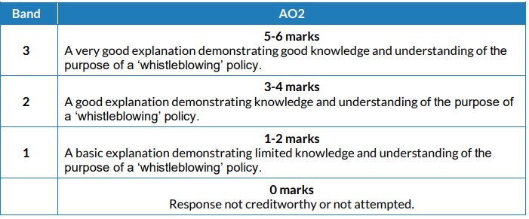
Question 5 (b) AO2 mark bands
Look at the banded descriptors and what you have underlined and make a judgement, i.e. give yourself a mark out of 6 for AO2.
Your teacher can advise if you are between bands.
Notes:
Look at the banded descriptors and what you have underlined and make a judgement, .ie. give yourself a mark out of 6 for AO2.
Your teacher can advise if you are between bands.

Slide 51
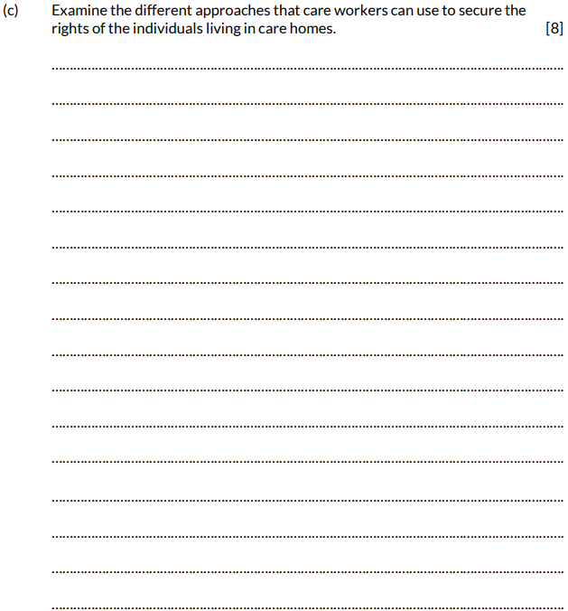
Question 5 (c), AO3
The command word here is ‘Examine’ – investigate closely and in detail.
This is a high tariff question. Plan your answer carefully.
Key words: ‘different approaches’, ‘secure rights’, ‘individuals in care homes’.
Notes:
Read the question
The command word here is ‘Examine’ – investigate closely and in detail.
This is a high tariff question. Plan your answer carefully.
Key words: ‘different approaches’, ‘secure rights’, ‘individuals in care homes’.

Slide 52
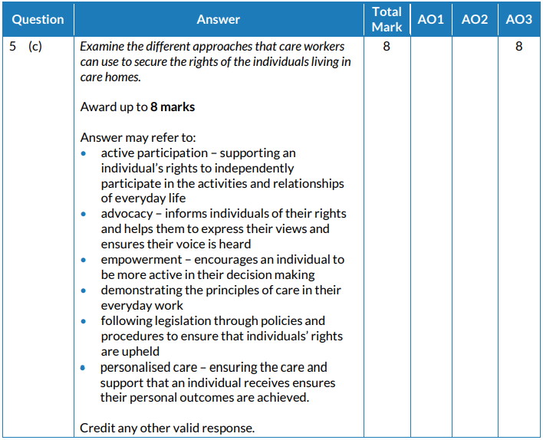
Question 5 (c) AO3 mark scheme
Look at your answers and underline anything in your answer that is in the lists or anything else you feel is appropriate and deserves a mark under “Credit any other … ”
This will then help you award a mark as, for this type of question, it’s not 1 mark per point.
We are looking for application of knowledge through extended writing.
Notes:
Look at your answers and underline anything in your answer that is in the lists or anything else you feel is appropriate and deserves a mark under “Credit any other … ”
This will then help you award a mark as, for this type of question, it’s not 1 mark per point.
We are looking for application of knowledge through extended writing.

Slide 53
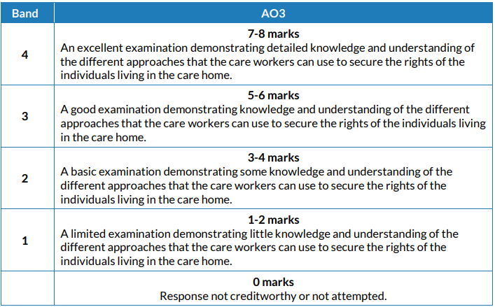
Question 5 (c) AO3 mark bands
Look at the banded descriptors and what you have underlined and make a judgement, i.e. give yourself a mark out of 8 for AO3.
Your teacher can advise if you are between bands.
Notes:
Look at the banded descriptors and what you have underlined and make a judgement, i.e. give yourself a mark out of 8 for AO3.
Your teacher can advise if you are between bands.

Slide 54
How did you do?
Well done – you have made it to the end of the paper.
You should now be able to give yourself a mark out of 100.
As there are no previous examinations from which to give you an indication of how you would have achieved, it is best to be guided by the UMS scale as detailed in this slide to get an approximate grade for your hard work.
Remember to double your mark – so, if you had 60/100, that x 2 would be 120 UMS – which would equate to a Grade C.
Total UMS | A | B | C | D | E
200 | 160 | 140 | 120 | 100 | 80
Notes:
Well done – you have made it to the end of the paper.
You should now be able to give yourself a mark out of 100.
As there are no previous examinations from which to give you an indication of how you would have achieved, it is best to be guided by the UMS scale as detailed in this slide to get an approximate grade for your hard work.
Remember to double your mark – so, if you had 60/100, that x 2 would be 120 UMS – which would equate to a Grade C.

Slide 55
Any questions?
Do you have any further questions about this exam?
If so, write them on a Post-It note and stick it to the front of your paper to give to your teacher.

