Slide 1
Online Exam Review
Level 2 Health and Social Care: Principles and Contexts
Unit 1: Promoting health and well-being throughout the life stages (January 2021)

Slide 2
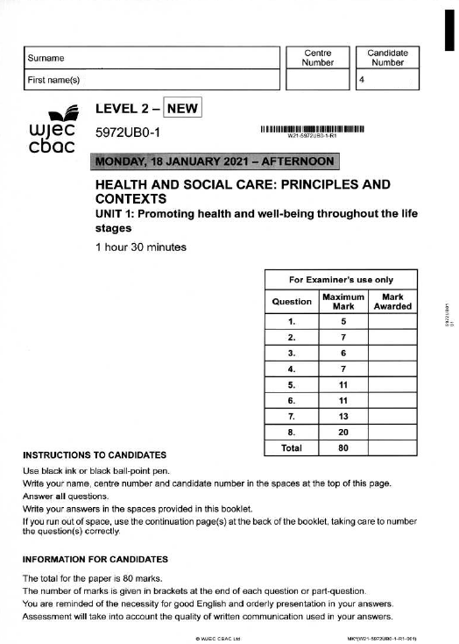
Unit 1: Promoting health and well-being throughout the life stages
Online examination review (OER)

Slide 3
General points on exam technique
Read through the whole question before starting to answer. This will help you understand what is required of you.
Use a highlighter to pick out key words.
Look at the command words and the number of marks available for each question, they will help you decide how much detail is needed.
If a word is bold, it is important.
Keep your exam paper open at the double page spread, do not fold it in half.
Read your answers to check they make sense.

Slide 4
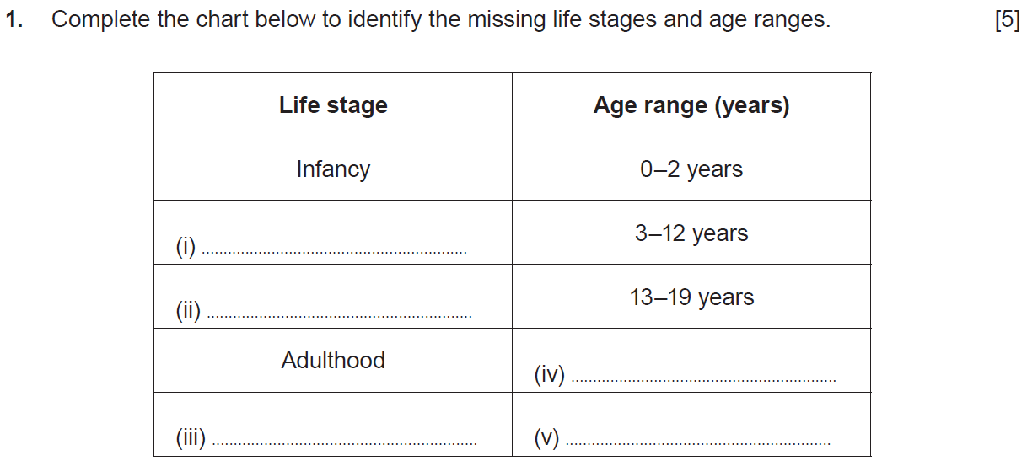
Question 1

Slide 5
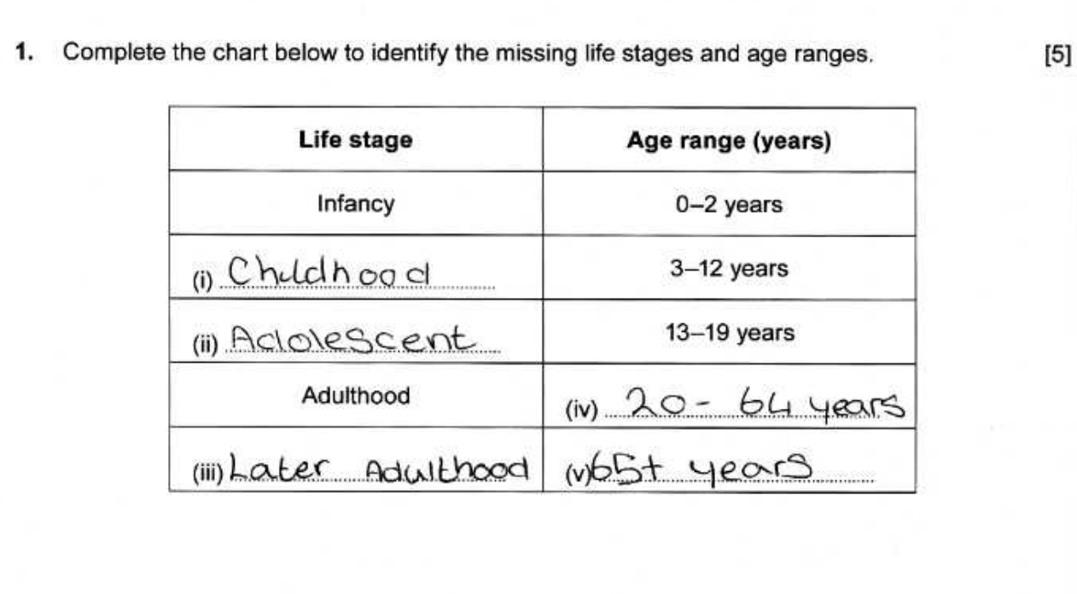
Question 1 candidate 1 answer

Slide 6
Question 1 candidate 1 answer with examiner’s comments
This candidate lost 1 mark for (ii) –
the correct term for this life stage
is adolescence; an adolescent is
a person, not a life stage.
Total marks awarded
4/5

Slide 7
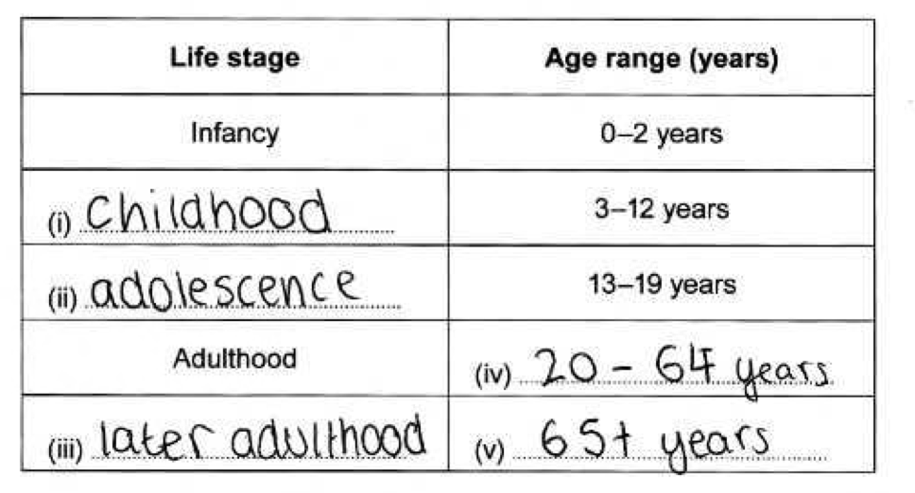
Question 1 candidate 2 answer

Slide 8
Question 1 candidate 2 answer with examiner’s comments
This candidate scored 5 marks for
correctly identifying the life stages
and age range.
Total marks awarded
5/5
Most candidates were able to correctly identify the life stages.

Slide 9
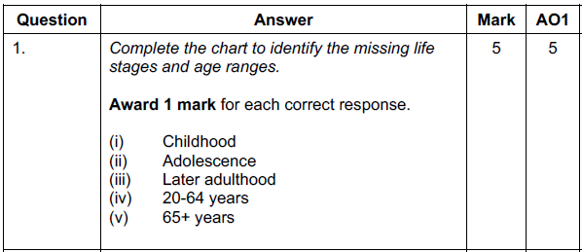
Question 1 mark scheme

Slide 10
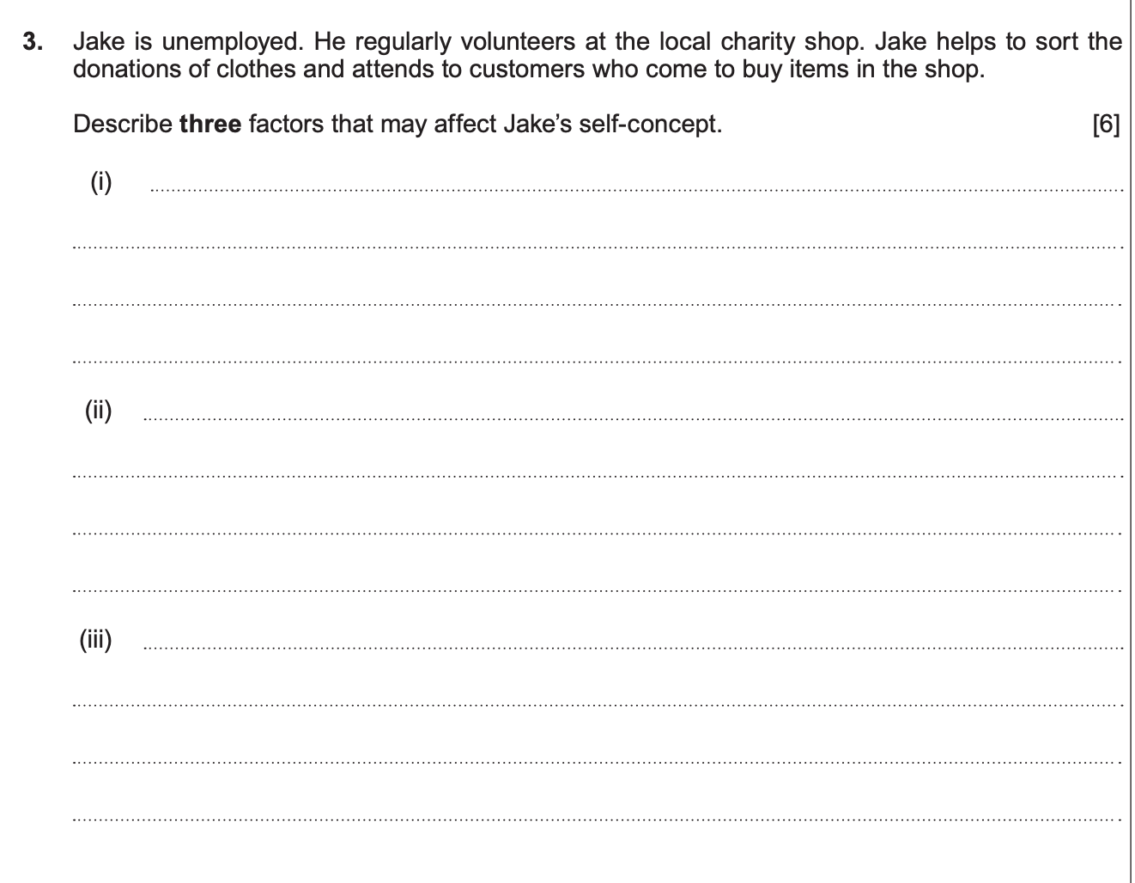
Question 3

Slide 11
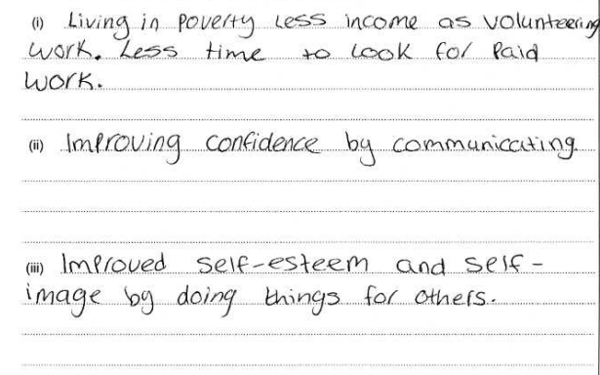
Question 3 candidate 1 answer

Slide 12
Question 3 candidate 1 answer with examiner’s comments
The response makes no link with
self concept.
0 marks
This response lacks description.
For 2 marks, a link to relationships
or socialisation is required
This is a good response,
worthy of the full 2 marks.
Clear link between self-esteem and
helping others.
This question links to topic area 1.3 in specification. The question requires candidates to describe how current circumstances may affect Jake’s view of himself.
Total marks awarded
3/6

Slide 13
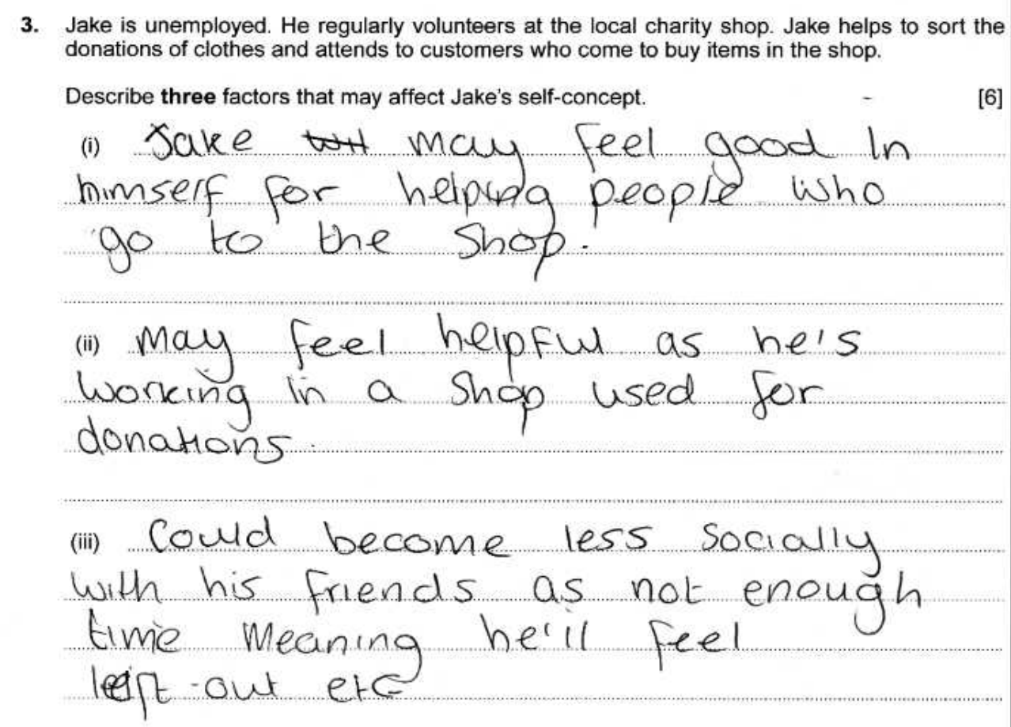
Question 3 candidate 2 answer

Slide 14
Question 3 candidate 2 answer with examiner’s comments
.
The candidate has shown some understanding of self-concept factors.
Clearly describes how he views himself, showing understanding.
(ii) (iii) Responses are basic, lacking accurate descriptions of self- concept.
Total marks awarded
4/6

Slide 15
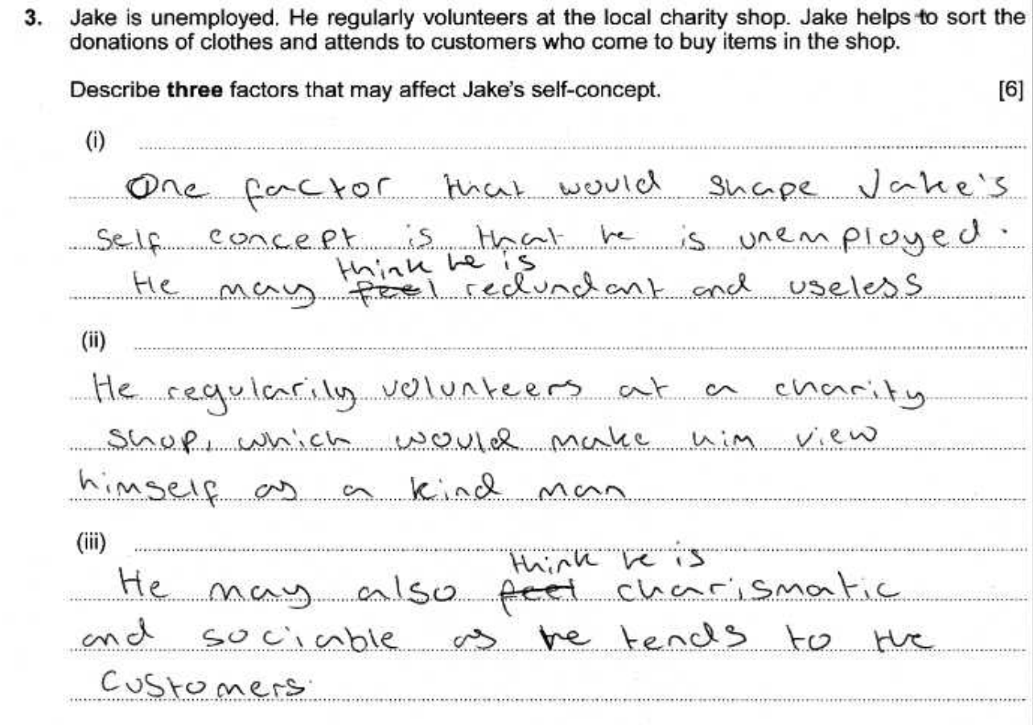
Question 3 candidate 3 answer

Slide 16
Question 3 candidate 3 answer with examiner’s comments
This candidate has shown a good understanding of self-concept, describing in detail the view Jake has of himself.
Total marks awarded
6/6

Slide 17
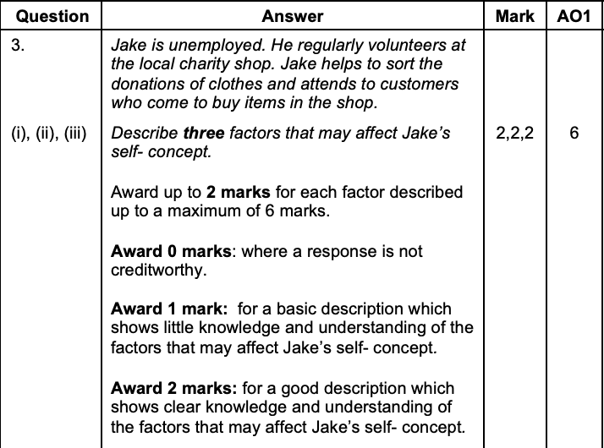
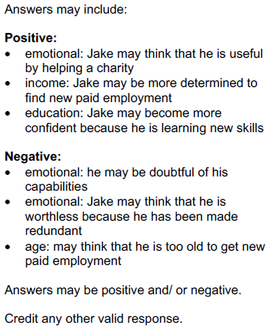
Question 3 mark scheme

Slide 18
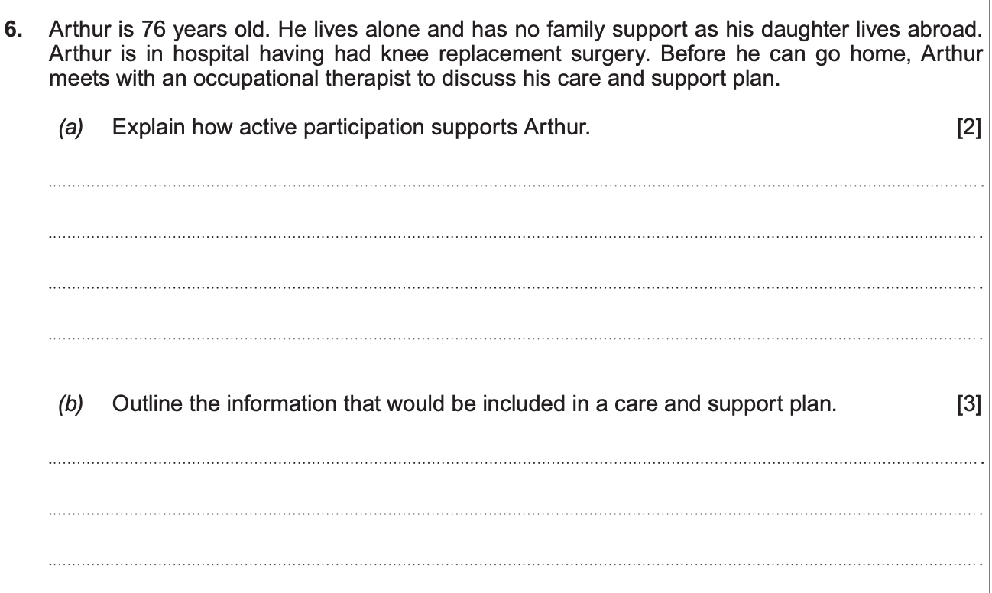
Question 6 (a) (b)

Slide 19
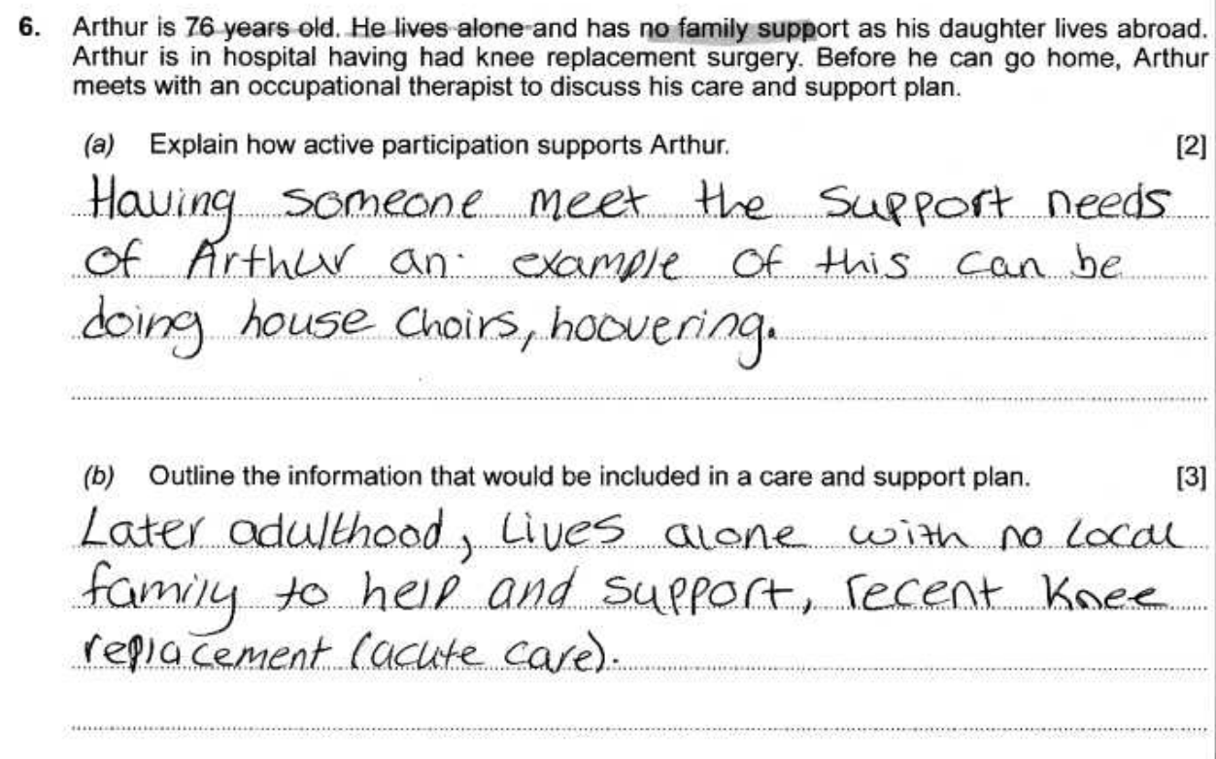
Question 6 (a) (b) candidate 1 answer

Slide 20
Question 6 (a) (b) candidate 1 answer with examiner’s comments
The answer briefly explains the role of a care worker, not active participation: Arthur being at the centre of the plan, identifying his choices, priorities and goals.
0 marks awarded.
This question is asking what is in a care plan. This is a basic response with vague reference to Arthur’s current circumstances only.
1 mark awarded.
Total marks awarded
1/5

Slide 21
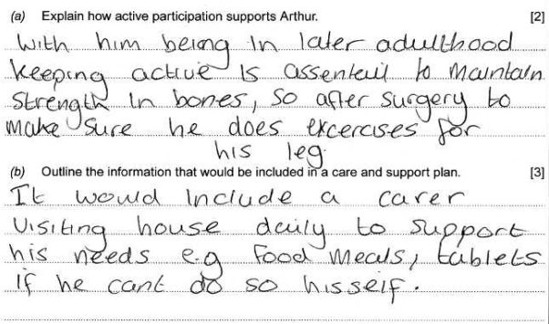
Question 6 (a) (b) candidate 2 answer

Slide 22
Question 6 (a) (b) candidate 2 answer with examiner’s comments
No credit for this response, as the
candidate has not explained
active participation
A basic response that outlines limited
information that may be included
Candidates were mostly able to outline the need and some information included in a care plan, marks were lost for not explaining the importance for Arthur to be included and his opinion valued in the care package.
Total marks awarded
1/5

Slide 23
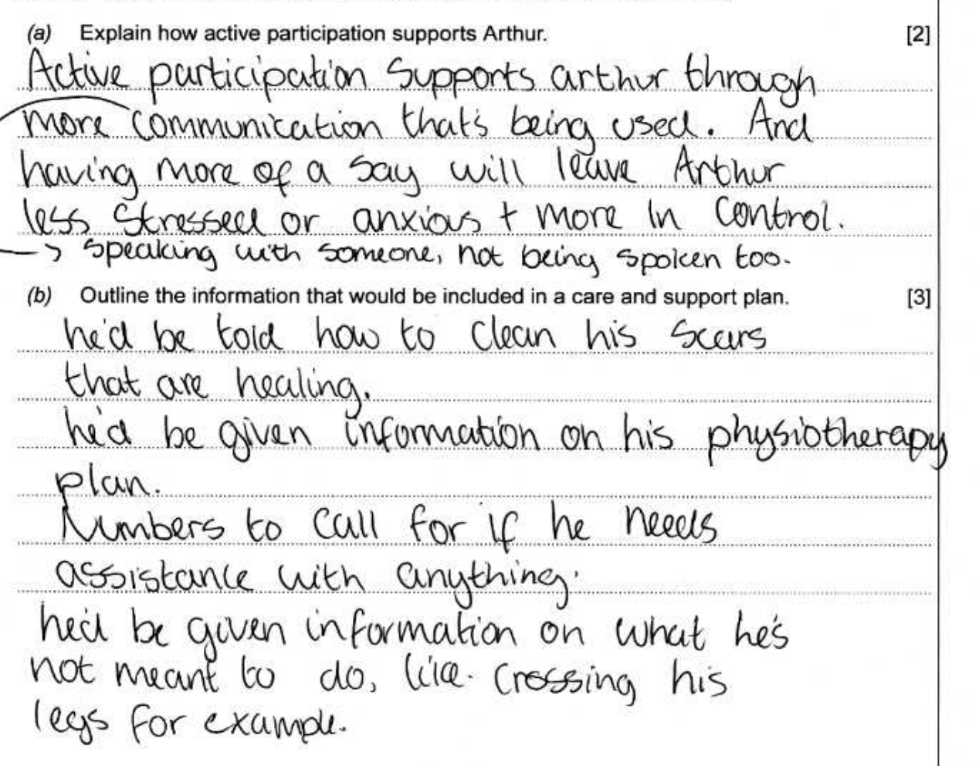
Question 6 (a) (b) candidate 3 answer

Slide 24
Question 6 (a) (b) candidate 3 answer with examiner’s comments
A detailed answer, clearly explaining that Arthur will have a voice in his care, which will provide him with autonomy and dignity.
2 marks awarded.
This question is asking for information that would be included in a care plan, and the candidate has outlined a range of information, including guidance for Arthur to manage his wounds and
details of the tertiary services involved in his care. Personal details, e.g. name and date of birth would also be credited.
3 marks awarded.
Total marks awarded
5/5

Slide 25
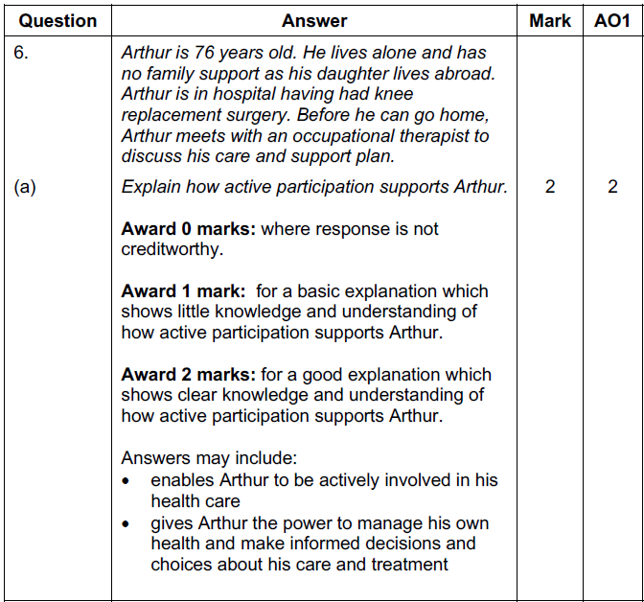
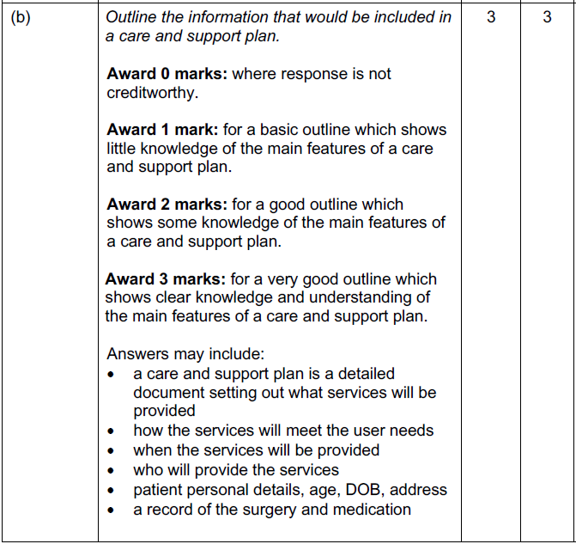
Question 6 (a) (b) mark scheme

Slide 26
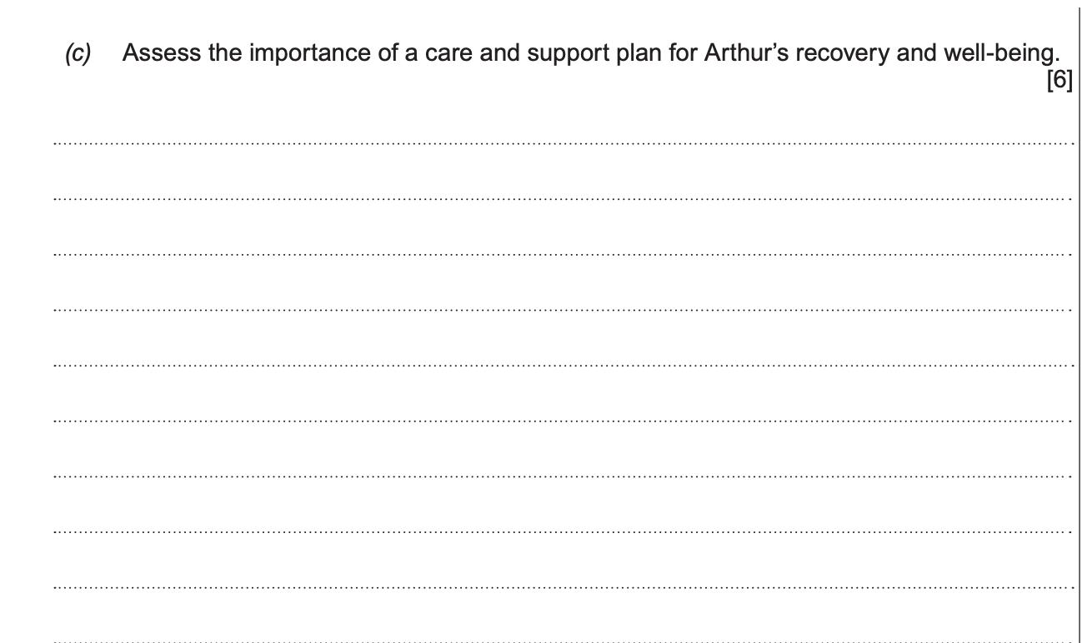
Question 6 (c)

Slide 27
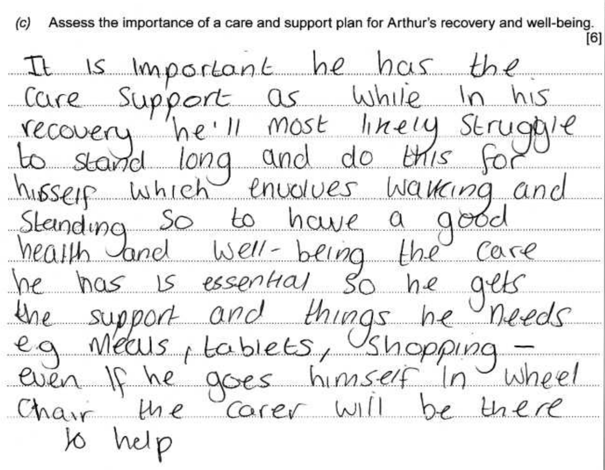
Question 6 (c) candidate 1 answer

Slide 28
Question 6 (c) candidate 1 answer with examiner’s comments
The candidate has focused on the content of a care and support plan, with limited assessment of why the plan is important for Arthur.
Total marks awarded
2/6

Slide 29
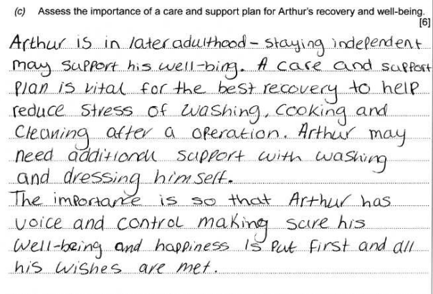
Question 6 (c) candidate 2 answer

Slide 30
Question 6 (c) candidate 2 answer with examiner’s comments
A good response, showing
understanding of the importance of a
care and support plan to assist
with Arthur’s independence.
Total marks awarded
3/5

Slide 31
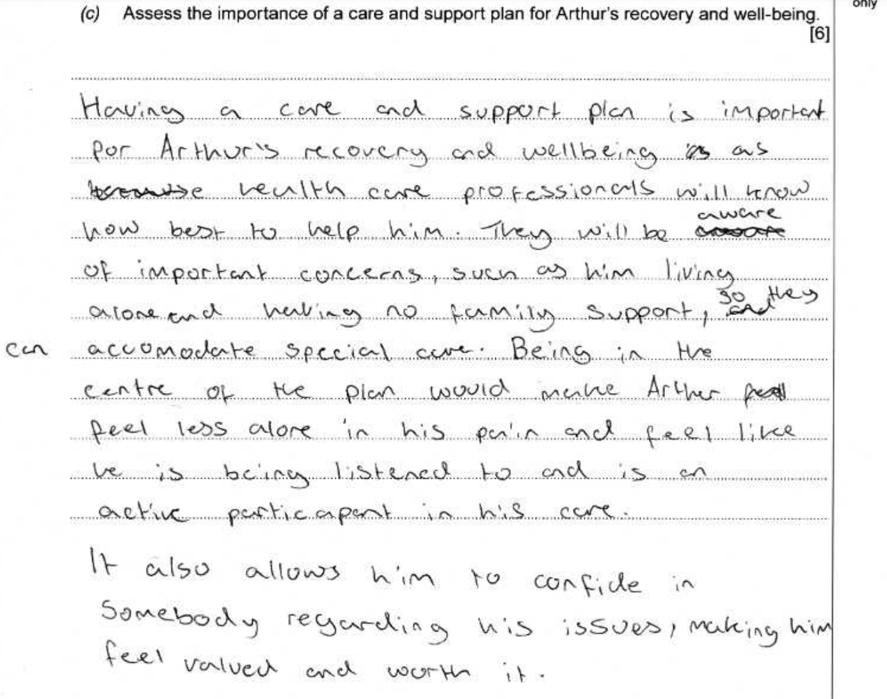
Question 6 (c) candidate 3 answer

Slide 32
Question 6 (c) candidate 3 answer with examiner’s comment
This is a very good response – a clear assessment, showing detailed knowledge and understanding of why a care and support plan is important for Arthur.
Total marks awarded
6/6

Slide 33
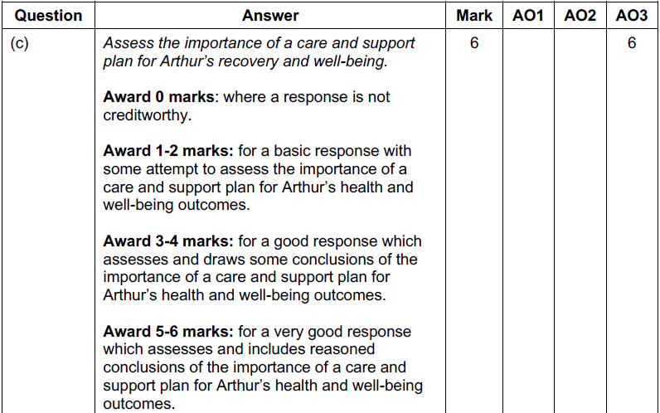
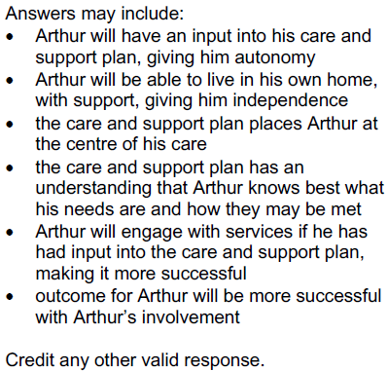
Question 6 (c) mark scheme

Slide 34
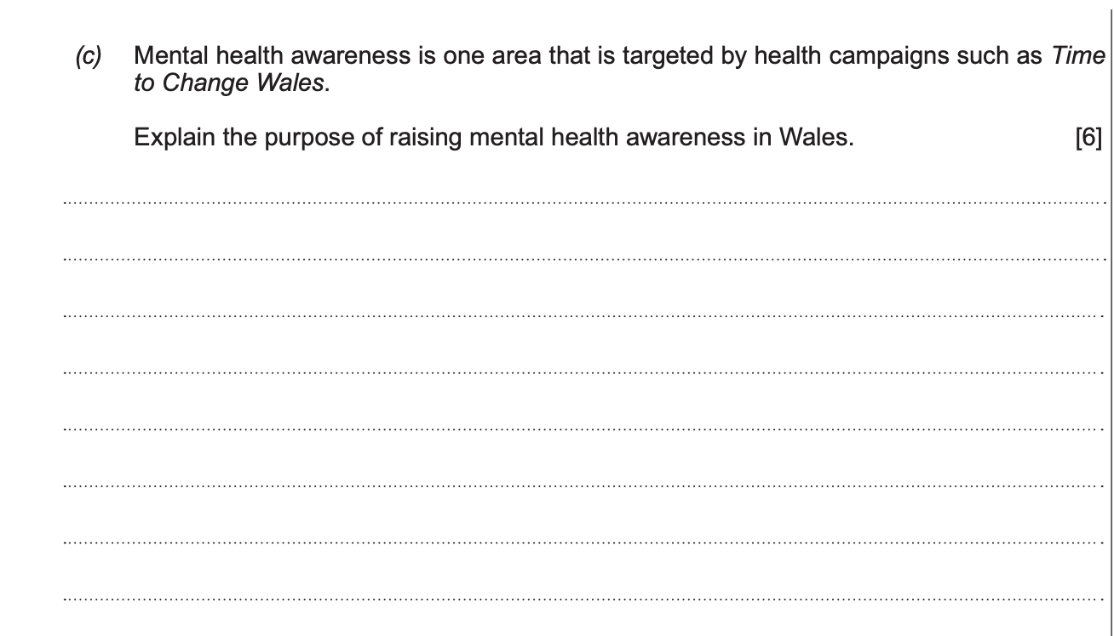
Question 8 (c)

Slide 35
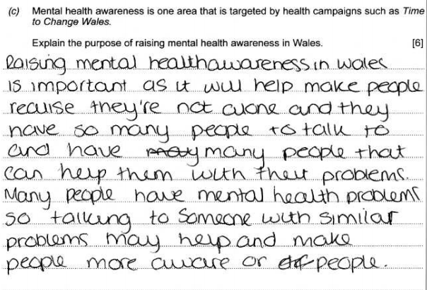
Question 8 (c) candidate 1 answer

Slide 36
Question 8 (c) candidate 1 answer with examiner’s comments
The response explains the purpose of campaigns in raising awareness of support for individuals living with mental health. The response is repetitive, and the candidate does not address the importance of raising awareness and changing attitudes towards mental health in society.
Total marks awarded
2/6

Slide 37
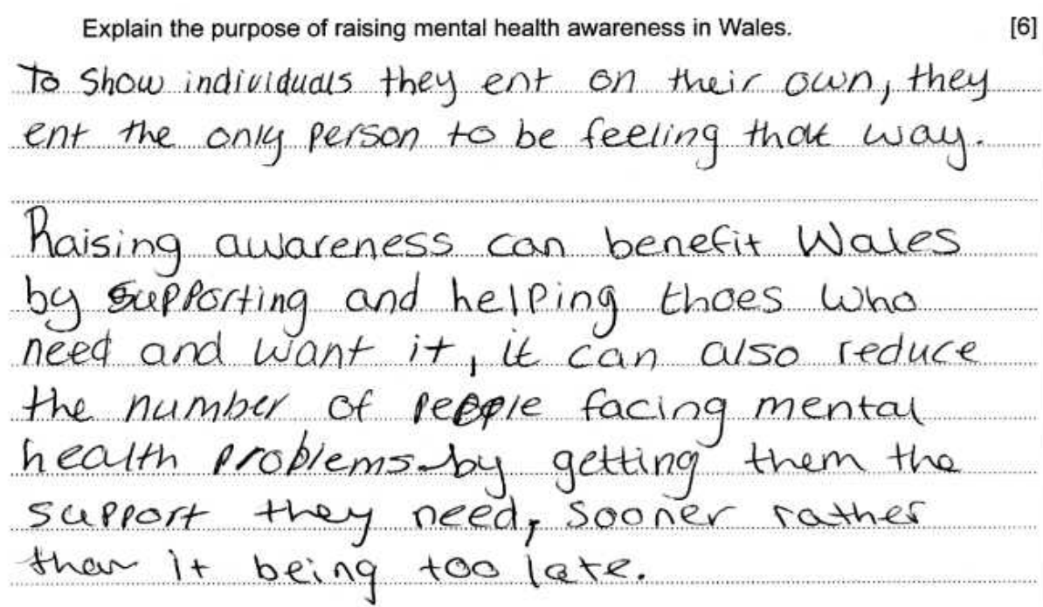
Question 8 (c) candidate 2 answer

Slide 38
Question 8 (c) candidate 2 answer with examiner’s comments
The response explains the purpose of campaigns in raising awareness of support for individuals living with mental health but does not address the importance of raising awareness and changing attitudes towards mental health in society.
Total marks awarded
3/6

Slide 39
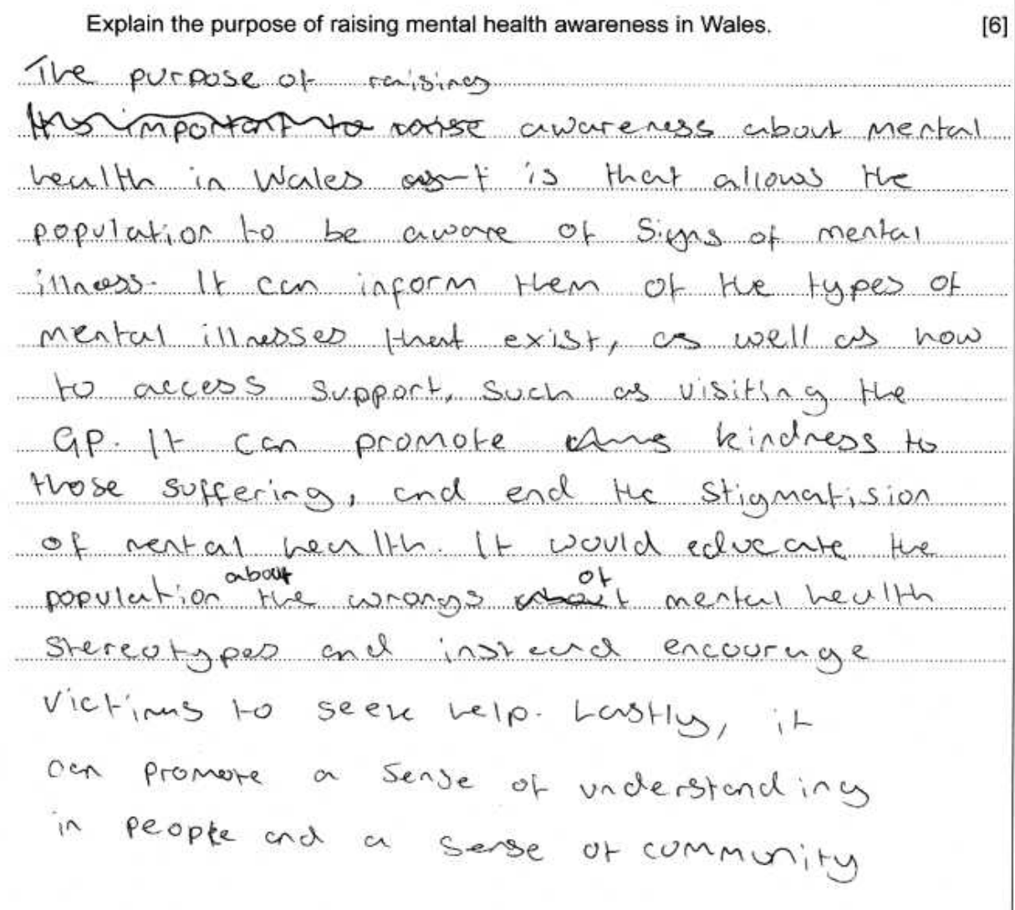
Question 8 (c) candidate 3 answer

Slide 40
Question 8 (c) candidate 3 answer with examiner’s comments
A very good answer, explaining the purpose of raising mental health awareness for individuals living with mental health and for society. The candidate uses appropriate vocabulary, including ‘stigma’, ‘stereotype’ and ‘victimise’.
Total mark awarded
6/6

Slide 41
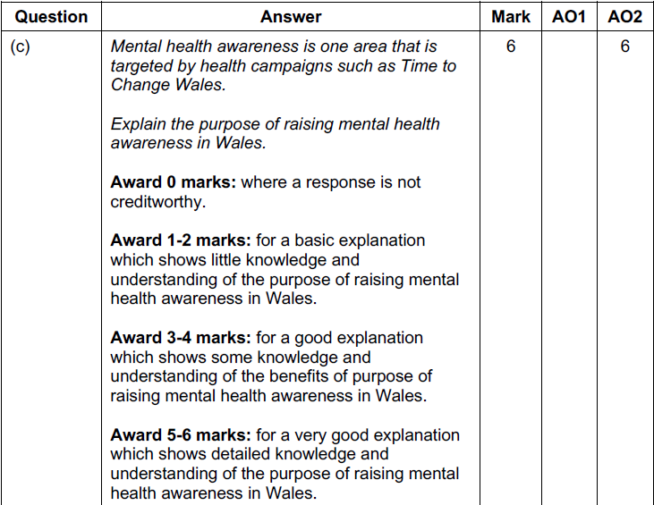
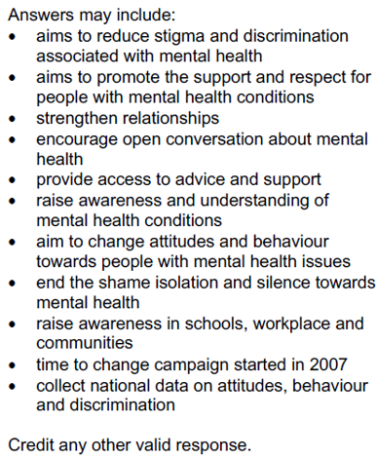
Question 8 (c) mark scheme

Slide 42
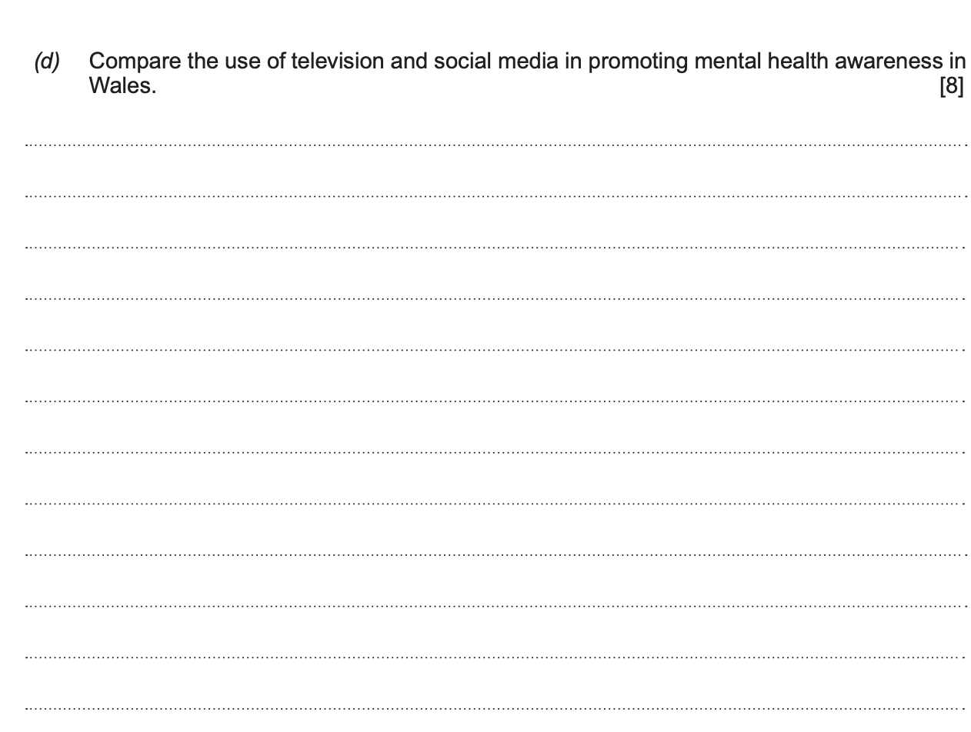
Question 8 (d)

Slide 43
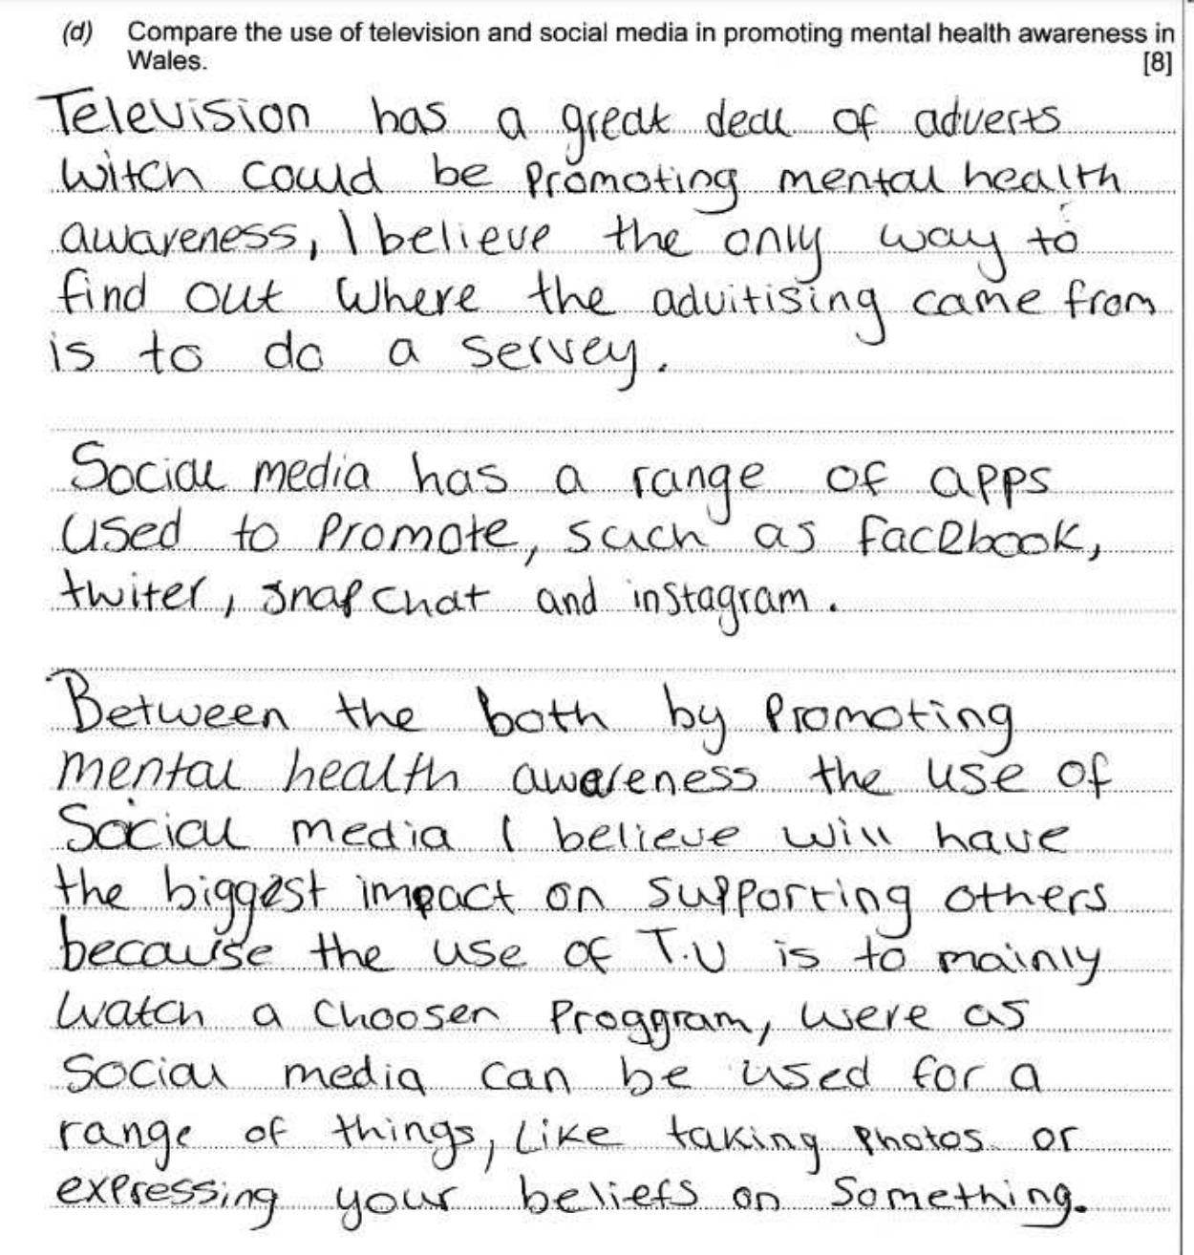
Question 8 (d) candidate 1 answer

Slide 44
Question 8 (d) candidate 1 answer with examiner’s comments
A limited response, with little comparison of TV and social media for promoting mental health awareness. The candidate does reach an unsupported conclusion.
Total marks awarded
2/8

Slide 45
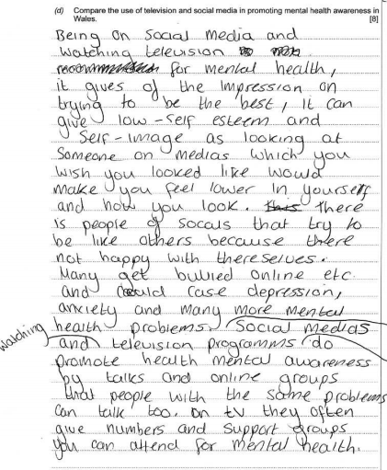
Question 8 (d) candidate 2 answer

Slide 46
Question 8 (d) candidate 2 answer with examiner’s comments
A good response focused on social media. Basic information on the use of television for advertising with some comparison made. Lacks detail and conclusion.
Total marks awarded
4/8

Slide 47
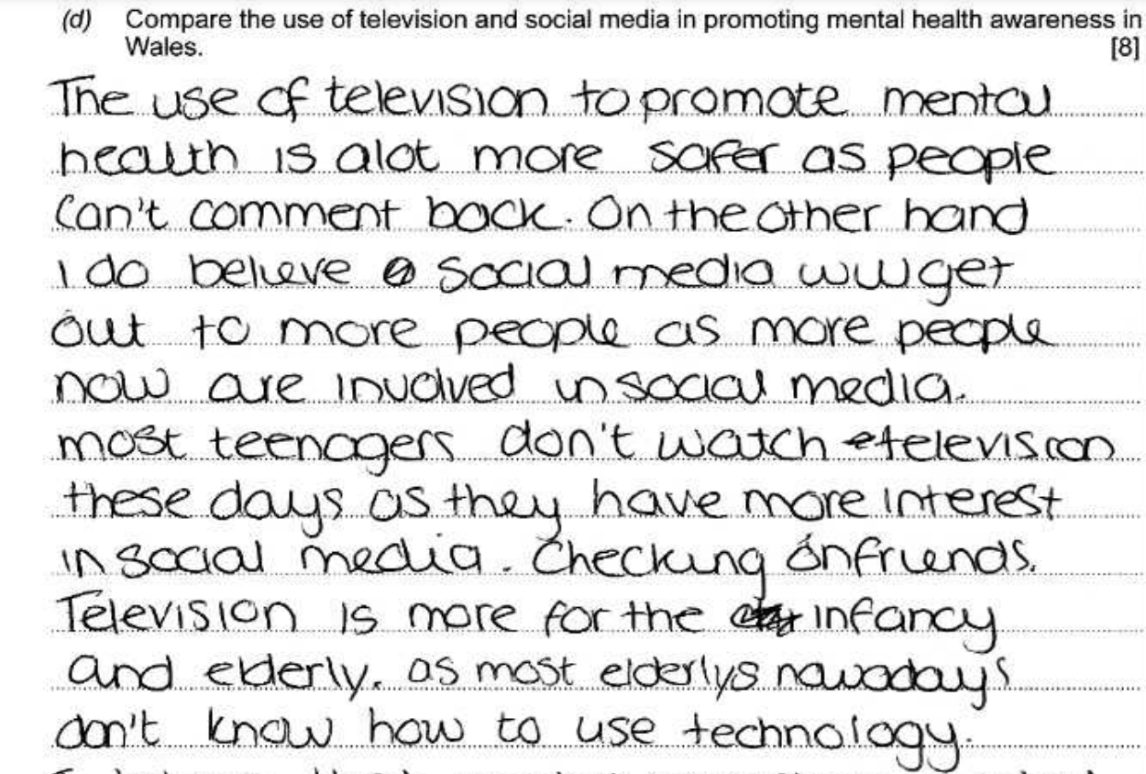
Question 8 (d) candidate 3 answer

Slide 48
Question 8 (d) candidate 3 answer with examiner’s comments
A very good response, comparing TV and social media. The candidate supports their argument with examples throughout and sums up the points with a conclusion.
Total marks awarded
8/8

Slide 49
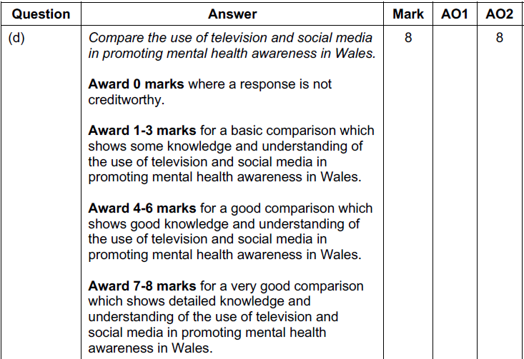
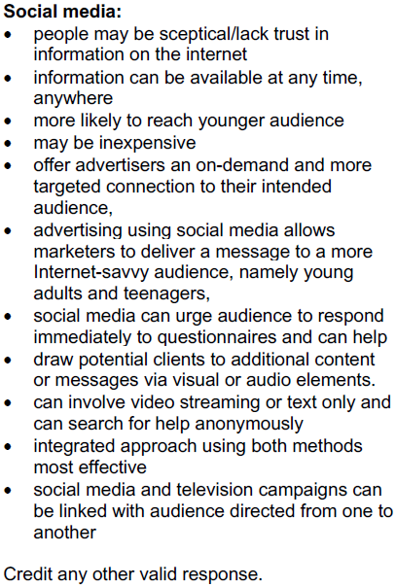
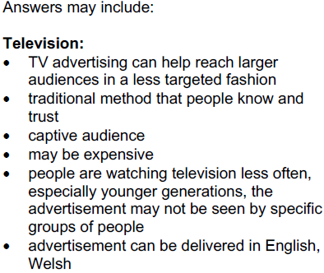
Question 8 (d) mark scheme

