Slide 1
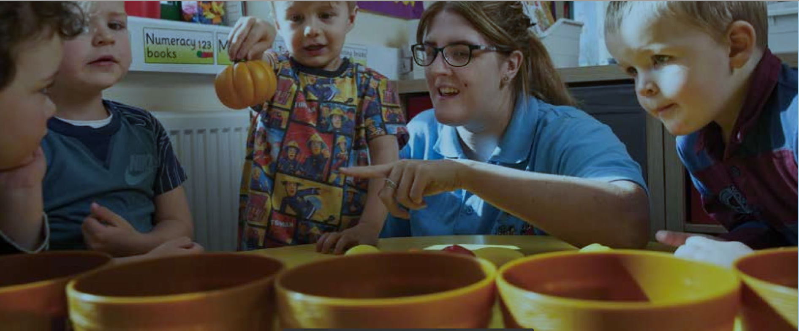
Unit 330: Walk-through Exam
Level 3 Children’s, Care, Play, Learning and Development: Practice and Theory
Notes:
Change the layout to be sector specific – you can do this on the HOME tab, under the section titled SLIDES, then select from layout options

Slide 2
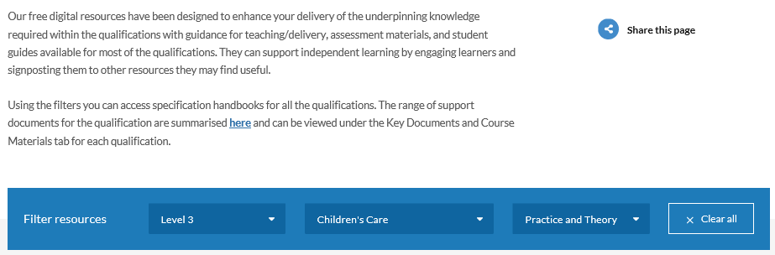
Resources

Slide 3
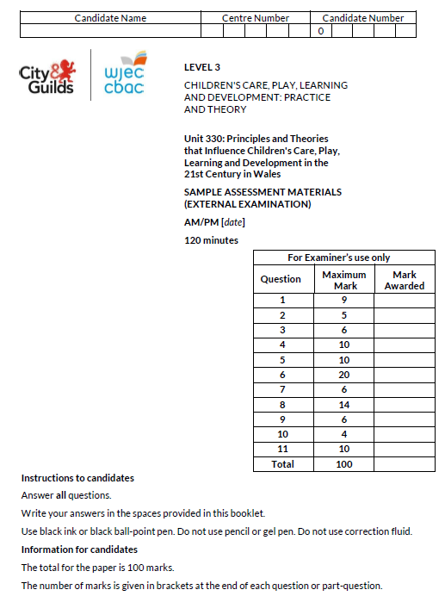
Unit 330: Principles and Theories that Influence Children's Care, Play, Learning and Development in the 21st Century in Wales
Theory - External Exam
• This exam is available to sit in January and May/June each
year
• Results for the January exam are available in March
• Results for the May/June exam are available in August
• The is the opportunity to re-sit this exam but only in January or
May/June
• This exam is worth 10% of the qualification
• 120-minute written exam
• A maximum of 100 marks available
• Mixture of short and extended answer questions
• Graded: Pass/Fail
The exam is available in paper format or on-screen – this depends on what your centre chooses when entering their candidates
If you are completing the paper exam you will need to use black-ink pens. You may also take highlighter pens into the exam.

Slide 4
What you should have in front of you:
A copy of the exam paper
A pen, pencil
A highlighter pen
A watch
Post-it notes

Slide 5
General points on exam technique
Read through the whole question before starting to answer. This will help you understand what is required of you.
Use a highlighter to pick out key words.
Look at the command words and the number of marks available for each question, they will help you decide how much detail is needed.
If a word is bold it is important.
Keep your exam paper open at the double page spread, do not fold it in half.
Read your answers to check they make sense.

Slide 6
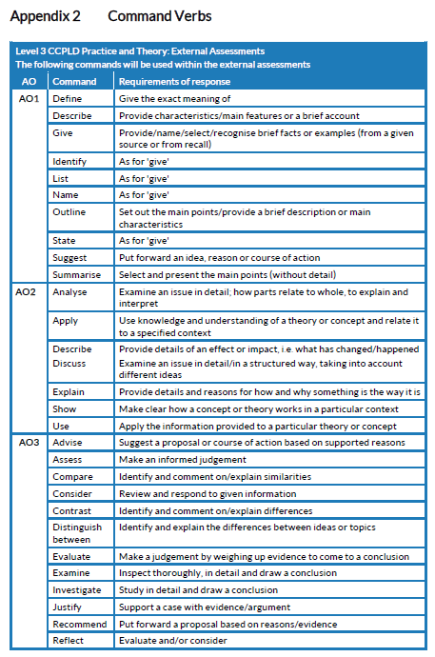
Command Verbs

Slide 7
What should I do first?
Make sure to put your name, candidate number and centre number on the Question paper
Carefully read the front cover of the exam paper.

Slide 8
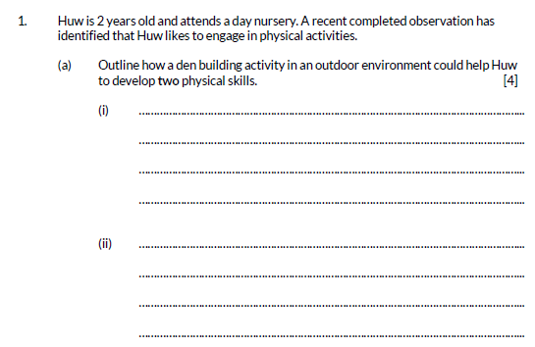
Question 1 (a)

Slide 9
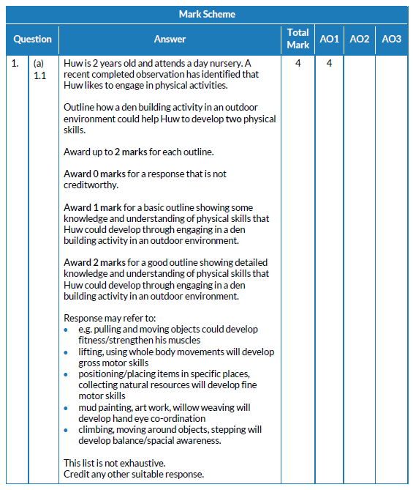
Question 1 (a)

Slide 10
Question 1 (b)

Slide 11
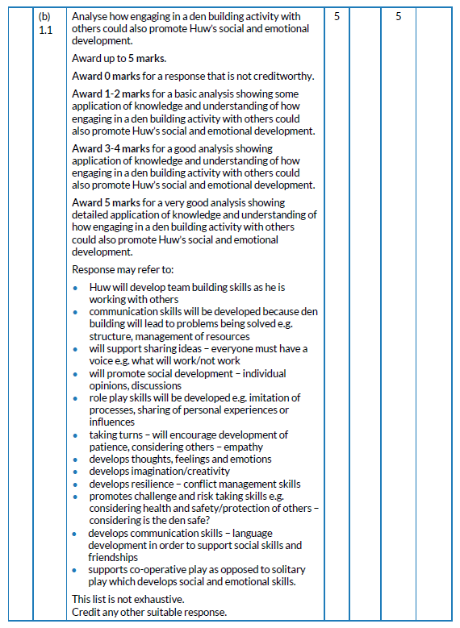
Question 1 (b)

Slide 12
Question 2

Slide 13
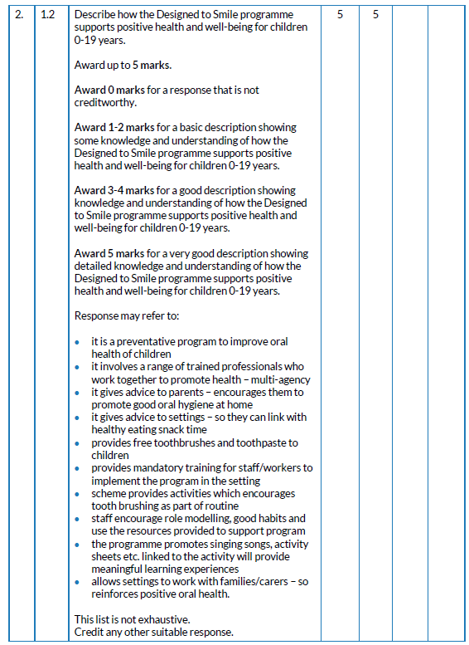
Question 2

Slide 14
Question 3

Slide 15
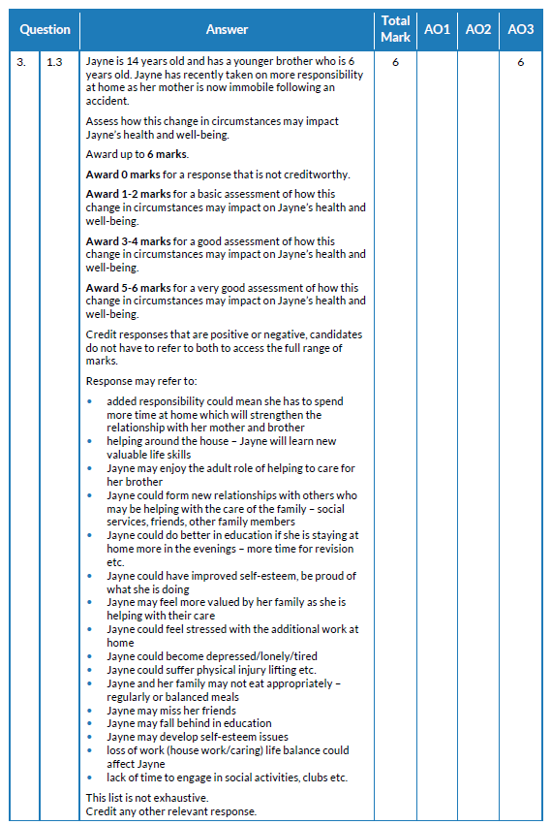
Question 3

Slide 16
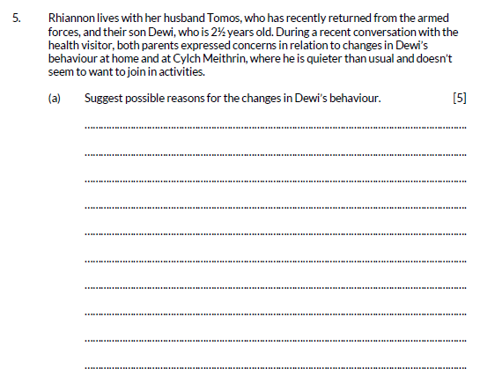
Question 5 (a)

Slide 17
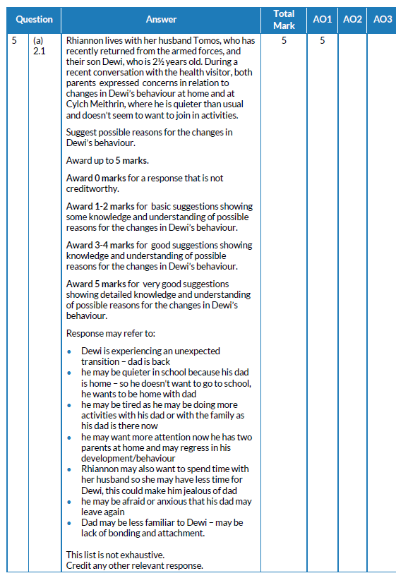
Question 5 (a)

Slide 18
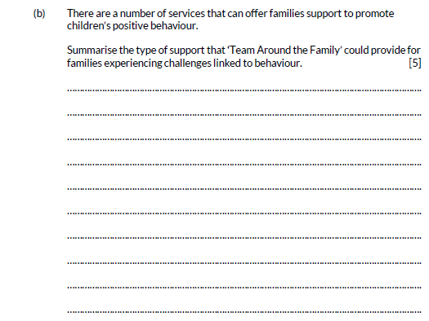
Question 5 (b)

Slide 19
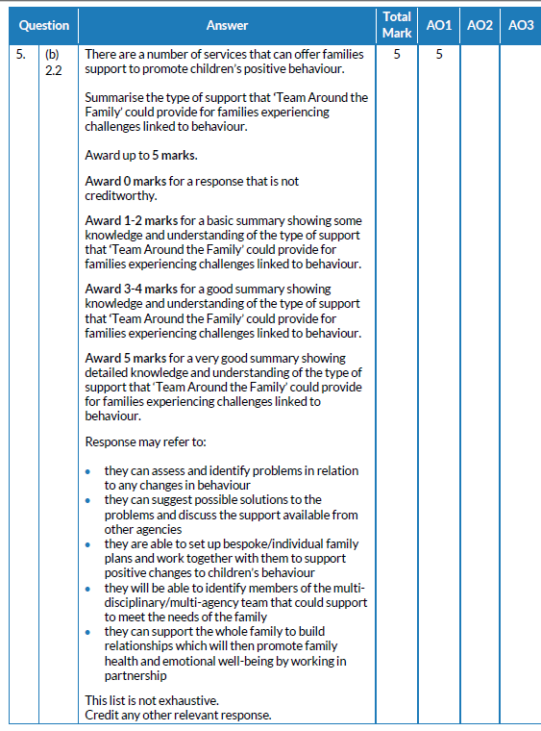
Question 5 (b)

Slide 20
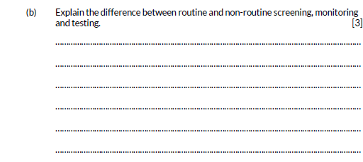
Question 6 (b)

Slide 21
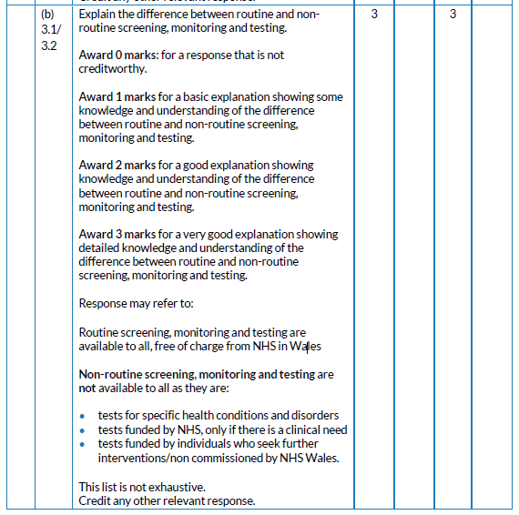
Question 6 (b)

Slide 22
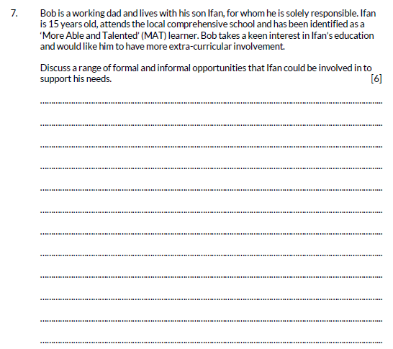
Question 7

Slide 23
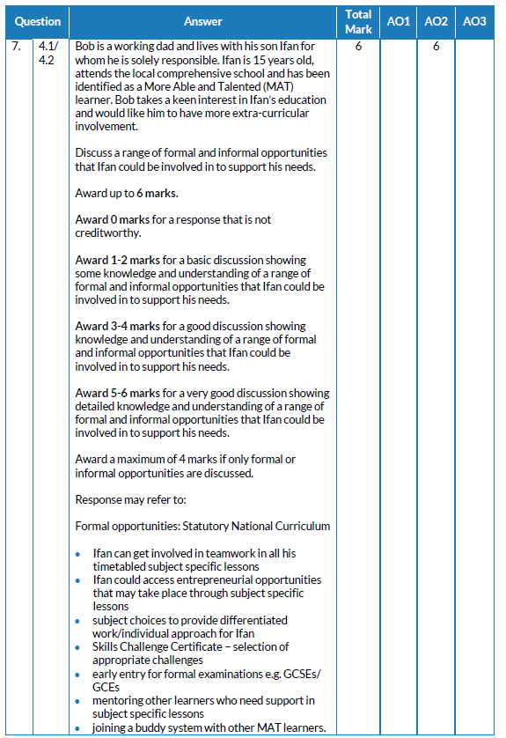
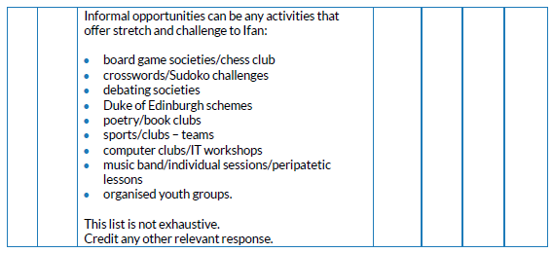
Question 7

Slide 24
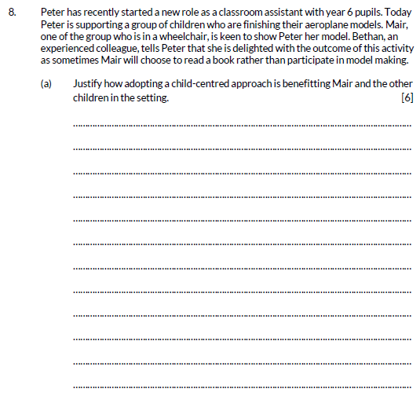
Question 8 (a)

Slide 25
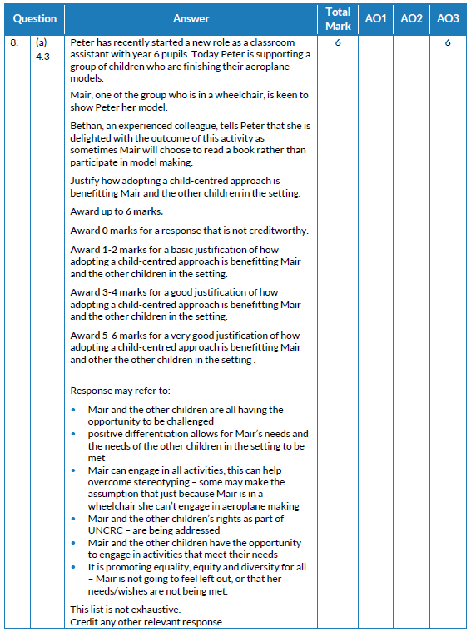
Question 8 (a)

Slide 26
Question 11

Slide 27
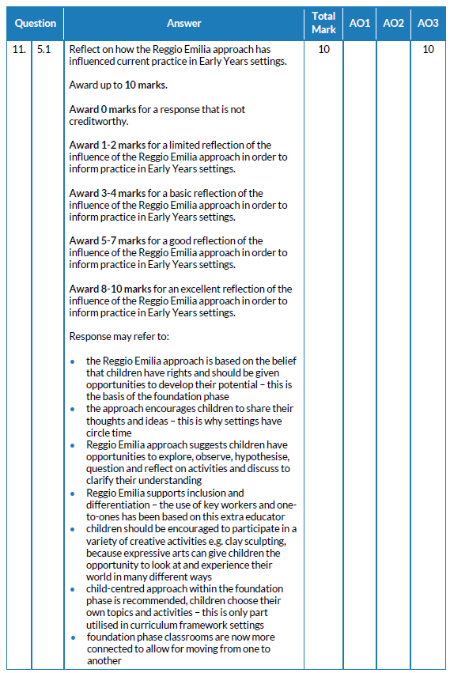
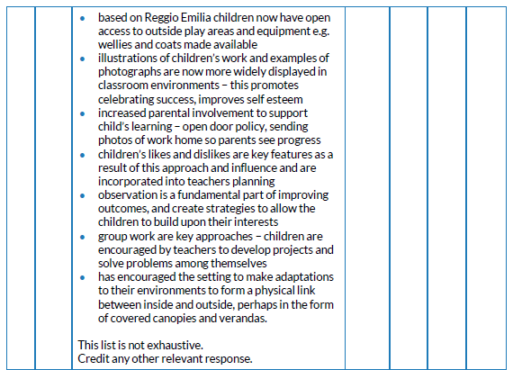
Question 11

Slide 28
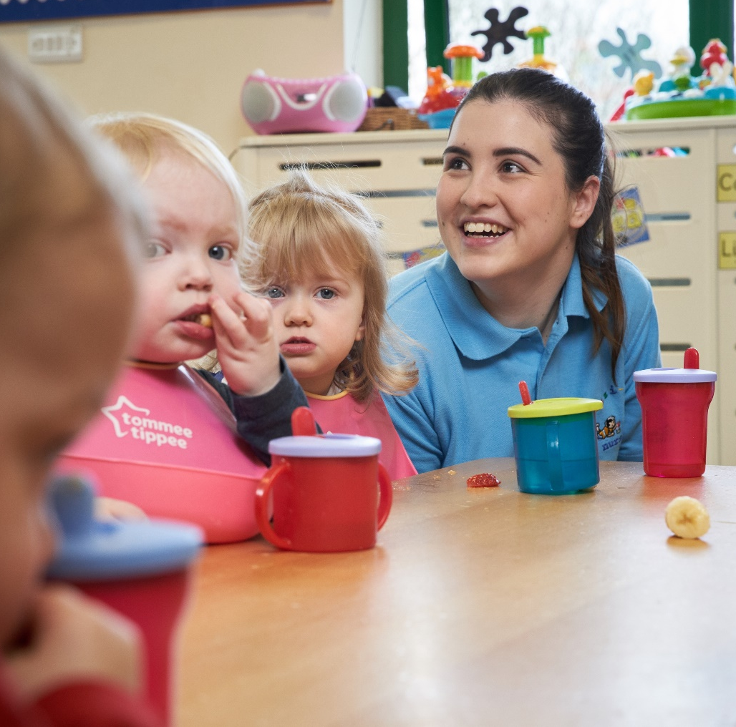
Diolch
Thank you

