Slide 1


Cyflwyniad a Swyddogaethau Cyffredinol
Introduction and General Functions

Slide 2















Mae’r adnodd hwn wedi’i ddatblygu mewn partneriaeth â’r Consortiwm Ymarferwyr Gwasanaethau Cymdeithasol (SSP) ar ran Gofal Cymdeithasol Cymru. Mae’r consortiwm yn cynnwys y partneriaid canlynol:
This resource has been developed in partnership by the Social Services Practitioner (SSP) Consortium on behalf of Social Care Wales. The consortium is made up of the following partners:
Gofal Cymdeithasol Cymru a'i gynghorwyr penodedig sy'n berchen ar hawlfraint y deunyddiau hyn. Gall darparwyr dysgu, awdurdodau lleol a darparwyr gwasanaethau gofal yng Nghymru gopïo, atgynhyrchu, dosbarthu neu drefnu bod y Rhaglen Ddysgu Ymarferwyr Gwasanaethau Cymdeithasol (SSP) ar gael fel arall i unrhyw drydydd parti arall ar sail ddielw yn unig. Rhaid i unrhyw bartïon eraill sy’n dymuno copïo, atgynhyrchu, dosbarthu neu fel arall wneud y Rhaglen Ymarferwyr Gwasanaethau Cymdeithasol (SSP) ar gael i unrhyw drydydd parti arall geisio caniatâd ysgrifenedig Gofal Cymdeithasol Cymru ymlaen llaw.
The copyright to these materials rests with Social Care Wales and its appointed advisers. The Social Services Practitioner (SSP) Programme of learning may be copied, reproduced, distributed or otherwise made available to any other third party by learning providers, local authorities and care service providers in Wales on a not-for-profit basis only. Any other parties that wish to copy, reproduce, distribute or otherwise make the Social Services Practitioner (SSP) Programme available to any other third party must seek the prior written consent of Social Care Wales.

Slide 3
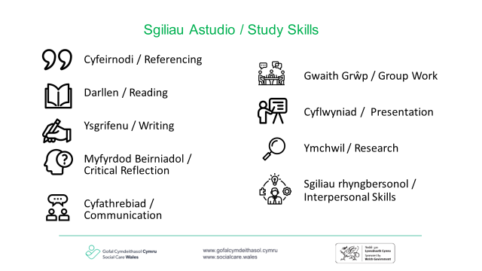

Slide 4
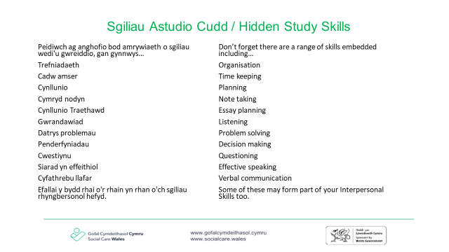

Slide 5

Gobeithion Gorau
Best Hopes
Trowch at y person sy'n eistedd nesaf i chi a chael sgwrs am eich gobeithion gorau o'r sesiwn hyfforddi hon.
Yna gofynnir i chi gyflwyno'ch partner trwy roi ei enw a dweud beth hoffent ei gaffael o'r sesiwn heddiw.
Turn to the person sat next to you and have a conversation about what your best hopes are from this training session.
You will then be asked to introduce your partner by giving their name and saying what they would like to take away from today.
Notes:
What do we know about the Act so far … it may be more than you think!

Slide 6
Nodau a deilliannau dysgu
Aims and learning outcomes
Mae’r hyfforddiant hwn yn rhoi trosolwg o’r Ddeddf ac yn archwilio Rhan 2: Adrannau 5-7, 15 ac 17 yn fwy manwl
Erbyn diwedd yr hyfforddiant byddwch yn:
  Ymwybodol o rannau a nodweddion y Ddeddf
  Deall ei nodau a'i hethos, a'r hyn y bwriedir iddi ei gyflawni
  Deall goblygiadau'r ddyletswydd i hybu llesiant ar gyfer ymarfer
  Deall rolau hanfodol gwybodaeth, cyngor a chymorth
  Myfyrio ar oblygiadau'r Ddeddf
This training provides an overview of the Act and explores Part 2: Section 5-7, 15 and 17 in more detail
By the end of the training you will:
  Be aware of the parts and features of the Act
  Understand its aims and ethos, and what it is intended to deliver
  Understand the implications for practice of the duty to promote well-being
  Understand the critical roles of information, advice and assistance
  Reflect on the implications Of the Act

Slide 7
trosolwg
overview
Deddfwriaeth statudol
Caiff ei hegluro gan gyfraith achosion
Dyletswyddau a Phwerau - rhaid a dylid
Dull gwahanol i lawer o ddeddfwriaeth flaenorol
Bydd angen newid diwylliannol ar gyfer staff a'r gwasanaeth cyfan
Statutory legislation
Will be clarified by case law
Duties and Powers- must and should
Different approach to much of previous legislation
Will require a cultural change for staff and service as a whole

Slide 8
trosolwg
overview
Seiliedig ar gryfderau
Canolbwyntio ar yr unigolyn
Canolbwyntio ar ganlyniadau
Mae'r gofynion yn adlewyrchu rhaglenni datblygu gwasanaeth a hyfforddiant a nodwyd eisoes fel arfer gorau
Mae’n bosibl y bydd angen rhagor o hyfforddiant/gweithdai i helpu i wreiddio newid arfer
Strengths based approach
Person centred
Outcome focussed
Requirements mirror service development and training programs already identified as best practice
Further training/workshops may be required to help embed practice change

Slide 9
cyflwyniad
introduction
Caiff Deddf Gwasanaethau Cymdeithasol a Llesiant (Cymru) ei gweithredu o 6 Ebrill 2016
Mae’n disodli llawer o ddeddfau blaenorol ac yn rhoi effaith i’r polisi a nodir yn Gwasanaethau Cymdeithasol Cynaliadwy i Gymru Fframwaith Gweithredu
Mae'n dod â dyletswyddau newydd i mewn ac yn cynnwys oedolion, plant a gofalwyr
The social services and well-being (Wales) Act was implemented on 6 April 2016
It replaced many previous laws and gives effect to the policy set out in Sustainable Social Services for Wales A Framework for Action
It brings in new duties and covers adults, children and carers
Pobl
lles
Atal
Cydweithredu
People
Well-being
Prevention
Collaboration

Slide 10
Y rhan o'r ddeddf
The part of the act
1. Cyflwyniad | 2. Swyddogaethau cyffredinol
3. Asesu Anghenion Unigolion | 4. Diwallu anghenion
5. Codi tâl ac Asesiad Ariannol | 6. Plant sy'n Derbyn Gofal a Phlant sy'n cael eu Lletya
7. Diogelu | 8. Swyddogaethau Gwasanaethau Cymdeithasol
9. Cydweithrediad a Phartneriaeth | 10. Cwynion ac Eiriolaeth
11. Amrywiol a chyffredinol
Introduction | 2. General Functions
3. Assessing the needs of individuals | 4. Meeting needs
5. Charging and Financial Assessment | 6. Looked after and Accommodated children
7. Safeguarding | 8. Social Services Functions
9. Co-operation and Partnership | 10. Complaints and Advocacy
11. Miscellaneous and general

Slide 11
Deddfwriaeth wedi'i diddymu:
Legislation repealed:
Deddf Gofalwyr (Cydnabyddiaeth a Gwasanaethau) 1995
Deddf Gofalwyr a Phlant Anabl 2000
Deddf Gofalwyr (Cyfle Cyfartal) 2004
Mesur Strategaethau ar gyfer Gofalwyr (Cymru) 2010
Deddf Cymorth Gwladol 1948
Deddf Gwasanaethau Iechyd ac Iechyd y Cyhoedd 1968
Deddf Cleifion â Salwch Cronig a Phersonau Anabl 1970
Deddf Dyfarniadau Iechyd a Gwasanaethau Cymdeithasol a Nawdd Cymdeithasol 1983
Deddf Personau Anabl (Gwasanaeth, Ymgynghori a Chynrychioli) 1986
Deddf Gofal Cymunedol y GIG 1990
Deddf Iechyd a Gofal Cymdeithasol 2001 (DPs)
The cares (Recognition and Services) Act 1995
The cares and Disabled Children Act 2000
The cares (Equal Opportunities) Act 2004
The Carers Strategies (Wales) Measure 2010
National Assistance Act 1948
Health Services & Public Health Act 1968
Chronically Sick and Disabled Persons Act 1970
Health & Social Services & Social Security Adjudications Act 1983
Disabled Persons (Service, Consultation and Representation) Act 1986
NHS Community Care Act 1990
Health & Social Care Act 2001 (DPs)

Slide 12
Plant
Children
Bydd y darpariaethau ar gyfer plant mewn angen yn Rhan 3 (adran 17) o Ddeddf Plant 1989 yn cael eu datgymhwyso mewn perthynas â Chymru. Yr awdurdod cyfreithiol ar gyfer darparu gwasanaethau i blant a’u teuluoedd, gan gynnwys plant anabl, yn lle hynny fydd Rhannau 2 i 5 o’r Ddeddf. Fodd bynnag, nid yw’r system gofal a chymorth cyffredinol ar gyfer Cymru o dan Rannau 2 i 5 yn berthnasol yn achos plant sy’n derbyn gofal. Yn lle hynny, mae Rhan 6 o’r Ddeddf yn cynnwys rhwymedigaethau awdurdodau lleol mewn perthynas â phlant sy’n derbyn gofal.
Mae’r Ddeddf yn cyflwyno dyletswydd newydd i Gymru i roi gwybod am blant sy’n wynebu risg o dan Ran 7.
The children in need provisions of Part 3 (section 17) of the Children Act 1989 will be dis applied in relation to Wales. The legal authority for the provision of services for children and their families, including disabled children, will instead be Parts 2 to 5 of the Act. However, the general care and support system for Wales under Parts 2 to 5 does not apply in the Case of looked-after children. Instead, Part 6 of the Act contains local authority obligations in relation to looked-after children.
The Act introduces a new duty to Wales to report children at the risk under Part 7.

Slide 13
Pa ddeddfwriaeth nad yw'n newid
What legislation is not changing
Deddf Iechyd Meddwl 1983 fel y'i diwygiwyd 2007
Deddf Galluedd Meddyliol 2005
Trefniadau Diogelu Wrth Amddifadu o Ryddid 2007
Rhan 4 a 5 Deddf Plant 1989
Mental health Act 1983 as amended 2007
Mental Capacity Act 2005
Deprivation of Liberty Safeguarding 2007
Part 4 and 5 Children Act 1989

Slide 14
Beth mae’r Ddeddf yn ceisio’i gyflawni:
Atal
What is the Act trying to achieve:
Prevention
Mwy o gefnogaeth lles
More well-being support
Lefel uwch o wasanaethau ymyrraeth gynnar / atal
Increased level of early intervention / prevention services
Sbectrwm gofal
A chymorth
Spectrum of care
And support
ataliol
Dwys
preventative
Intensive
Gwell mynediad at wybodaeth
Cyngor ac adnoddau cymunedol
Better access to information,
Advice & community resources
Llai o angen am gymorth
dwys a reolir
Less need for intensive
Managed support

Slide 15
Beth mae hyn yn ei olygu i bobl ag anghenion gofal a chymorth?
What does this mean for people with care and support needs?
Mae fy llais yn bwysig
Bydd gennyf lais cryf a rheolaeth dros ba ofal a chymorth sydd eu hangen arnaf
Bydd y ffocws ar wneud yr hyn sy'n bwysig i mi a'r hyn y gallaf ei wneud fy hun neu gyda chefnogaeth teulu, ffrindiau a chefnogwyr
Bydd yn hawdd cael gafael ar wybodaeth a chyngor perthnasol a chlir i helpu i wneud y penderfyniadau hyn
Bydd cyngor ar gael
Byddaf yn cael help yn gynnar, felly nid wyf yn cael fy hun mewn argyfwng
Mae gen i hawl i fod yn ddiogel
Bydd pwerau cryfach yn sicrhau bod plant ac oedolion sy'n wynebu risg yn cael eu hamddiffyn
My voice matters
I will have a strong voice and control over what care and support I need
The focus will be on doing what matters to me and what I can do myself or with support from family, friends and supporters
It will be easy to access relevant, clear information and advice to help make these decisions
Advice will be available
I will get help early, so I don’t find myself in crisis
It’s my right to be safe
Stronger powers will ensure the protection of children and adults at risk

Slide 16
Beth mae hyn yn ei olygu i ofalwyr?
What does this mean for carers?
Mae fy llais yn bwysig
Bydd gennyf lais cryf a rheolaeth dros ba gefnogaeth sydd ei hangen arnaf
Bydd y ffocws ar wneud yr hyn sy'n bwysig i mi
Bydd yn hawdd cael gafael ar wybodaeth a chyngor perthnasol a chlir i’m helpu i wneud y penderfyniadau hyn
Bydd cyngor ar gael
Byddaf yn cael help yn gynnar, felly nid wyf yn cael fy hun mewn argyfwng
Mae angen i ni i gyd weithio gyda'n gilydd
Byddaf yn gyfartal yn y bartneriaeth
Rhaid i gymunedau ddod at ei gilydd i gefnogi ei gilydd
My voice matters
I will have a strong voice and control over what support I need
The focus will be on doing what matters to me
It will be easy to access relevant, clear information and advice to help me make these decisions
Advice will be available
I will get help early, so I don’t find myself in crisis
We all need to work together
I will be an equal in the partnership
Communities must come together to support each other

Slide 17
Ffilm
Film
Yr hyn sy'n bwysig i ni
What matters to us
Notes:
https://www.youtube.com/watch?v=a2KiTnsv5ZM

Slide 18
Ymarfer unigol
Individual exercise
Ar eich pen eich hun, ysgrifennwch yr hyn rydych chi'n meddwl allai fod yn heriau allweddol wrth wreiddio ac ymestyn dewis a rheolaeth pobl mewn Gofal Cymdeithasol i Oedolion a Phlant.
3 munud ar eich pen eich hun
5 munud o rannu gyda'r person nesaf atoch chi
7 munud o adborth i'r prif grŵp
On your own write down what you think might be the key challenges in embedding and extending people’s choice and control in Adults and Children’s Social Care.
3 minutes on your own
5 minutes share with the person next to you
7 minutes feedback to the main group

Slide 19
Pwyntiau dysgu allweddol
Key learning points
Mae’r Ddeddf yn cwmpasu ac yn cefnogi oedolion, plant a gofalwyr.
Mae’r Ddeddf yn ceisio ail-gydbwyso ffocws gofal a chymorth ar atal ac ymyrryd yn gynt yn hytrach nag ymyrryd ar adeg o argyfwng yn unig.
Mae’r Ddeddf yn gofyn am newid diwylliant o’r ffordd y mae gwasanaethau wedi’u darparu’n aml, i ddull sy’n seiliedig ar gydweithio, a pherthynas gyfartal rhwng ymarferwyr a phobl sydd ag anghenion gofal a chymorth.
Un o nodau allweddol y Ddeddf i unigolion fod yn ganolog i benderfyniadau a chael eu cefnogi i gael dewis a rheolaeth dros eu bywydau. Bydd hyn yn golygu gweithio 'gydag unigolion' nid 'gwneud pethau iddyn nhw'.
Mae’r egwyddorion a’r dyletswyddau sydd wedi’u hymgorffori yn y Ddeddf yr un mor berthnasol i ofalwyr ag anghenion cymorth a’r unigolion y maent yn gofalu amdanynt.
The Act covers and supports for adults, children and carers.
The Act attempts to rebalance the focus of care and support on prevention and earlier intervention rather than only intervening at crisis point.
The Act requires a culture change from the way in which services have often been provided, to an approach based on collaboration, and an equal relationship between practitioners and people who have needs for care and support
One of the key aims for the Act for individuals to be at the end centre of decisions and to be supported to have a choice and control of their lives. This will mean working ‘with individuals’ not ‘doing to them’.
The principles and duties enshrined in the Act apply equally to carers with support needs and the individuals they care for.

Slide 20
Lles a dyletswyddau cyffredinol eraill
Well-being and other overarching duties

Slide 21
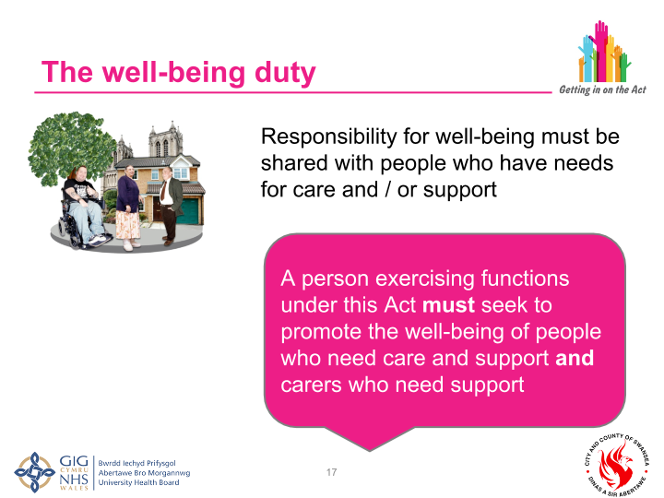
Y ddyletswydd lles
The well-being duty
Rhaid rhannu’r cyfrifoldeb am lesiant gyda phobl sydd ag anghenion gofal a/neu gymorth
Responsibility for well-being must be shared with people who have needs for care and / or support
Rhaid i berson sy’n arfer swyddogaethau o dan y Ddeddf hon geisio hybu lles pobl sydd angen gofal a gofalwyr sydd angen cymorth
A person exercising functions under this Act MUST seek to promote the well-being of people who need care and support AND carers who need support

Slide 22
Datganiad lles
Well being statement
Mae Llywodraeth Cymru wedi cyhoeddi datganiad lles sy’n disgrifio agweddau ar les sy’n ymwneud â phob maes o fywyd unigolyn.
Mae’n disgrifio’r canlyniadau lles cenedlaethol ac mae hefyd yn nodi pa agweddau ar les y dylid eu mesur
The Welsh Government has published a well being statement that describes aspects of well being that relate to all areas of an individuals life.
It describes the national well being outcomes and also sets out what aspects of well being be measured

Slide 23
Ymarfer unigol
Individual exercise
Ar eich pen eich hun ysgrifennwch:
Beth ydych chi'n ei ddeall wrth y term lles?
Beth fyddech chi’n ei ystyried yw’r ffactorau allweddol sy’n dylanwadu ar eich lles personol?
3 munud ar eich pen eich hun
5 munud o rannu gyda'r person nesaf atoch chi
7 munud ar gyfer adborth grŵp
On your own write down:
What do you understand by the term well-being?
What would you consider to be the key factors that influence your personal well-being?
3 minutes on your own
5 minutes to share with the person next to you
7 minutes for group feedback

Slide 24
Diffiniad o les i oedolion
Definition of well-being for adults
Fy lles
Iechyd corfforol a meddyliol ac emosiynol
Amddiffyn rhag camdriniaeth ac esgeulustod
Addysg, hyfforddiant a hamdden
Perthnasoedd domestig, teuluol a phersonol
Cyfraniad a wneir i gymdeithas
Sicrhau hawliau a hawliadau
Addasrwydd llety byw
Rheolaeth dros fywyd o ddydd i ddydd
Cymryd rhan mewn gwaith
My well-being
Physical & mental health & emotional
Protection from abuse and neglect
Education, training and recreation
Domestic, family and personal relationships
Contribution made to society
Securing rights and entitlements
Suitability of living accommo-dation
Control over day-to-day life
Participation in work

Slide 25
Diffiniad o les i plant
Definition of well-being for children
Fy lles
Iechyd corfforol a meddyliol ac emosiynol
Amddiffyn rhag camdriniaeth ac esgeulustod
Addysg, hyfforddiant a hamdden
Perthnasoedd domestig, teuluol a phersonol
Cyfraniad a wneir i gymdeithas
Sicrhau hawliau a hawliadau
Cymdeithasol ac economaidd
Addasrwydd llety byw
lles
datblygiad
My well-being
Physical & mental health & emotional
Protection from abuse and neglect
Education, training and recreation
Domestic family and personal relationships
Contribution made to society
Securing rights and entitlements
Social and ecomonics
Suitability of living acoomommo-dation
Welfare
Development

Slide 26
Ymarfer grŵp
Group exercise
Ystyried beth allai lles ei olygu i oedolyn neu blentyn ag anghenion gofal a chymorth, a sut y gallwn ni fel gwasanaeth helpu i hyrwyddo llesiant y bobl rydym yn gweithio gyda nhw.
Cwblhewch y tabl yn eich grwpiau
Consider what well-being might mean for an adult or child with care and support needs, and how we as a service can help promote well- being for the people we work with.
Complete the table in your groups

Slide 27
Mecanweithiau I hybu lles
Asesiad y boblogaeth
Ystod a lefel gwasanaethau ataliol
Hyrwyddo gwasanaethau a arweinir gan ddefnyddwyr
Darparu gwybodaeth, cyngor a chymorth
Asesu, cynllunio ac adolygu anghenion unigolion
Mechanisms to promote well-being
Population assessment
Range and level of preventative services
Promote user-led services
Provide information, advice and assistance
Assessment, planning and review of individuals, needs

Slide 28
Other overarching duties
Adults best placed to judge their own well-being
Views, wishes and feelings of those with parental responsibility
Promoting independence
Respecting dignity
Participation
Characteristics, culture and belief
Views, wishes and feelings of the individual
Upbringing of the child by the child’s family
Notes:
As well as the well-being duty there are other overarching duties that underpin the Act, and the local authority must take steps to ensure that all services are delivered in a away which complies with these duties. These duties apply to local authorities (or other organisations they have delegated functions to) and their practitioners when dealing with a person who may have needs for care and support or a carer with support needs, even if it has not been established that the individual has such needs or would be eligible.
Four of these overarching duties apply in all cases, whether an adult or a child. The duty to:
Ascertain and have regard to the individual’s views, wishes and feelings, in so far as is reasonable practicable
Have regard to the importance of promoting and respecting the dignity of the individual
Have regard to the importance of providing appropriate support to enable the individual to participate in decisions that affect them to the extent that it is appropriate in the circumstances, particularly where the individual’s communication is limited for any reason
Have regard to the characteristics, culture and beliefs of an individual, including language
Two overarching duties apply specifically to adults, which are a) to begin with the presumption that they are best placed to judge their own well-being and b) to have regard to the importance of promoting their independence where possible. Promoting independence should be viewed in the context of the Framework for Action on Independent Living which is based on the social model of disability i.e. it recognises that people with impairments are disabled by the barriers that commonly exist in a society. If fully realised, the social model would mean that disabled people were able to participate fully in society, and the impact of their impairment would be substantially reduced.
In relation to children there is also the duty to a) promote the upbringing of the child by the child’s family, in so far as doing so is consistent with the well-being of the child and b) for under 16s, to ascertain and have regard to the views, wishes and feelings of those with parental responsibility, in so far as is practical and consistent with the child’s well-being.

Slide 29
Hawliau Dynol
Human Rights
Confensiwn y cenhedloedd unedig ar Hawliau'r Plentyn
Egwyddorion y Cenhedloedd Unedig ar gyfer Pobl Hŷn
Confensiwn y Cenhedloedd Unedig ar Hawliau Pobl Anabl
Confensiwn Ewropeaidd ar Hawliau Dynol
United nations convention of the Rights of the Child
United nations Principles for Older Persons
United nations Convention of the rights of Disabled people
European convention of Human Rights

Slide 30
Newid Diwylliannol: ble ydych chi nawr?
Cultural Shift: where are you now?
Canolbwyntio ar y
gwasanaeth
Canolbwyntio ar y person
Service
focused
Person
focused

Slide 31
Atal ac Ymyrraeth Gynnar
Prevention and Earlier intervention

Slide 32
Cyd-destun atal
Context of prevention
Sut i wneud gwasanaethau cymdeithasol yn gynaliadwy gyda phwysau enfawr ar alw
Ein tasg yw sicrhau bod gwasanaethau lle mae eu hangen ar bobl; cefnogi pobl cyn iddynt gael eu hunain mewn argyfwng neu cyn i broblemau wreiddio. Yn ddelfrydol, rydym am atal anawsterau rhag codi yn y lle cyntaf
Mae gan ddulliau ataliol rôl allweddol i’w chwarae wrth hyrwyddo lles
Fodd bynnag, nid oes un diffiniad o'r hyn yw gweithgarwch ataliol
How to make social services sustainable with huge pressures on demand
Our task is to ensure that services are there when people need them; to support people before they find themselves at crisis point or problems become entrenched. Ideally we want to stop difficulties from arising in the first place.
Preventative approaches have a key role to play in promoting well-being
However, there is no one definition for what constitute preventative activity
Notes:
Quick research - What section of the Act covers preventative services?

Slide 33
Ymarfer unigol
Individual Exercise
Ar eich pen eich hun, ysgrifennwch pam mae atal yn bwysig?
Pa wasanaethau lleol y gallwch feddwl amdanynt a allai ddarparu swyddogaeth ataliol yr ydych wedi'i ystyried o'r blaen?
Beth yw'r cyfleoedd yn lleol i waith ataliol
Beth yw'r rhwystrau posibl i weithio fel hyn?
On your own write down why is prevention important?
What local services can you think of that might provide a preventative function what you have considered before?
What are the opportunities locally to preventative work.
What are the potential barriers to work in this way?

Slide 34
Ystod a lefel gwasanaethau ataliol
A range and level of preventative services
Rhaid i awdurdodau lleol sicrhau ystod o lefelau o wasanaethau ataliol sydd:
  Yn helpu i atal, oedi neu leihau'r angen am ofal a chymorth parhaus
  Hyrwyddo magwraeth plant gan eu teulu
  Lleihau effaith anableddau pobl
  Helpu i atal camdriniaeth neu esgeulustod
  Galluogi pobl i fyw mor annibynnol â phosibl
  Lleihau'r angen am: orchmynion gofal neu oruchwylio; achos troseddol yn erbyn plant; mynd â phlant i ofal awdurdod lleol neu lety diogel
Rhaid i fyrddau iechyd lleol hefyd ddefnyddio dull ataliol sy’n helpu i gyflawni’r nodau hyn
Local authorities must ensure a range of level of preventative services which:
  Help prevent, delay or reduce needs for care and support
  Promote the upbringing of children by their family
  Minimise the effect of people’s disabilities
  Help prevent abuse or neglect
  Enable people to live as independently as possible
  Reduce the need for: care or supervision orders; criminal proceeding against children; taking children into local authority care or secure accommodation
Local health boards must also take a preventative approach that helps to achieve these aims

Slide 35
Hydwyddo mwy o amrywiaeth o ran darpariaeth
Promoting greater diversity of delivery
Mentrau cymdeithasol
Cydweithfeydd
Trydydd Sector
Arweinir gan ddefnyddwyr
Social enterprises
Co-operatives
Third Sector
Used-led

Slide 36
Astrudiaeth achos
Case study
Dylan
Dylan

Slide 37
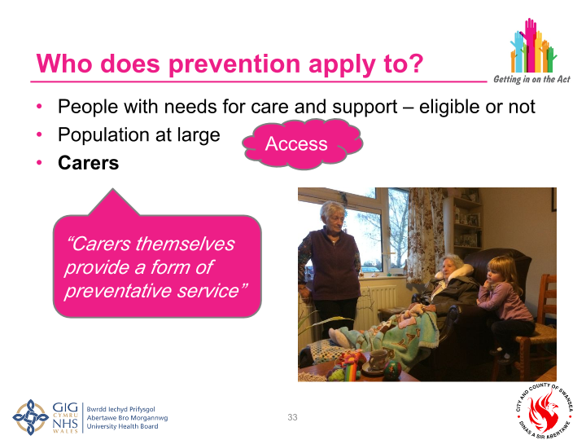
I bwy mae atal yn berthnasol?
Who does prevention apply to?
Pobl ag anghenion gofal a chymorth – cymwys neu beidio
Poblogaeth yn
gyffredinol
Gofalwyr
People with needs for care and support – eligible or not
Population at large
Carers
Mynediad
Access
“Mae gofalwyr eu hunain yn darparu math o wasanaeth ataliol”
“Carers themselves provide a form of preventatives service”

Slide 38
Plant a theuluoedd, ac atal
Children and families, and prevention
Mae’r Ddeddf yn atgyfnerthu’r egwyddor o gefnogi teuluoedd i ofalu am blant gyda phwyslais ar helpu rhieni i ddatblygu eu gallu eu hunain i nodi a rheoli problemau, gan gadw teuluoedd gyda’i gilydd mewn amgylchedd diogel, cefnogol a sefydlog.
Gofynion ar gyfer dull amlasiantaethol o ddiogelu a hybu lles plant
Ymyrraeth gynnar i blant a theuluoedd yn hollbwysig i'r agenda atal
The Act reinforces the principle of supporting families in caring for children with an emphasis on helping parents develop their own ability to identify and manage problems, keeping families together in safe, supportive and stable environment
Requirements for a multi agency approach to safeguard and promote the well-being of children
Early intervention for children and families critical to prevention agenda

Slide 39
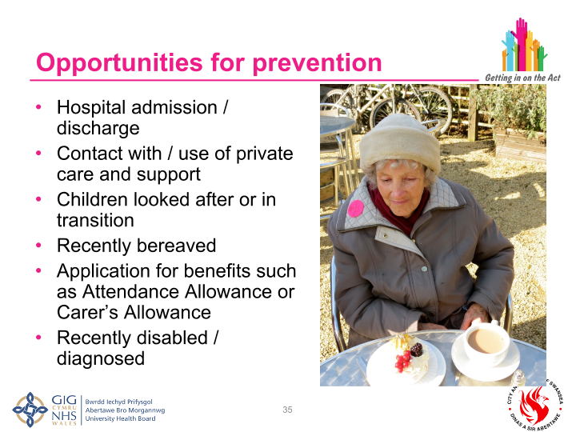
Cyfleoedd ar gyfer atal
Opportunities for prevention
Derbyn/rhyddhau o'r ysbyty
Cyswllt â / defnydd o ofal a chymorth preifat
Plant sy'n derbyn gofal neu sy'n trosglwyddo
Wedi cael profedigaeth yn ddiweddar
Cais am fudd-daliadau fel lwfans gweini neu Lwfans Gofalwr
Yn ddiweddar anabl / diagnosis
Hospital admission / discharge
Contact with / use of private care and support
Children looked after or in transition
Recently bereaved
Application for benefits such as attendance allowance or Carer’s Allowance
Recently disabled / diagnosed

Slide 40
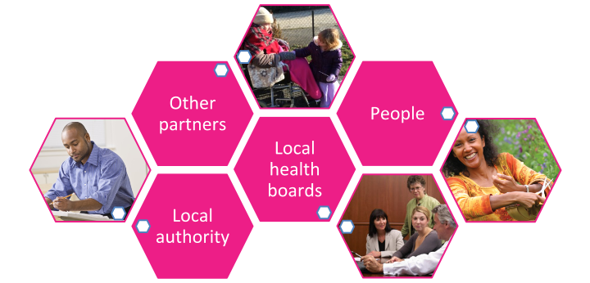
Pwy sy'n gyfrifol am atal?
Who is responsible for prevention?
Partneriaid eraill
People
Other Partners
Local
Health boards
Pobl
Byrddau Iechyd lleol
Local authority
Awdurdod
lleol

Slide 41
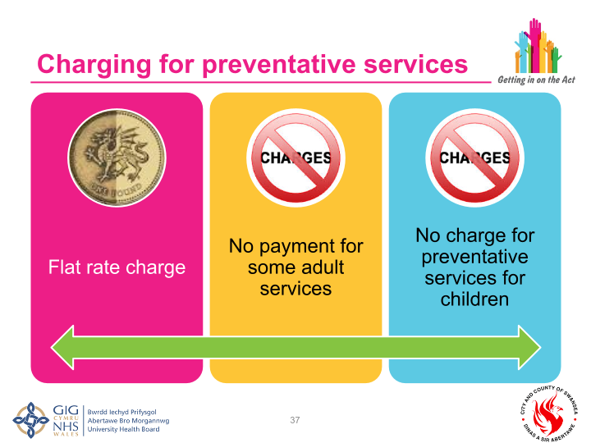
Codi tâl am wasanaethau ataliol
Charging for preventative services
Tâl cyfradd unffurf
Dim tâl am rai gwasanaethau oedolion
Dim tâl am wasanaethau ataliol i blant
No payment for some adult services
No charge for preventative services for children
Flat rate charge

Slide 42
Gwybodaeth, Cyngor a Chymorth
Information, Advice and Assistance

Slide 43
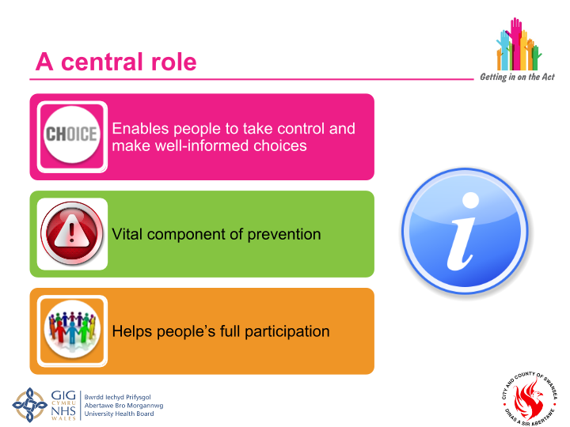
Rôl ganolog
A central role
Mae'n galluogi pobl i gymryd rheolaeth a gwneud dewisiadau gwybodus ac mae'n elfen hanfodol o ddull ataliol.
Enables people to take control and make well-informed choices
Elfen hanfodol o atal
Vital component of prevention
Yn helpu cyfranogiad llawn pobl
Helps people’s full participation

Slide 44
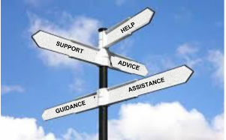
Gwasanaeth gwybodaeth, cyngor a chymorth
An information, advice
and assistance service
Dyletswydd ar awdurdodau lleol – gyda chymorth gan eu bwrdd iechyd lleol – i sicrhau y darperir gwasanaeth gwybodaeth a chyngor ar gyfer yr holl bobl yn eu hardal
Cymorth i gael mynediad at y cymorth gofal hwnnw
A duty on local authorities – with support from their local health board – to ensure the provision of an information and advice service for all people in their area
Assistance in accessing that care support

Slide 45
Ymarfer Grŵp
Group Exercise
Trafodwch mewn grŵp ac ysgrifennwch:
Sut mae'r gwasanaeth gwybodaeth, cyngor a chymorth wedi'i sefydlu yn Abertawe ar gyfer oedolion a phlant?
Beth yw cryfderau a gwendidau'r trefniadau presennol.
Sut brofiad fydd y gwasanaeth i'r rhai sy'n ei dderbyn, yn eich barn chi.
Discuss in group and write down:
How is the information, advice and assistance service set up in Swansea for adults and for children ?
What are the strengths and weakness in the current arrangements.
What do you think the service will be like for those receiving it.

Slide 46
Beth yw gwybodaeth, cyngor a chymorth?
What is information, advice and assistance?
Information/ Gwybodaeth
Advice/ Cyngor
Taflenni,
Gwefannau:
Llyfrgelloedd, CAB,
Cyfarwyddiadau,
llinellau ffôn,
Grwpiau cymorth, siopau un stop, gweithwyr rheng flaen,
ac ati
Leaflets,
Websites,
Libraries, CAB,
Directions,
Telephone lines,
Support groups, one stop shops, front line workers,
ect
Help dros y ffôn
neu linellau ymholiadau,
siopau un stop,
canolfannau cerdded i mewn,
Tîm asesu
Gweithwyr rheng flaen,
gwybodaeth deuluol
gwasanaeth,
ac ati
Telephone help
or enquiry lines,
one stop shops,
walk in centres,
Assessment team,
Front line workers,
family information
service,
ect
Cymorth/ Assistance
Gwneud cyswllt,
llenwi ffurflenni,
cludiant,
hebrwng y
person
Making contact,
completing forms,
transport,
accompanying the
Person
Gweithredu gyda'r person
Taking action with the person
Darparu data i'r person
Providing data to the person
Archwilio opsiynau gyda'r person
Exploring options with the person

Slide 47
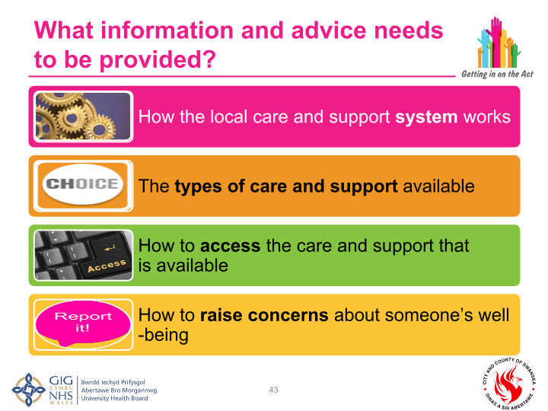
Pa wybodaeth a chyngor y dylid eu darparu
What information and advice needs to be provided
Sut mae'r system gofal a chymorth lleol yn gweithio
How the local care and support system works
Y mathau o ofal a chymorth sydd ar gael
The types of care and support available
Sut i gael mynediad i'r gofal a’r cymorth sydd ar gael
How to access the care and support that is available
Sut i godi pryderon am les rhywun
How to raise concerns about someone’s well -being

Slide 48
Pwy sydd ei angen
Who needs it
Pobl
pontio i fyd oedolion
Testun pryderon diogelu
Sy'n cysylltu â'r awdurdod lleol
A allai ddatblygu angen gofal a chymorth yn y dyfodol
Sy'n gymwys i gael gofal a chymorth
Yn yr ystâd ddiogel
Sy'n aelodau o'r teulu neu'n ofalwyr
Eisiau cynllunio ar gyfer eu dyfodol nhw neu eu plentyn
People
transitioning to adulthood
Subject to safeguarding concerns
Who contact the local authority
Who may develop care and support need in the future
Who are eligible for care and support
In the secure estate
Who are family members or carers
Wanting to plan for their or their child’s future

Slide 49
Pryd maen nhw ei angen
When do they need it?
Ar gael cysylltiad â'r system gofal a chymorth
Ar 'bwyntiau sbardun' allweddol ym mywydau pobl
  Fel rhan o asesiad
  Yn ystod cyfnod o ailalluogi
  O gwmpas ac yn dilyn asesiad ariannol
  Yn ystod neu ar ôl ymholiad diogelu
  O blentyndod
On contact with care and support system
At keys ‘trigger points’ in people’s lives
  As part of an assessment
  During a period of reablement
  Around and following financial assessment
  During or following a safeguarding enquiry
  From childhood

Slide 50
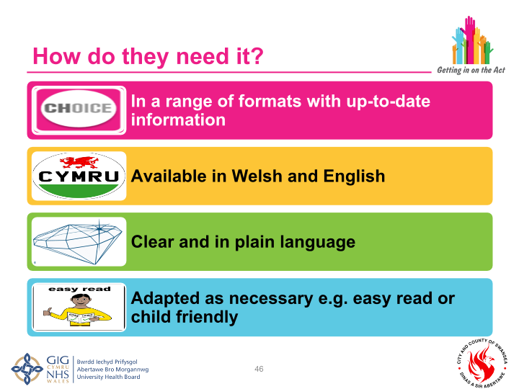
Sut maen nhw’n gwneud hyn?
How do they do it?
Mewn amrywiaeth o fformatau gyda'r wybodaeth ddiweddaraf
In range of formats with up-to-date information
Ar gael yn y Gymraeg a'r Saesneg
Available in Welsh and English
Mewn iaith glir ac eglur
Clear and in plain language
Wedi'i addasu yn ôl yr angen ee hawdd ei ddarllen neu gyfeillgar i blant
Adapted as necessary e.g. easy read or child friendly

Slide 51
Eiriolaeth
A allai'r person hwn brofi rhwystrau rhag cymryd rhan lawn?
A ellir eu cefnogi'n well i'w galluogi i oresgyn rhwystrau?
[addasiad rhesymol o dan Ddeddf Cydraddoldeb 2010]
J darparu cefnogaeth a gwneud addasiadau
gallai
gellid
J Cytuno ar 'unigolyn priodol'
A ydynt yn dal i wynebu rhwystrau rhag cymryd rhan lawn?
A oes 'unigolyn priodol' – gofalwr, ffrind neu berthynas – a all eu cefnogi i gyfranogi'n llawn?
oes
ydynt
nac oes
J Dyletswydd i drefnu eiriolwr proffesiynol annibynnol

Slide 52
Advocacy
Might this person experience barriers in participating fully?
Can they be better supported to enable them to overcome barriers?
[reasonable adjustment under the Equality Act 2010]
J provide support and make adjustments
yes
yes
Is there an ‘appropriate individual’ – a carer, friend or relative – who can support them to participate fully?
J Agree ‘appropriate individual’
Do they still experience barriers in participating fully?
yes
yes
J Duty to arrange for independent professional advocate
no
Notes:
What might be some of the barriers to participating fully?
Advocacy is covered under Part 10 of the Act.

Slide 53
Rhywstrau I gyfranogiad
Barriers to
participation
Deall gwybodaeth berthnasol
Cadw gwybodaeth
Defnyddio neu bwyso a mesur y wybodaeth
Cyfleu eu barn, eu dymuniadau a'u teimladau
Understanding relevant information
Retaining information
Using or weighing up the information
Communicating their views wishes and feelings
A oes angen eiriolwr?
A oes gan y person alluedd?
Is there a need for an advocate?
Does the person have capacity?

Slide 54
Gweithio'n ataliol
Working preventively

Slide 55
Linking information, advice and prevention
Cysylltu gwybodaeth, cyngor ac atal
Adnabod a thargedu unigolion trwy'r gwasanaeth gwybodaeth, cyngor a chymorth
Casglu'r wybodaeth hon a rhoi adborth i gomisiynwyr a'r gymuned
Dulliau canolbwyntio ar yr unigolyn / lles at asesu, cynllunio ac adolygu
Identify and target individuals through the information, advice and assistance service
Capture this information and feedback to commissioners and community
Person focused / well-being approaches to assessment, planning and review

Slide 56
Ymarfer
Ysgrifennwch y gwerthoedd a'r ymddygiadau staff sy'n cefnogi gwaith ataliol
Rhowch gylch o amgylch y rhai sydd eisoes yn bresennol yn eich tim
Exercise
Write down the staff values and behaviours that support preventative working
Circle the ones already present in your team

Slide 57
Crynodeb
Summary
Darn sylweddol o ddeddfwriaeth sy’n moderneiddio’r fframwaith cyfraith gofal a chymorth, gan gyflwyno:
  Dyletswyddau newydd i awdurdodau lleol a'u sefydliadau partner
  Hawliau newydd i ddinasyddion
Nod y Ddeddf yw:
  Rhoi pobl a’u lles wrth wraidd gofal a chymorth
  Ail-gydbwyso'r ffocws i atal ac ymyrraeth gynharach
  Hyrwyddo gweithio mewn partneriaeth, cydweithio a chydgynhyrchu
Mae newidiadau mawr i’r ffordd y bydd pobl yn cael mynediad at y system gofal a chymorth
A significant piece of legislation that modernises the framework of care and support law, brining in:
  New duties for local authorities and their partner organisations
  New rights for the citizens
The Act aims to:
  Put people and their well-being at the centre of care and support
  Rebalance the focus to prevention and earlier intervention
  Promote partnership working, collaboration and co-production
There are major changes to the way that people will access the care and support system

