Slide 1
Online Exam Review – June 2022
Level 2 Health and Social Care: Principles and Contexts
Unit 1: Promoting health and well-being throughout the life stages

Slide 2
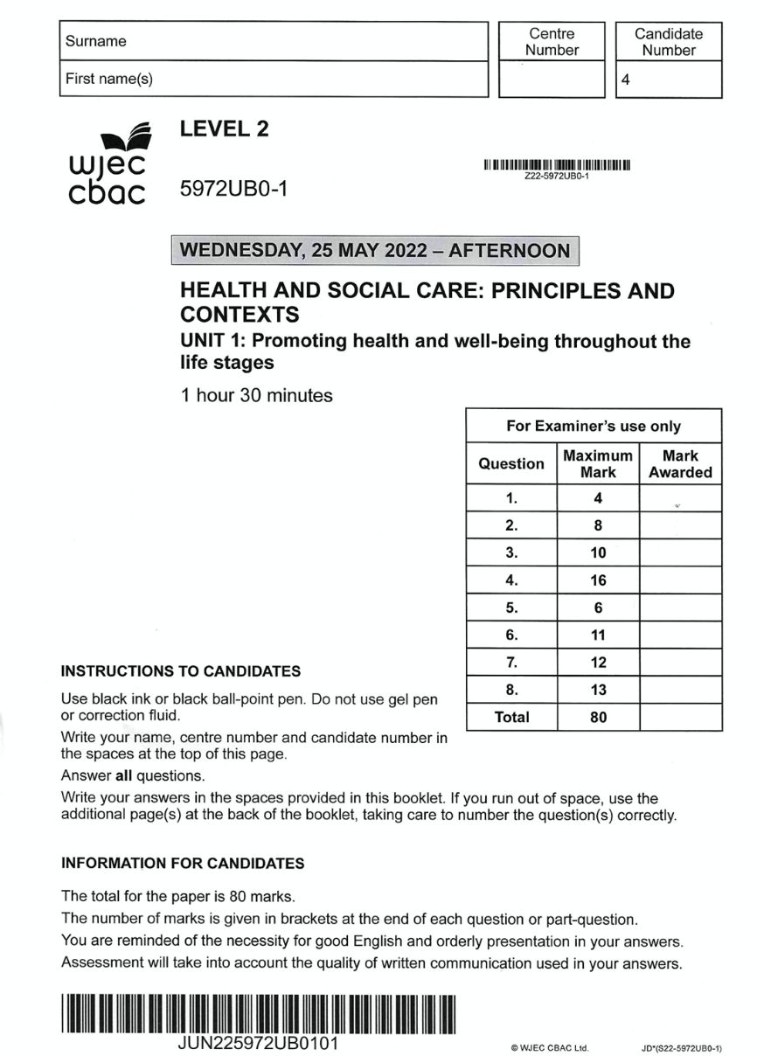
Unit 1: Promoting health and well-being throughout the life stages
Online examination review (OER)

Slide 3
General points on exam technique
Read through the whole question before starting to answer. This will help you understand what is required of you.
Use a highlighter to pick out key words.
Look at the command words and the number of marks available for each question – they will help you decide how much detail is needed.
If a word is bold, it is important.
Keep your exam paper open at the double-page spread, do not fold it in half.
Read your answers to check they make sense.

Slide 4
Question 2

Slide 5
Question 2 Candidate 1 answer

Slide 6
Question 2 Candidate 1 answer with examiner’s comments
The candidate was not awarded a mark
because the answer vaguely refers
to food preference with no reference to
intellectual development.
The candidate was not awarded a
mark as no influence on
physical development was suggested.
The candidate was awarded 1 mark
for suggesting that play will
help a child make friends.
Total marks awarded
1/6

Slide 7
Question 2 Candidate 2 answer

Slide 8
Question 2 Candidate 2 answer with examiner’s comments
The candidate was awarded 1 mark
for a basic response.
The candidate was awarded 2 marks for a
good response that accurately suggested that
tooth brushing would develop good hygiene
routine and healthy development of teeth and gums.
The candidate was awarded 1 mark for
suggesting children will make friends and play
different games. ‘Express themselves’ was not given
credit as it links to emotional development.
Total marks awarded
4/6

Slide 9
Question 2 Candidate 3 answer

Slide 10
Question 2 Candidate 3 answer with examiner’s comments
The candidate clearly links hunger with reduced
brain development. 2 marks
The candidate has responded in detail, suggesting
the physical health of teeth and the development
of co-ordination through brushing action. 2 marks
The candidate has responded in detail, suggesting
development of friendship and development of
good manners. 2 marks
Total marks awarded
6/6

Slide 11
Question 2 mark scheme

Slide 12
Question 4

Slide 13
Question 4 Candidate 1 answer

Slide 14
Question 4 Candidate 1 answer with examiner’s comments
This is a basic response that states that a
young carer is young and is caring for her
mother. The candidate was awarded 1 mark.
A good response would add more detail, such
as caring for a family member who is physically
or mentally unwell or disabled.
This is a basic response that contains some
repetitive references to causing stress.
Whilst the candidate refers to growth,
there is no explanation of how being a carer
may influence the carer’s growth.
1 mark awarded
Total marks awarded
2/8

Slide 15
Question 4 Candidate 2 answer

Slide 16
Question 4 Candidate 2 answer with examiner’s comments
The response makes no suggestion as to who
is being cared for, e.g. a family member,
close friend or sibling, 1 mark
This is a good response that correctly explains
a young carer may become socially isolated
and depressed. Credit was given for explaining
the experience of providing care may
inspire a young carer to choose a caring
career in the future. To achieve higher marks,
the answer should explain influences on all
three areas of growth, health and well-being.
4 marks
Total marks awarded
5/8

Slide 17
Question 4 Candidate 3 answer

Slide 18
Question 4 Candidate 3 answer with examiner’s comments
The candidate has given examples of family members
that may require support, but is incorrect to suggest that
care would be for someone older. The support could be for
a sibling or someone younger. The response does not state
that the young carer is a child or young person.
1 mark
This is a very good response, giving detailed explanation of
the influence on growth, health, and well-being,
6 marks
Total marks awarded
7/8

Slide 19
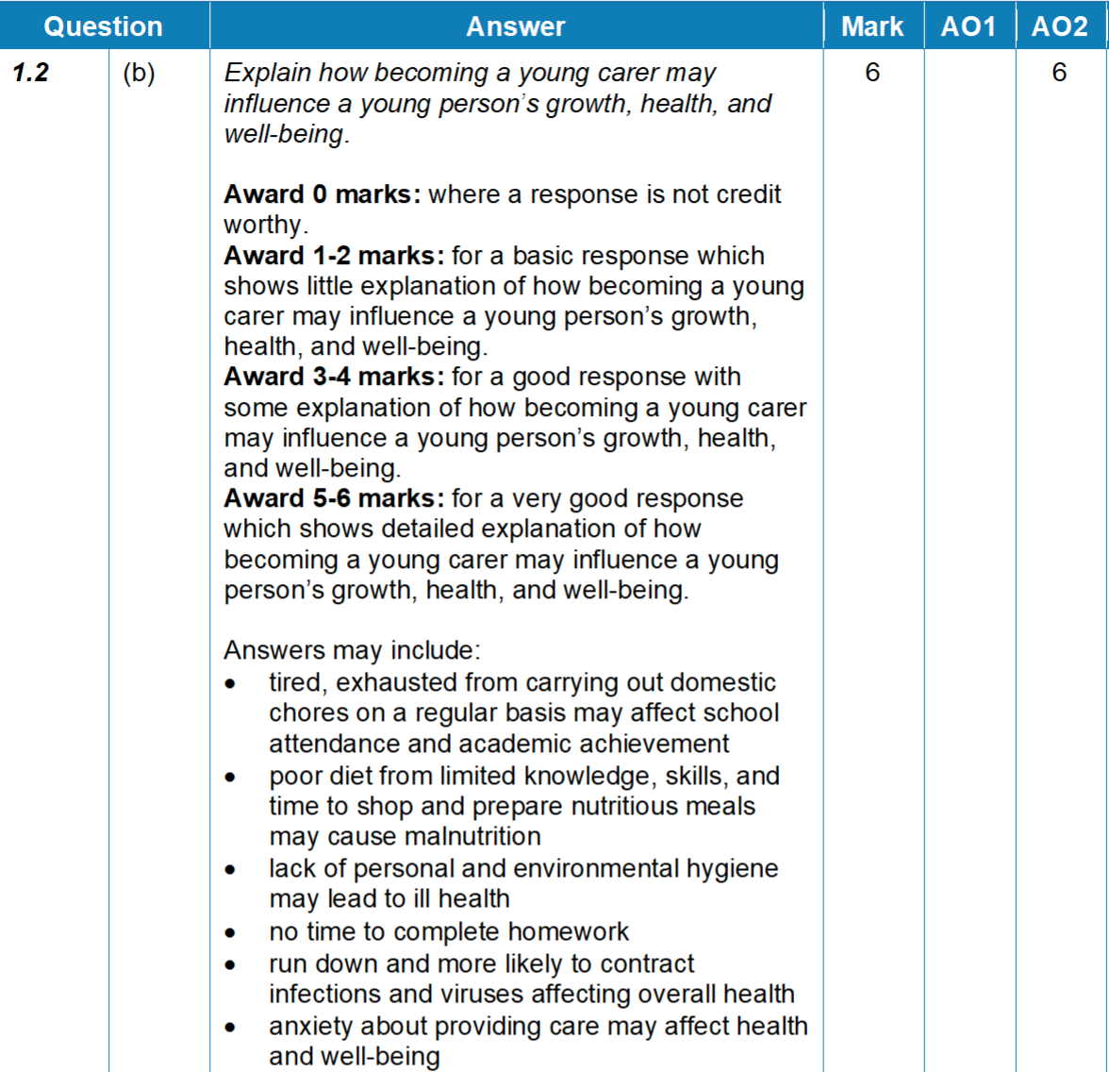
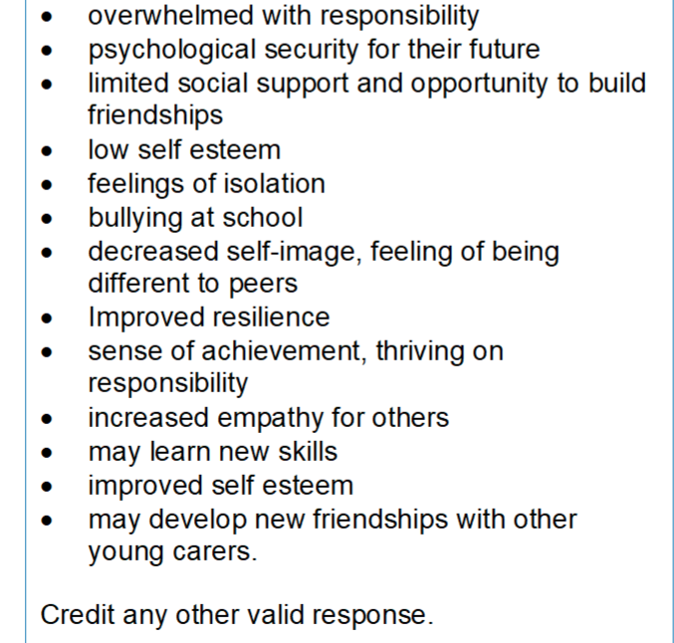
Question 4 mark scheme

Slide 20
Question 8 (b)

Slide 21
Question 8 (b) Candidate 1 answer

Slide 22
Question 8 (b) Candidate 1 answer with examiner’s comments
The command verb is DISCUSS,
requiring a detailed examination of the issues,
including the advantages and weaknesses of
advertising through television and newspapers.
This is a basic response,
briefly addressing one advantage.
2 marks
Total marks awarded
2/8

Slide 23
Question 8 (b) Candidate 2 answer

Slide 24
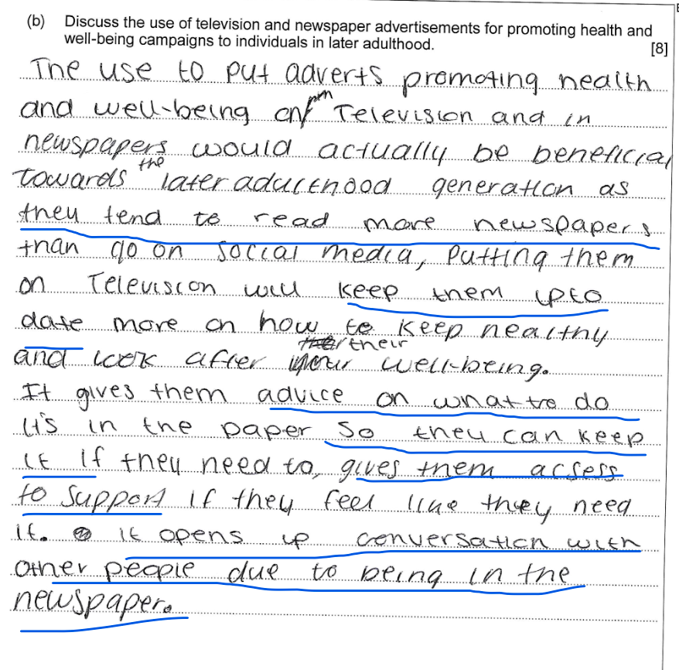
Question 8 (b) Candidate 2 answer with examiner’s comments
This is a good response that discusses in detail
the strengths of using television and
newspapers to target individuals in later adulthood.
To gain top marks, weaknesses/disadvantages
of these methods should have been
included to give a balanced discussion.
6 marks
Good point showing understanding
Total marks awarded
6/8

Slide 25
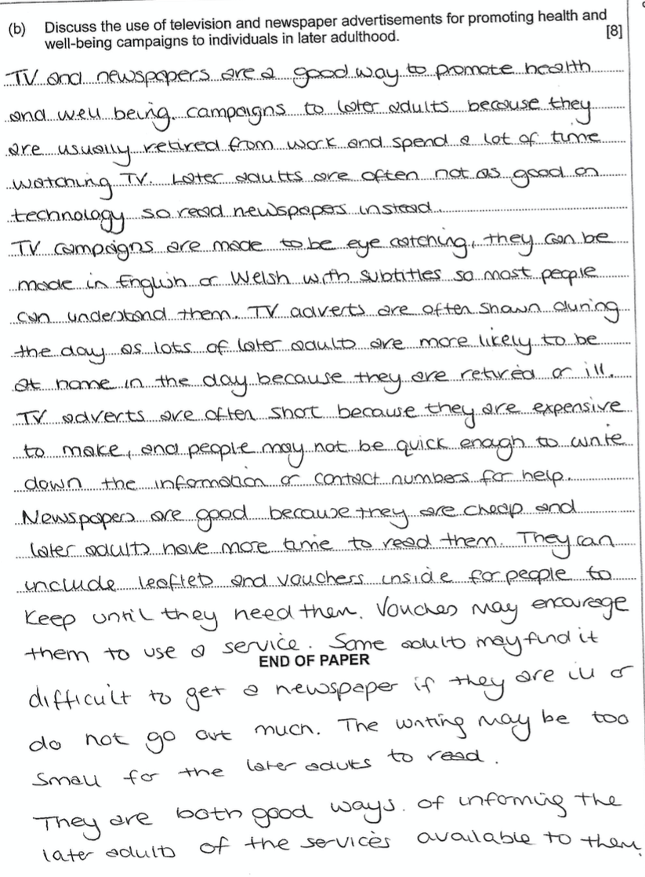
Question 8 (b) Candidate 3 answer

Slide 26
Question 8 (b) Candidate 3 answer with examiner’s comments
This is a very good response. The candidate has
shown clear knowledge and understanding and
discusses in detail a range of positive and
negative viewpoints for television and newspapers.
8 marks
Total marks awarded
8/8

Slide 27
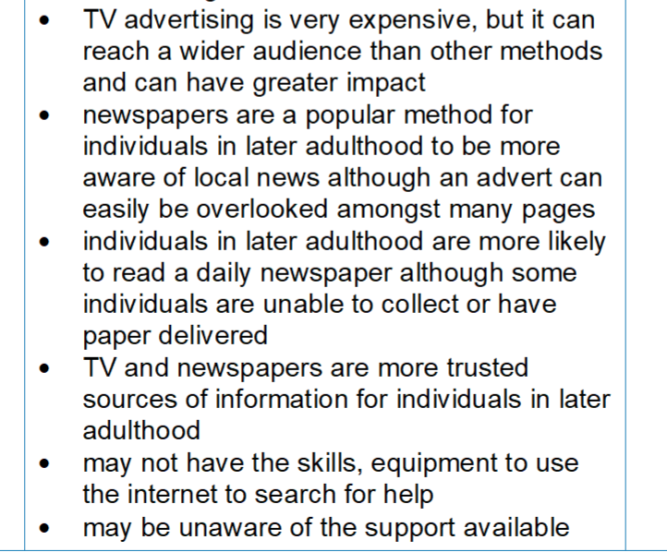
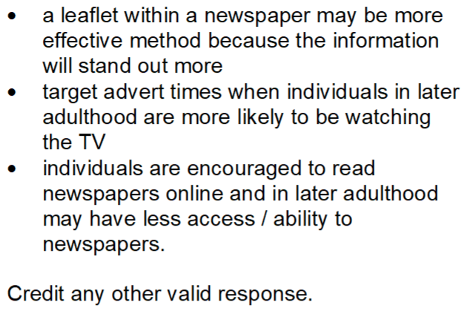
Question 8 (b) mark scheme

