Slide 1



CCPLD Level 3: Practice and Theory
Unit 331
Spring Network 2024

Slide 2



This event is supported and facilitated by representatives and subject specialists from WJEC and City & Guilds.
WJEC
Amy Allen-Thomas
Subject Officer – Children’s, Care, Play, Learning and Development
Level 2 CCPLD: Core
Level 2 CCPLD: Practice and Theory
Level 3 CCPLD: Practice and Theory
City & Guilds and WJEC continue to work collaboratively and in partnership with the following organisations who will also be contributing to this event:
Qualifications Wales
Social Care Wales
Health Education and Improvement Wales
Lianne Haymer
Principal Examiner – Level 3 CCPLD: Practice and Theory
Sian Bevan
Principal Examiner - Level 2 CCPLD: Practice and Theory
Team Leader - Level 3 CCPLD: Practice and Theory

Slide 3
Audio Recording
The presenter is required to make an audio recording of this event. This is a control designed to ensure that WJEC is able to demonstrate compliance with regulatory Conditions of Recognition; specifically, conditions relating to the confidentiality of assessment materials.
The recording will be made available to the qualifications regulator if required, but it will not be shared with any other third parties. The recording will be stored securely by WJEC for a period of three years and then permanently destroyed.
Please note that delegates are NOT PERMITTED to make an audio or video recording of any aspect of this event.

Slide 4

Using Teams
During this Teams session, it would be beneficial to all if the following protocols are adhered to:
Microphones to be muted when not speaking
Use the ‘raise your hand’ feature to ask a question or use the chat function
Activate your camera if you wish to do so
Technical problems:
If you experience technical problems with your sound or your web camera, this is often out of our control, but in the first instance we advise you leave and re-join the meeting or contact your own IT support.

Slide 5
Event Materials
This PPT presentation will be sent to the email address(es) you provided on registration.

Slide 6

Aim and objectives
The online session will provide participants with an opportunity to:
Listen to high level Principal Examiner feedback on Unit 331 from January 2024 examination
Read and digest candidates responses before the session and propose awarded marks in line with mark scheme in preparation
Participate in discussion for each marked response
Gather hints and tips on the marking process to embed in delivery and assessment at centre level
Question and answer opportunities with the technical adviser and subject specialists
New Mailbox for WJEC CCPLD Qualifications
CCPLD@wjec.co.uk

Slide 7
Entries for January 2024 exam
 | Onscreen only
Number of entries | 127
Mean mark | 48.7
D | 62
M | 47
P | 33

Slide 8
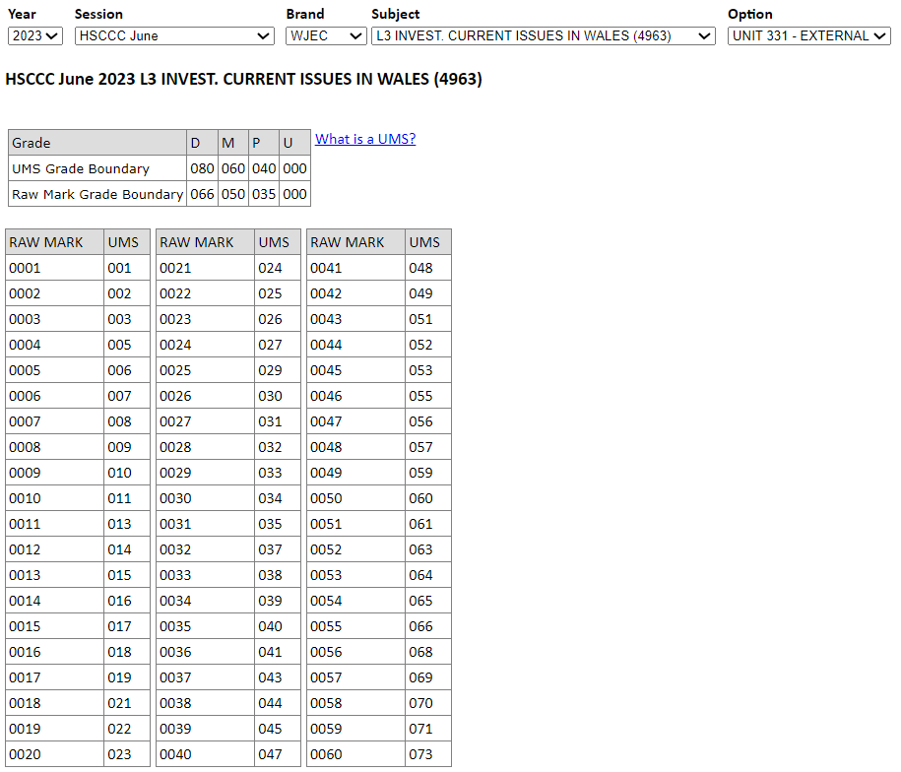

UMS calculator
https://www.wjecservices.co.uk/MarkToUMS/default.aspx
Unit 330 and 331 UMS combined grade

Slide 9
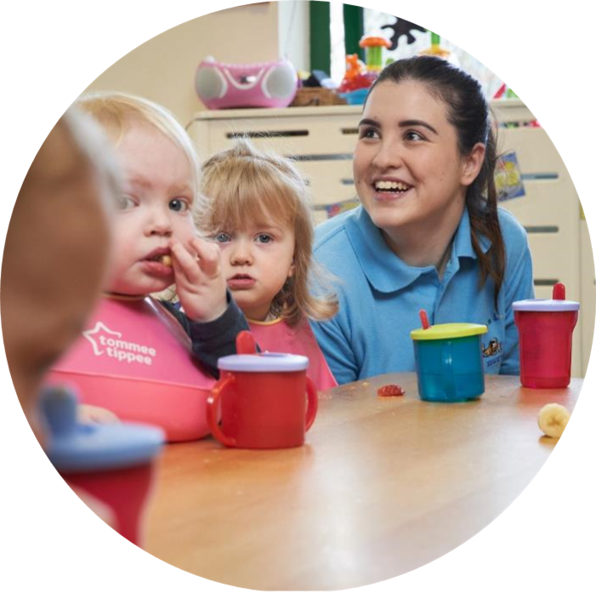
Unit 331 – Winter 2024
Support Pack

Slide 10
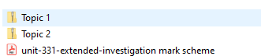


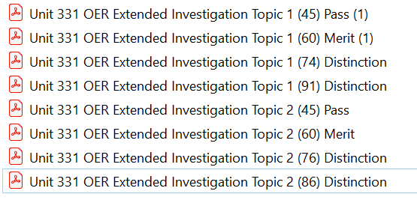
Level 3 Children's Care, Play, Learning and Development: Practice and Theory (healthandcarelearning.wales)
Winter 2024

Slide 11
Principal Examiner Feedback
Unit 331 – Winter 2024

Slide 12
High level feedback –Investigation structure
Title and topic choice to be clearly indicated on first page of paper to ensure there is clarity of the task boundaries.
Candidate centre number, candidate number and page numbers need added to all pages submitted.
Tasks 1, 2, 3, 4, 5, 6 must be clearly labelled to identify task boundaries.
Reference lists should be provided at the end of the whole investigation.
Word count stated clearly excluding reference and bibliography list.
Candidates need to avoid the use of tables and bullet points.
Proformas should be avoided, the unit 331 examination paper is the main source of guidance for successful completion.
Word documents are required to be uploaded by centres rather than pdf documents.

Slide 13
High level feedback – Investigation content
The topic focus area is central to their whole investigation.
Word count should not exceed 5500, tasks over this allowance will not be marked.
Presenting material copied directly from books or other sources without acknowledgment will be left unmarked.
Observe the stated evidence required some tasks specify emboldened ‘must include or could include’
Discussions of laws, legislation and frameworks must relate to Wales and be referenced appropriately
Centres should allow for individuality in the investigation completion.
Candidates should only take on areas of discussion that they are able to discuss effectively as an individual
The Harvard referencing style is the appropriate choice for referencing.

Slide 14
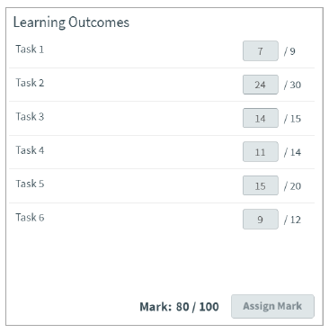
Topic 2 and Principal Examiners overall comments
Topic 2: There are a range of factors that can impact on children’s development in the short and long term.
Research factors that promote positive health and
well-being. .
Principal examiner feedback
This investigation is of a high standard and has been awarded within the higher marking bands for the majority of tasks.
This investigation provides a thorough evidence base relating to the chosen topic and focus areas and has been well referenced throughout to provide an in-depth study.
​

Slide 15
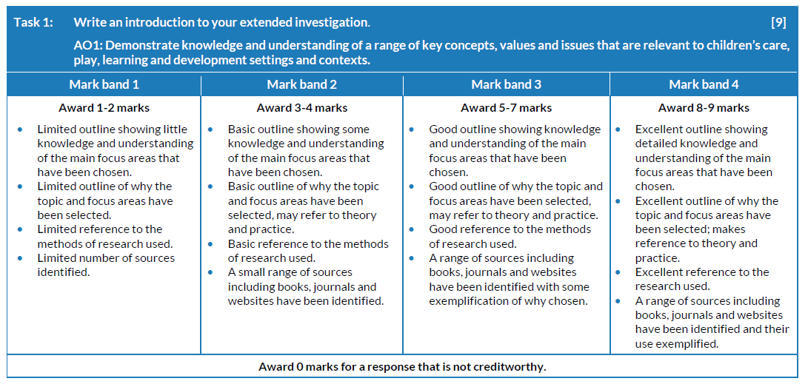
Topic 2 - Task 1 and mark scheme
Write an introduction to your extended investigation.
Outline:
• the main focus areas you have chosen to research in relation to your selected topic
• why you have selected the topic and the focus areas; you may wish to refer to personal interest, taught content, sector engagement and work placement for the methods of research that you have used
• sources used as part of investigating the topic and focus areas.
[9 marks]
As a guide, aim to write approximately 450 words for this section.

Slide 16
Topic 2 - Task 1 Candidate’s answer with Examiner’s comments
I have chosen topic two for my project because I wish to go to university and get a degree in primary education. The career I want to pursue is primary teaching as I have been passionate about it since a young age. This topic is about children’s development and the factors that can impact it, which is important as teachers play a vital role in helping the children develop. It is also important for a teacher to know what other factors impact a child’s development so researching this topic can benefit me in my future education and career.
The two focus areas I have chosen are play and the learning environment. I have chosen play because it has a massive impact on children’s development and it plays a vital role in their early years as a lot of their time is spent playing. I also have chosen the learning environment because it is very interesting to me how the different learning environments can help the children’s development in different ways. Learning environments is an environmental factor and the environment is an important factor in impacting children’s development.
Creating a good learning environment can be the difference between failure and success (Virtual College, 2022). Play can be a range of factors including physical and social. Some children may have different preferences of learning environments to others and develop better in one learning environment compared to another child. For example, a child with ADHD may prefer to be in an outdoor environment and it could have a better impact on the child’s development.
As I am on placement in a primary school setting, I get to observe the children play and develop in the different learning environments so it is beneficial in helping me carry out this project. I have had experience in different learning environments such as outdoor areas such as forest school and the different areas in the indoor environment such as the construction area and the role play area. I am in a reception class so most of their day consists of play so I can see how important it is. That is why I chose it for one of my focus areas.
For this project I have carried out mostly secondary research which included reading books from the library as well as relevant online journals and websites. I have also carried out primary research as I have had conversations with practitioners in my setting about their opinions on my chosen topic and factors. This is beneficial as they have had experience working in a childcare setting. One source that has been useful in carrying out this project is Wales: A Play Friendly Country. This is a Welsh Statutory Guidance which has provided thorough information on play opportunities and the importance of play which is relevant to one of my chosen focus areas.
Principal examiner feedback​
​
Task 1 provides the focus required for the investigation to describe factors that promote positive health and well-being.
7 marks awarded out of 9

Slide 17
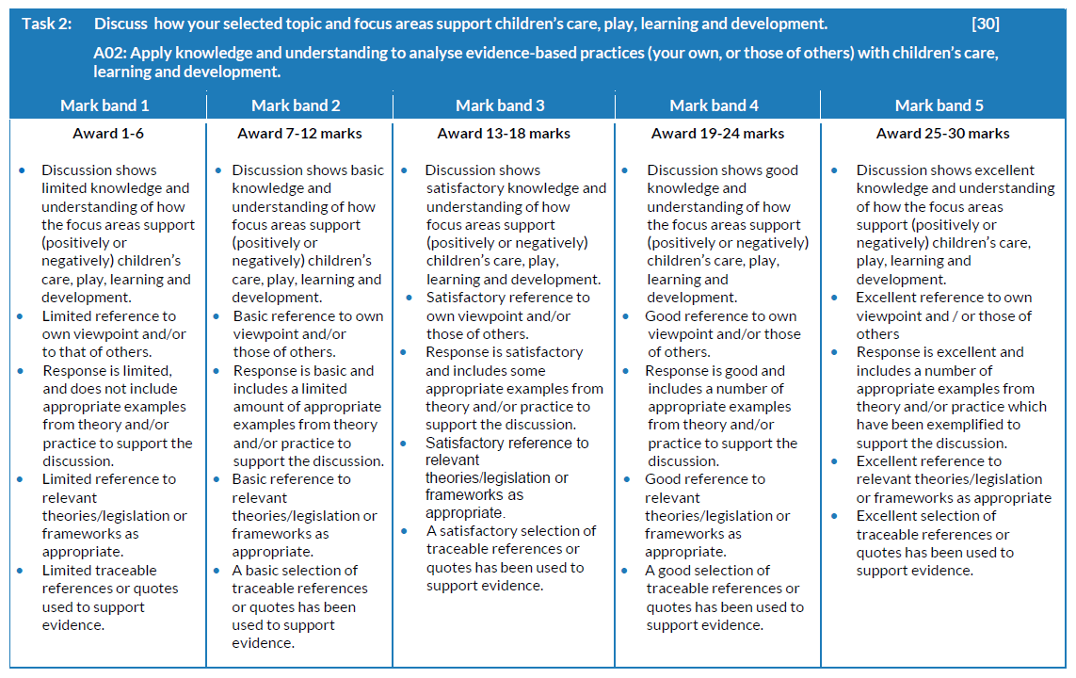
Topic 2 - Task 2 and mark scheme
Discuss how your selected topic and focus areas support children’s care, play, learning and development.
Your evidence must include:
• how the focus areas support (positively or negatively) children’s care, play, learning and development
• a variety of viewpoints, including your own and/or those of others
• appropriate examples from theory and/or practice to support your discussion
• how relevant theory/legislation or frameworks (as appropriate) have impacted on the topic and focus areas
• traceable references or quotes to support evidence.
[30 marks]
As a guide, aim to write approximately 1500 words for this section.

Slide 18
Topic 2 - Task 2 Candidate’s answer
Play plays a crucial role in children’s development and can positively support children’s care, play, learning and development. There are different types of play, such as cooperative play which can help the children’s social development and constructive play which can help the children’s cognitive and physical development. My personal opinion is that play is the most beneficial for children regarding their development. A theorist that agrees with this is Jean Piaget. “Play is the work of childhood” (Piaget, 1936). According to Piaget (1936), children come to understand concepts by learning through play. Part of Piaget’s theory includes the preoperational stage which is ages 2 to 7. This is the stage where children are given the opportunity for pretend play and there are certain toys that can help the children through this play (Gallo, A. 2021).
In placement, toys are available for the children to play with which encourages Piaget’s theory and gives the children a chance for pretend play. In the classroom we have construction sets, dolls, dress up clothes, crayons and many more toys the children can play with. These toys will help the children develop in different areas. For example, the construction set will help improve the children’s fine-motor skills and cognitive development whereas the dress up clothes will improve the children’s imagination skills and their emotional development. This shows how play positively supports children’s care, play, learning and development. Practitioners in my setting agree with Piaget’s theory and have embedded this theory because they are aware of the benefits that impact the children’s development when they are playing. I also know that other settings I have visited, such as a day nursery, have also embedded Piaget’s theory and have many toys on offer for the children to help them develop.
According to the Playwork Principles (2005), all children and young people need to play and play is fundamental to the healthy development of individuals. The Playwork Principles was made by the Welsh Government so this shows how important play is. The Playwork Principles supports that play supports children's care, play, learning and development because it encourages children to play. The Playwork principle is used in placement because in my placement play takes up the majority of the day. The practitioners in my setting realise how important play is which is why the children are allowed to play for the majority of the day. I agree with this and think that play supports children’s care, play learning and development. I have witnessed on placement how the children are developing whilst they are playing. For example, I have witnessed a group of children role playing being teachers together which is improving their social and language development because they are playing together and communicating, as well as their cognitive development and imagination skills because they were pretending to be a teacher doing phonics.
Another crucial role in children’s development is the learning environment. There are many different learning environments such as the classroom environment which includes reading areas, role play areas, construction areas. Literacy and numeracy can be taught indoors but also in an outdoor learning environment. These areas all help the children develop in different ways. For example, the role play area will help the children develop their imagination skills as well as improve their emotional development because they will be experiencing different emotions as they are playing and imagining.
The classroom environment is mostly where the children will learn phonics, literacy and numeracy. This will help improve the children’s cognitive development as well as their communication skills. During phonics in placement, the children ask questions and are engaging so they are learning and developing. They feel comfortable asking the teacher for help and are also engaging in active listening. Many practitioners in my setting think that the classroom environment is the most beneficial to the children because it can support the children's development because they are comfortable in this environment and are developing in lots of different areas. I agree that the classroom environment is the most beneficial regarding cognitive development and I also think that it provides many opportunities and areas for the children to develop. However, I think that play and being outdoors is the most beneficial for the children's development overall.
Continued ...

Slide 19
Topic 2 - Task 2 Candidate’s answer (continued) with Examiner’s comments
One key theory I have observed in placement is Helen Bilton’s theory of outdoor learning. Some practitioners implant this theory in settings as they know the benefits regarding the children’s development as it offers more opportunities such as sensory play and natural resources. An outdoor learning environment such as forest school can positively support children’s development. This impacts the children as it allows them to take risks such as climbing a tree which can help build the child’s confidence. It allows the children to develop in areas they may not be able to outside of forest school in childcare settings.
Outdoor learning environments support children’s care, play, learning and development. An example from practice that supports this is observations I have carried on in an outdoor learning environment. In forest school, I observed a child playing and could see how she was developing in different areas. The child rolled around in the grass, played in the mud and climbed trees so they are participating in important sensory play whilst also developing their gross and fine motor skills. Some of the children in my setting have also said that their favourite part of school is forest school. This shows that children can be at their happiest in the outdoors and if they are happy and enjoying themselves then it will help improve their development and improve their overall experience in settings.
However, another viewpoint involves the indoor learning environment and the use of technology and how that is beneficial. The new curriculum for Wales has an element called the Digital Competence Framework (DCF). The DCF was the first element from the new curriculum for Wales to be made available (Welsh Government, 2018). This supports how important digital skills are and the fact that it was the first element to be made available must mean that it is beneficial for children and can help them to develop. Some practitioners in my setting agree with this framework as they think that digital skills are beneficial. I agree and it also seems like society agrees that this is the way the world is going and digital skills are becoming more of a necessary skill to have rather than a useful skill. According to the Welsh Government (2020), digital competence is essential for learners to have the potential to be successful in today's society. In placement, I have seen how this framework has impacted my setting and how it supports children’s development. One example from placement was an activity I did with the children in the computer room. They had to upload a picture of their work onto the app the school uses to share information with the parents and carers. The children really enjoyed this activity so it helped to improve their emotional development as well as digital skills. The Welsh Government, 2020) also states in the new curriculum that the skills children gain from technology is actively promoting their well-being. This shows how different learning environments such as forest school, the classroom and the computer room, can positively support children's care, play, learning and development.
Principal examiner feedback​
​
Task 2 provides an opportunity to discuss the selected topic and focus areas using a fair a balanced approach of research.
This task shows a good understanding of the research and investigation with some examples to support the discussion.
24 marks awarded out of 30

Slide 20
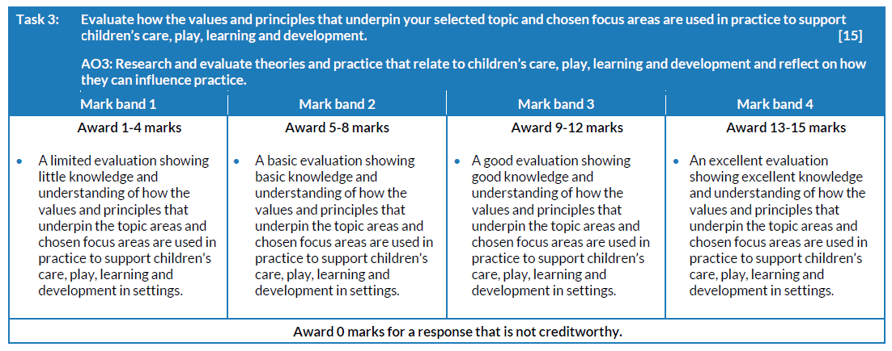
Topic 2 - Task 3 and mark scheme
Evaluate how the values and principles that underpin your selected topic and chosen focus areas are used in practice to support children’s care, play, learning and development.
Your evidence could include reference to:
• effective communication
• teamwork and collaborative working
• equality/inclusion/diversity
• freedom to participate
• children’s rights being upheld
• professional skills
or any other, as appropriate. [15 marks]
As a guide, aim to write approximately 750 words for this section.

Slide 21
Topic 2 - Task 3 Candidate’s answer with Examiner’s comments
Teamwork and collaborative working is essential in supporting children’s care, play, learning and development when used in practice. Collaborative working is used in practice and it includes allied health professionals such as an occupational therapist and speech and language therapist. These professions all work together to provide the best possible care and development for the children. As I have seen in placement, certain children meet with certain allied health professionals for an intervention. For example, one child meets with a speech and language therapist twice a week. I can see the development in the child over the past few months and can see it is really helping him develop. Teamwork and collaborative working is important so the children’s needs are met. It is beneficial in practice as everyone can work together and the professions can share good practice. Many teachers and professions working with the children may have different knowledge so putting it all together by collaborative working means the best possible outcome can be achieved for the support of the child’s care, play, learning and development.
Teamwork and collaboration is also equally important in the different learning environments. In forest school it is important that practitioners work together to make sure the child is safe and that they are developing whilst in this outdoor learning environment. It is beneficial as practitioners can collaborate to come up with activities to complete in forest school that can promote the child’s development in different areas, such as sensory activities. In placement, we have collaborated with other professions such as a gardener who came in and taught the children how to grow vegetables. This shows how beneficial collaboration is as the children are developing life skills and their learning. Teamwork and collaboration means the children can progress and learn new skills in an area they may not have been taught if it wasn't for collaboration with other professions. If practice didn't collaborate with allied health professions then certain children may not get the help they need and reach a level of development they would with help and support.
Teamwork and collaboration is also important in play. When children engage in cooperative play it can help their holistic development. Teamwork will help develop the children's communication skills which will improve their social and language development. In placement, I have seen children play together and work as a team to build structures out of blocks which is improving their active listening skills as well as problem solving as they are working cooperatively to achieve a common goal.
Equality, inclusion and diversity is also important in practice to support the children’s care, play, learning and development. An act that supports this is the Equality Act 2010. As stated by the Equality Act (2010), schools cannot lawfully discriminate against pupils because of their sex, race, disability, religion or belief or sexual orientation. It is important that this Act is followed in schools so every child is given equal opportunities and there is no discrimination. In placement, they follow the child centred approach so no child is excluded. The children are included in the decision making which therefore promotes inclusion in practice. Equality, inclusion and diversity is necessary in practice so all the children enjoy their time in school so are therefore developing at the best rate.
Equality, inclusion and diversity is crucial in the learning environments. Outdoor learning environments, including forest school, must be accessible to all children. Equality, inclusion and diversity is beneficial in different learning environments as it means all children have the ability to develop. In placement, there are areas in forest school that are wheelchair friendly so children with mobility difficulties can easily access forest school and are not excluded. If exclusion occurs then certain children may not be able to develop and progress in certain areas which will negatively affect the child's development.
Equality, inclusion and diversity is also crucial in play. It is important that children are taught about diversity in schools so that no child gets excluded because of their beliefs and backgrounds. In the role play area in placement we have dolls that embrace diversity. We also have books about different religious holidays such as Hanukkah. This helps the children understand and respect different religions and cultures as they are playing which is also helping to improve their social and intellectual development.
Principal examiner feedback​
​
This task provides an excellent understanding of the values and principles and the range of evidence required has been addressed to a good level.
14 marks awarded out of 15

Slide 22
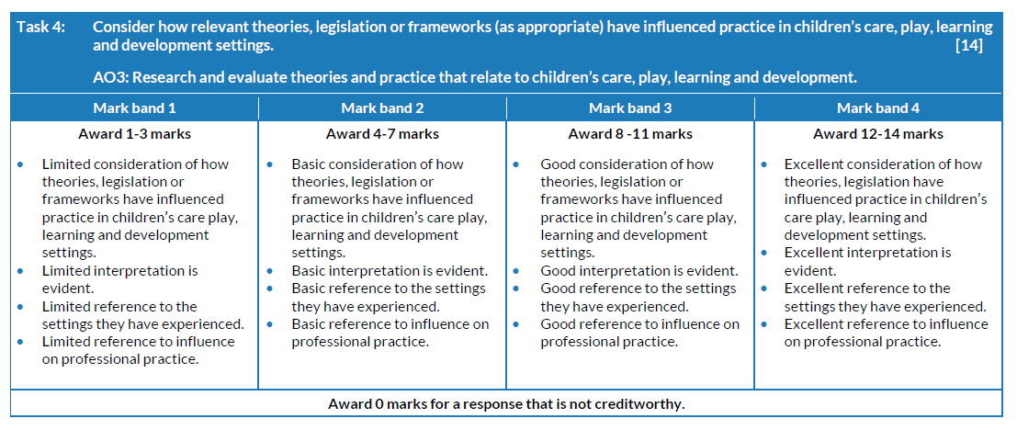
Topic 2 - Task 4 and mark scheme
Consider how relevant theories, legislation or frameworks (as appropriate) have influenced practice in children’s care, play, learning and development settings.
Your evidence must include clear Iinks to how the theories, legislation or frameworks have influenced practice in the settings you have experienced. [14 marks]
As a guide, aim to write approximately 700 words for this section.

Slide 23
Topic 2 - Task 4 Candidate’s answer
There are many theorists that can influence practice in different childcare settings. One theorist in particular who has a big impact on the setting I am currently in is B.F Skinner. According to Skinner (1938) children learn as a result from the consequence of their behaviour. Skinner’s theory has influenced practice in the settings I have been in because we use rewards and acknowledgements when the children have behaved well or tried hard in something. In the placement I am currently in, children who have achieved in an area receive a certificate and a sticker at the end of the week. Other awards that are given to well behaved children include stationary items such as a rubber or pencil and sweets. The children are always very happy when they get a certificate which is helping their emotional development and giving them a sense of pride. Skinner’s theory has influenced practice because the children try hard so they can get a certificate. The children in my placement always do their best in an area if a reward is mentioned. For example, one child in placement was messing around in class and wasn’t concentrating on the task they were meant to be doing. Once a reward was mentioned the child then got on with their work and tried hard to accomplish it. This shows how Skinner's theory of operant conditioning does work and has influenced practice. Other childcare settings have also been influenced by Skinner’s theory. This has been shown as I have researched other schools and websites. His theory of operant conditioning continues to be an important concept today in parenting and education (Cherry, K. 2023). This shows that Skinner’s theory is a big influence in not just my experience in placement but also in other childcare settings. Skinner’s theory also benefits the children as it will improve their self esteem when they know they have achieved something and will help to improve their emotional development.
Another approach that has influenced practice is Wales: A Play Friendly Country. This is a statutory guidance which is about play opportunities. Wales: A Play Friendly Country (2014) states that children have the fundamental right to be able to play and that play is essential for the growth in children’s cognitive, physical, social and emotional development. This is embedded with my placement experience because the children have lots of play opportunities and get to play for the majority of the day. The practitioners in my setting realise the importance of Wales: A Play Friendly Country and agree that play is essential for growth which is why it has been embedded in settings. Wales: A Play friendly Country (2014) also states that the children should have experience with loose parts, the senses and risk taking. This has influenced my setting because we have lots of loose parts because we recognise the importance and how loose parts can encourage imagination. We also have forest school, which is an outdoor learning environment, which encourages risk taking. For example, climbing trees and jumping off tyres encourages risk taking. Forest school and outdoor learning environments also encourage the senses because the children get to feel all different materials and textures such as playing in the mud or feeling bark. This shows how Wales: A Play Friendly Country has influenced practice in settings because forest school has now become a bigger part of schools and more are appearing across the country. In my placement, all the year groups go to forest school at least once a week and get to play freely there which is encouraging development in lots of different areas.
Principal examiner feedback​
​
This is a clear and well written consideration of the legislation and theory that has influenced practice.
There are a good range of evidence areas provided to emphasise the impact of significant changes and advancements in practice.
11 marks awarded out of 14

Slide 24
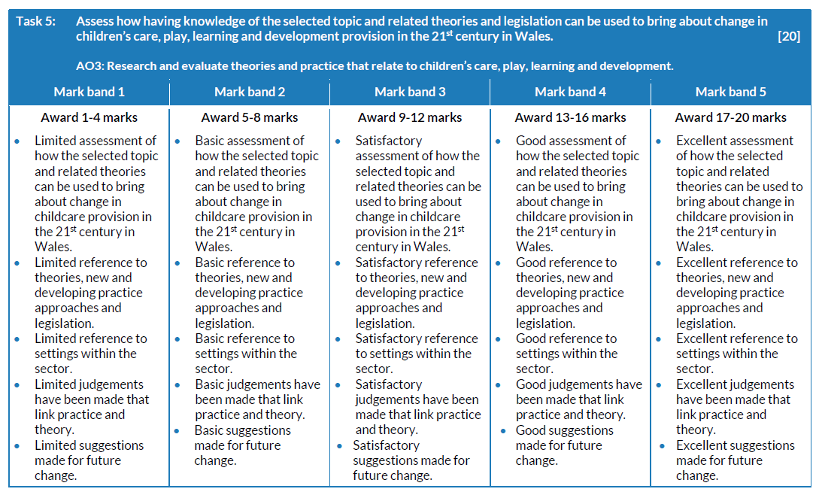
Topic 2 - Task 5 and mark scheme
Assess how having knowledge of the selected topic and related theories and legislation can be used to bring about change in children’s care, play, learning and development provision in the 21st century in Wales.
Your evidence must:
• demonstrate an awareness of new and developing practice approaches
• refer to a range of settings within the sector
• make judgements that link practice with theory (topic focus, related theories and legislation)
• make suggestions for future change that could be adopted in practice to support children’s care, play, learning and development.
Evidence must refer to research undertaken and must relate to experiences in practice.
[20 marks]
As a guide, aim to write approximately 1000 words for this section.

Slide 25
Topic 2 - Task 5 Candidate’s answer with Examiner’s comments
Children's care, play, learning and development provision has been changing throughout the 21st century in Wales. A very big change was bringing in the New Curriculum for Wales. This curriculum was brought in because society is changing (Welsh Government, 2022). The new curriculum has a more holistic approach as it mentions that it will equip them with high standards of literacy and numeracy. Detailed knowledge of the curriculum has further developed my understanding of factors that can impact children’s development. This will bring change to a child’s development as it will further improve their intellectual development because the curriculum has a focus on literacy and numeracy.
In child provisions, there is now a new focus which is a child centred approach. This style of learning involves putting the child at the centre of their learning (Designs For Education, 2018). This research is supported as in placement I have seen this approach be adopted and the children get to make their own choices more, such as free play. A theorist that supports this approach is Maria Montessori. Her approach allows children to develop at their own pace. According to Montessori (1909) her theory is a child-led approach that empathises independence. Montessori’s method has five fundamental principles, one of them including ‘the prepared environment’. The Montessori classroom was designed to foster exploration, independence and learning and equipped with materials designed to stimulate the child’s senses (Main, 2023). This theory shows the importance of a learning environment as well as being a child centred approach. Montessori's theory has further developed my knowledge of a child centred approach and how important that is for a child’s development which is beneficial for me to understand as this is the approach that is being taken in settings. Being in placement has made me come to the conclusion that I agree that a child centred approach should be used in practice because of how beneficial it is to the child’s development. The child-led approach and adapting Montessori’s theory in practice is a positive change because it benefits children as it embraces curiosity and improves their intellectual development as they are critically thinking in this way of learning (Connect Childcare, 2022).
The learning environments have also changed over the years. The indoor learning environment, such as the classroom, now has more neutral colours instead of bright colourful classrooms. Current research shows that neutral classroom tones place less stress on a child’s cognitive load (Cook, 2023). In placement, we have neutral coloured classrooms with wooden tables and chairs and I also know that other primary schools and day nurseries that I have visited also follow this approach.
Based on placement experience, I think that neutral tones are beneficial to the children's concentration and development and that more research should be put into neutral tones in classrooms but also everywhere else regarding childcare settings to make sure the children’s development is at the best it can be. I think that neutral tones in learning environments will be more beneficial in early years settings as they are younger and it will be more calming for them. The Playwork Principles (2005) states that playworkers should recognise their own impact on the play space. Regarding this principle, more research means practitioners will know what is best for the children which further supports the child’s development.
Another learning environment that has become a bigger part of provisions is forest school and outdoor learning. Forest schools focus on play and exploration and research shows that forest school can improve risk taking (Murphy, 2021). In placement I have experienced a child improve her risk taking skills. She was very scared and hesitant to jump off the tire her fellow pupils were jumping off. She jumped off the tire with a little encouragement from her pupils and was very proud of herself. This shows how forest school can help develop children’s risk taking skills as well as improving their confidence and self esteem so I personally think forest school should be a mandatory part of the curriculum because of all the benefits it brings for the child’s care, play, learning and development.
Continued ...

Slide 26
Topic 2 - Task 5 Candidate’s answer with Examiner’s comments
A theorist who further supports outdoor learning is Lev Vygotsky. According to Vygotsky (1978), children learn through interacting with the environment. Vygotsky’s theory has further developed my knowledge of the importance of an outdoor learning environment. This is important because outdoor learning is becoming more popular in settings and I think in the future there will be more research into forest school and the benefits and it will become a positive main part of provision. Placement experience has shown me how important forest school is for the development of children as it promotes exploration which will help improve their cognitive development. It also provides natural resources and more sensory activities that an indoor learning environment can’t provide. In placement, the after school club also provides an opportunity to go to forest school so it is being developed into other settings within the childcare sector which further shows the importance.
I think that a change in the future that could be adopted into practice to help improve children's, care, play learning and development regarding the child centred approach and learning environments could be to let the children have more control over the learning environment they want to be in. As stated by Bilton (1998), outdoor space has a better sense of freedom and can benefit the children in multiple ways. Using my developed knowledge on Bilton’s and Montessori’s theories as well as the child centred approach, I think that children choosing which learning environment they want to be in will help their development more which is why I think it should be implemented into practice in the future. Article 31 of the UNCRC (1989) states that children have the right to engage in play. I think this further supports that children should have my power in their choice of play in different learning environments.
Principal examiner feedback​
​
This task demonstrates a fair assessment of new and developing practices to support children in practice.
There is a good level of research and links to practice. A higher level of suggestions for future change would have enhanced this task and possibly moved awarding into the higher mark band.
15 marks awarded out of 20

Slide 27
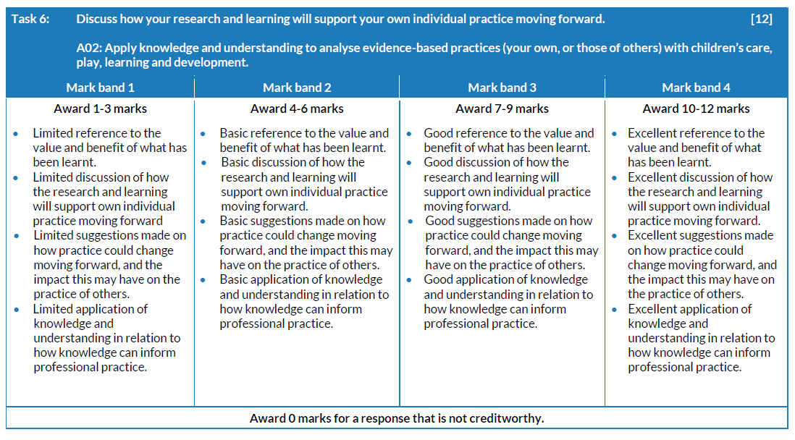
Topic 2 - Task 6 and mark scheme
Discuss how your research and learning will support your own individual practice moving forward.
Your evidence must include:
• a reflection of the value or benefits of what you have learnt as part of investigating the topic and focus areas
• what you would like to do, based on your findings, to improve your own future practice
• reference to any impact changes to your own practice could have on the practice of others.
[12 marks]
As a guide, aim to write approximately 600 words for this section.

Slide 28
Topic 2 - Task 6 Candidate’s answer with Examiner’s comments
Throughout this project, I have developed detailed knowledge and understanding on the topic of the range of factors that can impact on children’s development in the short and long term. I have particularly learnt a lot about my chosen focus areas which are learning environments and play. I have learnt a great deal of knowledge on outdoor learning and forest school as well as the importance of how learning environments are presented, such as neutral tones in the classroom. This project has also provided me with detailed knowledge on my chosen focus area of play. It has helped me come to the conclusion that play is even more important regarding a child’s development than I thought. This will help me progress in placement as I now will observe more when the children are playing and this project has helped me to understand why it is important that I do that.
Researching factors that can impact children’s development and my chosen focus areas has confirmed that I do want to go into the career of teaching which helped me come to the conclusion of what university I want to study at. This project has been beneficial to me in my future studies at university as I found that my chosen university includes a topic on factors that impact children’s development. Another benefit of this project is that I have gained more knowledge on different theorists because of my research and how theories can have a big impact on settings. I found out that Bilton’s theory of outdoor learning has a big impact on the setting I am currently in and developing knowledge on that theory will be beneficial for me in placement.
In the future I would like to further develop knowledge on a child’s development which I will do so in my future studies and career as it is an important topic and it is also interesting to me. The knowledge I have gained from this project will also benefit children in the future when I go into my desired career in teaching. My knowledge will mean I can help the children’s development in my future class and school because I know about the benefits of play and the learning environment. This project has inspired me to improve my own practice as I would also like to further develop my knowledge on learning environments such as forest school. I can do this in placement when I go to forest school once a week and I can see first hand how the outdoor learning environment is helping the children’s development.
I can share my knowledge that I have gained from this project with other practitioners as it is important that practitioners have knowledge on this subject as it will benefit the children. By promoting the importance of play and the learning environments, I will be able to influence others in my practice. Practitioners in my setting will then be able to share my knowledge with friends and other practitioners in other settings to improve knowledge on this topic in many settings.
In conclusion, I have found that there are a range of factors that can impact children’s development in the short and long term. I have found that factors such as the learning environment and play have many benefits to children’s development and can help the child develop in many ways such as holistic development. I have also found that there are many theorists and legislation that impact settings that can also help improve the children’s development. This project has really benefited me as I have gained detailed knowledge on areas that will benefit me in both my future practice and studies.
Principal examiner feedback​
​
Task 6 brings together a wide range of research and the findings as a concluding overview.
There are clear key areas addressed when discussing personal future practice and possible improvements for practice which have been gained from the investigation.
9 marks awarded out of 12

Slide 29
Topic 2 - Bibliography
www.virtual-college.co.uk. (2022). What Makes a Good Learning Environment? | Virtual College. [online] Available at:https://www.virtual-college.co.uk/resources/what-makes-a-good-learning-environment.[Accessed 22 Nov. 2023]
Pether, A. (2018). The Value of Child-Centred Learning for your Early Years Setting -Designs For Education. [online] Designs For Education. Available at:https://www.designsforeducation.co.uk/child-centred-learning/. [Accessed 21 Nov. 2023]
Main, P. (2023). Montessori Education. [online] www.structural-learning.com. Available at: https://www.structural-learning.com/post/montessori-education#:~:text=The%20Montessori%20method%20is%20a. [Accessed 20 Nov. 2023]
Connect Childcare (2022). The Value of ‘Child-Led’ Learning in the EYFS - Connect Childcare. [online] connectchildcare.com. Available at:https://connectchildcare.com/blog/the-value-of-child-led-learning-in-the-eyfs/. [Accessed 22 Nov. 2023]
Cook, C. (2023). Do neutral colours lead to calmer classrooms? | Tes. [online] www.tes.com. Available at:https://www.tes.com/magazine/teaching-learning/general/neutral-colours-calmer-classrooms #:~:text=Some%20believe%20they%20have%20a [Accessed 15 Nov. 2023].
Murphy, N. (2021). Benefits of Forest Schools. [online] CPD Online College. Available at: https://cpdonline.co.uk/knowledge-base/safeguarding/forest-schools/. [Accessed 15 Nov. 2023]
Welsh Government (2022). Education is changing. [online] GOV.WALES. Available at: https://www.gov.wales/education-changing. [Accessed 16 Nov. 2023]
Welsh Government (2022). Education is changing. [online] GOV.WALES. Available at: https://www.gov.wales/education-changing. [Accessed 15 Nov. 2023]
Digital Competence Framework guidance. (2018). Available at:https://hwb.gov.wales/storage/337437b8-cfe3-4305-ae32-f47ad82f3e76/digital-competence-f ramework-guidance-2018.pdf. [Accessed 15 Nov. 2023]
12 Department for Education (2023). Early years foundation stage statutory framework (EYFS).[online] GOV.UK. Available at:https://www.gov.uk/government/publications/early-years-foundation-stage-framework--2.[Accessed 20 Nov. 2023]
Cherry, K. (2023). B. F. Skinner: The Life of Psychology’s Radical Behaviorist. [online] Verywell Mind. Available at:https://www.verywellmind.com/b-f-skinner-biography-1904-1990-2795543#:~:text=Skinner%20believed%20that%20all%20learning. [Accessed 15 Nov. 23]
Alanna Gallo (2021). What are the stages of play? Jean Piaget’s Theory of Play! [online] Play. Learn. Thrive. Available at:https://playlearnthrive.com/stages-of-play-jean-piagets-theory/. [Accessed 15 Nov. 23]

Slide 30
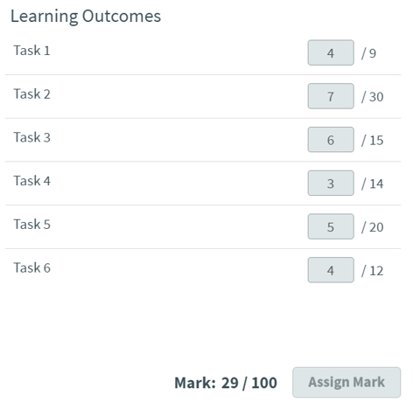
Topic 1 and Principal Examiners overall comments
Topic 1
Accessing formal and informal learning opportunities can promote learning and development for children 0–19 years.
Research the value of promoting learning through a range of learning environments.
Principal examiner feedback
This investigation has some good areas, although there are weaker areas which lack clear knowledge and understanding of the chosen topic and areas of focus.
​

Slide 31
Topic 1 - Task 1 and mark scheme
Write an introduction to your extended investigation.
Outline:
• the main focus areas you have chosen to research in relation to your selected topic
• why you have selected the topic and the focus areas; you may wish to refer to personal interest, taught content, sector engagement and work placement for the methods of research that you have used
• sources used as part of investigating the topic and focus areas.
[9 marks]
As a guide, aim to write approximately 450 words for this section.

Slide 32
Topic 1 - Task 1 Candidate’s answer with Examiner’s comments
My aim within this investigation is to understand and show why Schools across Wales should enhance child-centred settings in 21st Century Curriculums and how a form of learning, like play, is one of the most supported styles for young children based on general and overall development. When approaching this topic, I will be using a variety of academic resources such as websites, journals and books to outline young children learn best through play. Any references to school settings, refers to my experiences in Foundation Phase in my course placement.
The reason why I have chosen this focus area is simply because schools do not implement play enough. I believe play is most concepted for freedom and used in spare time whereas, my investigation will show that children learn best during play and it is a form of work. In fact, play is usually where children will gain skills from the most. From experience in school settings and personal experiences, I can fully say that majority will agree that Play is the most memorable and enjoyable time whilst in education. My focus area is upon how children learn best through play and how their settings can provide further guidance and promote this area of learning. You rarely see more than one table in a school classroom and this is because statistics are showing the significance on how play impacts a child’s academic success. Many schools now have the chance to make their own curriculums to ensure it is most suitable for their learners. I feel that this is greatly important for not only the children but also staff.
Play has stages of learning, and there are many types of play. Fewer include Functional play, Constructive play, Roleplay and Games with rules. This source states that research shows play is chosen more than 50% of the time, which purely shows it is a common activity to want for children. Each individual has different learning styles, needs and abilities and play are so adaptable. Moving forward into 2024, school settings must have equipped environments and nurturing, tailored lessons for all learners to have the opportunity to play. One of many theorists who believe first-hand experiences are essential to the best optimal start of a child’s life is Jean Piaget. Piaget believes that play stages are based on age and ability for example, an infant compared to a seven-year-old will have different types of play/aspects. Play opens curiosity and autonomy that children thrive and succeed off. This way of learning is cooperative and fun, play develops confidence, skills and self-regulation. While a child is playing, they are also constructing therefore, new skills are being met and previous ones are even stronger to experience more type of play. (Community Playthings, 2023).
Principal examiner feedback​
​
This task aims to set out the investigation as a whole and define the areas of focus based on the value of promoting learning through a range of learning environments. The content lacks the evidence required.
4 marks awarded out of 9

Slide 33
Topic 1 - Task 2 and mark scheme
Discuss how your selected topic and focus areas support children’s care, play, learning and development.
Your evidence must include:
• how the focus areas support (positively or negatively) children’s care, play, learning and development
• a variety of viewpoints, including your own and/or those of others
• appropriate examples from theory and/or practice to support your discussion
• how relevant theory/legislation or frameworks (as appropriate) have impacted on the topic and focus areas
• traceable references or quotes to support evidence.
[30 marks]
As a guide, aim to write approximately 1500 words for this section.

Slide 34
Topic 1 - Task 2 Candidate’s answer
Child-Centred Settings provide professional care and support, who also specialise in enriching the play and natural environments. Allied professionals are a term for key workers within childcare sectors, the team ranges from councillors, teachers, therapists, governed bodies and so on. They help all settings to adapt to everyone’s needs and desires. The Play work Principles (PPSG 2005) is the lead body for education in play work and want to work alongside their 8 principles to put in practice that every child needs to play and it is freely chosen and that staff are pledged to tailor lessons to centre each child and choses styles that encourage the children.
It appears that in today’s society, schools are becoming more inclusive and abundant to offering more support and working alongside key professionals, ensuring their giving the best service. The importance of play is that is a self-initiated activity. Play allows a child to gain control and take part in a task they prefer and that they learn from. Play is an informal learning opportunity that promotes an individual development and learning. A professional has less involvement which makes it play a crucial role in childhood as they are getting to have first-hand led experiences. Within this event, a child is encouraging to make decisions, choices and can learn from them and eventually become resilient. It seems to be even the simplest activity like playdough or outdoor play that can help a child learn more, than sitting on a table experiencing a teacher-led task. Play rich environments show that children preform differently when it is seen as play. It is easy to see that children are more engaged in play rather than during a formal learning opportunity. (Broadhead, P., Howard, J. and Wood E, 2010).
Play provides approaches to play work in schools and the intention to play is about letting a child think and act for themselves. Play is about creating environments that a child can chose their own activity and style from. It supports the child holistically and reduces the separation from children acting accordingly in schools, compared to at home. Key professionals must be aware of the importance of play and what benefits come from it because schools hold most value which comes from how they deliver it. In practice, settings promote play by having missions or role play areas that build upon the child’s imagination and choice. Play works influence the whole of children’s routine, so it is even more important that every child has the opportunity to an informal learning environment. Frameworks positively impact settings and make better change to give every child the chance to access places, and activities that will develop creativity, imagination, confidence, strong mental and physical health, as well as social aspects. Frameworks like the Foundation Phase, provides continuous play whether that may be focused, enhanced or continuous. Play is pleasure and schools contribute to how much play takes place; play is essential. Play helps children create, transform and understand about the world and communication. The benefit from play is that the child is at focus of the learning which develops many life skills like humour, risk-taking, boundaries, exploring and experiencing unknown things, making friends and caring for others, muscular development, problem solving and so on. When children play, adventure and have that control, it creates the feeling of autonomy which are positive feelings in the human brain that makes an individual feel good of themselves. (Brown, F, 2014).
With reference to settings and how child-centred practice is used, it is visible to see that child-centred approaches work best just because the schools are facilitating to each learner. Child-centred play is found that the children are more engaged. During Early Years ages ranging from 0-7, you notice that a child is ego-eccentric. To analyse what is meant, a child is less likely to participate if it is not regarding them. Child-Centred Settings highly value working through play as it lets children learn and grow. Informal play can drive children to challenge themselves, however it is difficult for children to view play as work. Although, they engage more, they may feel as though they do not have to work as hard, but equally that is why play is so important because it is flexible and motivating. The design of setting can have a huge effect on how a child may behave and adhere to learning through play due to stimulation and choice. (Designs for education, 2023).
Child-Centred education promotes young children learning best through play. Moreover, play strategy improves academic success just due to the fact of lessons being accommodated to the child in its simplest form like promoting children to learn at their own pace. Every child is different, which is why there are different learning styles. Learning towards a child’s personal interest, goal or hobby will help them develop way further than being disengaged in a sit-down activity. Play enhances a child to perform better in the future and develop self-discovery, responsibilities, aspects of the world, choice and how they react to results. Learning through play environments are designed to meet the child’s interests in mind and “A child who has more exposure to extracurricular activities is better able to identify their strengths and develop their innate skills”, which shows the process starts with what a child can do, and play helps stimulate this and aims to build upon their individual needs and growth. (Shinde, V, A, 2023)
Continued ...

Slide 35
Topic 1 - Task 2 Candidate’s answer (continued) with Examiner’s comments
To demonstrate what is meant by Child-centred education, in my placement setting, collectively as a team and following curriculums like the UNCRC, they have modernised their balance of formal and informal learning opportunities and created an activity called ‘Daily Missions’. A play worker can observe and intervene if they feel as though the activity is being mis led by playtime however, the activity is strictly created for the children to learn and have fun independently. This is a term for play, each child is provided with a Missions book and once they have completed their work they can go and find/do their Missions. Every month the Missions get changed, and by the end of the month all missions are solved and completed. The children get to earn some responsibility when finding the missions in the classrooms and getting to build/ use their imagination and decision making. If all missions are completed, the children are allowed a reward and will feel the sense of achievement. Some Missions may look like their topic they have currently been studying or something related to them as a class therefore, it is an exciting and engaging time in their day. Often, the children will prefer to do Missions all day, but they still understand that they at least do one or two pieces of formal learning. Personally, it is clear how determined a child is to learn when they like/ are intrigued by it and it is structured just by having a rich, positive environment both at home and in school.
Early childhood, play, learning and care can shape a child’s life, therefore, play being so important. Settings must have good quality and ‘rights-based approach’ so that children are in the right place of development. This framework states that all settings should abide by this quality to ensure children are always improving. Play supports positive attachments, social interaction, speech, children to understand their rights and sense of belonging. Workers should plan to make sure children’s rights are into their practice, supporting and identifying any needs. ECPLC Framework underpins the value of how effective informal play/learning is as they’re providing natural opportunities that the child can encounter decisions and risks from and broaden their thinking skills. (Welsh Government, 2023).
In many schools, including mine, policies include implementing child-centred learning, however it becoming more common. Settings must include nurturing environments that are happy and beneficial. Usually, those with no environment to play in when at home will take advantage of the play areas while in education. Play is a misconception of learning with no provision. A child will learn more when they are interested and a part of it. It can be difficult for an adult to attend meetings let alone a young child sit down majority of their time in school and write. In my experience, it is greater enjoyment for the child to actually take part and feel like they can achieve something. It is just as important for workers to recognise this too! Child-centred means that the child is the main focus and I can see the difference when in class. Without even realising, child learn fine-motor skills, exploring, trying new things/pushing themselves and nurturing throughout play. Informal learning generally becomes a last option when that option it the most time children are engaged with.
Most of my experience within school settings have contained hands-on tasks which are more visual, creative games/games with rules and outdoor activities. One of many informal learning opportunities I was apart of was understanding senses and learning styles. The specific learning style was kinaesthetic. The class had to taste foods covering sweet, sour, spicy and salty areas where they were using their thinking skills as well as understand the five senses. In my classroom, there are corners called Loose Parts which include roleplay, blocks, art, outdoor, pe, music, sensory and literacy and maths. These activities provide hands-on experience, curiosity, put their own style on the task, innovation which children thrive from constructive activities like the ones mentioned.
Principal examiner feedback​
​
Task 2 demonstrates a limited knowledge and understanding of how the focus areas support the chosen topic.
7 marks awarded out of 30

Slide 36
Topic 1 - Task 3 and mark scheme
Evaluate how the values and principles that underpin your selected topic and chosen focus areas are used in practice to support children’s care, play, learning and development.
Your evidence could include reference to:
• effective communication
• teamwork and collaborative working
• equality/inclusion/diversity
• freedom to participate
• children’s rights being upheld
• professional skills
or any other, as appropriate. [15 marks]
As a guide, aim to write approximately 750 words for this section.

Slide 37
Topic 1 - Task 3 Candidate’s answer with Examiner’s comments
There are many values and principles, some briefly mentioned above, that outline how play is apart of school setting curriculums to further support children’s care, play, learning and development. The Play work Principles refers to teamwork and collaborative working. Principles link to play so that the practice is supported and at the correct standard. Their principles accord to how settings respond to play and how effective the environments are. Each principle has high standards such like ensuring play works act as advocates and the role of implementing place is to support a place of where children and young people can carry this out. The Play work Principles enhance how the focus is the child and play should develop naturally. (The Playwork Foundation for play work, playworkers and play, no date).
The values of child-centred practice allow children to have be active participants in their own learning, which makes it fun. Learning through play upholds the child’s rights and ensures it is an inclusive place. It is important that key professionals understand their roles within play-based activities and child-led learning as they must plan suitable, nurturing, free play tasks where the children can initiate and conform them. Play and child-centred settings means that children are able to know the sense of the world and creates plenty of social interaction and goodness for their holistic well-being and development; positive and stimulating environments will support this growth. To add, implementing principles of child-centred approach into all settings will promote more play. Settings will be able to adapt and disengage from the unfortunate separation between differences of learners and this can be done by putting each child in the main centre. Changing environments that will cover all areas of development, appropriate equipment, wide range of sources and preparing staff to plan activities can help this. (Education Endowment Foundation, 2023).
Hearing children’s voices is a vital part of encouraging child-centred settings, listening to a child’s opinion goes a long way. It is said that allocated funds for play has taken a lead for The Welsh Government to make sure this takes place in all schools. To maintain the improvement and work towards becoming inclusive and child-centred principles, teams should have meetings and support one another making progress to ensure policies are understood, sufficient play and diverse involvement. The UNCRC, United Nations Convention of the Child should be considered and children must realise their rights. Collaboration and emphasise of the rights highlight every child’s right to play is achieved. Creating spaces and building community are factors that make this reachable. I believe it starts when the child is happy, comfortable and safe. Schools need to be designed for all abilities, ages and needs. Play Wales survey mentions children explaining “I’d rather be playing”. This shows that more hands-on and experimental activities must be used. Children’s play is inspiring and gives opportunities to explore. (Chairperson, T, K, 2013).
Playing and exploring can be their learning things for the first time, this learning style gives chances to learn from them and try again. Once they have fully developed in that stage of their learning, they know and feel when they can move on. That is what is unique. All children want to play, it is natural, it is something we can all share and celebrate. Play lets a child discover and be willing which is the reason why young children learn best through play. Recognising the importance of play can actually impact children’s development, confidence, think about problems, connect with others and abilities and talents. Child-centred settings promote individuals to become active learners and good practice, observations and assessments will encourage this. The opportunity to learn in the moment is crucial to a child’s success; they learn more and feel happier. (Mc Tavish, A, 2013).
Young children learn best when they physically do it themselves. Play is all about learning to be independent and being able to shape things differently and bring it to life. Role play is extremely important in this. Children will succeed better in the future if they have the chance to try now and be able to have that strength to keep trying. Play and child-centred approaches influence and value it. It is done by knowing a mistake is a norm throughout childhood and even adult. Playing can become just as difficult as work is seen to be, play is equally work; a creative piece of work is produced as work. Building a journey of children’s interests, likes and dislikes is a child-centred approach. Settings implement the Early Years Curriculum by physical tasks, stories, missions and hunts, role play areas, arts and creativity spaces, messy play which includes malleable experiences and outdoor exploration. Play supports a child not to feel scared, shy or insecure. (Little Rascals day nursery and preschool, 2023).
Principal examiner feedback​
​
There are limited evidence based and focused discussions developed within task 3.
6 marks awarded out of 15

Slide 38
Topic 1 - Task 4 and mark scheme
Consider how relevant theories, legislation or frameworks (as appropriate) have influenced practice in children’s care, play, learning and development settings.
Your evidence must include clear Iinks to how the theories, legislation or frameworks have influenced practice in the settings you have experienced. [14 marks]
As a guide, aim to write approximately 700 words for this section.

Slide 39
Topic 1 - Task 4 Candidate’s answer
The Foundation Stage Curriculum has a set of values to ensure workforces introduce play-based learning, and incorporate natural resources into learning. Theory in practice includes building their education around them, so knowing what the child can do and cannot as of yet and the ability to have a go again, what activities do they enjoy, those who need more support and encouragement. The Pedagogy in early childhood learning supports how practitioners implement this way of learning. Government policies change overtime to make it more suitable so learning through play is always modified. Having been allowed for settings to design their own models and context of play appropriate to their learners makes, it makes their learning accessible, personal pace, choice, and pursuing. Accommodating to play can make many achievements and effective skills of development, reflecting on own development gives a sense of happiness and being proud of something. Some schools, including mine, encourage children to create a ‘My Learning Journey’ which helps them track their own journey and allows them to work with not only school but families too. Policy relates to play and how it is used because it influences the environment and how you adapt it. (Moyles, J, 2015).
Legislations promote and support incorporating meaningful, joyful activities that a child learns a build from. Theory impacts how settings deliver as they are adapting each day, influencing play into practice and promoting child-centred approaches. The service must be close knit so the children can also make positive relationships. Working alongside natural environments and teams who encourage play is rewarding when you see so much progression. Frameworks state play activities should be included in a child’s everyday education. As mentioned, practice underpins learning styles, one of many, Forest Schools. It is seen by EFYS that it is important to include styles for inclusion and learning. Multiple settings now implement these specific styles because it focuses on visual, auditory and kinaesthetic learners. Forest Schools is an opportunity and area for trial and errors, finding out own learning styles which is enhancing that hands-on approach. It is more engaging and fuller of play opportunities. Learning styles evolve around risk taking and how well a child knows themselves, but also the teachers that plan this and that children are not exposed to this enough. The purpose of child-centred settings is so that have a responsibility and skills that link to all areas of learning. (Constable, K, 2014).
Another framework that has influenced childcare settings is Current play polices in Wales since 2002. This policy was founded that children all have a right to play. The Play Policy’s implantation plan has impacted my setting as they have adopted their areas to newer, safer environments that nature and imbed child-centred approaches and within my school’s ethos, using regular interventions. With being 2023, having an abundance of technology and less of natural and authentic teaching ways, is challenging for children to even see the world as we understand it. As a school it is so significant to understand play, the benefits and how it shapes a child’s life, community and society. (Chwarae Cymru Play Wales, 2022).
The meaning of having a child-centred setting is that you worship the child within their learning process. Play allows children to see learning as a different perspective, letting them be apart of their education. Children learn best through play as it is direct and personal and it centres the child’s experiences, accessibility, bonds, their surrounding of the world, holistic development and learning as they go. A child with support will feel their ideas are valued, get a feeling of care, ensure the child makes decisions and contributes to self-esteem as a developing learner. (WJEC CBAC, 2019).
Principal examiner feedback​
​
Task 4 lacks focus which is relevant for the chosen investigation areas.
There are few relevant theories and legislation discussed that have influenced practice.
3 marks awarded
out of 14

Slide 40
Topic 1 - Task 5 and mark scheme
Assess how having knowledge of the selected topic and related theories and legislation can be used to bring about change in children’s care, play, learning and development provision in the 21st century in Wales.
Your evidence must:
• demonstrate an awareness of new and developing practice approaches
• refer to a range of settings within the sector
• make judgements that link practice with theory (topic focus, related theories and legislation)
• make suggestions for future change that could be adopted in practice to support children’s care, play, learning and development.
Evidence must refer to research undertaken and must relate to experiences in practice.
[20 marks]
As a guide, aim to write approximately 1000 words for this section.

Slide 41
Topic 1 - Task 5 Candidate’s answer with Examiner’s comments
I have reached to the aim of my investigation regarding the importance of informal learning opportunities, like play and creating child-centred environments, and with having the knowledge, it will have impact on my provision becoming a key professional. From the influence of legislation, bringing change to the settings in 21st Century in Wales will include creating their own curriculums. This is in fact so there is an adjustable plan for schools to commit by and having a curriculum supports what the staff shall facilitate and what children will be learning. The reason for having customised curriculums is because every child is different and it is evidently shown in my investigation that play and child-centred approach supports this. I believe this strategy is relevant as schools know their children’s best interests and how to follow them.
There is a new curriculum for schools that they must design their own, which means rules and principles vary. (The Welsh Government, no date) has allocated that the curriculum must meet certain needs, such as what the children should learn, reasons why and how it should be taught, children understanding modern ideas for example, technology. Schools have 4 broad aims of curriculums that they need to achieve however, the main curriculum is that they will not tell schools specifically on what way it should be taught, and their new own curriculums need to include enterprising, informed, ambitious, healthy and confident learners.
Theory’s of play in childcare settings influence better change for example, Jean Piaget. Paiget was a constructive theorist, who thought that play is based on developmental stages and is a develop cycle. He also believed that children learned better through experimental activities and would remember more from them due to having a go themselves and testing their knowledge they already know and what is a new experience. Jean Piaget made theories through how hands-on learning helped a child develop better rather than formal based learning. Play helps a child have the optimum start in life, he stated that repetition was how a child would learn and implement it. Understanding play is important as a child will bring an object to life, they develop a sense of themselves. Another theorist is Lev Vygotsky. His ideas helped those who work with children allow for play to be different. Children will want to do what suits them and not worry about the future or past. This relates to my setting because the children love to role-play. They will remember something if it was eye-catching and a task they were able to get involved with. Planning the environment and class tailored to the learners will create this further and takes the child’s advantage to their natural need of playing and imagining. (Albrecht, K, 2016).
Play is generalising as extra-curricular activity. In my setting, the playworker’s have had the role of assessing the environments, in case of possible risk to barriers to the children’s play opportunities. As I am continuing my development in a college setting and school, I am understanding that my role is to observe and not to interfere and I am not the centre of a child’s learning, they are. In my experience in my setting, weekly, even monthly check-ins with small groups or one-to-ones support the class because the professionals give them a chance to hear what they prefer or liked about that topic. My setting works in a way to deliver so they have a brief plan of what topics need to be in lessons and as much as possible they will turn it into free-play or as they call it the term ‘Missions’ so that children have the role of teaching. I feel as though this works the best because each child has interactions and that this is good practice because the children agree and are always happy with how and what they are learning. More project-based, wide range of play environment, flexible working, messy play, outdoor activities and games would bring substantial amount of change to not just my school but others provisions. A range of sources, activities and environments promotes choice. In the future curriculums, children should be offered more play opportunities and children will be able to voice their ideas each month or when they move on to a new topic in order to have a role in their learning.
Continued ...

Slide 42
Topic 1 - Task 5 Candidate’s answer with Examiner’s comments
In my setting, recently, the class have been assessed on various resources covering their mathematical skills, cognitive, literacy and social/play involvement. The class scored slightly low for their age group which is totally ok because that is simply just where they are but the main cause of concern was because they have not experienced hands-on or playful activities. I set out a fun corner, where it was friendly and small. The activities included games with rules as they could not understand the concept of rules or a basic game. I gave them the opportunity to read and figure it out for themselves, and then I intervened when needed to show them visually how you would carry it out. Afterwards, the children had so much pride and wanted to try do this at home. Something small like a game of snap, can be so big to a child who has not been able to access play.
The Fundamentals of play work suggests play-rich environments have better potential for children’s development because children discover the world and development through play. This is because the child is thought of and their accountability is provided for which is done by planned activities. Play should contain free, spontaneous and creative actions. Quality of Play supported many provisions to make their schools personal, meet physical and mental health, safety, comforted and welcoming. Working within play work and childcare comes much value towards learning and improvement, studying this topic has helped me become more aware of how theory’s and theorists affect our schools and curriculums. In addition, Maria Montessori was a believer in making the child making the most of their learning style. She said that the child leads the learning, therefore, having positive space and environments helps children access anything and chose how they change it to what’s appropriate to themselves. (Brown, F and Taylor, C, 2008).
Provisions are constantly changing which means schools are continuously adapting, these are positive changes as having a diverse, equal and inclusive environment means children and happier and learn better. Stay and Play are sessions that provides play opportunities that offer families to join if wanted as well. It is a friendly environment which I believe all schools should accommodate to because you are able to relate to active activities like adventure walks, beach, local park; which this could be tailored any way. It gives young children time to mix with others and re-create this at home not just school. (Stay and Play Flying Start, no date).
Principal examiner feedback​
​
This task provides a basic discussion relating to the benefits of change for childcare settings, although this is limited for future changes.
There is a basic discussion relating to the focus areas chosen.
5 marks awarded out of 20

Slide 43
Topic 1 - Task 6 and mark scheme
Discuss how your research and learning will support your own individual practice moving forward.
Your evidence must include:
• a reflection of the value or benefits of what you have learnt as part of investigating the topic and focus areas
• what you would like to do, based on your findings, to improve your own future practice
• reference to any impact changes to your own practice could have on the practice of others.
[12 marks]
As a guide, aim to write approximately 600 words for this section.

Slide 44
Topic 1 - Task 6 Candidate’s answer with Examiner’s comments
Throughout this investigation it has made me, as a developing practitioner, tailor the way I view the experiences whilst in my setting. After researching the value of play and how child-centred education impacts a child’s life, the focus of play is to promote activities involving sand and water trays, messy play and roleplay which are greatly beneficial forms of play-based learning. I believe making better change means child-centred must be small, practical class numbers meaning teams can work closely together supporting everyone’s need to develop.
The Benefits of Play for a Child’s Development states curriculums for play have been unregulated for years which has high affects on different generations, unlike today. Each school follows legislations and Play Policy that upholds the profession of children’s rights in Article 17 of UNCRC, every child needs to play. Children are always playing, even in adult-led sessions there are ways of collaborating play. The author believes that play increases happiness. This shown by play times during school, in my setting, it is visible that behaviour changes once the child has been able to have freedom. Play is a child’s growth in childhood and ways children learn through play can be learning skills like cognitive, physical, communication, social and emotional every day, promoting healthy habits in social interaction, play works through stress and fear and make their own investigation by exploring. Many are un aware that play can also help a child’s mindfulness. It takes them to another world where they can choose, decide and act. Self-control is not familiarised and is not seen as something a child should understand but it should. Children will be able to face their struggles and engage in positive risks and time to regulate themselves. Those who are deprived from play could face issues like failure, an unwanted behaviour towards education and results and it is difficult whilst at home that child is viewing different boundaries, rules and less of a child-centred approach. Similar to the children who are unfortunate to not have the chance to access play at home, which is why it is extremely important for childcare settings to adjust. Those children are then able to explore equal opportunities and have the play time they should receive. (Horizons, B, 2023).
The Welsh Government has taken control on the importance of children’s play and it should be central in settings. It comes under Article 31, Leisure and play, children have the right to participate in artistic and relatable activities. When schools make general topics, they have the role to listen to the child first. The Welsh Government desires for environments to be high quality play opportunities.
One way to bring change in schools is by advocating for the importance of play-based learning. Sharing research and policies can help workers adopt new methods. Most importantly, supporting initiates and settings that promote principles can make a difference. By implementing child-centred learning, learners are likely to be more engaged and motivated. My approaches also foster critical thinking, creativity, confidence and problem-solving skills. Also, promotes development as children collaborate, communicate and build. These changes will make a more enjoyable, energised and effective working environment for all children.
Having the knowledge of the vital role of play has being in early childhood, supports my professional development by allowing me to create more effective experiences for children. It helps me understand included approaches in my teaching. This knowledge additionally supports me to actively promote play and inclusivity to meet each interests and unique needs. Ultimately, it enhances my ability to create a child-centred setting and legislations like Play Wales, United Nation Convention Rights of the Child, Play Work Principles, The Welsh Government Policy, EFYS, ECPLC and frameworks like the Foundation Phase will help me comply to my setting.
Principal examiner feedback​
​
There are basic discussions based on the benefits gained from the whole investigation for the candidates personal learning.
There is a lack of development recognition and of how they can develop learning into future practice.
4 marks awarded out of 12

Slide 45
Topic 1 - Reference List:
Broadhead, P., Howard, J. and Wood E. (2010). Play and Learning in the Early Years: from Research to Practice: London: SAGE.
Brown, F. (2014). Play and Play Work: 101 Stories of Children Playing. Milton Keynes: Open University Press.
Chairperson, T. K. (2013). Play for Wales. Parkhouse: Play Wales. P:3, 6-8,18,20,22.
Chwarae Cymru Play Wales, (2022). Current Play Policy in Wales. Play Wales. Available at: https://play.wales/play-policy-legislation/current-policies/#:~:text=In%202002%2C%20the%20Welsh%20Government,%20are%20central%20to%20policy%20making [Accessed on: 20th October 2023]
Community Playthings, (2023). The Importance of Constructive Play. Community Products, LLC. Available at: https://www.communityplaythings.com/resources/articles/constructive-play#:~:text=In%20fact%2C%20research%20shows%20that,outdoor%20activity%20(lhn%201998). [Accessed on: 26th October 2023]
Constable, K. (2014). Bringing the Forest School Approach to your Early Years Practice. London: Routledge (Bringing the Forest School Approach to your Early Years Practice.
Education Endowment Foundation, (2023). Play Based Learning. EEF. Available at: https://educationendowmentfoundation.org.uk/education-evidence/early-years-toolkit/play-based-learning [Accessed on: 23rd October 2023]
Designs for education, (2023). The Value of Child-Centred Learning for your Early Years Setting. Designs for Education. Available at: https://www.designsforeduication.co.uk/child-centred-learning/#:~:text=As%20such%2C%20a%20child-centred,encourages%20a%20child’s%20natural%20curiosity. [Accessed on: 20th October 2023] P:2
Flying Start, Cardiff, (no date). Stay and Play. Flying Start. Available at: https://www.flyingstartcardiff.co.uk/what-we-do/stay-and-play/ [Accessed on: 27th October 2023]
Horizons, B. (2023) The Benefits of Play for a Child’s Development. Bright Horizons Family Solution. Available at: https://www.brighthorizons.com/resources/Article/benefits-play-child-development [Accessed on: 24th October 2023] P:1,2
Little Rascals Day Nursery and Preschool, (2023). Learning Through Play. Little Rascals. Available at: https://littlerascalsnursery.co.uk/learning-through-play [Accessed on: 27Th October 2023]
Mc Tavish, A. (2013). Playing and Exploring a Practical Guide to how Babies and Young Children Learn. London: Practical Pre-School Books. (Learning and Teaching in the Early Years).
Moyles, J. (ed.) (2015) The Excellence of Play. 4th edn. Maidenhead, Berkshire England. Open University Press.
Shinde, V, A. (2023) Concept, Characteristics and Importance of Child-Centred Education. Global Indian International school. Available at: pun.globalindianschool.org/blog-details/what-is-child-centred-education-and-why-is-it-important. [Accessed on:20th October 2023]
The Playwork Foundation for Playwork, Play Workers and Play, (no date). The Playwork Principles. The Playwork Foundation. Available at: https://playwprk.foundation/the-playwork-principles/#:~:text=1%20All%20children%20and%20young,personally%20directed%20and%20intrinsically%20motivated. [Accessed on: 20th October 2023]. P:1-2
Welsh Government, (2014). Wales- a Play Friendly Country. Welsh Government. Available at: https://www.idw.org.uk/wp-consent/uploads/2020/06/English -Curriculum-For-Wales-Designs.pdf [Accessed on: 26th October 2023] P:4-6
Welsh Government, (2023). A Quality Framework for Early Childhood Play, Learning and Care in Wales. Welsh Government. Available at: https://hwb.gov.wales/api/storage/031bbc2d-d2f8-429d-a944-5fc33484827d/a-quality-framework-for-early-childhood-play-learning-and-care-v1.pdf [Accessed on: 24th October 2023] P:1-7
Welsh Government, (no date). A New Curriculum in Wales. Changing in the way Children and Young people Learn in School. Welsh Government. Available at: https://www.ldw.org.uk/wp-consent/uploads/2020/06/English-Curriculums-For-Wales-Design.pdf [Accessed on: 26th October 2023] P:4-6
WJEC CBAC, (2019). The Meaning of the Term Child-Centred Approaches and The Importance of Child-Centred Approaches. WJEC. Available at: http://resource.download.wjec.co.uk.s3.amazonaws.com/vtc/2018-19/HSC18-193-1/multi-lang/unit04/01-child-centred-approaches.html [Accessed on: 20th October 2023] P:1,2

Slide 46
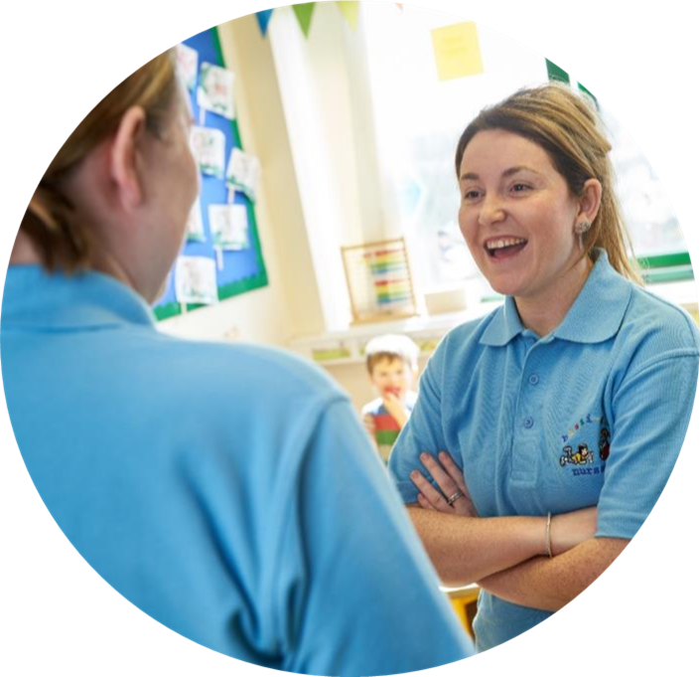
Next Submission date Wednesday 15th May 24
via Surpass upload

Slide 47
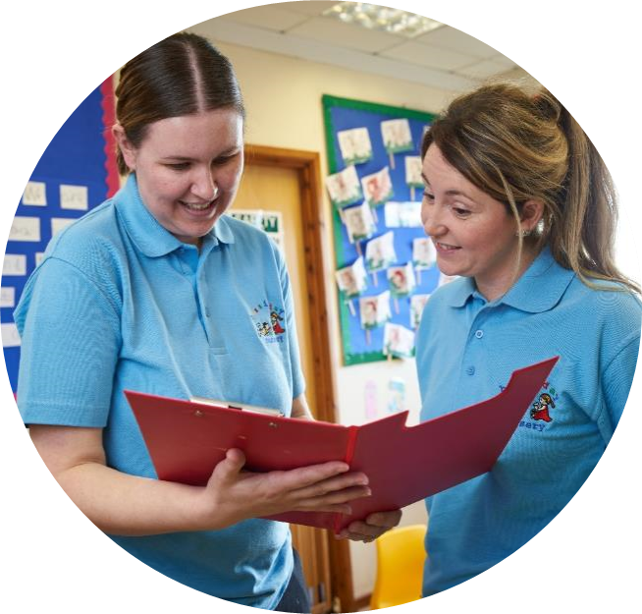

Event Evaluation
https://www.surveymonkey.co.uk/r/WJEConline2023-24

Slide 48

Diolch
Thank you

Slide 49
Contacts:
Contact our specialist Subject Officers, Technical Adviser and administrative support team for your subject with any queries.
WJEC
Amy Allen-Thomas - Subject Officer
Tania Lucas – Subject Support Officer
E-mail: ccpld@wjec.co.uk

