Slide 1
Yr Ymarferydd Gwasanaethau Cymdeithasol
Deddfwriaeth sy'n Ymwneud â Phlant
Uned 440 Canlyniad Dysgu 3
Deall y ddeddfwriaeth sy'n ymwneud â phlant a phobl ifanc
Social Services Practitioner
Legislation Relating to Children
Unit 440 Learning Outcome 3
Understand the legislation that relates to children and young people.

Slide 2


Slide 3
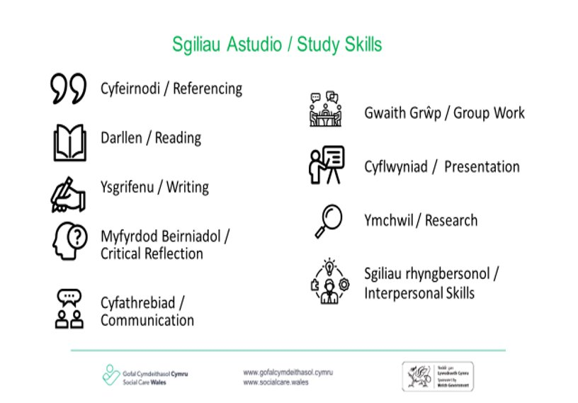

Slide 4
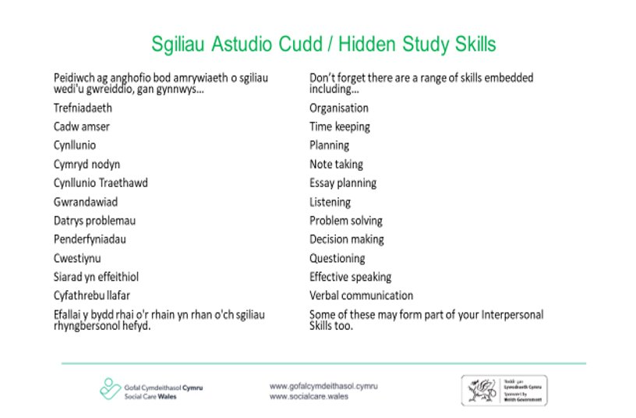

Slide 5

Nodau
Aims
I archwilio:
Prif ddarpariaethau Deddf Plant 1989 a 2004
Prif ddarpariaethau Deddf Plant a Theuluoedd 2014
Deddf Gwasanaethau Cymdeithasol a Llesiant (Cymru) 2014
Mesur Hawliau Plant a Phobl Ifanc (Cymru) 2011
Confensiwn y Cenhedloedd Unedig ar Hawliau'r Plentyn 1989
Eiriolaeth
To explore:
The main provisions of the Children Act 1989 and 2004
The main provisions of the Children and the Family Act 2014
The Social Services and Wellbeing (Wales) Measure 2011
The Rights of Children and Young Persons (Wales) Measure 2011
The United Nations Convention on the Rights od the Child 1989
Advocacy

Slide 6
Amcanion
Objectives
Gallu cymhwyso'r ddeddfwriaeth i'r astudiaeth achos ac i'ch gwaith
Disgrifio pwysigrwydd mabwysiadu dull gweithredu seiliedig ar hawliau
to be able to apply the legislation to the case study and to your work
To describe the importance of adopting a rights based approach

Slide 7
Cyflwyniad ymarfer unigol
Introduction individuals exercise
Nid oes un darn o ddeddfwriaeth sy’n llywio anghenion gofal a chymorth ac amddiffyn plant yng Nghymru.
Ar eich pen eich hun gwnewch restr o'r fframweithiau deddfwriaethol sy'n berthnasol i'ch lleoliad gwaith
There is no one piece of legislation informing the care and support needs and the protection of children in wales.
On your own make a list of the legislative frameworks that apply to your work setting

Slide 8
Deddf Gwasanaethau Cymdeithasol a Llesiant (Cymru) 2014
Social Services and Wellbeing (Wales) Act 2014
Ymarfer unigol
Faint o ddeilliannau lles sydd i blant?
Pa ran ac adran sy’n berthnasol i asesu plant lle mae’n ymddangos bod angen gofal a chymorth arnynt.
A all plentyn wrthod asesiad?
Pa ran sy’n berthnasol o safbwynt darparu cynllun gofal a chymorth ar gyfer y plentyn.
Individual exercise
How many wellbeing outcomes are there for children ?
What part and section applies to the assessment of children where it appears they have a need for care and support.
Can a child refuse an assessment?
What part to the provision of a care and support plan for the child.

Slide 9
Diogelu
Deddf Gwasanaethau Cymdeithasol a Llesiant (Cymru) 2014 - Rhan 7
Safeguarding
Social Services and Wellbeing
(Wales) Act 2014- Part 7
S130 Duty to report children at risk
(1)If a relevant partner* of a local authority has reasonable cause to suspect that a child is a child at risk and appears to be within the authority’s area, it must inform the local authority of that fact.
(2)If the child that the relevant partner has a reasonable cause to suspect is a child at risk appears to be within the area of a local authority other than one of which it is relevant partner, it must inform that other local authority.
A130 Dyletswydd i adrodd am blant sy'n wynebu risg
(1)Os oes gan bartner perthnasol* i awdurdod lleol sail resymol i amau bod plentyn yn blentyn sy’n wynebu risg a’i fod yn ymddangos ei fod o fewn ardal yr awdurdod, rhaid iddo hysbysu’r awdurdod lleol o’r ffaith honno.
(2)Os yw’n ymddangos bod y plentyn y mae gan y partner perthnasol achos rhesymol dros amau ei fod yn blentyn sy’n wynebu risg o fewn ardal awdurdod lleol ac eithrio un y mae’n bartner perthnasol iddo, rhaid iddo hysbysu’r awdurdod lleol arall hwnnw.

Slide 10

Plentyn mewn perygl
A child at risk
Plentyn sy’n profi neu sydd mewn perygl o gael ei gam-drin, ei esgeuluso neu fathau eraill o niwed
A child who is experiencing or is at risk of abuse, neglect or other kinds of harm
mae ganddo anghenion gofal a chymorth (p’un a yw’r anghenion yn cael eu diwallu ai peidio)
has needs for care and support (whether or not the needs are being met)

Slide 11
Diogelu Plant
Deddf Plant 1989
Child Protection
Children Act 1989
Dyletswydd awdurdod lleol i wneud ymholiadau ac ymchwilio os oes angen [Deddf Plant a47(1)]
Lle bo achos rhesymol i amau bod plentyn sy’n byw, neu’n cael ei ganfod yn ei ardal, yn dioddef, neu’n debygol o ddioddef, niwed sylweddol [a47(1)]
mae ‘niwed’ yn cynnwys ‘nam a ddioddefir o weld neu glywed rhywun arall yn cael ei gam-drin’ megis trais domestig adran 120 Deddf Mabwysiadu a Phlant 2002 a ddiwygiwyd gan Ddeddf Plant 1989 [a31(9)]
Nid yw niwed corfforol gwirioneddol yn rhywbeth “rhesymol” [Deddf Plant 2004, a58]
Duty for local authority to make enquiries and if necessary investigate [Children Act s47(1)]
Where reasonable cause to suspect that a child who lies, or is found, in its suffering, or is likely to suffer, significant harm [s47(1)]
‘harm’ includes ‘impairment suffered from seeing or hearing the ill-treatment of another’ such as domestic violence section 120 of adoption and Children Act 2002 amended the Children Act 1989 [s31(9)]
Actual bodily harm is bot “reasonable” [Children Act 2004, s58]

Slide 12
Egwyddorion allweddol Deddf Plant 1989
Children Act 1989 Key principles
Tair prif egwyddor a nodir yn CA 1989, a1:
Mae lles y plentyn yn hollbwysig a diogelu a hyrwyddo yw’r flaenoriaeth allweddol [a1(1)]
Mae oedi wrth ddatrys achos llys yn niweidiol i’r plentyn [a1(2)]
Rhaid i’r llys wneud gorchmynion dim ond os nad oes dewis arall [a1(5)
Three main principles set out in CA 19989, s1:
The child’s welfare is paramount and safeguarding and promoting it is the key priority [s1(1)]
Delay in resolving court proceedings is detrimental to the child [s1(2)]
Court must only make orders if there id no alternative [s1(5)

Slide 13
Rhestr Wirio Lles
Welfare Checklist
Yn benodol, mae llysoedd yn ystyried rhestr wirio lles:
Dymuniadau a theimladau canfyddadwy'r plentyn;
Anghenion corfforol, emosiynol ac addysgol;
Effaith debygol unrhyw newid mewn amgylchiadau;
Oedran, rhyw, cefndir ac unrhyw nodweddion perthnasol;
Niwed a ddioddefwyd neu mewn perygl o ddioddef;
Gallu rhieni neu rywun arall, i ddiwallu anghenion y plentyn;
Ystod o bwerau sydd ar gael i’r llys [a(3)]
In particular courts have regards to welfare checklist’:
Ascertainable wishes and feelings of child;
Physical, emotional and educational needs;
Likely effect of any change in circumstances;
Age, sex, background and any relevant characteristics;
Harm suffered or at risk of suffering;
Ability of parents or someone else, to meet child needs;
Range of powers available to the court [s(3)]

Slide 14
Grŵp 1
Group 1
Beth yw cyfrifoldeb rhiant?
Pwy sy'n ei gael yn awtomatig?
Sut y gellir ei gaffael?
Sut mae'n berthnasol i'r astudiaeth achos a pham mae'n bwysig gwybod hyn?
What is Parental responsibility?
Who automatically has it?
How can it be acquired?
How is there relevant to the case study and why is it important to know this ?

Slide 15
Beth yw Cyfrifoldeb Rhiant?
What is Parental Responsibility ?
3.-(1) Ystyr “cyfrifoldeb rhiant” yw'r holl hawliau, dyletswyddau, pwerau, cyfrifoldebau ac awdurdod sydd gan riant plentyn yn ôl y gyfraith mewn perthynas â'r plentyn fel ei eiddo.
3.-(1) “Parental responsibility” means all the rights, duties, powers, responsibilities and authority which by law a parent of a child has in relation to the child as his property

Slide 16
Pwy sydd â chyfrifoldeb rhiant?
Who has parental responsibility ?
Mam
Yn wreiddiol y tad os oedd yn briod â'r fam ar adeg geni'r plentyn (neu eu bod wedi priodi ers hynny)
Diwygiwyd bellach gan Ddeddf Mabwysiadu a Phlant 2002
Mother
Originally farther if married to the mother at the time of the child’s birth (or have subsequently married)
Now amended by the Adoption and Children Act 2002

Slide 17
Sut y gellir cael cyfrifoldeb rhiant?
How can parental responsibility be acquired?
Cael gorchymyn cyfrifoldeb rhiant – adran 4(1)(a)
Trwy ddull cytundeb ffurfiol gyda’r fam – adran 4(1)(b)
Cael gorchymyn preswylio
Cael eich penodi’n warcheidwad – adran 5
Cofrestru mam geni’r plentyn ar y cyd â’r fam (o 1^{af} Rhagfyr 2003)
Obtaining a parental responsibility order – section 4(1)(a)
Means of a formal agreement with mother – section 4(1) (b)
Being granted a residence order
Being appointed a guardian – section 5
Jointly registering the birth mother of the child with mother (from 1st December 2003)

Slide 18
Cyfrifoldeb rhiant
Parental responsibility
Mae’r Awdurdod Lleol yn cael cyfrifoldeb Rhiant drwy:
Gorchymyn amddiffyn brys
Gwneud gorchymyn gofal
Gorchymyn mabwysiadu
Am ragor o wybodaeth gweler:
http://www.childrenslegalcentre.com/userfiles/Parental%20Responsibility.pdf
The local Authority acquires Parental responsibility by:
An emergency protection order
The making of a care order
An adoption order
For further info see:
http://www.childrenslegalcentre.com/userfiles/Parental%20Responsibility.pdf

Slide 19
Grŵp 2
Group 2
Beth yw gorchymyn Adran 8 o dan Ddeddf Plant 1989?
Beth ellir ei ddiffinio o dan y gorchymyn hwn?
Sut gallai hyn fod yn berthnasol i'r astudiaeth achos?
What is a Section 8 order under the Children Act 1989?
What can be defined under this order?
How might this be relevant to the case study ?

Slide 20
Gorchymyn adran 8
Section 8 order
Gorchymyn trefniadau plant (gyda phwy a phryd y bydd plentyn yn byw, yn treulio amser neu'n dod i gysylltiad â hwy);
DS yn disodli gorchymyn cyswllt a gorchymyn preswylio [Deddf Plant a Theuluoedd 2014, a12, CA1989 diwygiedig
Gorchymyn mater penodol
Gorchymyn camau gwaharddedig
Pwy all wneud cais [hawliau awtomatig ac amodol] [a9]
Pŵer y llys i wneud gorchmynion adran 8 [a10]
Child arrangements order (with whom and when a child is to live, spend time or have contact);
NB replaces contact order and residence order [Children and Families Act 2014, s12, amended CA1989
Specific issue order
Prohibited steps order
Who can apply [automatic and conditional rights] [s9]
Power of court to make section 8 orders [s10]

Slide 21
Gorchymyn adran 8
Section 8 order
Gorchymyn trefniadau plant (gyda phwy a phryd y bydd plentyn yn byw, yn treulio amser neu'n dod i gysylltiad â hwy);
DS yn disodli gorchymyn cyswllt a gorchymyn preswylio [Deddf Plant a Theuluoedd 2014, a12, CA1989 diwygiedig
Gorchymyn mater penodol
Gorchymyn camau gwaharddedig
Pwy all wneud cais [hawliau awtomatig ac amodol] [a9]
Pŵer y llys i wneud gorchmynion adran 8 [a10]
In any proceedings for a section 8 order is respects each parent, unless the contrary is shown, it is presumed that involvement of that parent in the life of the child is concerned will further the child’s welfare [s1(2A)]
“involvement” means involvement of some kind, either direct or indirect, but not any particular division of a child’s time [s1(2B)]
[NB above introduced by Children and Families Act 2014, s11(2) amending the CA1989]

Slide 22
Grŵp 3
Group 3
Beth yw Adran 31, 44, 46 o dan Ddeddf Plant 1989
What are Section 31, 44, 46 under the Children Act 1989

Slide 23
Gorchymyn Amddiffyn Brys (a44)
Emergency Protection order (s44)
Lle mae achos rhesymol i gredu bod y plentyn yn debygol o ddioddef niwed sylweddol
Os na chaiff ei dynnu o gyfeiriad,
Neu os nad ydynt yn aros yn eu lleoliad presennol
Neu mae mynediad yn cael ei wrthod yn afresymol ac mae achos rhesymol i gredu bod angen mynediad fel mater o frys
Materion hawliau dynol ee Erthygl 8, ECHR
Where there is a reasonable cause to believe the child is likely to suffer significant harm
If not removed from an address,
Or if they do not remain in their current location
Or access is being unreasonably refused and reasonable cause to believe that access is required as natter of urgency
Issues for human rights eg Article 8, ECHR

Slide 24
Pŵer amddiffyn yr heddlu
Police power of protection
Rhaid bod gan swyddog heddlu sail resymol dros gredu y byddai plentyn fel arall yn dioddef niwed sylweddol [Deddf Plant 46]
Yn rhoi pŵer i symud y plentyn
Yn para hyd at 72 awr
A police officer must have reasonable grounds to believe a child would otherwise suffer significant harm [Children Act 46]
Gives power to remove the child
Lasts for up to 72 hours

Slide 25
Gorchmynion gofal a gorchmynion goruchwylio
Care orders and supervision orders
Beth yw gorchymyn gofal?
Beth yw gorchymyn goruchwylio?
Llys yn fodlon bod y plentyn yn dioddef, neu'n debygol o ddioddef, niwed sylweddol; a
Bod y niwed, neu’r tebygolrwydd o niwed, i’w briodoli i-
Gofal a roddir i blentyn, neu'n debygol o gael ei roi os na wneir gorchymyn, nad yw'n rhesymol disgwyl i riant ei roi, neu
Plentyn y tu hwnt i reolaeth rhiant [Deddf plant 31(2)
Gorchmynion gofal/goruchwylio dros dro [Deddf Plant 38]
Cyswllt rhieni ac ati â phlant mewn gofal [Deddf Plant 34]
What is a care order?
What is a supervision order?
Court satisfied that the child suffering, or is likely to suffer, significant harm; and
That the harm, or likelihood of harm, is attributable to-
Care given to child, or likely to be given if order not made, not being reasonable to expect a parent to give, or
Child beyond parental control [children Act 31(2)
Interim Care/supervision orders [Children Act38]
Parental contact etc. with children in care [Children Act 34]

Slide 26
Dylid gwaredu cais gorchymyn gofal ar gyfer gorchymyn goruchwylio:
Heb oedi;
O fewn 26 wythnos ym mhob achos
[Deddf Plant 32(1) (a)
Ond gellir ymestyn y cyfnod hwn hyd at 8 wythnos (gellir ei ymestyn fwy nag unwaith) [Deddf Plant 32(5)&(8)
[DS cyflwynwyd terfynau amser newydd gan Ddeddf Plant a Theuluoedd 2014, a14, sy’n diwygio Deddf Plant 1989
Gweithdrefnau Diogelu Cymru 2019
A care order for supervision order application should be disposed of:
Without delay;
In any event within 26 weeks
[Children Act 32(1)(a)
But this period can be extended or up to 8 weeks (can be extended more than once) [Children Act 32(5)&(8)
[NB new time limits introduced by Children and Families Act 2014, s14, amending the Children Act 1989
Wales Safeguarding Procedures 2019

Slide 27
Deddf Plant 2004
Children Act 2004
adran 25 i hybu cydweithrediad â phartneriaid perthnasol
Comisiynydd plant
Ystyried pwysigrwydd rhieni
Gwella lles plant
Swyddogaethau CAFCASS
section 25 to promote co-operation with relevant partners
Children’s commissioner
Regard for the importance of parents
Improving the wellbeing of children
Functions of CAFCASS

Slide 28
Deddf Plant a Theuluoedd 2014 - Rhan 2 Cyfiawnder teuluol
Children and Family Act 2014-Part 2 Family justice
Lleihau'r amser y mae'n ei gymryd i lys teulu benderfynu ar ddyfodol plentyn
Mae'n ofynnol i'r llys feddwl am y pethau sydd bwysicaf ar gyfer ei benderfyniad am y plentyn wrth gytuno ar y cynllun gofal
Barn arbenigol
Nid oes angen i'r llys barhau i wneud yr un penderfyniad ynghylch ble bydd plentyn yn byw yn ystod proses y llys
Shorten the time it takes a family court to decide about a child’s future
The court is required to think about the things that are most important for its decision about the child when agreeing the care plan
Expert opinion
The court doesn’t need to keep making the same decision about where a child will live during the court process

Slide 29
Deddf plant a theuluoedd 2014 - rhan 2 cyfiawnder teuluol
Children and family act 2014-part 2 family justice
Cyfryngu
Y ddau riant yn parhau i ymwneud â'u plant
Gorchymyn trefniadau plant
Darparu cyrsiau i helpu rhieni i aros ym mywydau eu plant
Mediation
Both parents staying involved with their children
Child arrangements order
Provision of courses to help parents stay in their children’s lives

Slide 30
Mesur Hawliau Plant a Phobl Ifanc (Cymru) 2011
The rights of Children and Young Persons (Wales) measure 2011
Yn gosod dyletswydd ar Weinidogion Cymru – rhaid iddynt roi sylw dyledus i ofynion Confensiwn y Cenhedloedd Unedig ar Hawliau’r Plentyn
Places a duty on Welsh Ministers – they must have due regard to the requirements of the united Nations Convention on the Rights on the Child

Slide 31
Astudiaethau dan Gyfarwyddyd
Directed Study
In preparation for the next lecture which will be focusing on part 6 of the social services and wellbeing (Wales) Act 2014 – looked after and accommodated Children
Research other legislation national policy and guidance that promotes the rights of children in wales
Watch this video
https://socialcare.wales/hub/sswbact
In preparation for the next lecture which will be focusing on part 6 of the social services and wellbeing (Wales) Act 2014 – looked after and accommodated Children
Research other legislation national policy and guidance that promotes the rights of children in wales
Watch this video
https://socialcare.wales/hub/sswbact
Notes:
Link will only take you to the homepage of the website not the video

Slide 32


Slide 33
Social Services Practitioner
Legislation Relating to Children
Unit 440 Learning Outcome 3
Understand the legislation that relates to children and young people.

Slide 34
Nodau
Aims
Egluro prif ddarpariaeth Deddf Gwasanaethau Cymdeithasol a Llesiant (Cymru) 2014 - Rhan 6 Plant sy’n Derbyn Gofal a Phlant sy’n cael eu Lletya
Eiriolaeth annibynnol
To explain the main provision of the Social Services and Wellbeing (Wales) Act 2014- Part 6 looked after and accommodated Children
Independent advocacy

Slide 35
Amcanion
Objectives
Gallu disgrifio prif ddarpariaethau rhan 6
Cymhwyso'r dysgu i astudiaeth achos
To be able to describe the main provisions of part 6
To apply the learning to a case study

Slide 36
Ymarfer grŵp
Group Exercise
Yn eich grwpiau trafodwch a rhannwch y pethau pwysicaf a ddysgwyd gennych (o leiaf 3) o wylio’r fideo
Pa ddeddfwriaeth a chanllawiau eraill yng Nghymru sy'n hyrwyddo hawliau'r plentyn
Enwebwch rywun i roi adborth i'r prif grŵp
In your groups discuss and share your biggest learnings (at least 3) from watching the video
What other legislation and guidance in Wales promotes the rights of the child
Nominate someone to feedback to the main group

Slide 37
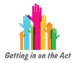



Rhannau o'r Ddeddf
Parts of the Act
1. Cyflwyniad
2. Swyddogaethau Cyffredinol
1. Introduction
2. General
Functions
3. Asesu anghenion unigolion
3. Assessing the needs of individuals
4. Meetings needs
5. Codi tâl ac asesiad ariannol
6. Plant sy'n Derbyn Gofal a Phlant sy'n cael eu Lletya
5. Charging and financial assessment
6. Looked after and accommodated Children
8. Swyddogethau Gwasanaethau Cymdeithasol
7. Diogelu
7. Safeguarding
8. Social Services Functions
9. Cydweithrediad a Phartneriaeth
10. Cwynion ac Eiriolaeth
9. Co-operation and Partnership
10. Complaints and Advocacy
11. Amrywiol a Chyffredinol
11. Miscellaneous and General

Slide 38

Y Ddyletswydd Llesiant
The Wellbeing Duty
Rhaid i berson sy’n arfer swyddogaethau o dan y Ddeddf hon geisio hybu lles pobl sydd angen gofal a gofalwyr sydd angen cymorth
A person exercising functions under this Act must seek to promote the well-being of people who need care and carers who need support

Slide 39
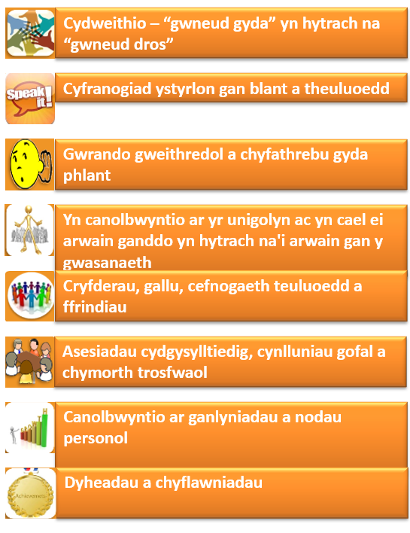
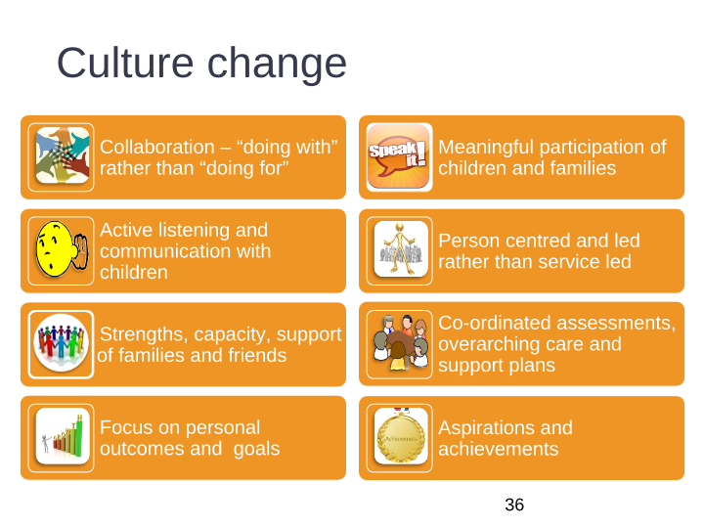
Newid mewn Diwylliant
Culture Change
Collaboration – “doing with” rather than “doing for”
Meaningful participation of children and families
Active listening and communication with children
Person centred and led rather than service led
Strengths, capacity, support of families and friends
Co-ordinated assessments, overarching care and support plans
Focus on personal outcomes and goals
Aspirations and achievements

Slide 40
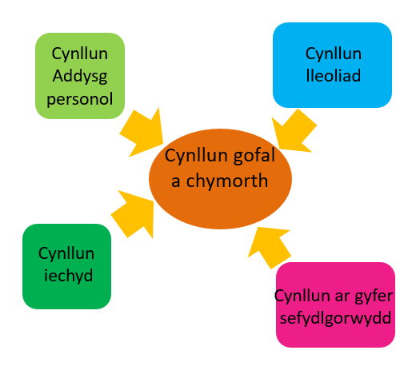
Cynllun gofal
a chymorth trosfwaol
Overarching care
and support plan
Personal
Education
plan
Placement
plan
Care and
support plan
Health
plan
Plan for
permanence

Slide 41
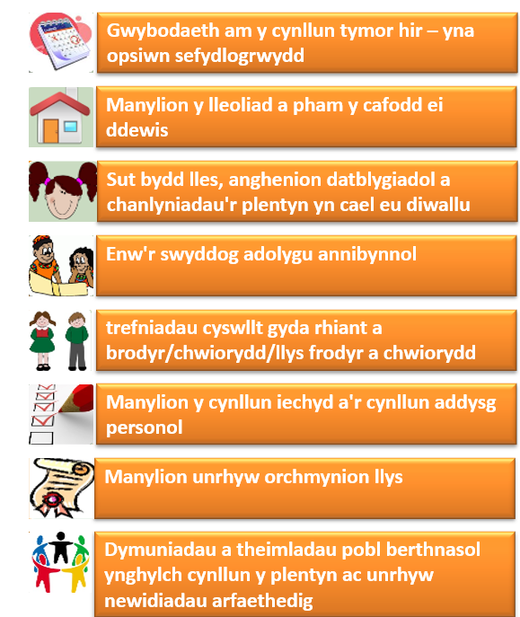
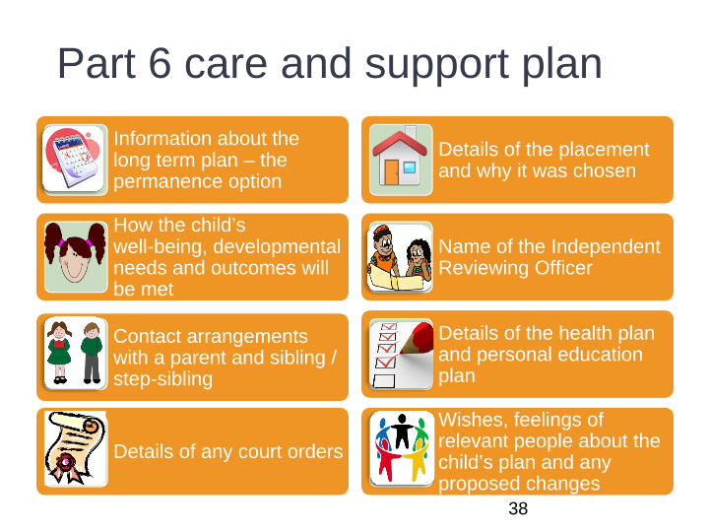
Rhan 6 cynllun gofal a chymorth
Part 6 care and support plan
Information about the long term plan – then permanence option
Details of the placement and why it was chosen
How the child’s well-being, developmental needs and outcomes will be met
Name of the independent reviewing officer
contact arrangements with parent and sibling/ step-sibling
Details of the health plan and personal education plan
Details of any court orders
Wishes, feelings of relevant people abut the child’s plan and any proposed changes

Slide 42
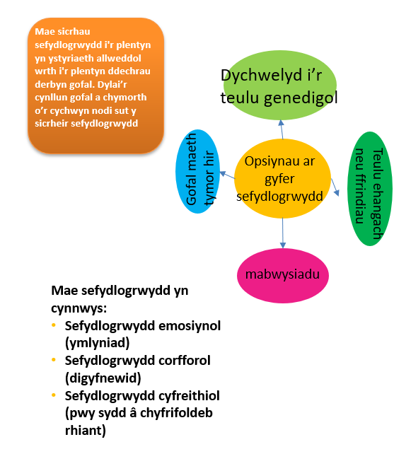
Cynllun ar gyfer
sefydlogrwydd
Plan for
permanence
Achieving permanence for the child is a key consideration from the child becomes looked after. The care and support plan from the outset should set out how permanence will be achieved
Return to
Birth family
Long term
foster care
Options for permanency
Wider family
or friends
adoption
Permanence includes:
Emotional permanence (attachment)
Physical permanence (stability)
Legal permanence (who has parental responsibility)

Slide 43
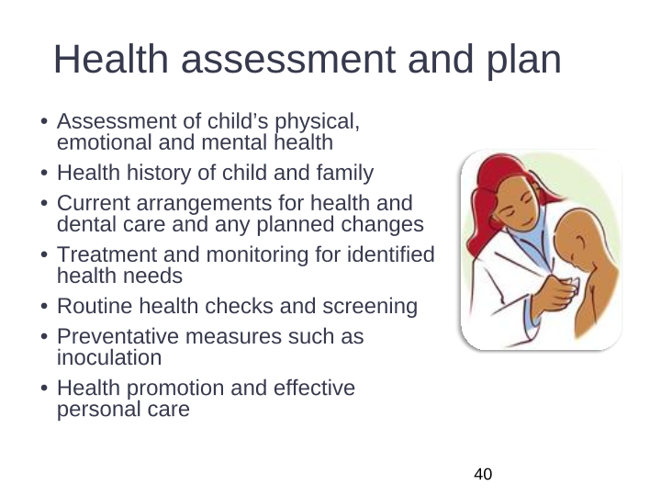
Asesiad
a chynllun iechyd
Health assessment
and plan
Asesiad o iechyd corfforol, emosiynol a meddyliol plentyn
Hanes iechyd y plentyn a'r teulu
Y trefniadau presennol ar gyfer gofal iechyd a deintyddol ac unrhyw newidiadau arfaethedig
Triniaeth a monitro ar gyfer anghenion iechyd a nodwyd
Gwiriadau iechyd a sgrinio arferol
Mesurau ataliol fel brechu
Hybu iechyd a gofal personol effeithiol
Assessment of child’s physical, emotional and mental health
Health history of child and family
Current arrangements for health and dental care and any planned changes
Treatment and monitoring for identified health needs
Routine health checks and screening
Preventative measures such as inoculation
Health promotion and effective personal care

Slide 44
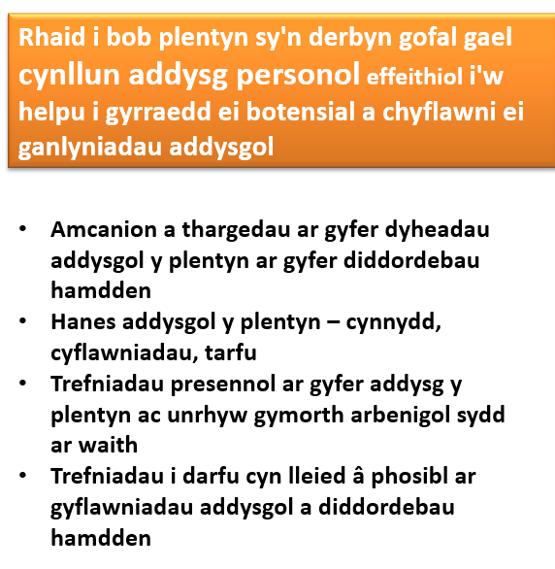
Hyrwyddo cyflawniad addysgol
Promoting educational achievement
Every looked after child must have an effective personal education plan to help them fulfil their potential and achieve their educational outcomes
Objectives and targets for the child’s educational aspirations for leisure interests
Child’s educational history – progress, achievements, disruption
Existing arraignments for the child’s education and any specialist support in place
Arrangements to minimise disruption of educational achievements and leisure interests

Slide 45

Lleoliadau
Placements

Slide 46

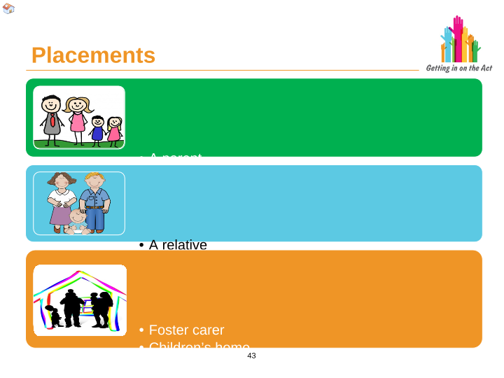


Lleoliadau
Placements
Rhiant
Person â chyfrifoldeb rhiant
Person â gorchymyn preswylio / trefniant plant
A person with parental responsibility
A parent
A person with a residence / child arrangement order
Perthynas
Ffrind
Person arall sy'n gysylltiedig â'r plentyn
A relative
A friend
Other person connected to the child
Gofalwr maeth
Cartref plant
Darpar fabwysiadydd
Llety â chymorth
Llety diogel
Foster carer
Children’s home
Prospective adopter
Supported lodgings
Secure accommodation

Slide 47
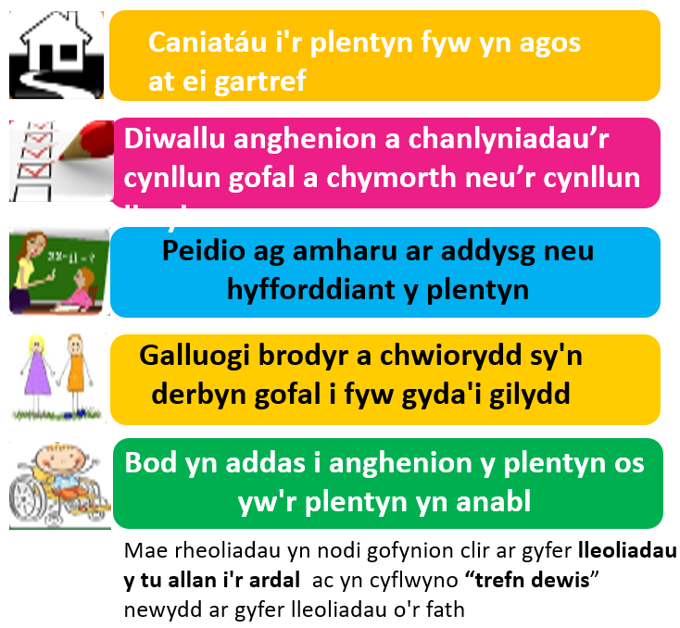
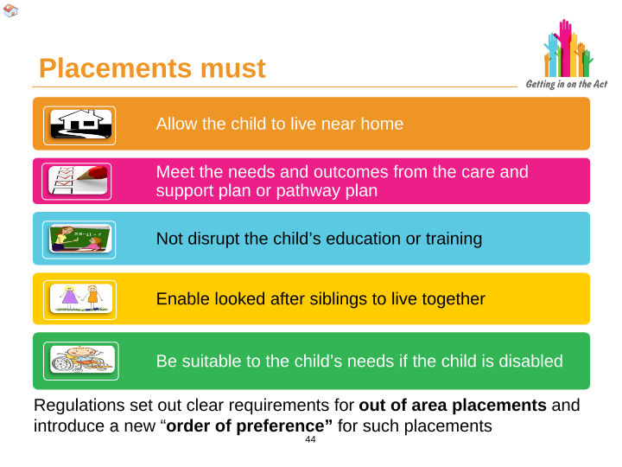
Rhaid i leoliadau
Placements must
Allow the child to live near home
Meet the needs and outcomes from the care and support plan or pathway plan
Not to disrupt the child’s education or training
Enable looked after siblings to live together
Be suitable to the child’s needs if the child is disabled
Regulations set out to clear requirements for out of area placements and introduce a new “order of preference” for such placements

Slide 48
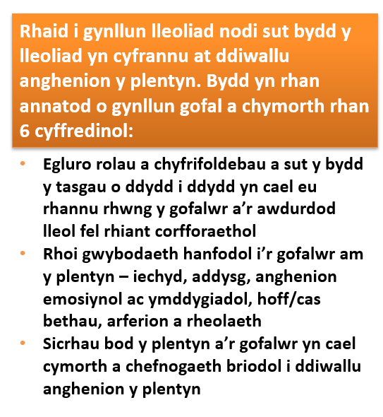
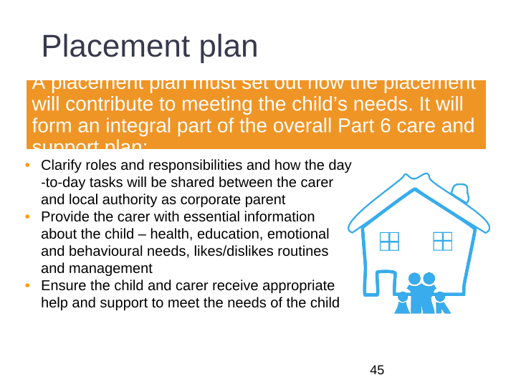
Cynllun Lleoliadau
Placements Plan
a placement plan must set out now the placement will contribute to meeting the child’s needs. It will form an integral part of the overall part 6 care and support plan:
Clarify roles and responsibilities and how the day-to-day tasks will be shared between the carer and local authority as corporate parent
Provide the carer with essential information about the child – health, education, emotional and behavioural needs, likes/dislikes routines and management
Ensure the child and carer receive appropriate help and support to meet the needs of the child

Slide 49
Cartref plant diogel
Secure children’s home
Gellir gosod plentyn sy'n derbyn gofal gael ei roi mewn llety diogel dim ond os oes:
Hanes o ddianc a dioddef niwed sylweddol neu
Ei fod yn debygol o anafu ei hun neu bobl eraill
A
Dim ond ar ôl cael gorchymyn llety diogel gan y llysoedd (ar ôl cyfnod cais cyn llys o 72 awr)
A looked after child can only be placed in secure accommodation if:
History of abscond and suffer significant harm or
Likely to injure him / herself or other people
And
Only after obtaining a secure accommodation order from the courts (after a pre court application period of 72 hours)
Egwyddorion sylfaenol:
“Ni chaiff unrhyw blentyn ei amddifadu o'i ryddid yn anghyfreithlon neu'n fympwyol. Rhaid i arestio, cadw neu garcharu plentyn fod yn unol â’r gyfraith a rhaid ei ddefnyddio dim ond fel cam olaf ac am y cyfnod byrraf priodol o amser.”
Erthygl 37b CCUHP
Underpinning principles:
“No child shall be deprived of his or her liberty unlawfully or arbitrarily. The arrest, detention or imprisonment of a child shall be in conformity with the law and shall be used only as a measure of last resort and for the shortest appropriate period of time.”
Article 37b UNCRC

Slide 50

Cadw mewn cysylltiad
Keeping touch

Slide 51
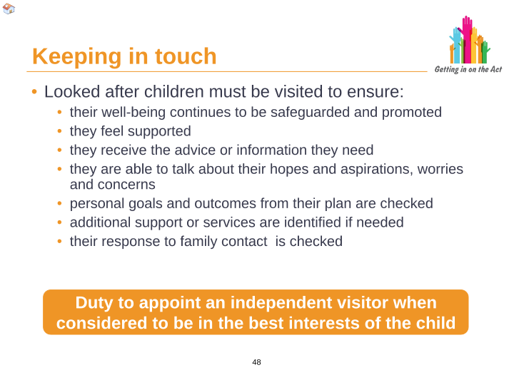
Cadw mewn cysylltiad
Keeping in touch
Rhaid ymweld â phlant sy’n derbyn gofal i sicrhau:
Mae eu lles yn parhau i gael ei ddiogelu a'i hyrwyddo
Maent yn teimlo eu bod yn cael eu cefnogi
Maent yn derbyn y cyngor neu'r wybodaeth sydd ei hangen arnynt
Gallant siarad am eu gobeithion a'u dyheadau, eu gofidiau a'u pryderon
Mae nodau personol a chanlyniadau eu cynllun yn cael eu gwirio
Nodir cymorth neu wasanaethau ychwanegol os oes angen
Mae eu hymateb i gyswllt teuluol yn cael ei wirio
Looked after children must be visited to ensure:
Their well-being continues to be safeguarded and promoted
They feel supported
They receive the advice or information they need
They able to talk about their hopes and aspirations, worries and concerns
Personal goals and outcomes from their plan are checked
Additional support or services are identified if needed
Their response to family contact is checked
Dyletswydd i benodi ymwelydd annibynnol pan ystyrir ei fod er lles gorau'r plentyn
Duty to appoint an independent visitor when considered to be in the best interests of child

Slide 52
Plant mewn sefydliadau eraill
Children in other establishments
Pan gaiff ei hysbysu, rhaid i’r awdurdod lleol:
Asesu anghenion y plentyn am ofal a chymorth
Trefnu bod y plentyn yn cael ymweliad yn yr un modd ag ymweliadau â phlant eraill sy'n derbyn gofal
Darparu gwasanaethau fel y bo'n briodol i fodloni gofal a chymorth
When notified the local authority must:
Assess the needs of the child for care and support
Arrange for the child to be visited in the same way as visits to other looked after children
Provide services as appropriate to meet care and support
Gan awdurdodau iechyd neu awdurdodau addysg - dyletswydd i hysbysu’r awdurdod lleol lle mae’r plentyn yn preswylio fel arfer
mewn cartrefi gofal ac ysbytai annibynnol - dyletswydd i hysbysu lleoliad y cartref gofal neu’r ysbyty
By health authorities or education authorities - duty to notify the local authority where child is normally resident
in care homes and independent hospitals – duty to notify where the care home or hospital is located

Slide 53

Adolygu
Review

Slide 54
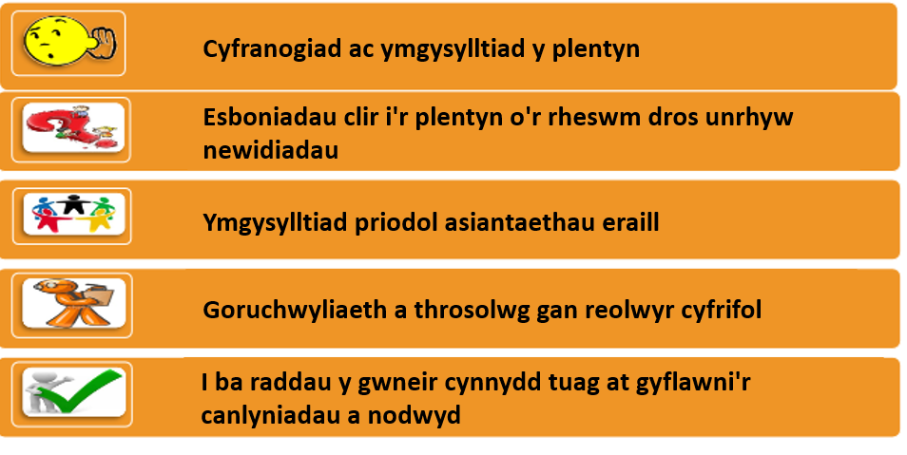
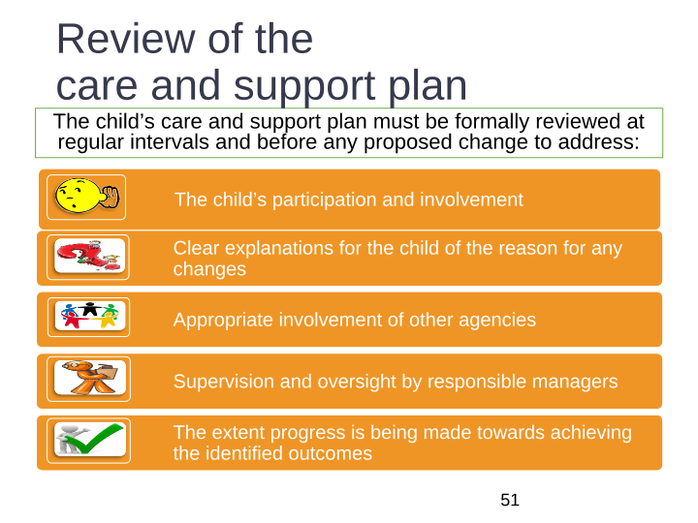
Adolygu'r cynllun gofal a chymorth
Review of the care and support plan
Rhaid i gynllun gofal a chymorth y plentyn gael ei adolygu’n ffurfiol yn rheolaidd a chyn unrhyw newid arfaethedig i fynd i’r afael â:
The child’s care and support plan must be formally reviewed at regular intervals and before any proposed change to address:
The child participation and involvement
Clear explanations for the child of the reason for any changes
Appropriate involvement of other agencies
Supervision and oversight by responsible mangers
The extent progress is being made towards achieving the identified outcomes

Slide 55
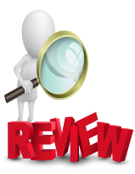
Rôl newidiol y swyddog adolygu annibynnol (IRO)
Changed role of independent reviewing officer (IRO)
Sicrhau bod y cynllun gofal a chymorth yn darparu ymateb gwirioneddol i anghenion pob plentyn sy’n derbyn gofal
Siarad yn bersonol â'r plentyn a sicrhau y rhoddir pwys ar ei farn
Sicrhau fod y plentyn yn deall unrhyw newidiadau yn llawn
Sicrhau nad oes “drifft”
Nodi bylchau
Monitro’r awdurdod lleol fel rhieni corfforaethol da, gan gynnwys camau gweithredu yn erbyn arfer gwael
Sicrhau fod y plentyn yn gwybod am ei hawl i gael eiriolwr
Sicrhau fod adolygiad yn cael ei gynnal cyn gorffen lletya
Ensure the care and support plan provides a real response to each looked after children’s needs
Personally speak with the child and ensure weight is given to their views
Ensure the child fully understands any changes
Ensure there is no “drift”
Identify gaps
Monitor the local authority as a good corporate parents, including actions against poor practice
Making sure the child knows about their rights to an advocate
Ensure a review takes place prior ceasing to be accommodated

Slide 56

Gadael gofal
Leaving care

Slide 57
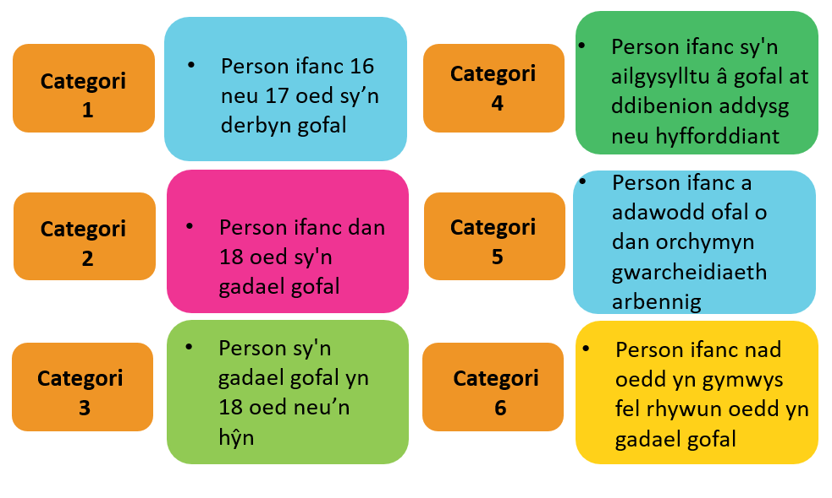
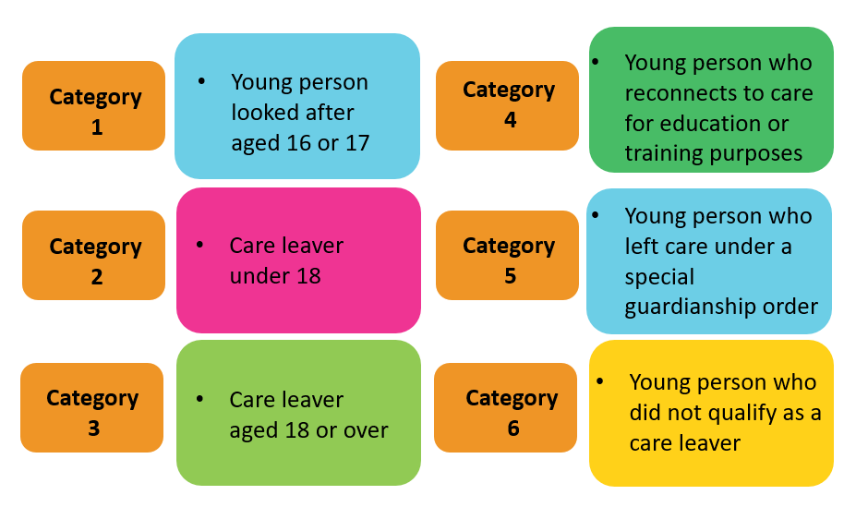
Chwe chategori o bobl ifanc
Six categories of young people

Slide 58
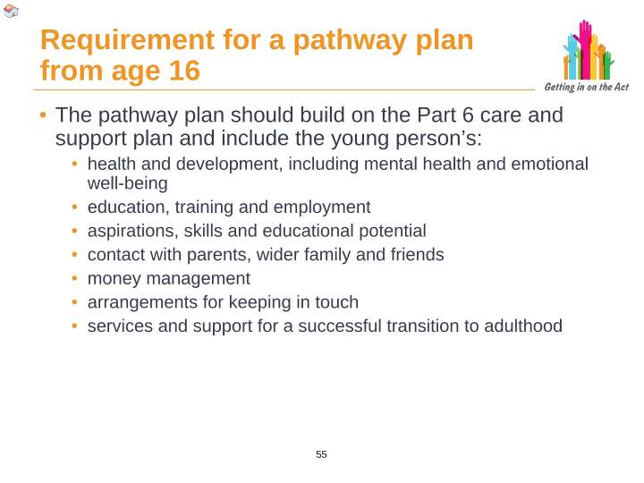
Gofyniad am gynllun llwybr o 16 oed
Requirement for a pathway plan from age 16
Dylai’r cynllun llwybr adeiladu ar gynllun gofal a chymorth rhan 6 a chynnwys y canlynol mewn perthynas â'r person ifanc:
  Iechyd a datblygiad, yn cynnwys iechyd meddwl a lles emosiynol
  Addysg, hyfforddiant a chyflogaeth
  Dyheadau, sgiliau a photensial addysgol
  Cyswllt â rhieni, teulu ehangach a ffrindiau
  Rheoli arian
  Trefniadau ar gyfer cadw cysylltiad
  Gwasanaethau a chymorth ar gyfer pontio llwyddiannus i fyd oedolion
The pathways plan should build on the part 6 care and support plan and include the young person’s:
  Health and development, including mental health and emotional well-being
  Education, training and employment
  Aspirations, skills and educational potential
  Contact with parents, wider family and friends
  Money management
  Arrangements for keeping touch
  Services and support for successful transition to adulthood

Slide 59
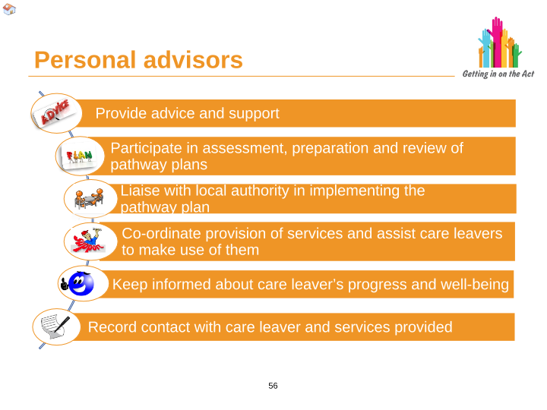

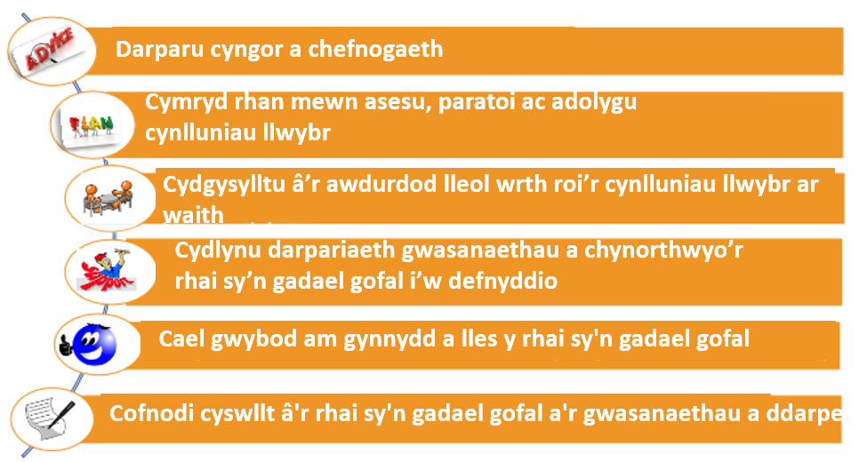
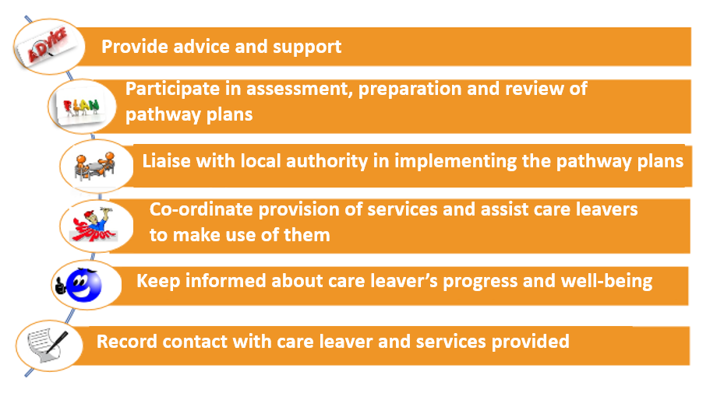
Personal advisors

Slide 60
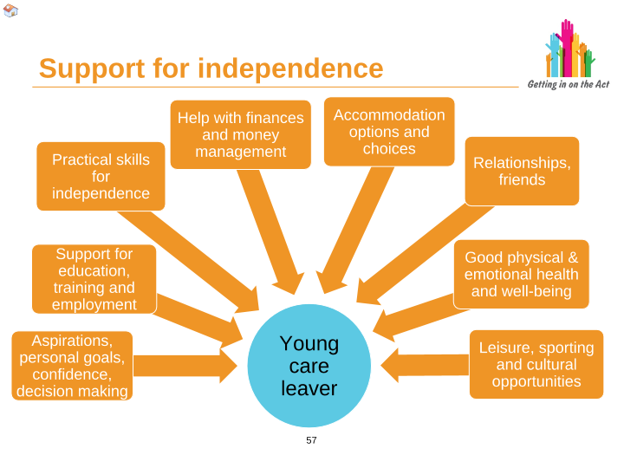


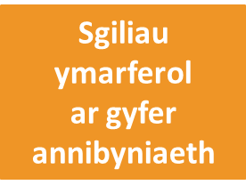

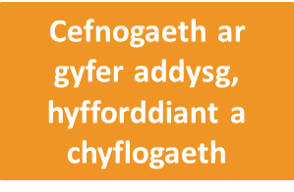
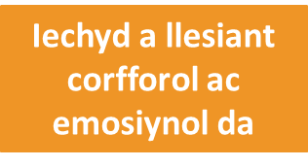
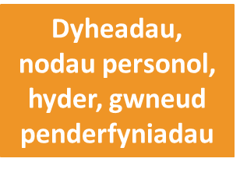

Cefnogaeth ar gyfer annibyniaeth
Cyfleoedd hamdden, chwaraeon a diwylliannol

Slide 61
Support for independence
Help with finances and money management
Accommodation options and choices
Practical skills
For
independence
Relationships,
Friends
Support for education, training and employment
Goof physical & emotional health and well-being
Aspirations personal goals, confidence, decision making
Young
Care
leaver
Leisure, sporting and cultural opportunities

Slide 62
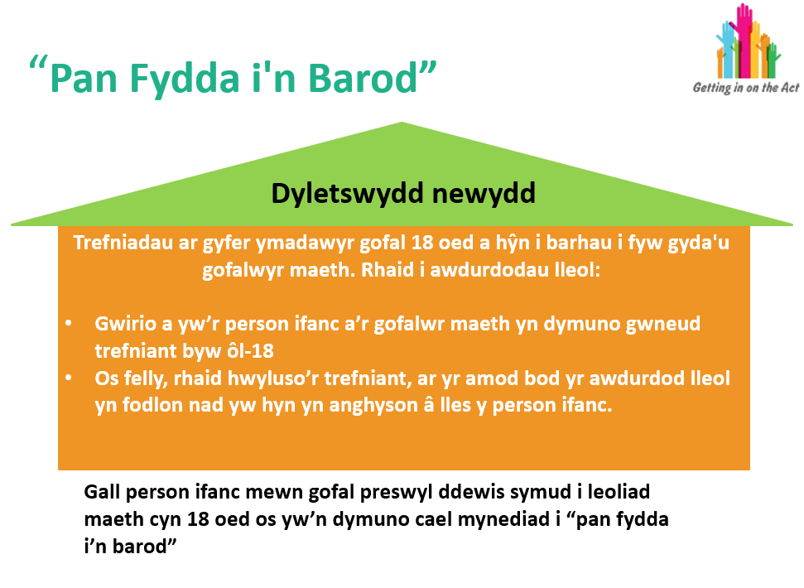


Slide 63
“When I am Ready”
New duty
Arrangements for care leavers aged 18 and above to continue living with their foster carers. Local authorities must:
Check whether the young person and foster carer wish to make a post-18 living arrangement
If so, facilitate the arrangement, provided the local authority is satisfied that this is not inconsistent with the young person’s well-being
Young person is residential care can choose to move to a foster placement before 18 if they wish to access “when I am ready”

Slide 64
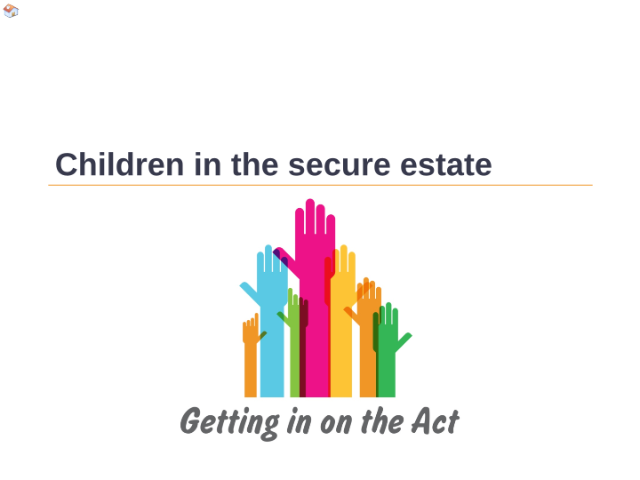
Plant mewn sefydliadau diogel Children in the secure estate

Slide 65
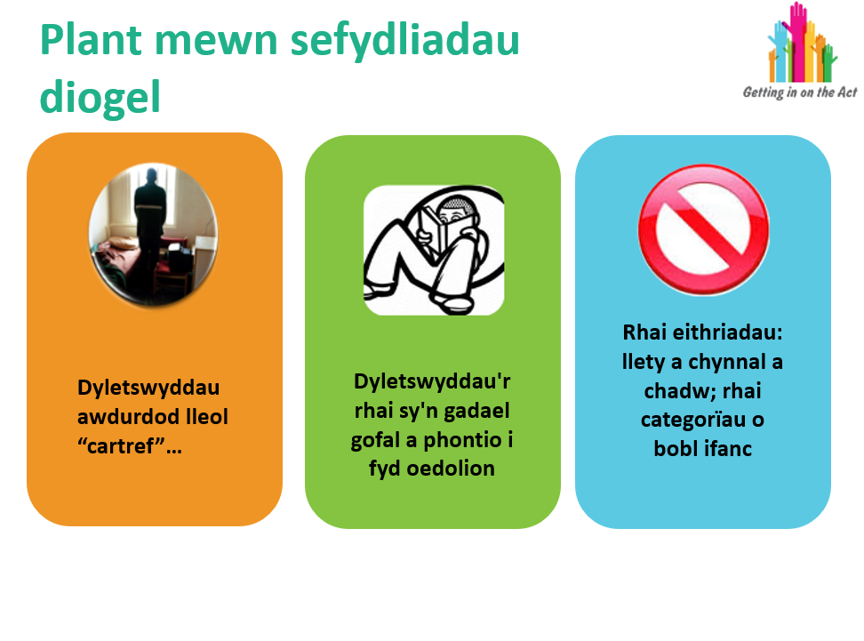

Slide 66
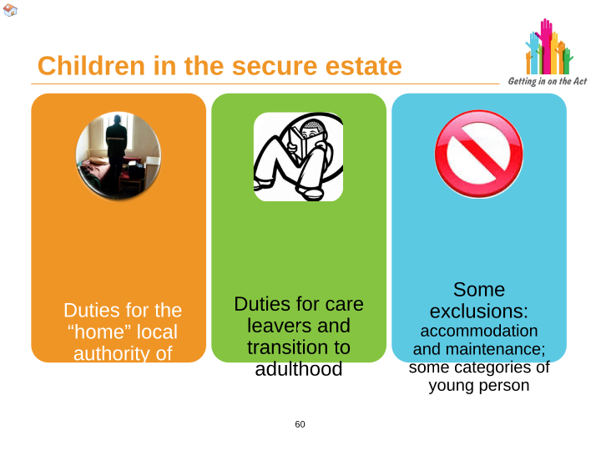
Children in secure estate
Some exclusions: accommodation and maintenance; some categories of young person
Duties for the “home” local authority of……
Duties for care leavers and transition to adulthood

Slide 67

Crynodeb Summary

Slide 68
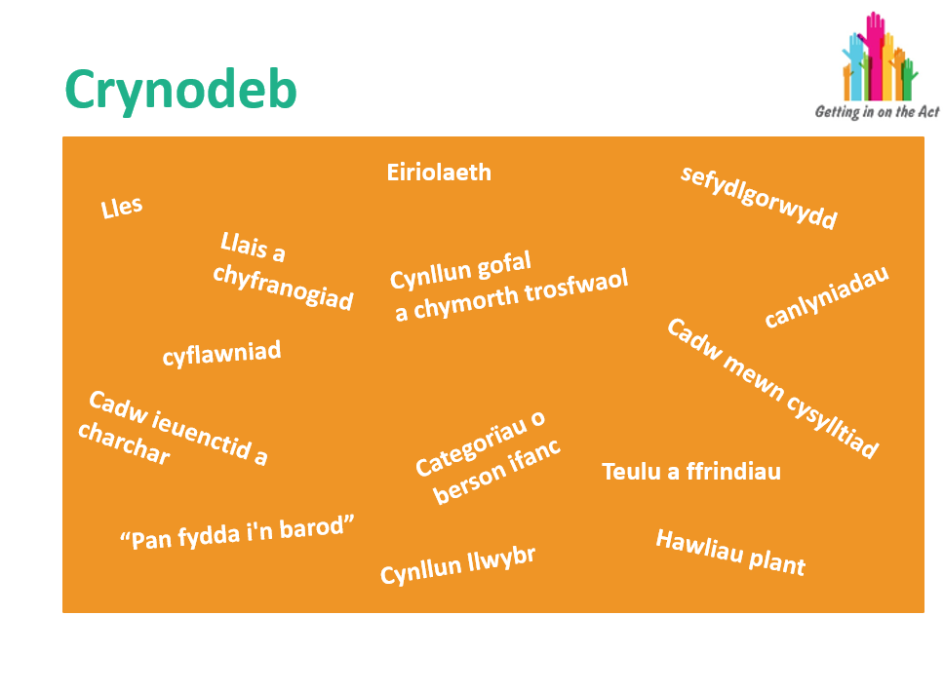

Slide 69
Summary
Advocacy
Well-being
permanence
Voice and
participation
Overarching care and
Support plan
outcomes
attainment
Keeping in touch
Youth detention and
prison
Categories of
young person
Family and friends
“when I am ready”
Pathway plan
Children’s rights

