Slide 1

Online Exam Review – January 2022
Level 3 Health and Social Care: Principles and Contexts
Unit 2: Factors affecting individuals’ growth and development across the lifespan, and how this impacts on outcomes, care and support needs

Slide 2
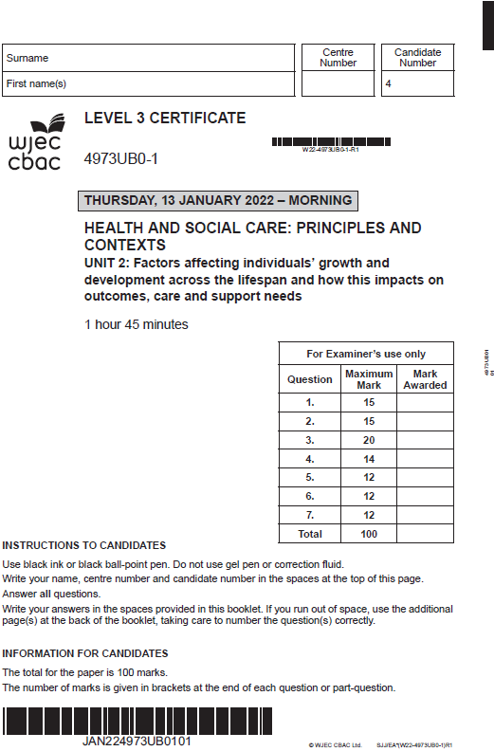

Unit 2: Factors affecting individuals’ growth and development across the lifespan, and how this impacts on outcomes, care and support needs
Online examination review (OER)

Slide 3
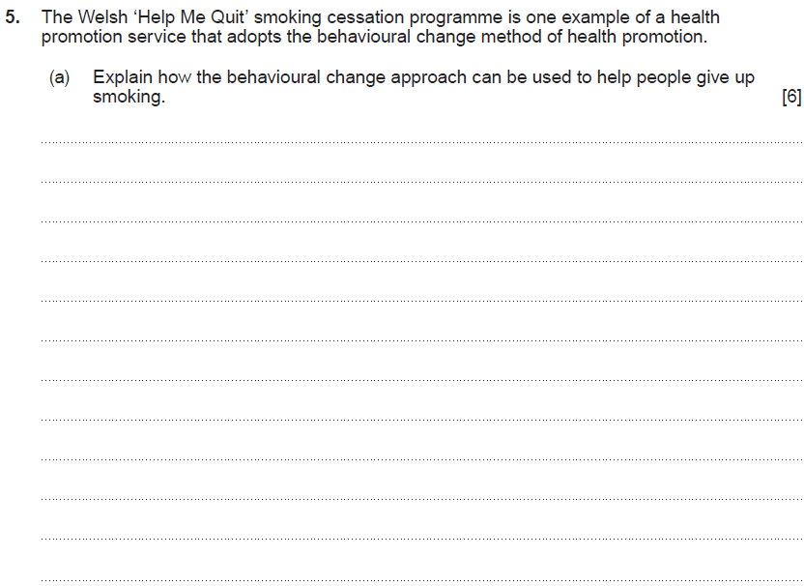
Question 5 (a)

Slide 4
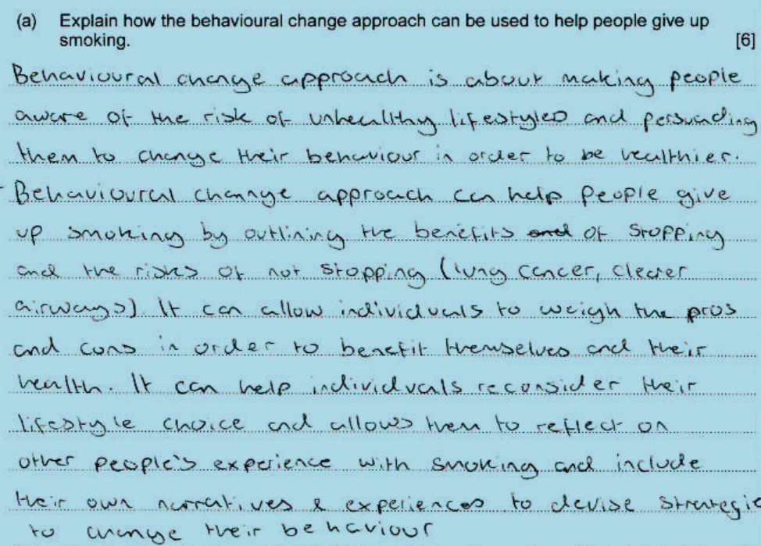
Question 5 (a) Candidate answer 1

Slide 5
Question 5 (a) Candidate answer 1 with examiner’s comments
A very good explanation demonstrating detailed knowledge and understanding of how the behavioural change model can be used to help people give up smoking.
The response correctly identifies that the approach encourages individuals to identify a healthier lifestyle by changing their behaviour. The candidate then suggests ways this can be achieved to give up smoking through an informed choice so the individual can weigh up the pros and cons to benefit themselves and their health. The response identifies the importance of reflecting on their own experiences to devise strategies to change their own behaviour and considers the experience of other smokers which could be through their success stories.
Extra marks were available for recognising websites such as Help Me Quit and attending smoking cessation programmes with others in the same situation. It is in-built and long-term in order to improve their overall health and well-being.
5 marks awarded – band 3

Slide 6
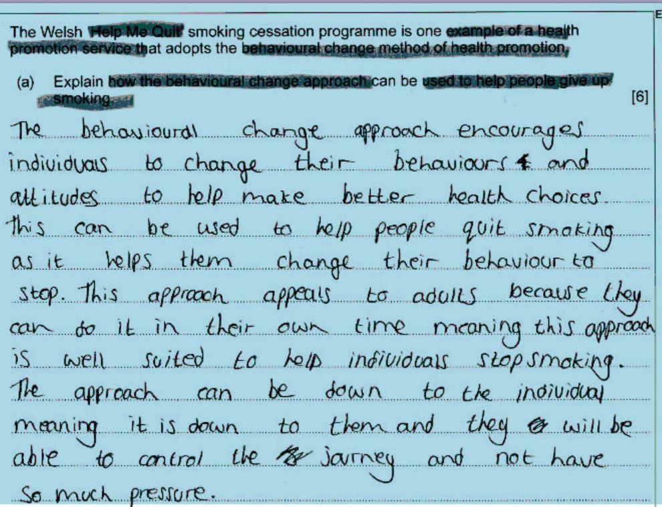
Question 5 (a) Candidate answer 2

Slide 7
Question 5 (a) Candidate answer 2 with examiner’s comments
A good explanation which demonstrates knowledges and understanding of how the behavioural change model can be used to help people give up smoking. A good example of highlighted text shown by the candidate.
The response correctly identifies that the approach encourages a change in both behaviours and attitudes to make healthier choices and how this can help smokers quit. It correctly explains the benefits of this approach for adults in changing their behaviour.
Extra marks were available for recognising the approach can use different methods to provide information to target smokers to give up, including websites such as Help Me Quit and attending smoking cessation programmes with others in the same situation. It is in-built and long-term in order to improve their overall health and well-being.
4 marks awarded – band 2

Slide 8
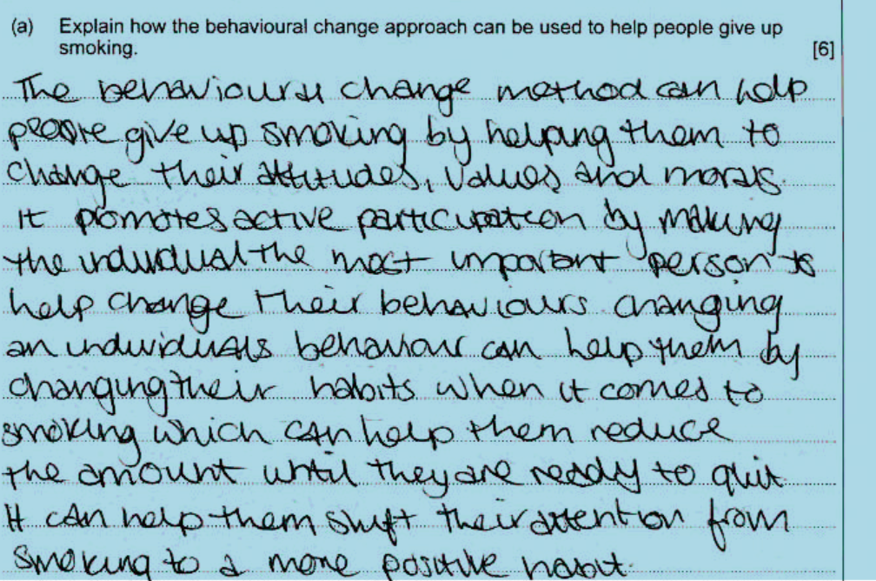
Question 5 (a) Candidate answer 3

Slide 9
Question 5 (a) Candidate answer 3 with examiner’s comments
A basic explanation which demonstrates some knowledge and understanding of how the behavioural change model can be used to help people give up smoking.
The response correctly identifies that the approach encourages a change in attitudes, values and morals and that the individual is the most important person to make the change, thereby understanding that individuals must take an interest in and responsibility for their own health.
Extra marks were available for recognising the approach can use different methods to provide information to target smokers to give up, including websites such as Help Me Quit and attending smoking cessation programmes with others in the same situation. An informed approach would help an individual to take an interest and responsibility in their own health. It is in-built and long-term in order to improve their overall health and well-being.
2 marks awarded – band 1

Slide 10
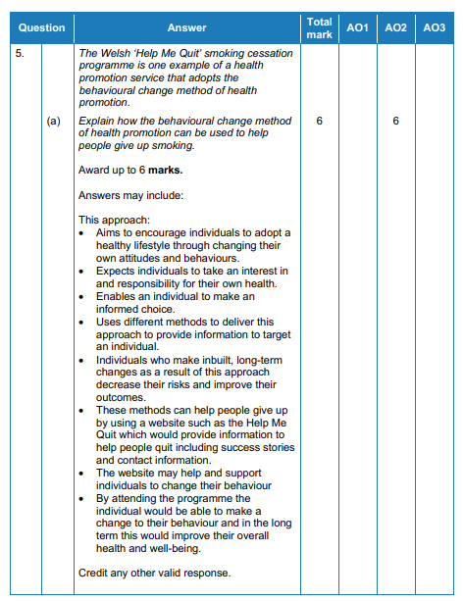
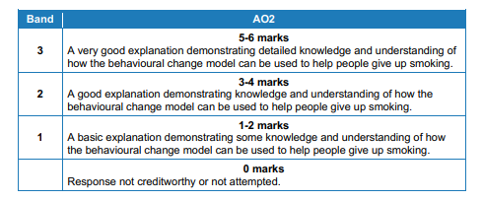
Question 5 (a) Mark scheme

Slide 11
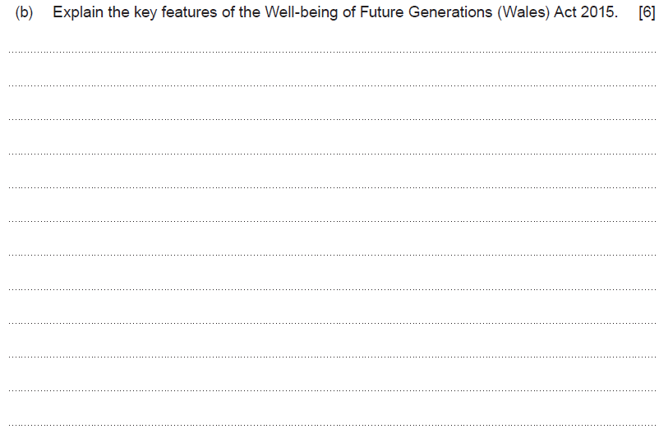
Question 5 (b)

Slide 12
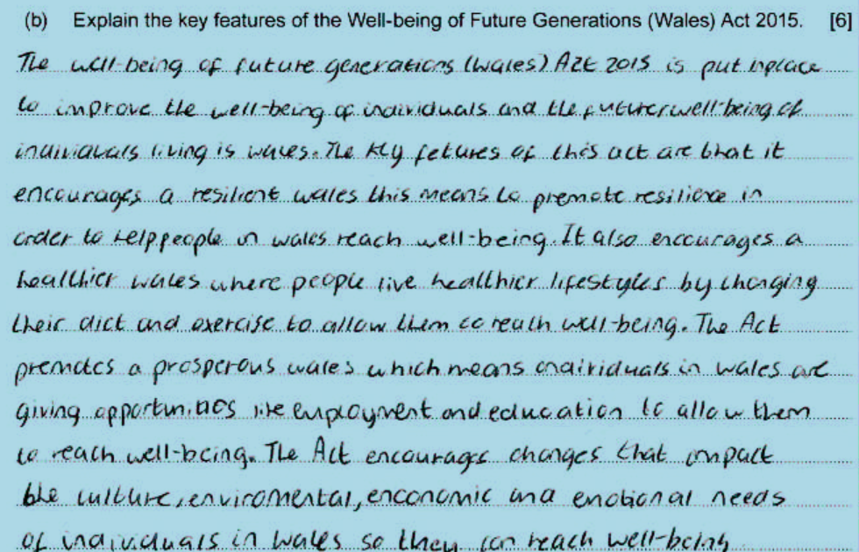
Question 5 (b) Candidate answer 1

Slide 13
Question 5 (b) Candidate answer 1 with examiner’s comments
A very good explanation, demonstrating detailed knowledge and understanding of the key features of the Future Generations Act (Wales) 2015.
The response refers accurately to several of the seven well-being goals, using correct terminology, and continues to explain how they will benefit Wales. It identifies a resilient Wales, a healthier Wales, and prosperous Wales. It further clarifies the overarching aim of the Act to improve the social, environmental, and cultural well-being of Wales.
For a top mark, responses could refer to all seven well-being goals and how importantly the Act binds national bodies and its expectations upon them.
5/6 marks – band 3

Slide 14
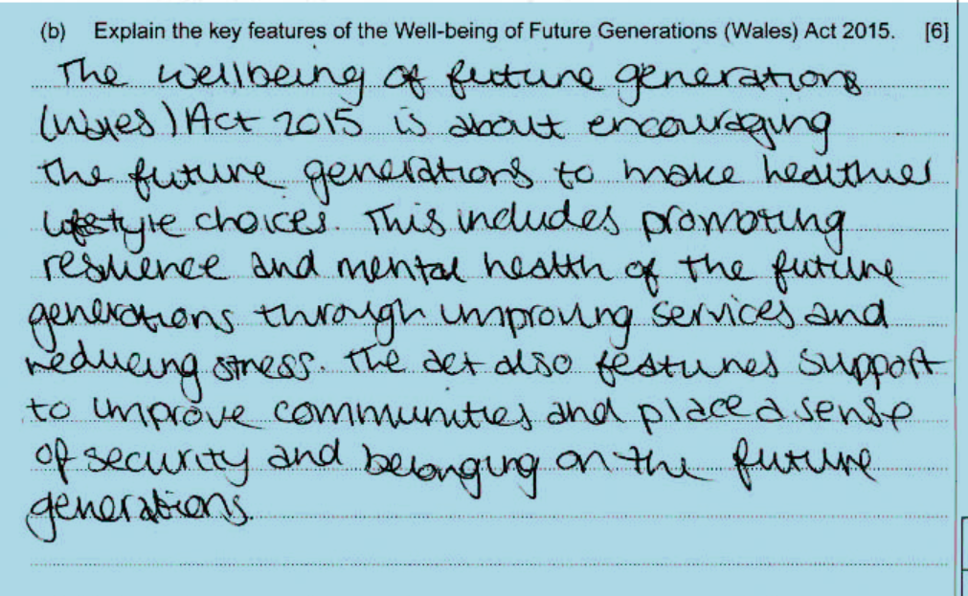
Question 5 (b) Candidate answer 2

Slide 15
Question 5 (b) Candidate answer 2 with examiner’s comments
A good explanation, demonstrating knowledge and understanding of the key features of the Future Generations Act (Wales) 2015.
The response refers to two of the seven well-being goals. Using their own words rather than the correct term “A healthier Wales”, the candidate refers to making healthier lifestyle choices and how this can be achieved through improving services. The response makes further reference to improving communities rather than “A Wales of cohesive communities” and then explains this briefly.
For higher bands, responses could refer to all seven well-being goals, the overarching aims of the Act to improve the social, economic, environmental and cultural well-being of Wales, and how importantly it binds national bodies and its expectations upon them.
3 marks – band 2

Slide 16
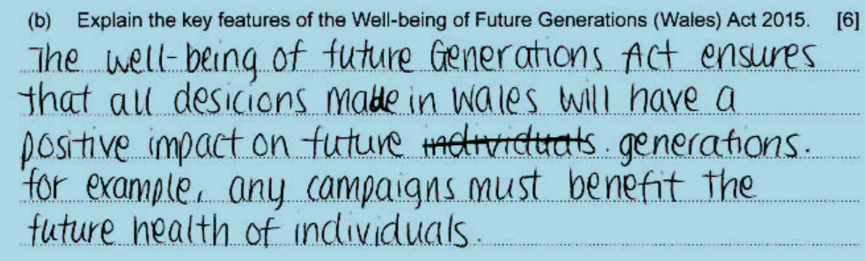
Question 5 (b) Candidate answer 3

Slide 17
Question 5 (b) Candidate answer with examiner’s comments
A basic explanation, demonstrating little knowledge and understanding of the key features of the Future Generations Act (Wales) 2015.
The candidate has provided a basic response, lacking in detail. They have identified correctly that the Act aims to ensure all decisions in Wales have an impact on future generations. However, the response is limited in depth and knowledge and fails to note the key features of the Act.
For higher bands, candidates need to consider the benefits based on the seven well-being goals, the overarching aim to improve the social, economic, environmental and cultural well-being of Wales and how importantly the Act binds national bodies and its expectations upon them.
.
1 marks – band 1

Slide 18
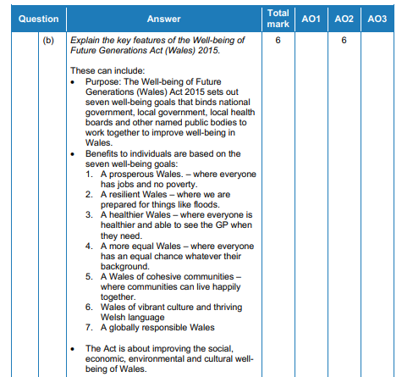
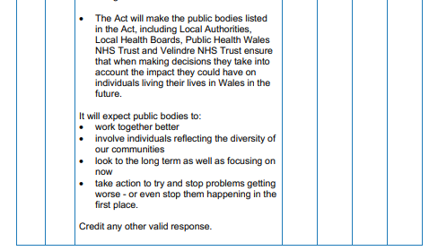
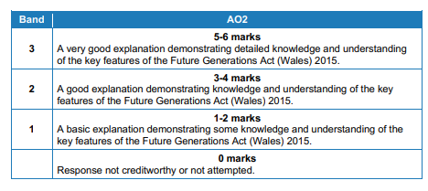
Question 5 (b) Mark scheme

Slide 19
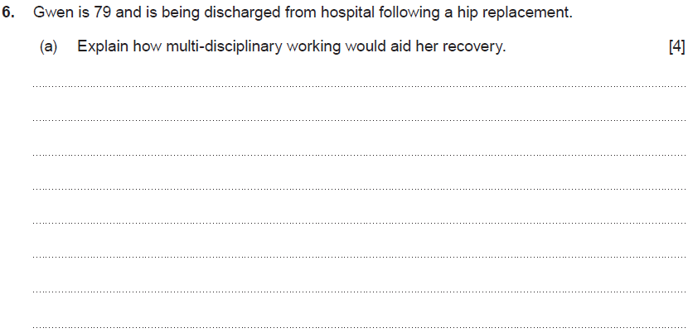
Question 6 (a)

Slide 20
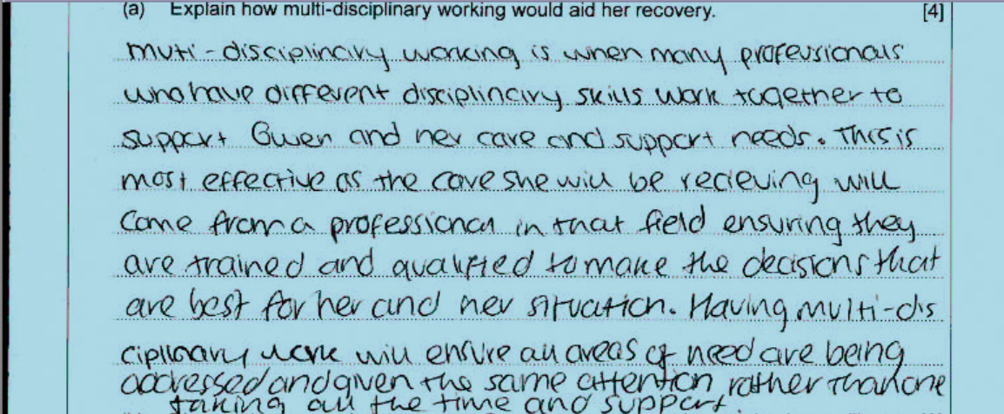
Question 6 (a) Candidate answer 1

Slide 21
Question 6 (a) Candidate answer 1 with examiner’s comments
A good explanation, showing knowledge and understanding of how multi-disciplinary working would aid Gwen’s recovery.
The response correctly identifies that professionals from different disciplines work together to support Gwen. The response then states the benefits, such as that professionals are trained to make the best decisions for Gwen’s situation, and all areas of her needs are being addressed.
Additional marks were available for recognising that multi-agency teams provide a seamless service, may come from all sectors, ensure continuity of care, ensure services are accessed quicker, enable professionals to talk to each other and ensure Gwen’s support is person-centered. The use of reablement services could be given as an example to support Gwen.
3 marks awarded

Slide 22
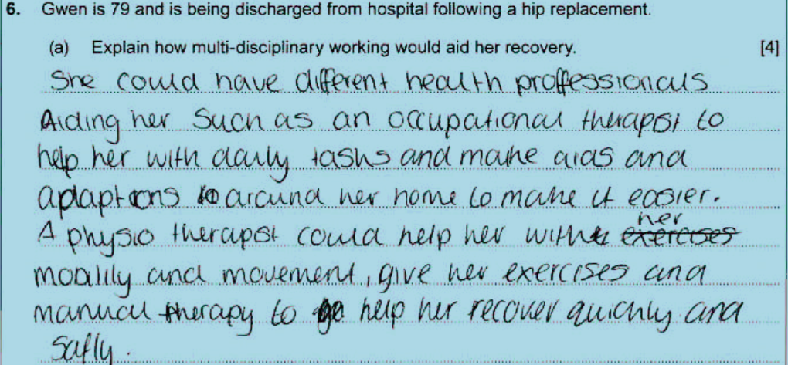
Question 6 (a) Candidate answer 2

Slide 23
Question 6 (a) Candidate answer 2 with examiner’s comments
A basic explanation, showing some knowledge and understanding of how multi-disciplinary working would aid Gwen’s recovery.
The response correctly identifies several professionals from different disciplines that would work together to support Gwen and help her recover but goes further to explain how this would help Gwen, and ensure she recovered quickly and safely. This could have been expanded on by explaining how this makes access to care quicker and easier so she is not waiting for services and that it may reduce replication of care and support, so she receives the correct care when she needs it.
Additional marks were available for recognising that multi-agency teams provide a seamless service, may come from all sectors, ensure continuity of care, ensure services are accessed quicker, enable professionals to talk to each other and ensure Gwen’s support is person-centered. The use of reablement services could be given as an example to support Gwen alongside the benefits of multi-disciplinary working.
2 marks awarded

Slide 24
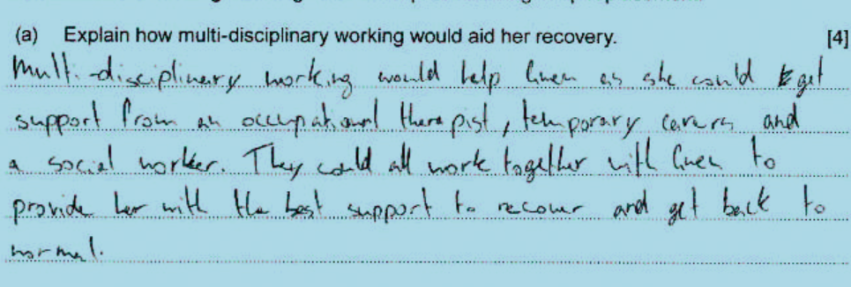
Question 6 (a) Candidate answer 3

Slide 25
Question 6 (a) Candidate answer 3 with examiner’s comments
A limited explanation, showing little knowledge and understanding of how multi-disciplinary working would aid Gwen’s recovery.
The response correctly identifies briefly several professionals from different disciplines that would work together to support Gwen and help her recover.
Additional marks were available for recognising that multi-agency teams provide a seamless service, may come from all sectors, ensure continuity of care, ensure services are accessed quicker, enable professionals to talk to each other and ensure Gwen’s support is person-centered. The use of reablement services could be given as an example to support Gwen alongside the benefits of multi-disciplinary working.
1 mark awarded

Slide 26
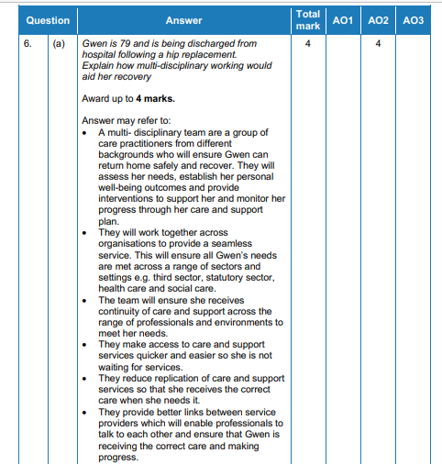
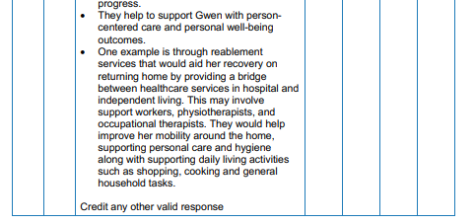
Question 6 (a) Mark scheme

Slide 27
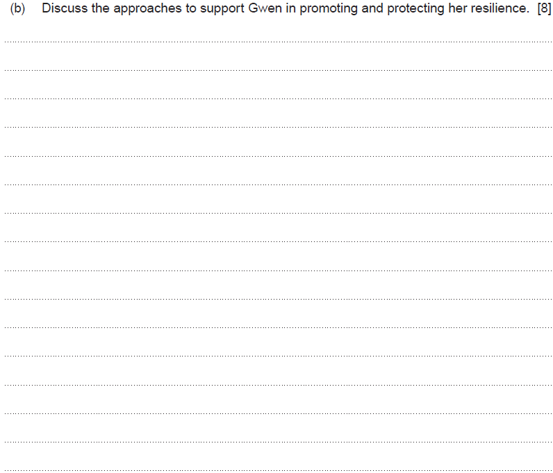
Question 6 (b)

Slide 28
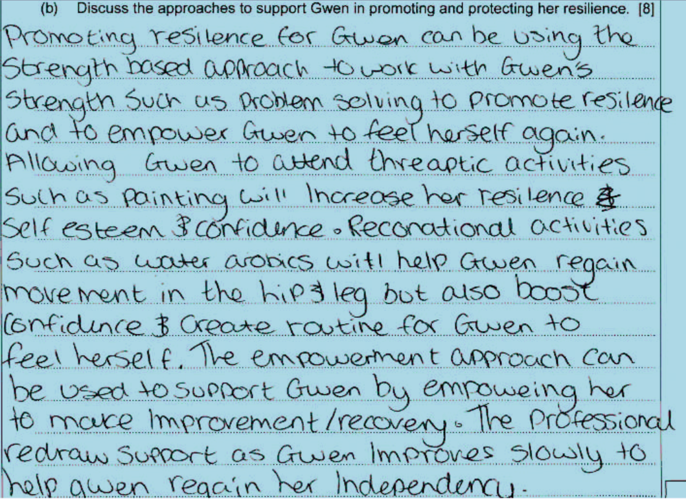
Question 6 (b) Candidate answer 1

Slide 29
Question 6 (b) Candidate answer 1 with examiner’s comments
A good discussion that shows knowledge and understanding of the approaches to support Gwen in promoting and protecting her resilience.
The candidate has correctly identified several of the key approaches such as the problem-solving approach, therapeutic activities, recreational activities, empowerment, and then related it correctly to how it would help Gwen and empower her to gain confidence again. The response demonstrates an understanding in the last sentence, explaining that, as she gains resilience, professionals can withdraw support so she can regain her independence.
To reach band 4, additional marks were available for increasing social network, making her responsible for her physical health and making lifestyle changes will help her mental health and reduce feelings of stress.
6 marks – band 3

Slide 30
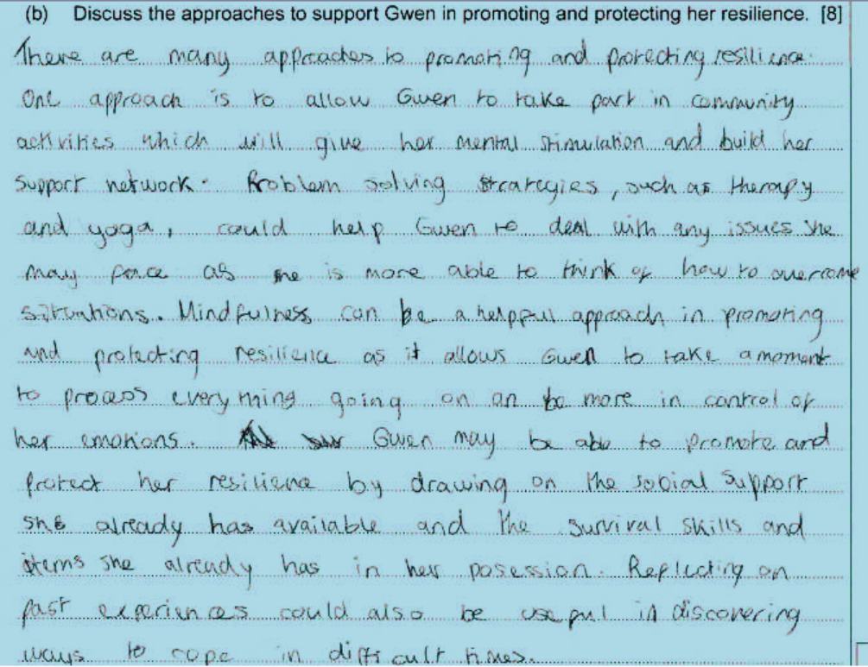
Question 6 (b) Candidate answer 2

Slide 31
Question 6 (b) Candidate answer 2 with examiner’s comments
A good discussion that shows knowledge and understanding of the approaches to support Gwen in promoting and protecting her resilience.
The candidate has correctly identified several of the key approaches, such as taking part in community activities, problem-solving activities, physical activities, social support, and then discussing specific benefits to Gwen. The response focuses on mental health and well-being activities such as mindfulness, along with reflecting on past experiences.
To reach band 4, additional marks were available for making Gwen responsible for her physical health and reduce feelings of stress, along with referring to the importance of Gwen living in a positive environment that is forward-looking and promotes her strengths and diversity.
5 marks – band 3

Slide 32
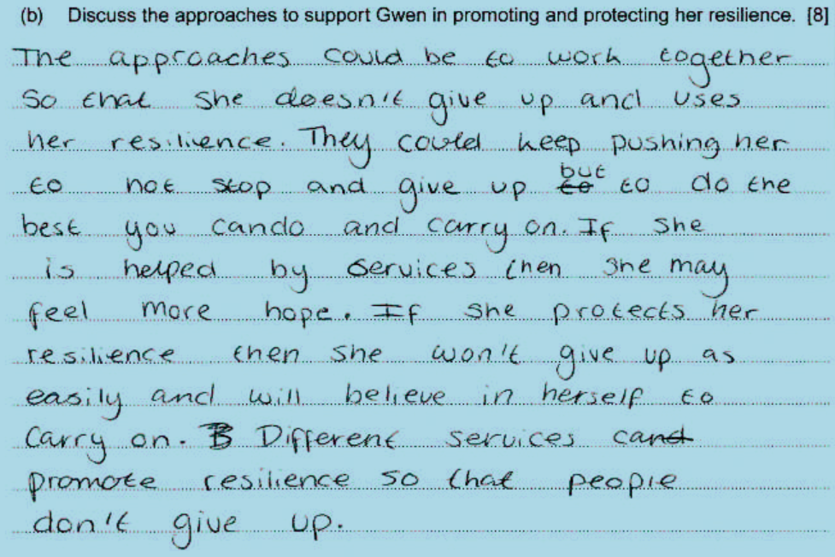
Question 6 (b) Candidate answer 3

Slide 33
Question 6 (b) Candidate answer 3 with examiner’s comments
A limited discussion that shows little knowledge and understanding of the approaches to support Gwen in promoting and protecting her resilience.
The candidate refers to the approaches generically and the overall benefits to Gwen. They were awarded a mark for their understanding that, if Gwen is in a positive environment and supported to promote her strength, this will help build her resilience.
There was limited discussion of the individual approaches identified in the specification such as encouraging Gwen to take part in therapeutic and recreational activities, engaging within her local community and increasing social networks, developing a positive, problem-solving approach.
1 mark – band 1

Slide 34
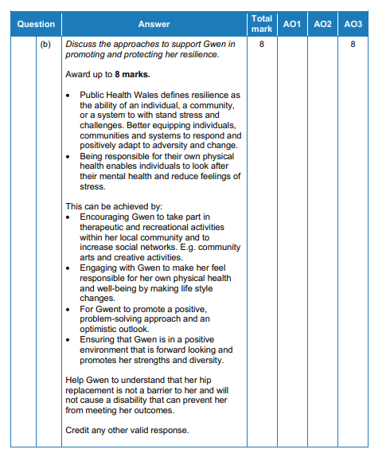
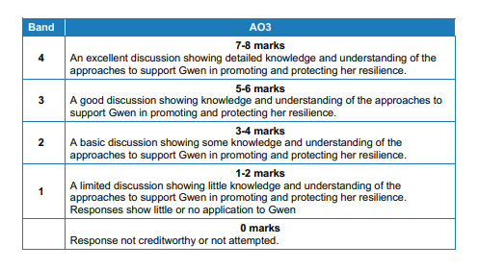
Question 6 (b) Mark scheme

Slide 35
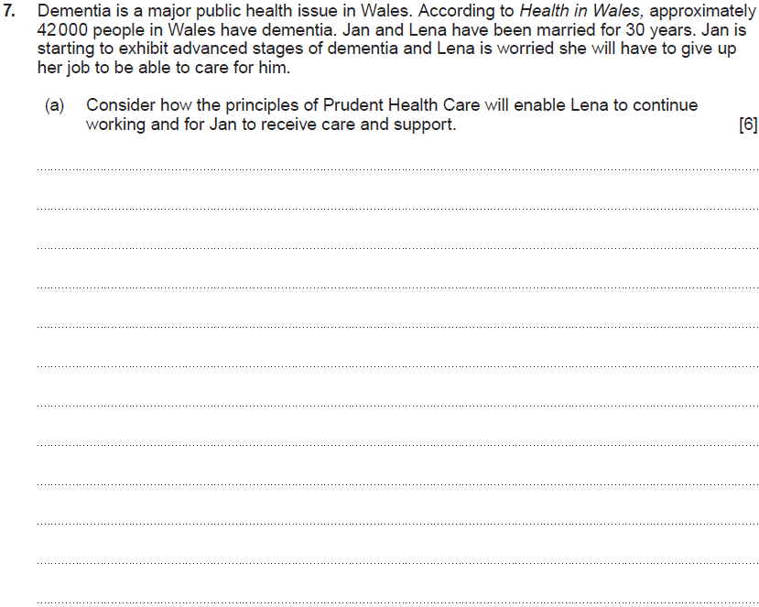
Question 7 (a)

Slide 36
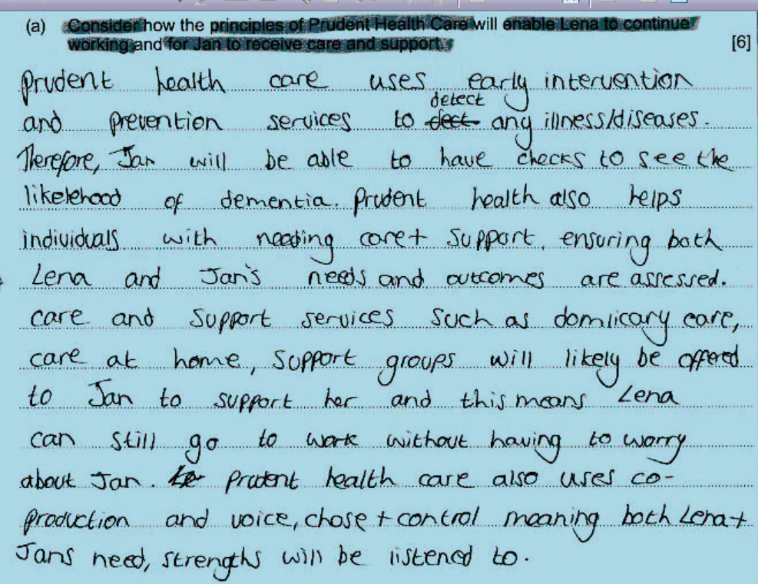
Question 7 (a) Candidate answer 1

Slide 37
Question 7 (a) Candidate answer 1 with examiner’s comments
A very good response, which demonstrates a detailed knowledge and understanding of Prudent Health Care principles and considers how these will benefit Lena and Jan.
The candidate correctly identifies the key principles, e.g. early intervention and prevention services, then applies the benefits to Lena/Jan. They identify, with examples, the most suitable care for Jan and recognise this will allow Lena to be supported and her wishes to remain working will be considered. They identify how the principles of co-production are used in decision-making, whilst referring to Lena and Jan’s strengths.
Additional marks were available for additional principles, such as: do only what is needed and no harm; using evidence-based approaches to reduce inappropriate variation; and public and professionals seen as equals.
5 marks awarded – band 3

Slide 38
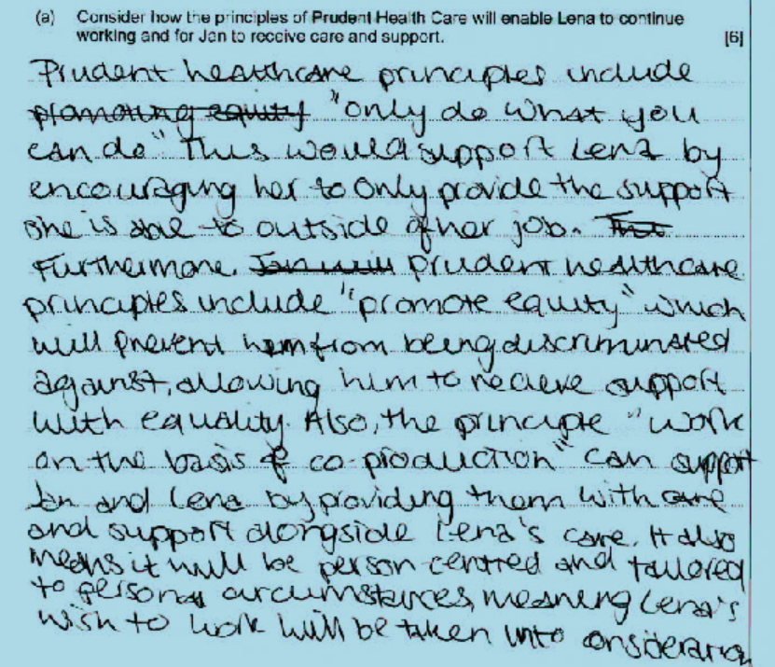
Question 7 (a) Candidate answer 2

Slide 39
Question 7 (a) Candidate answer with examiner’s comments
A good response, which demonstrates knowledge and understanding of Prudent Health Care principles and gives some consideration to how these will benefit Lena and Jan.
The candidate correctly identifies the key principles, e.g. only do what you can, then applies the benefits to Lena to allow her to work.
The candidate identifies briefly how the principle of co-production is used to support Lena and Jan through person-centered care but fails to identify that they are seen as equal partners and Lena is recognised as an expert in her own right.
Additional marks were available for further principles, such as: early intervention; using evidence-based approaches to reduce inappropriate variation; and public and professionals seen as equals. Jan would get the most suitable care at the earliest opportunity.
4 marks awarded – band 2

Slide 40
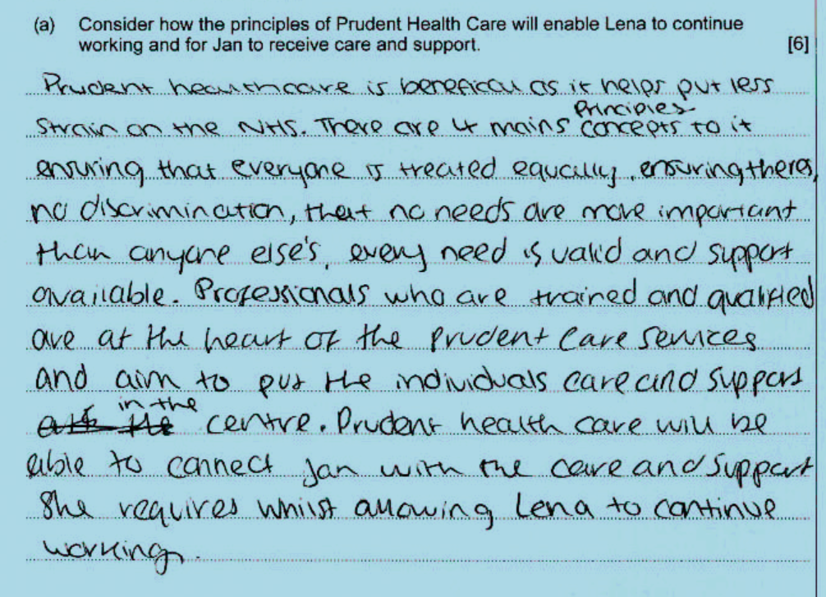
Question 7 (a) Candidate answer 3

Slide 41
Question 7 (a) Candidate answer 3 with examiner’s comments
A good response, which demonstrates knowledge and understanding of Prudent Health Care principles and gives some consideration to how these will benefit Lena and Jan.
The candidate refers to the four principles, e.g. everyone is treated equally, no needs are more important, although not using terminology from the approach. Reference should be made here to the principle of co-production.
The candidate correctly identifies that the principles allow Lena to continue working and Jan to receive care and support; however, this is a repeat of the question itself.
Additional marks were available for further principles, such as: early intervention; using evidence-based approaches to reduce inappropriate variation; and public and professionals seen as equals. Jan would get the most suitable care at the earliest opportunity.
3 marks awarded – band 2

Slide 42
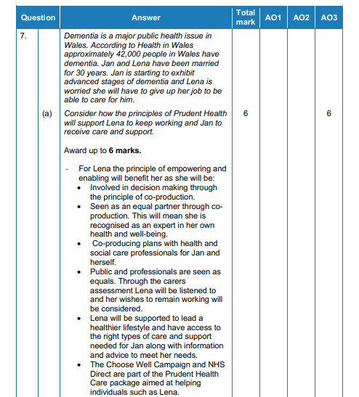
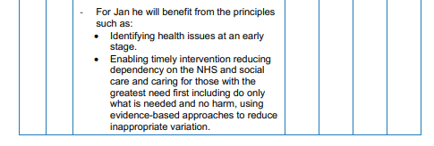
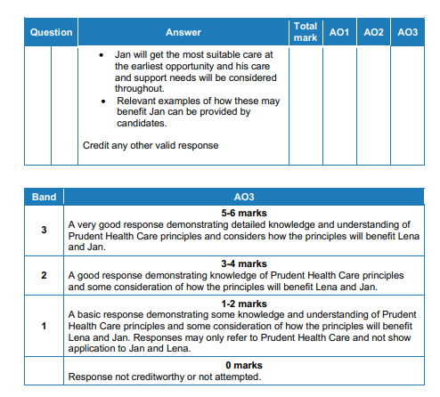
Question 7 (a) Mark scheme

Slide 43

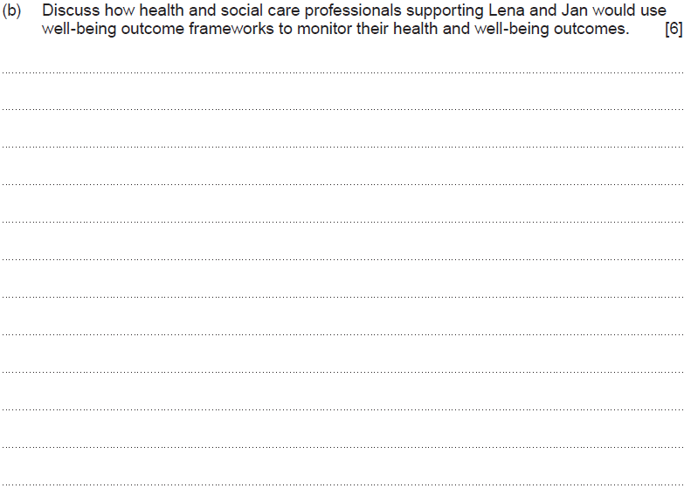
Question 7 (b)

Slide 44
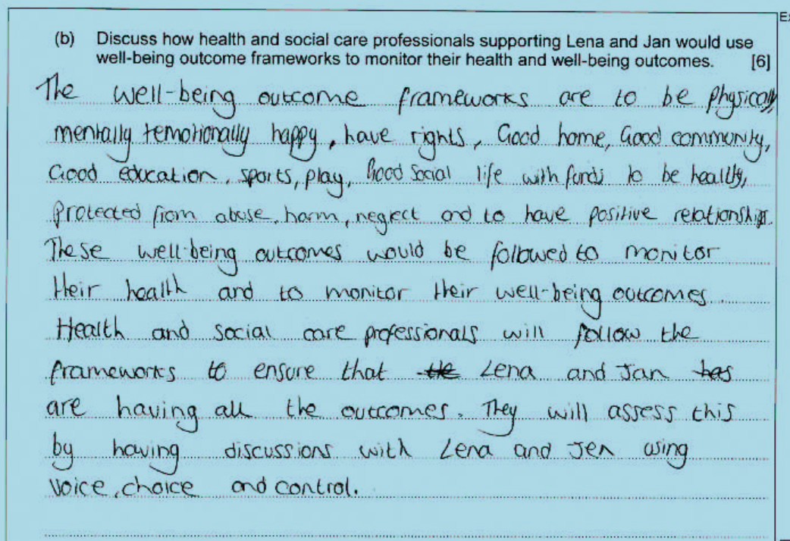
Question 7 (b) Candidate answer 1

Slide 45
Question 7 (b) Candidate answer 1 with examiner’s comments
A very good discussion, which demonstrates
detailed knowledge and understanding of how health and social care professionals supporting Lena and Jan would use well-being outcome frameworks to monitor their health and well-being.
The candidate is able to identify the key areas that are monitored through the framework and reinforces how these are used to monitor health, along with their well-being outcomes. The candidate refers to Lena and Jan, identifying the use of the framework for assessment purposes, with a focus on what matters to them through the use of voice, choice and control, therefore recognising that Lena and Jan are at the centre of their care and the framework is used for assessment by professionals.
Additional marks were available for: providing a consistent approach to assessment; and using support services to work together to monitor their health and well-being.
5 marks awarded – band 3

Slide 46
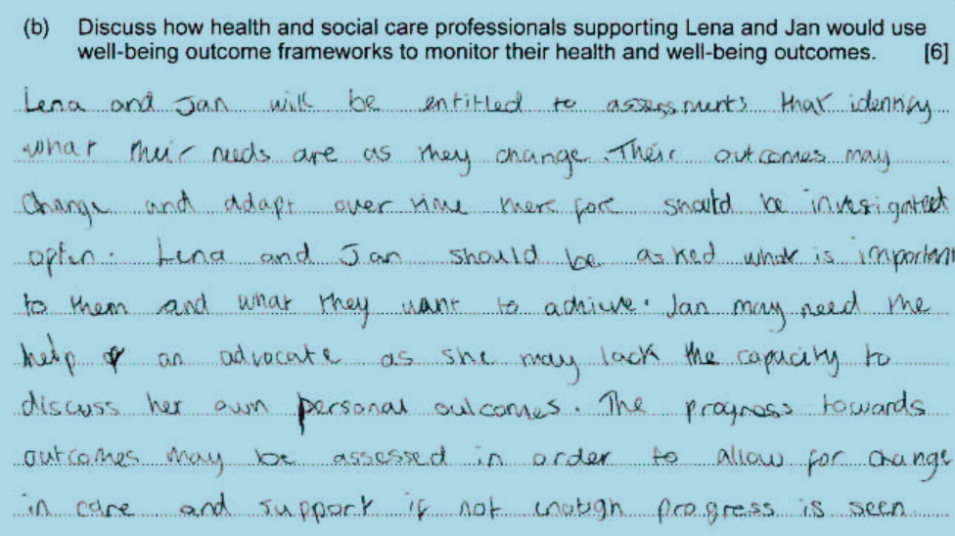
Question 7 (b) Candidate answer 2

Slide 47
Question 7 (b) Candidate answer 2 with examiner’s comments
A good discussion, which demonstrates knowledge and understanding of how health and social care professionals supporting Lena and Jan would use well-being outcome frameworks to monitor their health and well-being.
The candidate is able to identify the key areas that are monitored through the framework and reinforces how these are used to monitor health, along with their well-being outcomes. The candidate refers to Lena and Jan, identifying the use of the framework for assessment purposes, with a focus on what matters to them through the use of voice, choice and control, therefore recognising that Lena and Jan are at the centre of their care.
Additional marks were available for: providing a consistent approach to assessment; and using support services to work together to monitor their health and well-being.
3 marks awarded – band 2

Slide 48
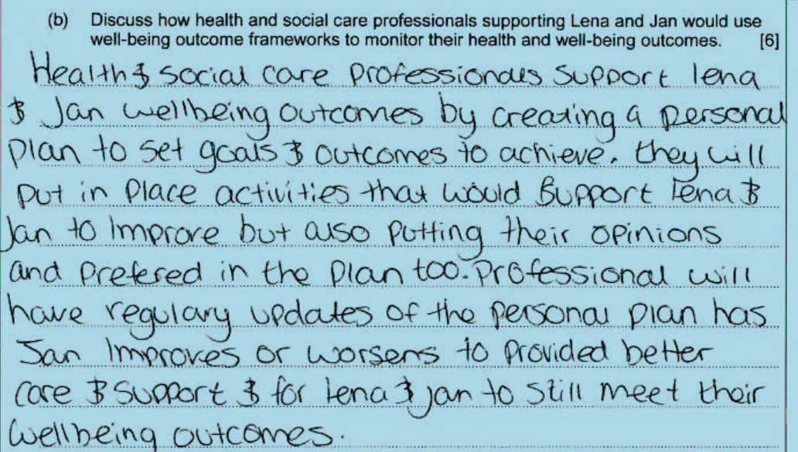
Question 7 (b) Candidate answer 3

Slide 49
Question 7 (b) Candidate answer 3 with examiner’s comments
A basic discussion, which demonstrates some knowledge and understanding of how health and social care professionals supporting Lena and Jan would use well-being outcome frameworks to monitor their health and well-being.
The candidate refers to Lena and Jan, identifying the use of a personal plan and its purpose but failing to answer the actual question by discussing how the well-being outcome framework is used to monitor health and well-being outcomes. The response shows an awareness of how monitoring may occur through professionals regularly updating the personal plan to improve care and support but fails to refer to the frameworks being part of the assessment process that can then provide a benchmark for monitoring.
Additional marks were available for: providing a consistent approach to assessment; using support services to work together to monitor their health and well-being; and, importantly, the key areas that are monitored on the framework, e.g. securing rights and entitlements, suitability of living accommodations.
2 marks awarded – band 1

Slide 50
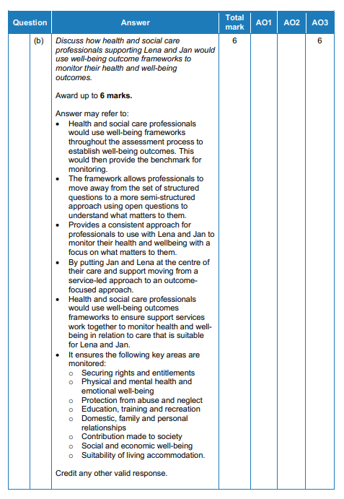
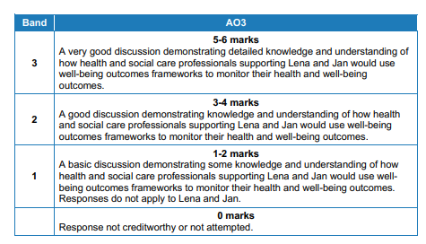
Question 7 (b) Mark scheme

