Slide 1
Yr Ymarferydd Gwasanaethau Cymdeithasol
Ymarfer Proffesiynol
Social Services Practitioner
Professional Practice
Notes:
WELSH
Cyn mynychu, mae'n ofynnol i ddysgwyr gael mynediad at gopi digidol neu gopi caled o'u Cod Ymarfer/Ymddygiad perthnasol gan gynnwys fersiwn 'i Gyflogwyr', rheoliadau RISCA a swydd ddisgrifiad, ac unrhyw ganllawiau ymarfer perthnasol eraill.
ENGLISH
Prior to attending, learners are required to have access to a digital or hard copy of their relevant Code of Practice/Conduct including ‘for Employers’ version, RISCA regulations and job description, and any other relevant practice guidance.

Slide 2


Slide 3
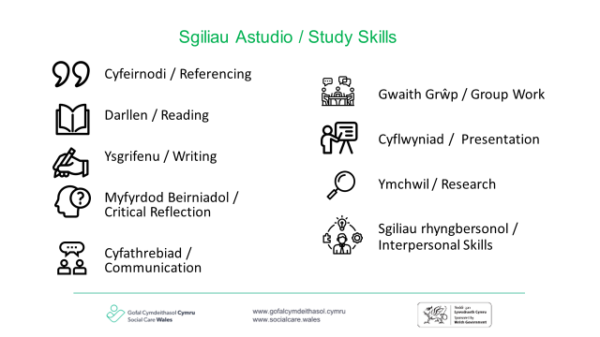

Slide 4
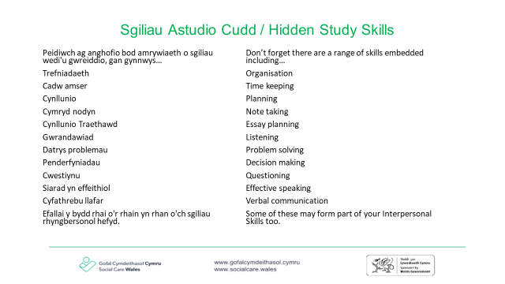

Slide 5
Deilliannau dysgu
Learning outcomes
Deall sut mae DPP yn arwain ac yn gwella ymarfer
Gallu defnyddio codau, deddfwriaeth a rheoliadau i lywio a gwella eich ymarfer
Deall trin data
Deall gweithio mewn partneriaeth
Understand how CPD guides and improves practice
Be able to use codes, legislation and regulations to inform and improve your practice
Understand data handling
Understand partnership working
Notes:
WELSH
Yn hollbwysig i unrhyw sesiynau a addysgir, mae disgwyliad y bydd unigolion yn rhannu profiadau o ymarfer sy’n ymwneud â phynciau a drafodir.
Rhaid cadw at gyfrinachedd, yn gyntaf trwy i'r siaradwr beidio â datgelu manylion personol yr unigolion/eraill dan sylw, ac yn ail gan gyfranogwyr eraill. Rhaid i brofiadau a rennir o fewn y grŵp aros o fewn y sesiwn a pheidio â chael eu datgelu gyda phartïon allanol, ac eithrio lle mae pryder diogelu.
ENGLISH
Paramount to any taught sessions, there is an expectation that individuals will share experiences of practice that relate to discussed topics.
Confidentiality must be adhered to, firstly from the speaker not disclosing personal details of individuals/others involved, and secondly form other participants. Experiences shared within the group must remain within the session and not disclosed with outside parties, with the exception of where there is a safeguarding concern.

Slide 6
Deilliant Dysgu 1
Learning Outcome 1
Sicrhau bod eich datblygiad proffesiynol parhaus eich hun yn bodloni safonau a gofynion ac yn adlewyrchu arfer gorau yng nghyd-destun gweithio yng Nghymru
Yn ogystal, gallu defnyddio codau, deddfwriaeth a rheoliadau i lywio a gwella eich ymarfer
Ensure that own continual professional development meets standards and requirements and reflects best practice in the context of working in Wales
Additionally, be able to use codes, legislation and regulations to inform and improve your practice

Slide 7




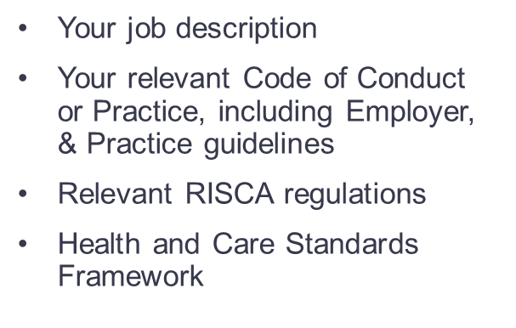
Ar gyfer yr uned hon bydd angen:
:
Eich swydd ddisgrifiad
Eich Cod Ymddygiad neu Ymarfer perthnasol, gan gynnwys canllawiau’r Cyflogwr a chanllawiau Ymarfer
Rheoliadau RISCA perthnasol
Fframwaith Safonau Iechyd a Gofal
Notes:
WELSH
Sleid yn ymwneud ag AC 1.1 Cyfrifoldebau ac atebolrwydd proffesiynol o fewn cyd-destun fframweithiau deddfwriaethol, safonau a Chodau Ymddygiad ac Ymarfer Proffesiynol perthnasol
Y nod yma yw bod pob dysgwr yn cael mynediad at y ddeddfwriaeth sy'n llywio eu hymarfer gan y bydd hyn yn cael ei ddefnyddio trwy gydol y sesiwn.
Dewch o hyd i reoliadau RISCA perthnasol yn: https://careinspectorate.wales/legislation
Cod Ymarfer Proffesiynol Gofal Cymdeithasol https://gofalcymdeithasol.cymru/cms_assets/file-uploads/Code-of-Professional-Practice-for-Social-Care-web-version.pdf
Cod Ymarfer Proffesiynol i Gyflogwyr https://gofalcymdeithasol.cymru/cms_assets/file-uploads/Employers-code.pdf
Cod Ymddygiad y GIG ar gyfer Gweithwyr Cymorth Gofal Iechyd yng Nghymru http://www.wales.nhs.uk/documents/Code_of_Conduct_for_Healthcare_Support_Workers_in_Wales.pdf
Cod Ymarfer ar gyfer Cyflogwyr GIG Cymru http://www.wales.nhs.uk/documents/Code_of_Practice_for_NHS_Wales_Employers.pdf
Deddf Gwasanaethau Cymdeithasol a Llesiant https://socialcare.wales/hub/sswbact
Fframwaith Safonau Iechyd a Gofal http://www.wales.nhs.uk/sitesplus/documents/1064/24729_Health%20Standards%20Framework_2015_E1.pdf
Cymru Iachach https://gov.wales/sites/default/files/publications/2021-09/a-healthier-wales-our-plan-for-health-and-social-care.pdf
Mae canllawiau Ymarfer Pellach ar gyfer pob rôl ar gael yn : https://gofalcymdeithasol.cymru/dealing-with-concerns/codes-of-pactice-and-guidance
ENGLISH
Slide relating to AC 1.1 Professional responsibilities and accountabilities within the context of relevant legislative frameworks, standards and Codes of Conduct and Professional Practice
The aim here is that all learners have access to the legislation that informs their practice as this will be used through the session.
ENGLISH LINKS (links also available on last slide)
Find relevant RISCA regs at: https://careinspectorate.wales/legislation
Code of Professional Practice for Social Care https://socialcare.wales/cms_assets/file-uploads/Code-of-Professional-Practice-for-Social-Care-web-version.pdf
Code of Professional Practice for Employers https://socialcare.wales/cms_assets/file-uploads/Employers-code.pdf
NHS Code of Conduct for Healthcare Support Workers in Wales http://www.wales.nhs.uk/documents/Code_of_Conduct_for_Healthcare_Support_Workers_in_Wales.pdf
Code of Practice for NHS Wales Employers http://www.wales.nhs.uk/documents/Code_of_Practice_for_NHS_Wales_Employers.pdf
Social Services and Wellbeing Act https://socialcare.wales/hub/sswbact
Heath and Care Standards Framework http://www.wales.nhs.uk/sitesplus/documents/1064/24729_Health%20Standards%20Framework_2015_E1.pdf
A Healthier Wales https://gov.wales/sites/default/files/publications/2021-09/a-healthier-wales-our-plan-for-health-and-social-care.pdf
Further Practice Guidance for each role available at : https://socialcare.wales/dealing-with-concerns/codes-of-practice-and-guidance

Slide 8
Dyletswydd Gonestrwydd
Duty of Candour
“Fel gweithiwr gofal cymdeithasol proffesiynol mae’n rhaid i chi fod yn agored ac yn onest gydag unigolion pan fydd rhywbeth sy’n mynd o’i le gyda’u gofal neu gymorth yn cael, neu sydd â’r potensial i gael, effaith andwyol ar eu llesiant.”
Gofal Cymdeithasol Cymru
“As a social care professional you must be open and honest with individuals when something that goes wrong with their care or support has, or has the potential to have, an adverse effect on their well-being.”
Social Care Wales
Notes:
WELSH
Sleid yn ymwneud ag AC 1.2 Gofynion deddfwriaethol, rheoleiddiol a sefydliadol yn ymwneud â Dyletswydd Gonestrwydd a phwysigrwydd bod yn agored ac yn onest os aiff pethau o chwith
Y nod yma yw bod pob dysgwr yn deall ei rôl o ran datgeliad llawn, didwylledd a gonestrwydd, pan nad yw safonau ac arfer da wedi'u cynnal. Byddant yn edrych yn ddiweddarach ar ganlyniadau Gwrandawiadau i ehangu eu dealltwriaeth.
Rhannwch y ddogfen (dogfennau) isod a thrafodwch gyda'r dysgwyr.
Dyletswydd Gonestrwydd Gofal Cymdeithasol
https://socialcare.wales/cms_assets/file-uploads/SCW-DutyofCandour-ENG-V01.pdf
Dyletswydd Gonestrwydd GIG Cymru
https://gov.wales/health-and-social-care-quality-and-engagement-wales-act-summary-html
ENGLISH
Slide relating to AC 1.2 Legislative, regulatory and organisational requirements related to Duty of Candour and the importance of being open and honest if things go wrong
The aim here is that all learners understand their role in full disclosure, openness and honesty, while standards and good practice has not been upheld. They will later look at Hearing outcomes to extend their understanding.
Please share the below document(s) and discuss with learners.
Duty of Candour Social Care
https://socialcare.wales/cms_assets/file-uploads/SCW-DutyofCandour-ENG-V01.pdf
Duty of Candour NHS Wales
https://gov.wales/health-and-social-care-quality-and-engagement-wales-act-summary-html

Slide 9
Dyletswydd Gonestrwydd
Duty of Candour
Meddyliwch yn Gyflym!
Myfyriwch ar eich profiadau eich hun pan rydych wedi cyflawni eich dyletswydd gonestrwydd.
Beth oedd eich meddyliau a'ch teimladau?
Quick Think!
Reflect on your own experiences when you have fulfilled your duty of candour.
What were your thoughts and feelings?
Notes:
WELSH
Sleid yn ymwneud ag AC 1.2 Gofynion deddfwriaethol, rheoleiddiol a sefydliadol yn ymwneud â Dyletswydd Gonestrwydd a phwysigrwydd bod yn agored ac yn onest os aiff pethau o chwith
Y nod yma yw bod pob dysgwr yn deall ei rôl o ran datgeliad llawn, didwylledd a gonestrwydd, pan nad yw safonau ac arfer da wedi'u cynnal. Byddant yn edrych yn ddiweddarach ar ganlyniadau Gwrandawiadau i ehangu eu dealltwriaeth.
Atgoffa am gyfrinachedd.
Anogwch y dysgwyr i fynegi sut maen nhw yn eu hymarfer eu hunain wedi ymrwymo i ddyletswydd gonestrwydd trwy gydol eu hymarfer mewn gofal cymdeithasol.
Gofynnwch a yw unrhyw un yn dymuno rhannu.
Ychwanegu enghreifftiau o ymarfer?
ENGLISH
Slide relating to AC 1.2 Legislative, regulatory and organisational requirements related to Duty of Candour and the importance of being open and honest if things go wrong
The aim here is that all learners understand their role in full disclosure, openness and honesty, while standards and good practice has not been upheld. They will later look at Hearing outcomes to extend their understanding.
Reminder of confidentiality.
Encourage the learners to express how in their own practice they have committed to duty candour throughout their practice in social care.
Ask if anyone wishes to share.
Add practice examples?

Slide 10
Rolau a chyfrifoldebau
Role and responsibilities
Defnyddiwch eich Cod a Swydd Ddisgrifiad i ystyried:
Eich rôl
Eich cyfrifoldebau
Yr hyn sydd y tu allan i'ch rôl/cyfrifoldeb a ble i geisio cymorth ar gyfer arweiniad y tu allan i'ch cyfrifoldeb neu lefel arbenigedd/profiad.
Use your Code and Job description to consider:
Your role
Your responsibilities
What is outside your role/responsibility and where to seek support for guidance outside your responsibility or level of expertise/experience.
Notes:
WELSH
Sleid yn ymwneud ag AC 1.4 Pwysigrwydd cydnabod a chadw at ffiniau eich rôl a'ch cyfrifoldebau eich hun ac 1.5 Sut a phryd i geisio cymorth ychwanegol mewn sefyllfaoedd y tu hwnt i’ch rôl, cyfrifoldebau, lefel profiad ac arbenigedd eich hun neu os oes ansicrwydd ynghylch sut i symud ymlaen â mater gwaith
Y nod yma yw bod pob dysgwr yn deall eu rôl a'u cyfrifoldebau ac yn gallu nodi meysydd sydd angen eu datblygu.
Cefnogi dysgwyr i ymchwilio i'w Cod a'u rheoliadau perthnasol, a'u swydd ddisgrifiad i archwilio eu cyfrifoldebau
At bwy maen nhw'n mynd/ble maen nhw’n chwilio am gymorth ac arweiniad pan nad ydyn nhw’n siŵr sut i symud ymlaen gyda mater gwaith, am gymorth ychwanegol neu lle mae cam gweithredu gofynnol y tu allan i’w cylch gwaith?
Bydd hyn yn achosi peth trafodaeth ynghylch gorgyffwrdd cyfrifoldeb a gellir ei gymhwyso o fewn y sleid nesaf.
ENGLISH
Slide relating to AC 1.4 The importance of recognising and adhering to the boundaries of own role and responsibilities and 1.5 How and when to seek additional support in situations beyond own role, responsibilities, level of experience and expertise or unsure as to how to proceed in a work matter
The aim here is that all learners understand their role and responsibilities and be able to identify areas which require development.
Support learners to research their relevant Code and regulations, and job description to explore their responsibilities
Who do they approach/where do they look for support and guidance when they are unsure on how to proceed in a work matter, for additional support or where a required action is outside of their remit?
This will cause some discussion around crossover of responsibility and that can be applied within the next slide.

Slide 11

Y Toesen
The Doughnut
Craidd – eich cyfrifoldebau craidd
Core - your core responsibilities
Creadigrwydd a barn
Creativity and judgement
Tu allan – cyfrifoldebau pobl eraill
Outside - other’s responsibilities
Notes:
WELSH
Sleid yn ymwneud ag AC 1.4 Pwysigrwydd cydnabod a chadw at ffiniau eich rôl a'ch cyfrifoldebau eich hun ac 1.5 Sut a phryd i geisio cymorth ychwanegol mewn sefyllfaoedd y tu hwnt i’ch rôl, cyfrifoldebau, lefel profiad ac arbenigedd eich hun neu os oes ansicrwydd ynghylch sut i symud ymlaen â mater gwaith
Y nod yma yw bod pob dysgwr yn deall eu rôl a'u cyfrifoldebau ac yn gallu nodi ffiniau.
Anaml y mae pob cyfrifoldeb ar ysgwyddau un person mewn IGC. Yn aml mae gorgyffwrdd, ac mae angen hyblygrwydd i sicrhau bod canlyniadau yn canolbwyntio ar yr unigolyn.
Mae'r Toesen yn ein cefnogi i gymhwyso ein rolau a'n cyfrifoldebau mewn ffordd fwy cyfannol na rhestru.
Edrychwch ar eich cyfrifoldebau a'u cymhwyso ar draws y 3 chategori.
Yma byddwn yn defnyddio teclyn The Doughnut Management gan Charles Handy i grwpio ein cyfrifoldebau.
Y Craidd yw ein cyfrifoldebau craidd - y dyletswyddau sydd angen eu cyflawni, ee asesiad anghenion ar gyfer pob unigolyn.
Mae'r tu allan yn gyfrifoldebau nad ydynt yn perthyn i ni, ee pa gwmni fydd yn gofalu am yr unigolyn
Y rhan fwyaf o'r toesen yw barn a chreadigrwydd o ran sut i gyflawni canlyniadau.
Mae Y Toesen yn ddamcaniaeth a gymerwyd o The Empty Raincoat Charles Handy
http://helensandersonassociates.co.uk/person-centred-practice/person-centred-thinking-tools/doughnut/
ENGLISH
Slide relating to AC 1.4 The importance of recognising and adhering to the boundaries of own role and responsibilities and 1.5 How and when to seek additional support in situations beyond own role, responsibilities, level of experience and expertise or unsure as to how to proceed in a work matter
The aim here is that all learners understand their role and responsibilities and be able to identify boundaries.
Rarely are all responsibilities one person’s in HSC. There is often cross over, and flexibility required to ensure outcomes are person centred.
The Doughnut supports us to apply our roles and responsibilities in a more holistic way than listing.
Look at your responsibilities and apply then across the 3 categories.
Here we will apply Charles Handy’s The Doughnut Management tool to group our responsibilities.
The Core is our core responsibilities- the duties that need to be done, eg, a needs assessment for each individual.
The outside are responsibilities that don’t belong to us, eg, which company will provide the care for the individual
The bulk of the doughnut is the judgement and creativity of how to achieve outcomes.
The Doughnut is a theory taken from The Empty Raincoat Charles Handy
http://helensandersonassociates.co.uk/person-centred-practice/person-centred-thinking-tools/doughnut/

Slide 12
Atebolrwydd
Accountability
“Mae atebolrwydd yn golygu bod yn gyfrifol i rywun, neu am ryw weithred, a'ch bod yn gallu egluro beth rydych yn ei wneud. ... Mae gweithwyr proffesiynol ym maes iechyd a gofal cymdeithasol yn cael eu dal yn atebol am eu gwaith gan eu cyrff rheoleiddio.'”
https://resources.collins.co.uk/free/hsc.pdf
“Accountability means being responsible to someone, or for some action, and that you are able to explain what you do. ... Professionals in health and social care are held accountable for their work by their regulatory bodies.’”
https://resources.collins.co.uk/free/hsc.pdf
Notes:
WELSH
Sleid yn ymwneud ag AC 1.3. Pwysigrwydd cydnabod a chadw at ffiniau eich rôl a'ch cyfrifoldebau eich hun
Y nod yma yw cyflwyniad i atebolrwydd.
https://resources.collins.co.uk/free/hsc.pdf
Discuss accountability – is this the same as blame? Accountability in a everyday life context - Brené Brown on Blame - YouTube
ENGLISH
Slide relating to AC 1.3. The importance of recognising and adhering to the boundaries of own role and responsibilities
The aim here an introduction to accountability.
https://resources.collins.co.uk/free/hsc.pdf

Slide 13
Atebolrwydd
Accountability
Ystyriwch:
Am beth ydych chi'n atebol?
Sut, pryd a ble ydych chi'n atebol?
Pam ydych chi'n atebol?
Sut ydych chi'n atebol am ansawdd eich ymarfer eich hun?
Trafodaeth Adolygu Ymarfer
Consider:
What are you accountable for?
How, when and where are you accountable?
Why are you accountable?
How are you accountable for the quality of your own practice?
Practice Review Discussion
Notes:
WELSH
Sleid yn ymwneud ag 1.3 Pwysigrwydd cydnabod a chadw at ffiniau eich rôl a'ch cyfrifoldebau eich hun
Y nod yma yw bod pob dysgwr yn nodi ei atebolrwydd, a sut mae hyn yn berthnasol i atebolrwydd ansawdd ei ymarfer ei hun.
Hyrwyddwch drafodaeth grŵp ar atebolrwydd a rhowch adborth fel grŵp.
Hybwch y defnydd o Godau i nodi rhesymau dros atebolrwydd.
Defnyddiwch yr adolygiad Ymarfer https://socialcare.wales/cms_assets/file-uploads/29.-Practice-Review-Adult-C.pdf i drafod atebolrwydd y gwahanol bartïon.
ENGLISH
Slide relating to AC 1.3 The importance of recognising and adhering to the boundaries of own role and responsibilities
The aim here is that all learners identify their accountability, and how does this apply to the accountability of quality of own practice.
Promote group discussion of accountability and feedback as a group.
Prompt use of Codes to identify reasons for accountability.
Use the Practice review https://socialcare.wales/cms_assets/file-uploads/29.-Practice-Review-Adult-C.pdfto discuss how could accountability of the different parties.

Slide 14
Datblygiad Proffesiynol
Professional Development
“Datblygiad Proffesiynol Parhaus (DPP) yw datblygiad wedi’i gynllunio, parhaus o wybodaeth a sgiliau proffesiynol trwy gydol eich bywyd gwaith. Mae’n ddull cyfannol o ddysgu sy’n cydnabod profiadau bob dydd fel cyfleoedd dysgu.”
Gofal Cymdeithasol Cymru
“Continuing Professional Development (CPD) is planned, ongoing development of professional knowledge and skills throughout your working life. It is a holistic approach to learning which recognises every day experiences as learning opportunities.”
Social Care Wales
Notes:
WELSH
Sleid yn ymwneud ag AC 1.7 Yr ystod o gyfleoedd dysgu a sut i gael mynediad atynt ac 1.8 Sut i ddefnyddio cyfleoedd dysgu yn effeithiol i wella eich gwybodaeth, dealltwriaeth, sgiliau ac ymarfer eich hun, gan gynnwys dysgu o brofiadau dydd i ddydd
Y nod yma yw cyflwyniad i DPP.
https://socialcare.wales/cms_assets/file-uploads/CCPD-toolkit-for-social-care-ENGv01.pdf
Gofynnwch i'r dysgwyr ddarllen drwy'r ddogfen atodedig i nodi pam mae DPP yn bwysig a dulliau dysgu a datblygu.
ENGLISH
Slide relating to AC 1.7 The range of learning opportunities and how to access them and 1.8 How to use learning opportunities effectively to improve own knowledge, understanding, skills and practice, including learning from day to day experiences
The aim here an introduction to CPD.
https://socialcare.wales/cms_assets/file-uploads/CCPD-toolkit-for-social-care-ENGv01.pdf
Ask learners to read through the attached document to identify why CPD is important and methods of learning and development.

Slide 15
Datblygiad Proffesiynol
Professional Development
Meddyliwch yn Gyflym!
Pam fod DPP yn bwysig?
Beth yw dulliau dysgu a datblygu?
Quick Think!
Why is CPD important?
What are methods of learning and development?
Notes:
WELSH
Sleid yn ymwneud ag AC 1.7 Yr ystod o gyfleoedd dysgu a sut i gael mynediad atynt ac 1.8 Sut i ddefnyddio cyfleoedd dysgu yn effeithiol i wella eich gwybodaeth, dealltwriaeth, sgiliau ac ymarfer eich hun, gan gynnwys dysgu o brofiadau dydd i ddydd
Y nod yma yw i bob dysgwr nodi cyfleoedd dysgu o fewn eu rolau a sut i'w defnyddio.
Canllawiau cyflwyno i roi enghreifftiau o: weithgareddau hyfforddi, mentora, hyfforddi, cysgodi, sefydlu, goruchwylio, darllen dan arweiniad, ymchwil, setiau dysgu gweithredol, trafodaethau grŵp cyfoedion
https://socialcare.wales/cms_assets/file-uploads/CCPD-toolkit-for-social-care-ENGv01.pdf
Gofynnwch i'r dysgwyr rannu'r hyn maen nhw wedi'i ymchwilio.
ENGLISH
Slide relating to AC 1.7 The range of learning opportunities and how to access them and 1.8 How to use learning opportunities effectively to improve own knowledge, understanding, skills and practice, including learning from day to day experiences
The aim here is for all learners to identify learning opportunities within their roles and how to use them.
Guidance for delivery to gives examples of: training activities, mentoring, coaching, shadowing, induction, supervision, guided reading, research, action learning sets, peer group discussions
https://socialcare.wales/cms_assets/file-uploads/CCPD-toolkit-for-social-care-ENGv01.pdf
Ask learners share what they have researched.

Slide 16
Datblygiad Proffesiynol
Professional Development
Dylai dysgwyr L4 hefyd edrych ar y canlynol i ddangos tystiolaeth o arfer wedi’i lywio gan dystiolaeth:
Adolygiadau Ymarfer
Canlyniadau gwrandawiadau
Ymchwil
Ble gallwch chi ddod o hyd i'r rhain?
L4 learners should also look at the following to evidence informed practice:
Practice Reviews
Hearing outcomes
Research
Where can you find these?
Notes:
WELSH
Sleid yn ymwneud ag AC 1.6, Pwrpas ymgymryd â datblygiad personol a phroffesiynol a'ch cyfrifoldeb personol o ran gwneud hynny ac 1.8 Sut i ddefnyddio cyfleoedd dysgu yn effeithiol i wella eich gwybodaeth, dealltwriaeth, sgiliau ac ymarfer eich hun, gan gynnwys dysgu o brofiadau dydd i ddydd
Y nod yma yw i bob dysgwr nodi ffynonellau gwybodaeth i ddatblygu ymarfer wedi'i lywio gan dystiolaeth a sut i'w defnyddio.
Cysylltwch yn ôl â sleidiau Dyletswydd Gonestrwydd a nodwch pa mor aml yn y canlyniadau gwrandawiadau y cynhelir y ddyletswydd hon.
Mae hefyd yn anelu at gyflwyno dysgwyr i Dasg A a dechrau dyddlyfr dysgwr (gweler y sleid nesaf) a fydd yn cefnogi'r meini prawf na ellir eu bodloni trwy dasgau B-E.
https://socialcare.wales/cms_assets/file-uploads/CCPD-toolkit-for-social-care-ENGv01.pdf
Gofynnwch i'r dysgwyr rannu'r hyn maen nhw wedi'i ymchwilio.
Disgwylir i ddysgwyr ymchwilio i arfer gorau eu hunain gan ddefnyddio'r pwyntiau fel cyfeiriad, o bosibl mewn 3 grŵp ac yna rhannu o fewn y sesiwn. Isod mae dolenni i gefnogi'r hyfforddwr os oes angen cyfeiriad ychwanegol ar ddysgwyr.
https://socialcare.wales/dealing-with-concerns/hearings
http://www.wales.nhs.uk/sitesplus/documents/888/PHW%20Learning%20from%20Reviews%20Report_2017-2018..pdf
https://www.cysur.wales/adult-practice-reviews/
https://www.cysur.wales/child-practice-reviews/
ENGLISH
Slide relating to AC 1.6, The purpose of undertaking personal and professional development and own responsibility for doing so and 1.8 How to use learning opportunities effectively to improve own knowledge, understanding, skills and practice, including learning from day to day experiences
The aim here is for all learners to identify sources of information to develop evidence informed practice and how to use them.
Link back to Duty of Candour slides and note how often in the hearing outcomes this duty is upheld.
It also aims to introduce learners to Task A and start a learner journal (see next slide) which will support the criteria which cannot be met through tasks B-E.
https://socialcare.wales/cms_assets/file-uploads/CCPD-toolkit-for-social-care-ENGv01.pdf
Ask learners share what they have researched.
Learners are expected to research best practice themselves using the points as direction, possibly in 3 groups and then share within session. Below are links to support the trainer if learners require additional direction.
https://socialcare.wales/dealing-with-concerns/hearings
http://www.wales.nhs.uk/sitesplus/documents/888/PHW%20Learning%20from%20Reviews%20Report_2017-2018..pdf
https://www.cysur.wales/adult-practice-reviews/
https://www.cysur.wales/child-practice-reviews/

Slide 17
Dyddlyfr Dysgwr
Learner Journal
Tasg A
Portffolio o dystiolaeth
Cadwch ddyddlyfr dysgwr i ddarparu tystiolaeth ar gyfer unrhyw ddeilliannau dysgu nad ydynt wedi'u harsylwi'n llawn trwy dasgau B-D.
Task A
Portfolio of evidence
Keep a learner journal to provide evidence for any learning outcomes not fully observed through tasks B-D.
Notes:
WELSH
Sleid yn ymwneud ag AC 1.8 Sut i ddefnyddio cyfleoedd dysgu yn effeithiol i wella eich gwybodaeth, dealltwriaeth, sgiliau ac ymarfer eich hun, gan gynnwys dysgu o brofiadau dydd i ddydd ac 1.9 Sut i ddefnyddio ffynonellau dysgu i ddatblygu ymarfer wedi'i lywio gan dystiolaeth
Y nod yma yw cyflwyno dysgwyr i Dasg A a dechrau dyddlyfr dysgwr a fydd yn cefnogi'r meini prawf na ellir eu bodloni trwy dasgau B-E. Bydd y sleidiau canlynol yn cyflwyno cylch dysgu a model adfyfyriol.
Mae Tasg A yn gofyn i chi gadw portffolio o dystiolaeth a dylai adlewyrchu eich dysgu wrth baratoi ar gyfer tasgau B-E. Bydd hefyd yn cefnogi unrhyw feini prawf efallai na chânt eu bodloni drwy dasgau B-E, er enghraifft, bydd adolygu rolau a chyfrifoldebau yn cefnogi meini prawf Uned 441, AC 1.13.
Ôl-ddyddiwch hyn i'r sesiwn ar gyfer Uned 440.
Gellir gweld enghraifft o hyn yn https://gofalcymdeithasol.cymru/cms_assets/file-uploads/CCPD-toolkit-for-social-care-ENGv01.pdf a ddefnyddiwyd yn flaenorol ar sleid 10, neu gall canolfannau ddarparu eu fformat eu hunain.
Drwy gydol y cymhwyster byddwch yn cadw dyddlyfr dysgwr ac yn cofnodi unrhyw brofiadau dysgu megis:
Hyfforddiant (gan gynnwys sesiynau SSP)
Hyfforddi/mentora
Goruchwyliaeth
Cyfarfodydd tîm
Myfyrio ar eich ymarfer eich hun gan gynnwys enghreifftiau nodedig neu ddangosol
Ymchwilio a myfyrio ar hyn, e.e., adolygiadau Achosion Difrifol, astudiaethau gofal, ymchwil, canlyniadau gwrandawiadau, ac ati
Bydd angen i chi gofnodi'r hyn rydych wedi'i ddysgu, myfyrdod gan ddefnyddio amrywiaeth o ddamcaniaethau myfyrio, a sut y bydd hyn yn dylanwadu ar eich ymarfer yn y dyfodol.
Dylai myfyrdod cyffredinol gynnwys: beth aeth yn dda, neu ddim cystal, a'u meddyliau a'u teimladau ar sut i wella eu hymarfer i gefnogi canlyniadau i unigolion.
Gallai hyn fod yn fuddiol hefyd wrth gofnodi eich dysgu yn unol â chofrestru.
ENGLISH
Slide relating to AC 1.8 How to use learning opportunities effectively to improve own knowledge, understanding, skills and practice, including learning from day to day experiences and 1.9 How to use sources of information to develop evidence informed practice
The aim here is to introduce learners to Task A and start a learner journal which will support the criteria which cannot be met through tasks B-E. The following slides will introduce learning cycle and reflective model.
Task A requires you to keep a portfolio of evidence and should reflect your learning in preparation for tasks B-E. It will also support any criteria that may not be met through tasks B-E, for example, reviewing of roles and responsibilities will support the criteria Unit 441, AC 1.13.
Backdate this to session for Unit 440.
An example of this can be accesses at https://socialcare.wales/cms_assets/file-uploads/CCPD-toolkit-for-social-care-ENGv01.pdf previously used in slide 10, or Centres may provide their own format.
Throughout the qualification you will keep a learner journal and record any learning experiences such as:
Training (including SSP sessions)
Coaching/mentoring
Supervisions
Team meetings
Reflection on your own practice including standout or showcase examples
Research and reflection on this, eg, Serious Case reviews, care studies, research, hearing outcomes, etc
You will need to record what you have learned, a reflection using a range of reflection theories, and how this will influence your practice in the future.
Reflection overall should cover: what has gone well, or less well, and their thoughts and feelings on how to improve their practice to support outcomes for individuals.
This could also be beneficial when logging your learning in line with registration

Slide 18
Rhoi dysgu ar waith
Applying learning into practice
Cylch Dysgu Kolb
Cylch datblygiad parhaus
Dysgu trwy brofiad a myfyrio
Kolb Learning Cycle
Continuous cycle of development
Learning through experience and reflection
Notes:
WELSH
Sleid yn ymwneud ag AC 1.10 Sut i gymhwyso dysgu a throsglwyddo sgiliau i sefyllfaoedd newydd
Y nod yma yw cyflwyno dysgwyr i gylch dysgu Kolb ac offeryn myfyriol Rayner y gellir eu hymgorffori yn y Dyddlyfr Dysgwr (Tasg A).
ENGLISH
Slide relating to AC 1.10 How to apply learning and transfer skills into new situations
The aim here is to introduce learners to Kolb learning cycle and Rayner’s reflective tool that can be incorporated into Learner Journal (Task A).

Slide 19
Cylch Dysgu Kolb
Kolb Learning Cycle
Cam profiadau concrit
Concrete experiences stage
Cam Arsylwi a Myfyrio
Observational and Reflective stage
Cam cysyniadoli haniaethol
Abstract conceptualisation stage
Cam arbrofi gweithredol
Active experimental stage
Notes:
WELSH
Sleid yn ymwneud ag AC 1.10 Sut i gymhwyso dysgu a throsglwyddo sgiliau i sefyllfaoedd newydd
Y nod yma yw i ddysgwyr gymhwyso'r cylch dysgu i'w rolau eu hunain.
Trafodwch y cylch gan ddefnyddio enghreifftiau o'u dysgu yn eu hymarfer eu hunain, o ddechrau eu rôl/systemau newydd yn eu lle.
CAM PROFIADAU CONCRIT profi sefyllfa neu weithgaredd
CAM ARSYLWI A MYFYRIO myfyrdod cychwynnol ar y gweithgaredd
CAM CYSYNIADOLI HANIAETHOL adolygu'r gweithgaredd a dod i gasgliadau
CAM ARBROFI GWEITHREDOL rhoi cynnig ar ddamcaniaethau a syniadau trwy brofi mewn sefyllfa newydd
ENGLISH
Slide relating to AC 1.10 How to apply learning and transfer skills into new situations
The aim here is for learners to apply the cycle of learning to their own roles.
Discuss the cycle using examples from their own practice learning from the start of their role/new systems in place.
CONCRETE EXPERIENCES STAGE experience situation or activity
OBSERVATIONAL AND REFELCTIVE STAGE initial reflection of activity
ABSTRACT CONCEPTUALISATON STAGE review activity and draw conclusions
ACTIVE EXPERIMENTATION STAGE try out theories and ideas by testing in a new situation

Slide 20
Ymarfer Myfyriol
Reflective Practice
Model Head Heard Tummy Toes Rayner
Iaith symlach i'w defnyddio yn eich gweithle gyda phob unigolyn gan gynnwys plant.
Crëwyd ar gyfer gofal gan yr addysgwr ymarfer Rachel Rayner ac mae'n ystyried bod newidiadau ffisiolegol yn gallu arwain myfyrdod.
Rayner’s Head Heard Tummy Toes Model
Simplified language to use within your workplace with all individuals including children.
Created for care by practice educator Rachel Rayner and considers physiological changes being able to lead reflection.
Notes:
WELSH
Sleid yn ymwneud ag AC 1.10 Sut i gymhwyso dysgu a throsglwyddo sgiliau i sefyllfaoedd newydd
Y nod yma yw i ddysgwyr gymhwyso offeryn myfyriol i'w rolau eu hunain.
Trafodwch y model gan ddefnyddio enghreifftiau o'u dysgu yn eu hymarfer eu hunain, o ddechrau eu rôl/systemau newydd yn eu lle.
Efallai y bydd y dysgwyr hefyd am ymgorffori hyn yn eu hymarfer gyda'r unigolion y maent yn eu cefnogi i wella cyfathrebu a chanlyniadau.
https://www.skillsforcare.org.uk/Documents/Learning-and-development/ASYE-adults/Tool-5.pdf
ENGLISH
Slide relating to AC 1.10 How to apply learning and transfer skills into new situations
The aim here is for learners to apply a reflective tool to their own roles.
Discuss the model using examples from their own practice learning from the start of their role/new systems in place.
The learners may also wish to embed this in their practice with the individuals they support to improve communication and outcomes.
https://www.skillsforcare.org.uk/Documents/Learning-and-development/ASYE-adults/Tool-5.pdf

Slide 21
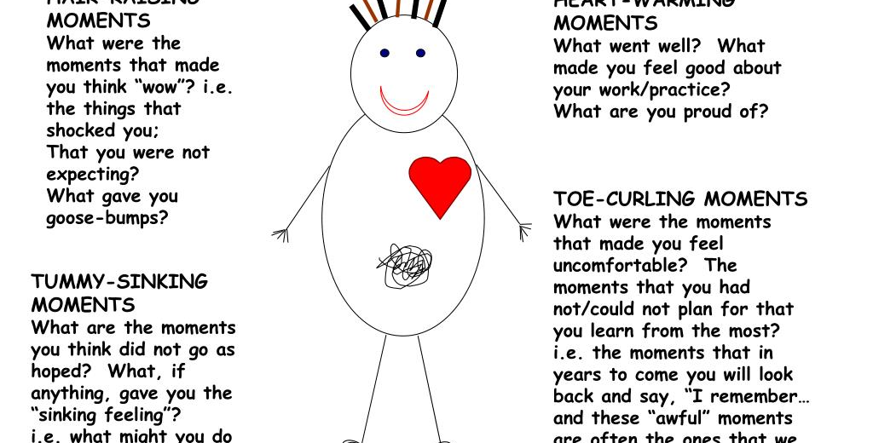
Model Head Heart Tummy Toes Rayner
Rayner’s Head Heart Tummy Toes Model.
Notes:
WELSH
Sleid yn ymwneud ag AC 1.10 Sut i gymhwyso dysgu a throsglwyddo sgiliau i sefyllfaoedd newydd
Y nod yma yw i ddysgwyr gymhwyso offeryn myfyriol i'w rolau eu hunain.
Trafodwch y model gan ddefnyddio enghreifftiau o'u dysgu yn eu hymarfer eu hunain, o ddechrau eu rôl/systemau newydd yn eu lle.
Efallai y bydd y dysgwyr hefyd am ymgorffori hyn yn eu hymarfer gyda'r unigolion y maent yn eu cefnogi i wella cyfathrebu a chanlyniadau.
ENGLISH
Slide relating to AC 1.10 How to apply learning and transfer skills into new situations
The aim here is for learners to apply a reflective tool to their own roles.
Discuss the model using examples from their own practice learning from the start of their role/new systems in place.
The learners may also wish to embed this in their practice with the individuals they support to improve communication and outcomes.

Slide 22
Myfyrdod gyda Siobhan Maclean
Reflection with Siobhan Maclean
Gwyliwch
Component Models of Reflection
Mae Siobhan yn trafod ‘Korthagen reflective Onion’ yma ond mae wedi cynhyrchu Cardiau Annog Ymarfer Myfyriol sy'n cynnwys 52 o Gardiau i wella Ymarfer proffesiynol
Watch
Component Models of Reflection
Siobhan discusses Korthagen reflective Onion here but has produced Reflective Practice Prompt Cards which contains 52 Cards to improve profession Practice
Notes:
WELSH
Sleid yn ymwneud ag AC 1.10 Sut i gymhwyso dysgu a throsglwyddo sgiliau i sefyllfaoedd newydd
Y nod yma yw i ddysgwyr gymhwyso offeryn myfyriol i'w rolau eu hunain.
https://m.youtube.com/watch?v=SU4tGEHZ4Ag – Cardiau Annog Ymarfer Myfyriol
ENGLISH
Slide relating to AC 1.10 How to apply learning and transfer skills into new situations
The aim here is for learners to apply a reflective tool to their own roles.
https://m.youtube.com/watch?v=SU4tGEHZ4Ag – Reflective Practice Prompt Cards

Slide 23

Astudiaethau dan gyfarwyddyd
Directed study
Ymchwiliwch i fodelau myfyriol, mae yna lawer o wahanol fodelau. Ceisiwch ddod o hyd i un sy'n gweithio i chi.
Rhowch gynnig ar ddilyn eich model dewisol a'i gymhwyso i fater ymarfer.
Research reflective models, there are many different models. Try and find one that works for you.
Have a go at following your chosen model and applying it to a practice issue.

Slide 24
Deilliant Dysgu 2
Learning Outcome 2
Bodloni gofynion ar gyfer cyflwyno, cofnodi, adrodd a storio gwybodaeth
Meet requirements for presenting, recording, reporting and storing information

Slide 25
Deddfwriaeth
Legislation
Rydych chi eisoes wedi rhoi sylw i:
GDPR a Deddf Diogelu Data 2018
Deddfau Hawliau Dynol a Chydraddoldeb
Cod Ymarfer/Ymddygiad
Adolygwch a thrafodwch yr hyn y maent yn ei ddweud am gyflwyno, cofnodi, adrodd, rhannu a storio gwybodaeth.
Ystyriwch gyfrinachedd.
You have previously covered:
GDPR and Data Protection Act 2018
Human Rights and Equality Acts
Code of Practice/Conduct
Review and discuss what they say about presenting, recording, reporting, sharing and storing information.
Consider confidentiality.
Notes:
WELSH
Sleid yn ymwneud ag AC 2.1 Gofynion deddfwriaethol ar gyfer trin gwybodaeth a 2.3 Fformat a phwrpas cofnodion, adroddiadau a rhannu gwybodaeth a sut y dylid eu cyflwyno
Y nod yma yw i ddysgwyr adolygu GDPR a deddfwriaeth arall yn ymwneud â thrin gwybodaeth.
Dylai fod gan bob dysgwr wybodaeth dda am GDPR yn barod a diben y sleid hon yn unig yw ailedrych ar ddeddfwriaeth a chysylltu â chodau proffesiynol.
Canllaw i GDPR
https://assets.publishing.service.gov.uk/government/uploads/system/uploads/attachment_data/file/711097/guide-to-the-general-data-protection-regulation-gdpr-1-0.pdf
ENGLISH
Slide relating to AC 2.1 Legislative requirements for handling information and 2.3 The format and purpose of records, reports and sharing of information and how this should be presented
The aim here is for learners to review GDPR and other legislation relating to handling information.
All learners should already have a good grounding of GDPR and this slide is solely to revisit legislation and link to professional codes.
Guide to GDPR
https://assets.publishing.service.gov.uk/government/uploads/system/uploads/attachment_data/file/711097/guide-to-the-general-data-protection-regulation-gdpr-1-0.pdf

Slide 26
Rhaid i'r cofnodion fod yn:
Records must be:
Cywir
Dyddiedig
Gwrthrychol
Dealladwy
Darllenadwy
Hygyrch
Adlewyrchu barn unigolion a/neu deuluoedd/gofalwyr
Accurate
Dated
Objective
Understandable
Legible
Accessible
Reflect the views of individuals and/or families/carers
Notes:
WELSH
Sleid yn ymwneud ag AC 2.6
Sicrhewch fod eich cofnodion ac adroddiadau eich hun yn: • cywir • dyddiedig • gwrthrychol • dealladwy • darllenadwy • hygyrch • adlewyrchu barn unigolion a/neu deuluoedd/gofalwyr • parchu unigolion a/neu deuluoedd/gofalwyr • wedi'u hysgrifennu mewn ffyrdd nad ydynt yn stigmateiddio nac yn atgyfnerthu canfyddiadau negyddol o unigolion a/neu deuluoedd/gofalwyr • defnyddio iaith gywir a disgrifyddion ar gyfer cyflyrau penodol • gwahaniaethu rhwng ffaith a barn • wedi'u cyflwyno i’r rhai sydd angen gwneud penderfyniadau neu gymryd camau • wedi'u storio, eu rhannu a’u cadw yn unol â pholisïau sefydliadol, gofynion cyfreithiol a diogelu data
A 2.3 Fformat a phwrpas cofnodion, adroddiadau a rhannu gwybodaeth a sut y dylid eu cyflwyno
Y nod yma yw atgoffa dysgwyr o ofynion 2.6 wrth baratoi ar gyfer arsylwi.
Gellid rhagflaenu'r sleid hon drwy nodi y gwahanol ofynion yn dilyn y ddeddfwriaeth.
ENGLISH
Slide relating to AC 2.6
Ensure that own records and reports are: • accurate • dated • objective • understandable • legible • accessible • reflect the views of individuals and/or families/carers • respectful of individuals and/or families/carers • written in ways that do not stigmatise or reinforce negative perceptions of individuals and/or families/carers • use accurate language and descriptors for specific conditions • differentiate between fact and opinion • presented to those who need to make decisions or take actions • stored, shared and retained in accordance with organisational policies, legal requirements and data protection
And 2.3 The format and purpose of records, reports and sharing of information and how this should be presented
The aim here is to remind learners of the requirements for 2.6 in preparation for observation.
This slide could be preceded with a shout out of the different requirements following the legislation.
Discuss Objective - can we put opinion in case notes? What is the danger here?
Legible - Family court in case Re M and N (Children)(Local authority gathering , preserving and disclosing evidence).
Contemporaneous coherent notes LA ended up withdrawing application backlog case notes to write up - any significant discussion record on system asap

Slide 27
Rhaid i'r cofnodion fod yn (parhad)
Records must be:
(cont.)
Wedi’u hysgrifennu mewn ffyrdd nad ydynt yn stigmateiddio nac yn atgyfnerthu canfyddiadau negyddol o unigolion a/neu deuluoedd/gofalwyr
Defnyddio iaith a disgrifiadau cywir ar gyfer cyflyrau penodol
Gwahaniaethu rhwng ffaith a barn
Wedi'u cyflwyno i'r rhai sydd angen gwneud penderfyniadau neu gymryd camau
Wedi'u storio, eu rhannu a'u cadw yn unol â pholisïau'r sefydliad, gofynion cyfreithiol a diogelu data
Written in ways that do not stigmatise or reinforce negative perceptions of individuals and/or families/carers
Use accurate language and descriptions for specific conditions
Differentiate between fact and opinion
Presented to those who need to make decisions or take actions
Stored, shared and retained in accordance with the organisational policies, legal requirements and data protection
Notes:
WELSH
Sleid yn ymwneud ag AC 2.6
Sicrhewch fod eich cofnodion ac adroddiadau eich hun yn: • cywir • dyddiedig • gwrthrychol • dealladwy • darllenadwy • hygyrch • adlewyrchu barn unigolion a/neu deuluoedd/gofalwyr • parchu unigolion a/neu deuluoedd/gofalwyr • wedi'u hysgrifennu mewn ffyrdd nad ydynt yn stigmateiddio nac yn atgyfnerthu canfyddiadau negyddol o unigolion a/neu deuluoedd/gofalwyr • defnyddio iaith gywir a disgrifyddion ar gyfer cyflyrau penodol • gwahaniaethu rhwng ffaith a barn • wedi'u cyflwyno i’r rhai sydd angen gwneud penderfyniadau neu gymryd camau • wedi'u storio, eu rhannu a’u cadw yn unol â pholisïau sefydliadol, gofynion cyfreithiol a diogelu data
A 2.3 Fformat a phwrpas cofnodion, adroddiadau a rhannu gwybodaeth a sut y dylid eu cyflwyno
Y nod yma yw atgoffa dysgwyr o ofynion 2.6 wrth baratoi ar gyfer arsylwi.
ENGLISH
Slide relating to AC 2.6
Ensure that own records and reports are: • accurate • dated • objective • understandable • legible • accessible • reflect the views of individuals and/or families/carers • respectful of individuals and/or families/carers • written in ways that do not stigmatise or reinforce negative perceptions of individuals and/or families/carers • use accurate language and descriptors for specific conditions • differentiate between fact and opinion • presented to those who need to make decisions or take actions • stored, shared and retained in accordance with organisational policies, legal requirements and data protection
And 2.3 The format and purpose of records, reports and sharing of information and how this should be presented
The aim here is to remind learners of the requirements for 2.6 in preparation for observation.
Case study exercise - 10 mins to look at example case note - highlight the issues - what would you want to know if you were picking up this case
5 minutes to look at improved case note

Slide 28
Ystyriwch yr iaith a ddefnyddiwn
Consider the language we use
- Rhaid osgoi labeli sy'n stigmateiddio a disgrifyddion ymddygiad personol, er enghraifft:
•ddim yn cydymffurfio
•camweithredol
•digymell
•Diog
Ystrywgar
- Stigmatising labels and personal behaviour descriptors must be avoided, for example:
non-compliant
dysfunctional
unmotivated
lazy
manipulative
Notes:
Avoiding the language of deficits - Think about the way statements are worded. How would you feel to reading them?

Slide 29
Dadbersonoli'r unigolyn
Depersonalising the individual
Yn yr un modd, dylem osgoi cyfeirio at yr unigolyn fel (er enghraifft) “mam” neu “dad” neu “mam-gu” ac ati a chyfeirio atynt wrth eu henwau priodol (tad y plant , Mr. Jones etc.)
Mae ef/hi yn LAC (Plentyn sy'n Derbyn Gofal)
Nhw/cleient/defnyddiwr gwasanaeth/claf
Mae hyn yn bwysig nid yn unig yn ymarferol ond hefyd o ran sut i ysgrifennu adroddiadau myfyriol.
Similarly, we should avoid referring to the individual as (for example) “mum” or “dad” or “gran” etc. and refer to them by their proper names. – (the children’s father , Mr. Jones etc.)
He/she is LAC (Looked After Child)
They/them/client/service user/patient
This is important not only in practice but also in terms of how you write up reflective accounts.

Slide 30
Ffrind nid Gelyn -
Gofal Cymdeithasol Cymru
Friend Not Foe - Social Care Wales
Cefnogi gwaith cofnodi ystyrlon sy’n canolbwyntio ar ganlyniadau ym maes gofal cymdeithasol yng Nghymru.
Wedi'i rhyddhau yn 2021, mae'r ddogfen yn cynnig arweiniad ar gefnogi cofnodion perthynol a chofnodi sy'n canolbwyntio ar ganlyniadau.
Cyfaill nid Gelyn
Supporting meaningful outcome focused recording in social care in Wales.
Released in 2021, the document offers guidance on supporting relational and outcomes-focussed recording.
Friend not Foe
Notes:
Students to work in groups, to look at a section of the document and make notes of the key points to share with others

Slide 31
Sut ydych chi'n cael caniatâd wrth rannu gwybodaeth?
How do you gain consent when sharing information?
Meddyliwch yn Gyflym!
Trafodwch mewn grwpiau bach y protocolau ar gyfer cael a chadarnhau caniatâd. Ystyriwch ganiatâd:
Unigolion a theuluoedd/gofalwyr wrth rannu gwybodaeth â gwasanaethau a gweithwyr proffesiynol
Unigolion wrth rannu gwybodaeth â theuluoedd/gofalwyr
Quick Think!
Discuss in small groups the protocols for gaining and confirming consent. Consider consent of:
Individuals and families/carers when sharing information with services and professionals
Individuals when sharing information with families/carers
Notes:
WELSH
Sleid yn ymwneud ag AC 2.2
Y nod yma yw i ddysgwyr drafod eu gwahanol ddulliau o gael caniatâd fel y gall dysgwyr eraill eu defnyddio os yw'n briodol, a thrafod unrhyw gyfyng-gyngor i wella myfyrio ac ymarfer.
Protocolau ar gyfer cael a chadarnhau caniatâd: • unigolion a theuluoedd/gofalwyr wrth rannu gwybodaeth â gwasanaethau a gweithwyr proffesiynol • unigolion wrth rannu gwybodaeth â theuluoedd/gofalwyr
Dylid hefyd ystyried y Ddeddf Galluedd Meddyliol
ENGLISH
Slide relating to AC 2.2
The aim here is for learners to discuss their different approaches of gaining consent so that other learners can utilise if appropriate, and dilemmas discussed to improve reflection and practice.
Protocols for gaining and confirming consent: • of individuals and families/carers when sharing information with services and professionals • of individuals when sharing information with families/carers
Should also consider Mental Capacity Act

Slide 32
Deilliant Dysgu 3
Learning Outcome 3
Datblygu Gweithio mewn Partneriaeth Effeithiol
Develop Effective Partnership Working

Slide 33
Beth yw Gweithio mewn Partneriaeth?
What is Partnership Working?

Slide 34
Gweithio mewn partneriaeth
Partnership working
Pwy?
Beth yw egwyddorion gweithio mewn partneriaeth?
Beth?
Beth yw rôl partneriaid?
Who?
What are the principles of partnership working?
What?
What is the role of partners?
Notes:
WELSH
Sleid yn ymwneud ag AC 3.3 Ystod a rôl partneriaid, gweithwyr proffesiynol ac asiantaethau ym maes iechyd a gofal cymdeithasol
Y nod yma yw i ddysgwyr ystyried ystod a rôl partneriaid, gweithwyr proffesiynol ac asiantaethau a gallai gynnwys:
• Grwpiau a rhwydweithiau cymunedol
• Trydydd sector/sector gwirfoddol
• Statudol gan gynnwys gwasanaethau tai a digartrefedd
• Sector preifat/annibynnol
• Yr Heddlu a gwasanaethau cyfiawnder troseddol
• Addysg
• Cyngor lles
• Gofal sylfaenol
• Gweithwyr iechyd proffesiynol
• Gweithwyr Cymdeithasol
• Therapyddion galwedigaethol
• Ffisiotherapyddion
• Gwasanaethau offer cymunedol
• Gwasanaethau technoleg gynorthwyol electronig
• Seiciatryddion
• Seicolegwyr
• Fferyllwyr
• Rheolwyr gwasanaeth
• Gweithwyr gofal a chymorth
ENGLISH
Slide relating to AC 3.3 The range and role of partners, professionals and agencies in health and social care
The aim here is for learners to consider range and role of partners, professionals and agencies and could include:
• Community groups and networks
• Third/voluntary sector
• Statutory including housing and homelessness services
• Private/independent sector
• Police and criminal justice services
• Education
• Welfare advice
• Primary care
• Health professionals
• Social workers
• Occupational therapists
• Physiotherapists
• Community equipment services
• Electronic assistive technology services
• Psychiatrists
• Psychologists
• Pharmacists
• Service managers
• Care and support workers

Slide 35
Gweithio mewn partneriaeth
Partnership Working
Pam?
Beth yw egwyddorion gweithio mewn partneriaeth?
Sut?
Beth yw protocolau gweithio mewn partneriaeth?
Why?
What are the principles of partnership working?
How?
What are the protocols of partnership working?
Notes:
WELSH
Sleid yn ymwneud ag AC 3.1, Yr egwyddorion a’r protocolau ar gyfer gweithio mewn partneriaeth, 3.4 Sut mae deddfwriaeth yn llywio'r angen i weithio mewn partneriaeth ar gyfer unigolion a gofalwyr a 3.5 Gwerth partneriaid, gweithwyr proffesiynol ac asiantaethau yn cydweithio i gefnogi unigolion a/neu ofalwyr i gyflawni canlyniadau cadarnhaol
Y nod yma yw i ddysgwyr ystyried yr egwyddorion a'r protocolau ar gyfer gweithio mewn partneriaeth.
Dylent ystyried:
PAM? Deddfwriaeth, codau, polisïau, gwerthoedd,
SUT? Cyfrinachedd a rhannu gwybodaeth, cadw cofnodion
ENGLISH
Slide relating to AC 3.1, The principles and protocols for partnership working, 3.4 How legislation informs the need to work in partnership for individuals and carers and 3.5 The value of partners, professionals and agencies working together to support individuals and/or carers to achieve positive outcomes
The aim here is for learners to consider the principles and protocols for partnership working.
They should consider:
WHY? Legislation, codes, policies, values,
HOW? Confidentiality and information sharing, record keeping
JAMBOARD - Consider Benefits and barriers of partnership working,

Slide 36
Rhwystrau
Barriers
Gwerthoedd gwahanol
(Model meddygol/cymdeithasol)
Hyfforddiant
Adnoddau
Diffyg eglurder ynghylch rolau
Cyfathrebu gwael
Cydlynu gwael
Cadw cofnodion anghyson/anghywir
Systemau TG
Anghydbwysedd pŵer
Protocolau sefydliadol
Different values
(Medical/social model)
Training
Resources
Lack of clarity around roles
Poor communication
Poor coordination
Inconsistent/ inaccurate record keeping
IT systems
Power imbalance
Organisational protocols

Slide 37
Sut gallwn ni oresgyn y rhwystrau hyn?
How can we overcome these barriers?
Adnoddau
Protocolau sefydliadol yn eu lle
Hyfforddiant rhyngbroffesiynol
Systemau a rennir
Parch
Ymddiriedolaeth
Gwybodaeth glir am rolau a chyfrifoldebau
Cyfathrebu da
Hyblygrwydd
Meddwl agored
Myfyrio
Resources
Organisational protocols in place
Inter-professional training
Shared systems
Respect
Trust
Clear knowledge of roles and responsibilities
Good communication
Flexibility
Open mindedness
Reflection

Slide 38

Tasg
Task
Meddyliwch mewn grwpiau bach
Ystyriwch achos rydych wedi gweithio arno lle bu gwrthdaro rhwng asiantaethau partner
Sut, os o gwbl y cafodd hyn ei ddatrys? Beth ydych chi'n meddwl y gellid bod wedi'i wneud yn wahanol? A ddangoswyd unrhyw gryfderau?
Beth oedd y canlyniad i'r unigolyn a oedd yn derbyn gofal a chymorth?
Think in small groups
Consider a case you have worked on where there has been conflict between partner agencies
How, if at all was this resolved? What do you think could have been done differently? Were there any strengths demonstrated?
What was the outcome for the individual receiving care and support ?
Notes:
Remember confidentiality

Slide 39
Cydgynhyrchu
Co-production
Mae cydgynhyrchu yn cydnabod bod pobl yn arbenigwyr yn eu bywydau eu hunain. Mae gweithio gyda phobl yn y modd hwn yn golygu gwthio’r pŵer yn y berthynas tuag at y person a’i roi wrth wraidd cynllunio ei ofal a'i gymorth.
Rydym yn gwneud hyn gan fod pobl yn arbenigwyr yn eu bywydau eu hunain ac yn y sefyllfa orau i ddweud wrthym beth sy'n bwysig iddynt a beth sy'n rhoi ymdeimlad o lesiant iddynt. Mae cryfderau pobl eu hunain yn bwysig ac mae angen eu cydnabod. Mae sgyrsiau ystyrlon wrth wraidd cydgynhyrchu.
Gofal Cymdeithasol Cymru
Co-production recognises that people are experts in their own lives. Working with people in this way means pushing the power in the relationship towards the person and putting them at the centre of their care and support planning.
We do this as people are experts in their own lives and are best placed to tell us what’s important to them and what gives them a sense of wellbeing. Peoples own strengths are important and need to be acknowledged. Meaningful conversations are at the heart of co-production.
Social Care Wales
Notes:
WELSH
Sleid yn ymwneud ag AC 3.2 Yr hyn y mae'r term 'cydgynhyrchu' yn ei olygu mewn perthynas â gweithio mewn partneriaeth
Y nod yma yw cyflwyniad i gydgynhyrchu.
ENGLISH
Slide relating to AC 3.2 What the term ‘co-production’ means in relation to partnership working
The aim here an introduction to co-production.

Slide 40
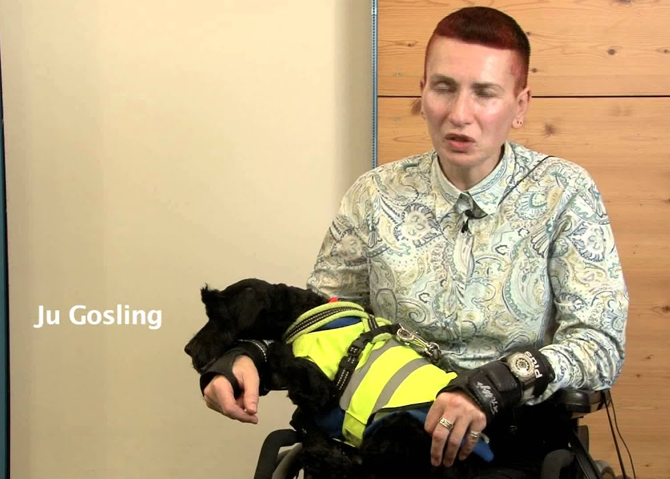
Gweithio gydag unigolion a/neu ofalwyr
Working with individuals and/or carers
Notes:
WELSH
Sleid yn ymwneud â 3.6 Pwysigrwydd sicrhau bod yr holl waith partneriaeth yn cynnwys unigolion a/neu eu gofalwyr
Y nod yma yw tynnu sylw at rai o'r rhwystrau y gallai unigolion fod wedi'u hwynebu yn hanesyddol i ddylanwadu ar eu disgwyliadau o weithio mewn partneriaeth.
Yn y fideo hwn, fe welwch amrywiaeth o bartneriaid yn trafod beth mae cydgynhyrchu yn ei olygu iddyn nhw.
Pa mor bwysig yw hi i gael y derminoleg yn gywir, a’r gwerth yn iawn i’r rhai sy’n derbyn gwasanaethau?
ENGLISH
Slide relating to 3.6 The importance of ensuring that all partnership working involves individuals and/or their carers
The aim here is to highlight some of the barriers individuals may have faced historically to influence their expectations of partnership working.
In this video, you will see a range of partners discuss what coproduction means to them.
How important is it to get the terminology right, and the value right to those receiving services?
Definitions and language are important. But the move toward co-production needs to be more than just a change in words, because there is a danger of assuming that the right words will be followed by the right actions. Real change is accompanied by a movement of resources to people who draw on care and support and to frontline staff.
There is a difference between co-production and involvement: involvement means being consulted, while co-production means being equal partners and co-creators.
Video Link https://www.youtube.com/watch?v=qG5F1rC_dN4

Slide 41
Mae cydgynhyrchu wedi’i rannu’n weithgareddau fel a ganlyn:
dylunio ar y cyd, gan gynnwys cynllunio gwasanaethau
gwneud penderfyniadau ar y cyd wrth ddyrannu adnoddau
darparu gwasanaethau ar y cyd, gan gynnwys rôl gwirfoddolwyr wrth ddarparu'r gwasanaeth
cyd-werthuso'r gwasanaeth
Co-production: what it is and how to do it | SCIE.
Co-production has been broken down into the following activities:
co-design, including planning of services
co-decision making in the allocation of resources
co-delivery of services, including the role of volunteers in providing the service
co-evaluation of the service
Co-production: what it is and how to do it | SCIE.

Slide 42
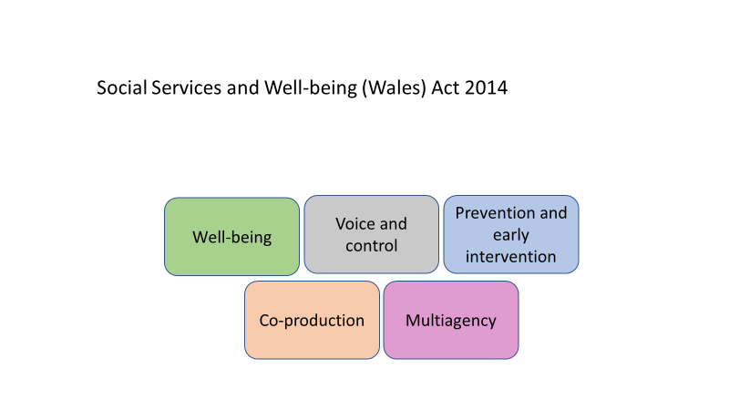
Notes:
Social care has traditionally been very ‘provider-led’. Providers of services, managers politicians, researchers, practitioners have shaped services and not those using it. This has been linked to issues such as institutionalisation and paternalism
SSWBA encourages a move away from needs based to rights based support. A focus on personal outcomes/ voice and control ensures practice is person centred and individuals are recognized as experts in their own life.
This translates into co-production. Individuals should be involved in planning and designing the services they receive

Slide 43
“Mae gweithio ar y cyd yn waith caled. Mae pobl yn meddwl yn y tymor byr. Maen nhw'n meddwl ei bod hi'n haws gwneud pethau eu hunain. Mae'n haws clymu careiau esgid plentyn na dangos iddynt sut i'w wneud.
“Mae angen buddsoddi amser i wneud iddo weithio’n dda, ond unwaith y byddwch wedi sefydlu’r perthnasoedd hyn mae’n effeithiol.” Alex Clapson, BASW 2015
Sut gallwch chi gefnogi cydgynhyrchu yn eich gwaith?
Ystyriwch sgiliau a gwerthoedd sy'n cefnogi cydgynhyrchu.
“Collaborative working is hard work. People think short-term. They think it is easier to do it themselves. It’s easier to tie the shoelace of a child than show them how to do it.
“It requires investment of time to make it work well, but once you have these relationships established it’s effective.” Alex Clapson, BASW 2015
How can you support co-production in your work?
Consider skills and values that support co-production.
Notes:
Work with people when carrying out interventions - do not act for them (unless required)
Do not rely on stereotypes

Slide 44

“Nid yw'r rhan fwyaf o bobl yn gwrando gyda'r bwriad o ddeall;
Maen nhw’n gwrando gyda’r bwriad o ymateb.”
Stephen Covey
“Most People do not listen with the intent to understand;
They listen with the intent to reply.”
Stephen Covey

Slide 45
Rhwystrau i gyfathrebu effeithiol
Barriers to effective communication
Gwnewch restr o rai o'r rhwystrau i gyfathrebu ag unigolion rydym yn gweithio gyda nhw, ein cydweithwyr, asiantaethau partner.
Sut ydym ni / gallwn ni oresgyn y rhwystrau hyn?
Beth yw manteision a heriau cyfathrebu rhithwir?
Make a list of some of the barriers to communication with individuals we work with, our colleagues, partner agencies.
How do we/ can we overcome these barriers?
What are the positives and challenges of virtual communication?

Slide 46

Stereoteipiau ac arferion gwrth-ormesol
Stereotypes and anti-oppressive practice
Pŵer - ystyriwch fodel PCS Thompson (2006) a'n rôl fel asiantau'r awdurdod lleol
'Rhwystr i gyfathrebu da yw unrhyw weithred, ymddygiad, agwedd, golwg ar y byd neu drefniant ffisegol (fel cynllun yr ystafell) sy’n atal y person arall rhag teimlo’n gyfforddus, cael ei dderbyn a chael ei werthfawrogi, a’i allu i gyfathrebu’n gadarnhaol ac yn effeithiol’
(Moss,2017, t.39)
Power- consider Thompson’s (2006) PCS model and our role as agents of the local authority
‘A barrier to good communication is any action, behaviour, attitude, world view or physical arrangement (such as room layout) that discourages the other person from feeling comfortable, accepted and valued, and their, ability to communicate positively and effectively’
(Moss,2017,p.39)
Notes:
According to Thompson, the workings of oppression can be analysed using a model that examines three levels:
P (personal)
C (cultural) and
S (structural):
Three levels that are closely interlinked and constantly interact with each other

Slide 47
Cydgynhyrchu yn y Ddeddf Gwasanaethau Cymdeithasol a Llesiant
Co-Production in Social Services and Wellbeing Act
“Ystyr llesiant, mewn perthynas â pherson, yw llesiant mewn perthynas ag unrhyw un o’r canlynol—
(a) iechyd corfforol a meddyliol a llesiant emosiynol;
(b) amddiffyn rhag camdriniaeth ac esgeulustod;
(c) addysg, hyfforddiant a hamdden;
(d) perthnasoedd domestig, teuluol a phersonol;
(e) cyfraniad a wneir i gymdeithas;
(f) sicrhau hawliau a'r hyn y mae gan rywun hawl iddo;
(g) llesiant cymdeithasol ac economaidd;
(f) addasrwydd llety byw.
“Well-being”, in relation to a person, means well-being in relation to any of the following—
(a)physical and mental health and emotional well-being;
(b)protection from abuse and neglect;
(c)education, training and recreation;
(d)domestic, family and personal relationships;
(e)contribution made to society;
(f)securing rights and entitlements;
(g)social and economic well-being;
(h)suitability of living accommodation.

Slide 48
Cydgynhyrchu yn y Ddeddf Gwasanaethau Cymdeithasol a Llesiant
Co-Production in Social Services and Wellbeing Act
Parhad...
(3) Mewn perthynas â phlentyn, mae “llesiant” hefyd yn cynnwys—
(a) datblygiad corfforol, deallusol, emosiynol, cymdeithasol ac ymddygiadol;
(b) “lles” fel y dehonglir y gair hwnnw at ddibenion Deddf Plant 1989.
(4) Mewn perthynas ag oedolyn, mae “llesiant” hefyd yn cynnwys—
(a) rheolaeth dros fywyd o ddydd i ddydd;
(b) cymryd rhan mewn gwaith.
Deddf Gwasanaethau Cymdeithasol a Llesiant (Cymru) 2014
Cont…
(3)In relation to a child, “well-being” also includes—
(a)physical, intellectual, emotional, social and behavioural development;
(b)“welfare” as that word is interpreted for the purposes of the Children Act 1989.
(4)In relation to an adult, “well-being” also includes—
(a)control over day to day life;
(b)participation in work.
Social Services and Wellbeing (Wales) Act 2014
Notes:
WELSH
Sleid yn ymwneud ag AC 3.2 Yr hyn y mae'r term 'cydgynhyrchu' yn ei olygu mewn perthynas â gweithio mewn partneriaeth
Y nod yma yw cyflwyniad i gydgynhyrchu.
ENGLISH
Slide relating to AC 3.2 What the term ‘co-production’ means in relation to partnership working
The aim here an introduction to co-production.

Slide 49
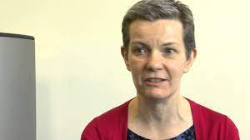
Cydgynhyrchu
Co-production
Meddyliwch yn Gyflym!
Beth mae 'Cydgynhyrchu' yn ei olygu mewn perthynas â gweithio mewn partneriaeth?
Quick Think!
What does Co-production mean in relation to partnership working?
Notes:
WELSH
Sleid yn ymwneud ag AC 3.2 Yr hyn y mae'r term 'cydgynhyrchu' yn ei olygu mewn perthynas â gweithio mewn partneriaeth
Y nod yma yw i ddysgwyr archwilio beth mae cydgynhyrchu yn ei olygu i'w rôl.
https://www.youtube.com/watch?v=D0lQsYZy9mo Video Link
ENGLISH
Slide relating to AC 3.2 What the term ‘co-production’ means in relation to partnership working
The aim here is for leaners to explore what co-production means for their role.

Slide 50
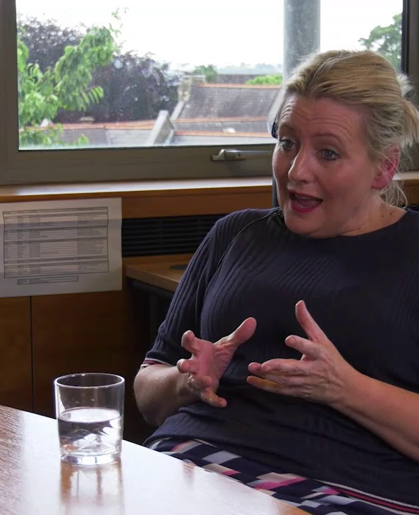
Goresgyn Rhwystrau i Weithio mewn Partneriaeth
Gwrandewch ar Keri yn siarad am sut roedd hi'n annog newid diwylliant yn y gwasanaethau plant trwy gydweithio â theuluoedd a staff rheng flaen.
Overcoming Barriers of Partnership Working
Listen to Keri talk about how she encouraged culture change in children’s services by collaborating with families and front-line staff.
Notes:
WELSH
Sleid yn ymwneud ag AC 3.3 Ystod a rôl partneriaid, gweithwyr proffesiynol ac asiantaethau ym maes iechyd a gofal cymdeithasol
Y nod yma yw amlygu sut y gall dysgwyr oresgyn rhwystrau trwy weithio mewn partneriaeth.
Bydd yr hyfforddwr yn trafod gyda'r dysgwyr ar ddiwedd y fideo sut mae hyn yn berthnasol i'w hymarfer.
https://www.youtube.com/watch?v=LKh5fHAy2y8 Video link
ENGLISH
Slide relating to AC 3.3 The range and role of partners, professionals and agencies in health and social care
The aim here is highlight how learners can overcome barriers through partnership working.
The trainer will discuss at the end of the video with the learners of how this relates to their practice.

Slide 51
Gweithio gydag unigolion a/neu ofalwyr
Working with individuals and/or carers
Meddyliwch yn Gyflym!
Pam ei bod yn bwysig bod yr holl waith partneriaeth yn cynnwys unigolion a/neu eu gofalwyr?
Quick Think!
Why is it important that all partnership working involves individuals and/or their carers?
Notes:
WELSH
Sleid yn ymwneud â 3.6 Pwysigrwydd sicrhau bod yr holl waith partneriaeth yn cynnwys unigolion a/neu eu gofalwyr
Y nod yma yw i ddysgwyr fyfyrio ar pam ei bod yn bwysig bod yr holl waith partneriaeth yn cynnwys unigolion a/neu eu gofalwyr.
Dylai’r hyfforddwr drafod egwyddor Llais a Rheolaeth y Ddeddf Gwasanaethau Cymdeithasol a Llesiant a chanlyniadau sy’n canolbwyntio ar yr unigolyn/plentyn.
ENGLISH
Slide relating to 3.6 The importance of ensuring that all partnership working involves individuals and/or their carers
The aim here is for learners to reflect on why it is important that all partnership working involves individuals and/or their carers.
The trainer should discuss Social Services and Wellbeing Act principle Voice and Control and person/child centred outcomes.

Slide 52
References
Cyfeiriadau
Moss, B.(2017) Communication Skills in Health and Social Care. 4th Edn. London:Sage
Sloper, P. 2004. Facilitators and barriers for co-ordinated multi-agency services. Child: Care, Health and Development 30(6), pp. 571–580
Thompson, N. (2006) Anti-Discriminatory Practice. 4th Edn. Basingstoke: Palgrave Macmillan.
Unable to translate to Welsh due to publications

