Slide 1
GCE Health and Social Care, and Childcare
Summer 2021
Notes:
This presentation is intended for those centres that have already delivered the AS units 1 and 2, and are planning their delivery of the A2 Units, 3, 4 or 5 and 6 for the Adult Social Care or Childcare Pathway at A2.

Slide 2
GCE Health and Social Care, and Childcare
This presentation is facilitated by representatives and subject specialists from WJEC.
Karen Bushell
WJEC Subject Officer
Health and Social Care, and Childcare
City & Guilds and WJEC continue to work collaboratively and in partnership with the following organisations who support this event:
Qualifications Wales
Social Care Wales
Health Education and Improvement Wales
Notes:
My name is Karen Bushell, I am the presenter today and also the Subject Officer for the new GCE, in addition to the new GCSE and legacy qualifications, and our England health and social care qualifications.
The qualification is part of the WJEC and C&G consortium offering for Wales and was designed in collaboration and partnership with many influential organisations in the sectors in Wales.

Slide 3
An Overview

Slide 4
GCE Health and Social Care, and Childcare
Overview
The GCE AS and A Level in Health and Social Care, and Childcare is divided into a total of six units:
two AS units (1 and 2) and four A2 Units (3, 4, 5, 6)
learners study a total of four units, two AS units plus the two A2 units related to their chosen pathway
Assessment
The GCE AS and A Level in Health and Social Care, and Childcare is assessed through 50% internal assessment and 50% external assessment.
Sample Assessment Materials are available for ALL units.
Candidates must successfully complete:
externally set, internally marked assignments
external examinations
Notes:
Read through slide.

Slide 5
GCE Health and Social Care, and Childcare
Assessment
This specification is divided into a total of six units, two AS units and four A2 units.
A level learners study a total of four units: two AS units plus the two A2 units related to their chosen pathway.
Qualification | Unit 1 | Unit 2 | Unit 3 | Unit 4 | Unit 5 | Unit 6
AS Health and Social Care, and Childcare | ✓ | ✓
Pathway 1 (Childcare) A level Health and Social Care, and Childcare | ✓ | ✓ | ✓ | ✓
Pathway 2 (Health and Social Care) A level Health and Social Care, and Childcare | ✓ | ✓ |  |  | ✓ | ✓
Notes:
Read through slide.

Slide 6
GCE Health and Social Care, and Childcare
Unit 1 (AS) Promoting health and well-being
Written examination: 2 hours
50% of AS qualification, 20% of A level qualification
80 marks
Areas of content
2.1.1 Definitions and concepts of health and well-being
2.1.2 Understanding perspectives of health, well-being and resilience
2.1.3 Supporting and promoting health, well-being and resilience in Wales
Overview
Learners will gain knowledge and understanding of:
the definitions of health and well-being, models of health, disability and well-being, holistic concepts of health and well-being and the factors that contribute to them
social and economic determinants and how they contribute to inequalities in health and well-being. Trends, patterns and perspectives of health, well-being and resilience. Legislation and strategies for promoting good health, well-being and resilience
preventative measures supported by lifestyle choices and local/national strategies. Definitions of health promotion and different approaches in promoting health, well-being and resilience. Welsh government initiatives and campaigns. The role of people working in health promotion.
Notes:
Read through the slide.

Slide 7
GCE Health and Social Care, and Childcare
Unit 2 (AS) Supporting health, well-being and resilience in Wales
Non-exam assessment: 30 hours
50% of AS qualification, 20% of A Level qualification
100 marks
Areas of content
2.2.1 Supporting individuals to achieve personal outcomes
2.2.2 Working practices within health and social care and childcare provision
2.2.3 Local and national provision
2.2.4 Responsibilities and rights of both providers and individuals
Overview
Learners will gain knowledge and understanding of:
supporting individuals to identify strengths and achieve personal outcomes for their health and well-being and to build resilience
person/child-centred care within outcome focused provision. The structure of health and social care and childcare provision in Wales and the sustainability of this provision
the range of roles and possible career pathways in Wales
how provision in Wales contrasts with provision elsewhere in the UK
the impact of Welsh legislation, national and local policies on the provision of health and social care and childcare and the rights of both the providers and individuals.
Notes:
Read through the slide.

Slide 8
Childcare Pathway

Slide 9
GCE Health and Social Care, and Childcare
Unit 3 (A level – Childcare Pathway) Theoretical perspectives of children and young people’s development
Written examination: 2 hours 30 minutes
30% of A level (Childcare pathway)
100 marks
Areas of content
2.3.1 Theories and principles of child development
2.3.2 The importance of play in learning and development
2.3.3 Behaviour of children and young people
Overview
Learners will gain knowledge and understanding of:
Key areas of development in children and young people (physical, cognitive, language, intellectual, social and emotional) and how theories and principles relate to areas of children's development
Definitions of play and play work, the purpose of play, stages of play and types of play
Factors that affect the behaviour of children and young people and the strategies and approaches that support children and young people to develop positive behaviour patterns.

Slide 10
GCE Health and Social Care, and Childcare
Resources: Unit 3
Exam Walk Through
Aimed at learners, the Exam Walk Through resource offers practical hints and tips on how to effectively approach questions in the examination paper. Using questions from past exam papers, the PPT with audio script and notes will walk learners through a mock examination paper, helping learners revise and practice useful exam techniques.
https://www.healthandcarelearning.wales/resources/gce-health-and-social-care-and-childcare-exam-walk-through-unit-3/
Notes:
Read through slide.

Slide 11
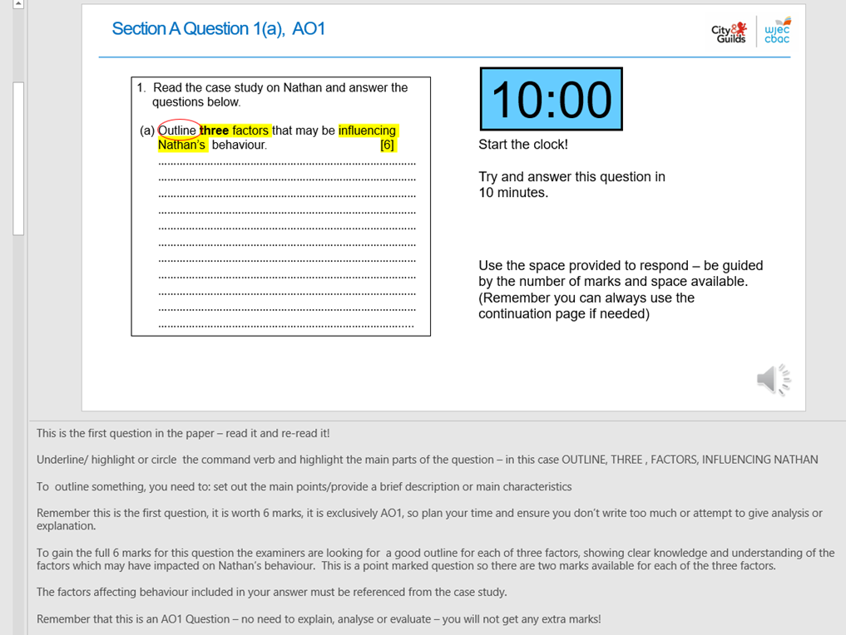
GCE Health and Social Care, and Childcare
Exam Walk Through
The EWT is designed to be used by the learner, rather than the teacher.
In addition to the content of the slides, the text is available to read as well as there being a voice over.
Each question is exemplified and the mark scheme is also explained for each question, to assist the learner in making judgements on their performance, and then improving their performance on each question.
Notes:
Read through slide.

Slide 12
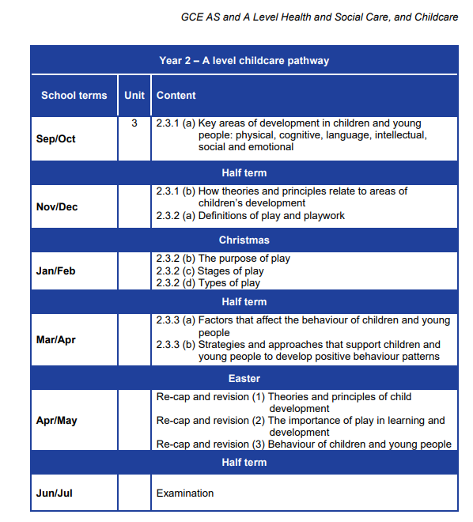
GCE Health and Social Care, and Childcare
GFT – Unit 3
The guidance for teaching is available for ALL units on the HCLW website:
Notes:
Read through slide.

Slide 13
GCE Health and Social Care, and Childcare
Support Materials – Unit 3
Power Point Resources to support delivery:
The supporting materials are designed to be used in the classroom to aid the delivery of this unit.
They include useful links to websites and supporting documents for this unit.
Notes:
Read through slide.

Slide 14
GCE Health and Social Care, and Childcare
Unit 4 (A level – Childcare pathway) Supporting the development, health, well-being and resilience of children and young people
Non-exam assessment: 40 hours
30% of A Level qualification
100 marks
Areas of content
2.4.1 Children and young people’s needs
2.4.2 Contemporary issues in providing care and support for children and young people
2.4.3 The role of current legislation and government initiatives to safeguard and improve care and support for children and young people in Wales
Overview
Learners will gain knowledge and understanding of:
the importance of meeting children’s and young people's needs at all the development stages
the types of transition, experiences and life changes which may affect the resilience and development of children and young people
understanding and responding to complex health and care needs of children and young people
the types and purpose of assessment in providing support for the needs of children and young people
barriers to accessing care and support services to meet specific needs.
social policy issues that affect childcare.
Notes:
Read through slide.

Slide 15
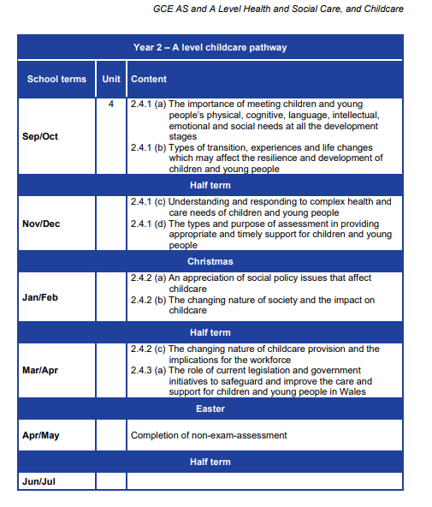
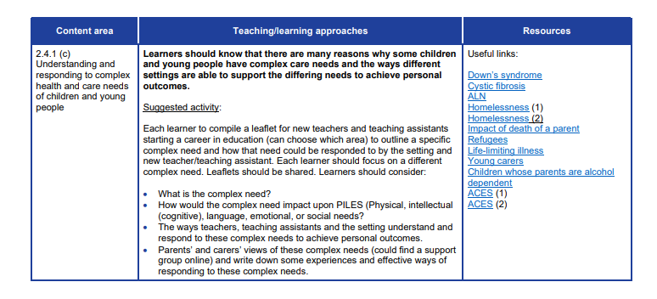
GCE Health and Social Care, and Childcare
GFT – Unit 4
The guidance for teaching is available for ALL units on the HCLW website:
Notes:
Read through slide.

Slide 16
GCE Health and Social Care, and Childcare
Support Materials – Unit 4
Power Point Resources to support delivery:
The supporting materials are designed to be used in the classroom to aid the delivery of this unit.
They include useful links to websites and supporting documents for this unit.
Notes:
Read through slide.

Slide 17
Adult Health and Social Care Pathway

Slide 18
GCE Health and Social Care, and Childcare
Unit 5 (A level – Adult Health and Social Care pathway) Theoretical perspectives of adult behaviour
Written examination: 2 hours, 30 minutes
30% of A level (Adult Health and Social Care pathway)
100 marks
Areas of content
2.5.1 Factors that affect the behaviour of adults
2.5.2 Understanding perspectives affecting adult behaviour
2.5.3 Strategies and approaches that support adults to develop positive behaviour patterns
Overview
Learners will gain knowledge and understanding of:
factors that affect the behaviour of adults
the importance and effects of resilience in dealing with care settings and situations
key theories associated with understanding and management of specific behaviours
key approaches in practice which relate to adult development and behaviour
strategies and approaches that can be used to support adults to develop positive behaviour patterns.
Notes:
Read through slide.

Slide 19
GCE Health and Social Care, and Childcare
Resources: Unit 5
Exam Walk Through
Aimed at learners, the Exam Walk Through resource offers practical hints and tips on how to effectively approach questions in the examination paper. Using questions from past exam papers, the PPT with audio script and notes will walk learners through a mock examination paper, helping learners revise and practice useful exam techniques.
https://www.healthandcarelearning.wales/resources/gce-health-and-social-care-and-childcare-exam-walk-through-unit-5/
Notes:
Read through slide.

Slide 20
GCE Health and Social Care, and Childcare
Exam Walk Through
The EWT is designed to be used by the learner, rather than the teacher.
In addition to the content of the slides, the text is available to read as well as there being a voice over.
Each question is exemplified and the mark scheme is also explained for each question, to assist the learner in making judgements on their performance, and then improving their performance on each question.
Notes:
Read through slide.

Slide 21
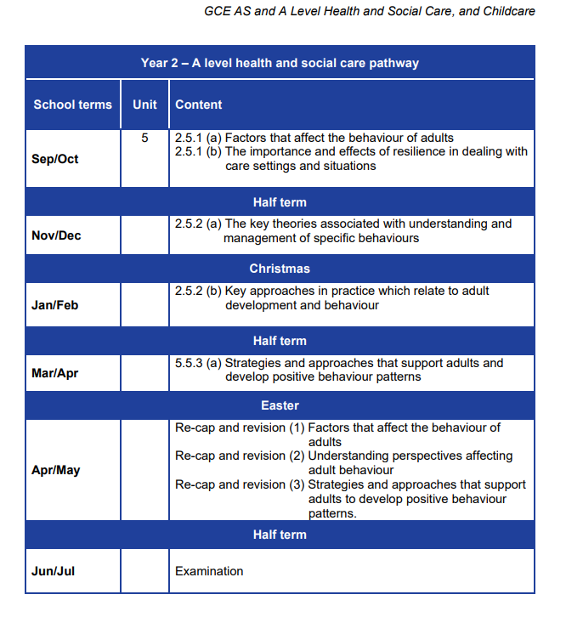
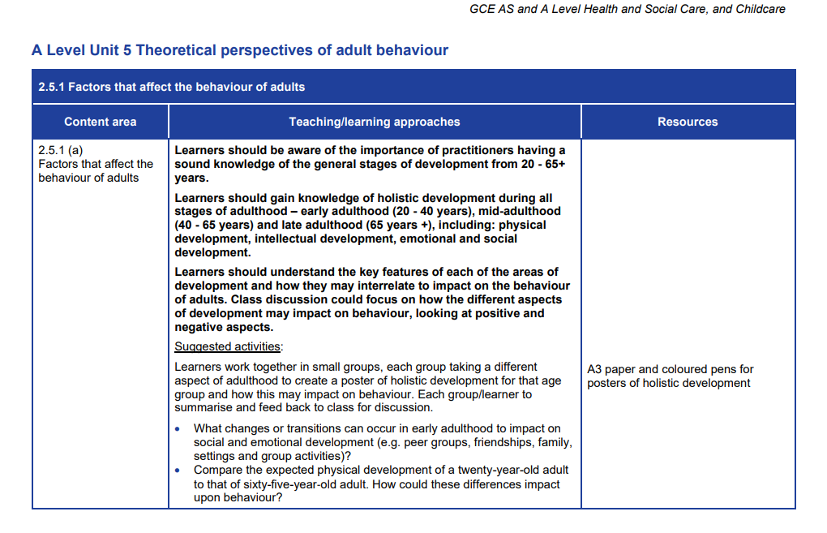
GCE Health and Social Care, and Childcare
GFT – Unit 5
The guidance for teaching is available for ALL units on the HCLW website:
Notes:
Read through slide.

Slide 22
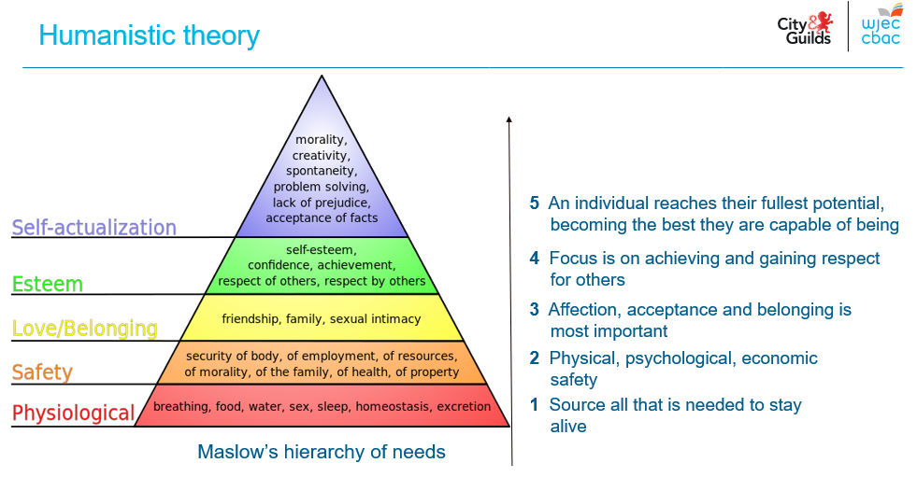
GCE Health and Social Care, and Childcare
Support Materials – Unit 5
Power Point Resources to support delivery:
The supporting materials are designed to be used in the classroom to aid the delivery of this unit.
They include useful links to websites and supporting documents for this unit.
Notes:
Read through slide.

Slide 23
GCE Health and Social Care, and Childcare
Unit 6 (A level – Adult Health and Social Care pathway) Supporting adults to maintain health, well-being and resilience
Non-exam assessment: 40 hours
30% of A Level qualification
100 marks
Areas of content
2.6.1 Adult care and support needs
2.6.2 Contemporary issues in providing care and support for adults
2.6.3 The role of current legislation and government initiatives to safeguard and improve the care and support for adults at risk in Wales
Overview
Learners will gain knowledge and understanding of:
the importance of providing outcome-focused care and support which meets an individual's needs in line with the Social Services and Well-being (Wales) Act 2014
barriers to accessing care and support services
factors which may affect the care and support needs of adults, including end-of-life care and complex care needs
the types and purpose of assessment in providing appropriate and timely support for individuals
social policy issues that affect adult health and social care and the role of current legislation and government initiatives to safeguard and improve the care and support for adults at risk in Wales.
Notes:
Read through slide.

Slide 24
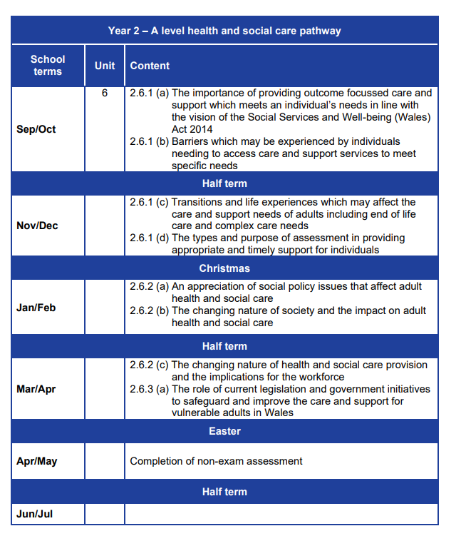
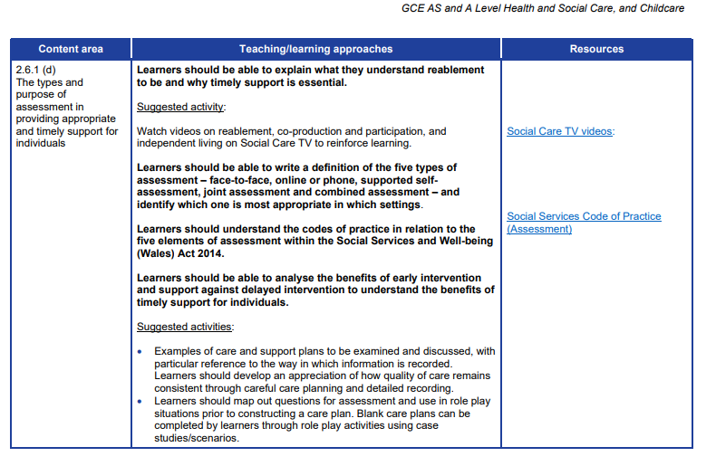
GCE Health and Social Care, and Childcare
GFT – Unit 6
The guidance for teaching is available for ALL units on the HCLW website:
Notes:
Read through slide.

Slide 25
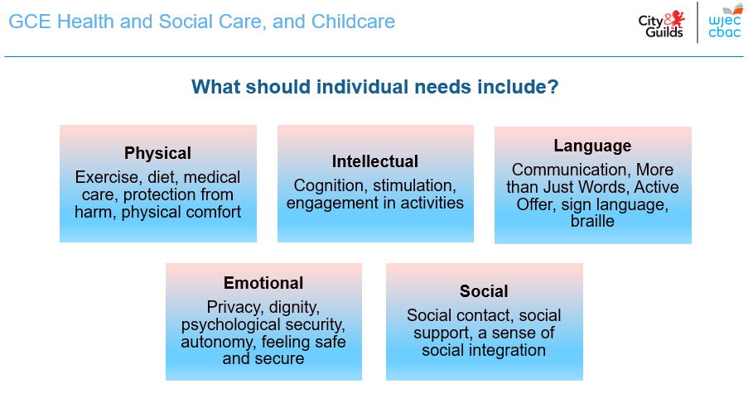
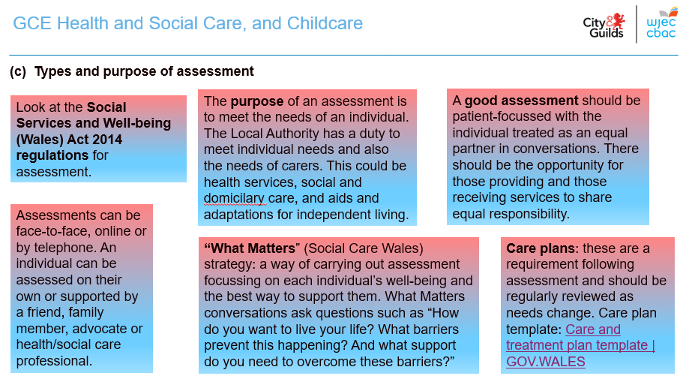
GCE Health and Social Care, and Childcare
Support Materials – Unit 6
Power Point Resources to support delivery:
The supporting materials are designed to be used in the classroom to aid the delivery of this unit.
They include useful links to websites and supporting documents for this unit.
Notes:
Read through slide.

Slide 26
GCE Health and Social Care, and Childcare
Resources
The AS text book is available to buy, the order form can be found here.
The A2 text book is due to be available in September 2021.
Past CPD materials
Assessment materials for Summer 2021 series
Notes:
Read through slide.

Slide 27
GCE Health and Social Care, and Childcare
Moderation
Marks from all NEA units will be submitted for first (external) moderation in May 2022.
Format will be submission of marks for all tasks into IAMIS system on secure website.
Sample will be generated electronically.
Work may be submitted electronically or in hard copy, either word processed, typed or handwritten.
Sample of work to be posted by 15 May to the moderator; an extra sample may be requested if applicable.
Moderators’ reports to be downloaded from secure website on results day.
Work will be returned to centres before the end of the summer term.
Exemplar work, once available, will be used at CPD to aid marking in centres, and made available on the secure website.
Notes:
Read through slide.

Slide 28
GCE Health and Social Care, and Childcare
Any questions?
Contacts
Contact our specialist Subject Officers and administrative support team with any queries
HSCandCC@wjec.co.uk
e-Assessment:
e-Assessment@wjec.co.uk
Notes:
Read through slide.

Slide 29
Diolch!
Thank you!
Notes:
Diolch!

