Slide 1
Online Exam Review
Level 3 Health and Social Care: Principles and Contexts
Unit 2: Factors affecting individuals’ growth and development across the lifespan, and how this impacts on outcomes, care and support needs (January 2021)

Slide 2
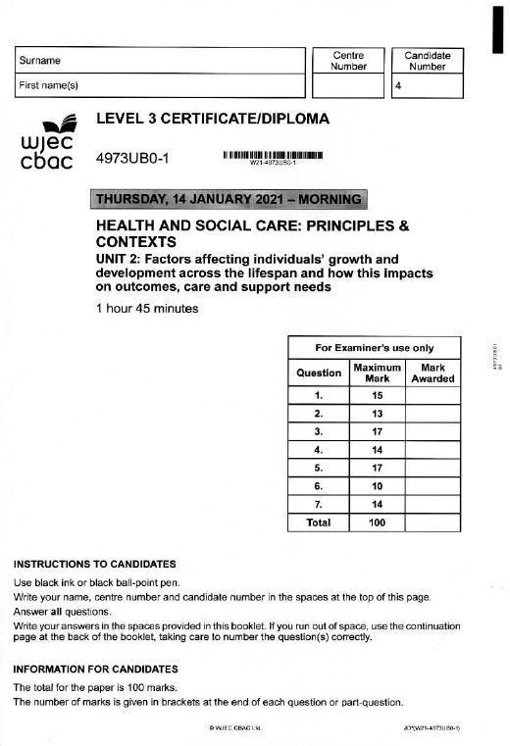
Unit 2: Factors affecting individuals’ growth and development across the lifespan, and how this impacts on outcomes, care and support needs
Online examination review (OER)

Slide 3
Question 4 (b)
(b) Explain, with reference to Cumming and Henry’s disengagement theory of ageing, why the risk of isolation may be greater in later adulthood. [8]

Slide 4
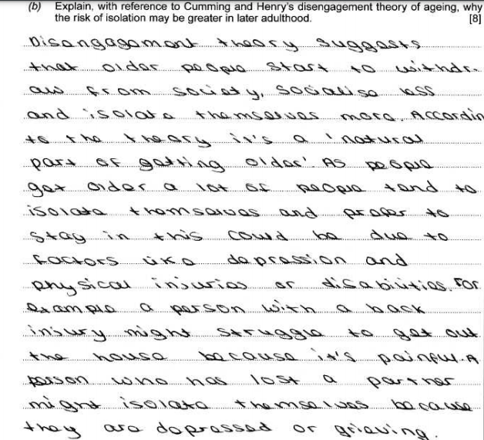
Question 4 (b) Candidate answer

Slide 5
Question 4 (b) Candidate answer with examiner’s comments
A good response which demonstrates some explanation with reference to Cumming and Henry’s disengagement theory of ageing, why the risk of isolation may be greater in later adulthood.
The candidate begins by explaining the basic concept of how the theory explains withdrawal in later adulthood and is a natural part of getting older. The candidate understands the question asks for why the risk may be greater in later adulthood and responds with several correct points. These include isolation and the preference for staying in, less able to go out due to ill-health, e.g. depression, physical injuries or disabilities. They correctly note the loss of a partner could cause depression or grieving.
Additional marks were available for reasons such as: less likely to travel, unable to embrace modern technology, less engagement due to retirement, less mobile so unlikely to access services.
5 marks awarded – band 3

Slide 6
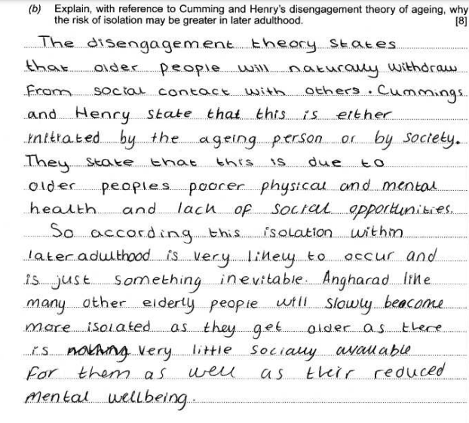
Question 4 (b) Candidate answer

Slide 7
Question 4 (b) Candidate answer with examiner’s comments
A basic response, demonstrating a limited explanation, with reference to Cumming and Henry’s disengagement theory of ageing, of why the risk of isolation may be greater in later adulthood.
The candidate begins correctly, explaining the theory links to withdrawal from social contact. They understand the question is asking them to explain why the risk of isolation may be greater in later adulthood and respond with a limited number of correct answers. They refer to physical and mental health resulting in a lack of social opportunities and, in the final sentence, mention there is very little socially available but make the same point again about mental well-being.
They fail to refer to loss of partner/friends, retirement, ill-health conditions, modern technology and less likely to travel. The overall response does not fully address the risk of isolation and refers more generally to the application of the theory.
4 marks awarded – band 2

Slide 8
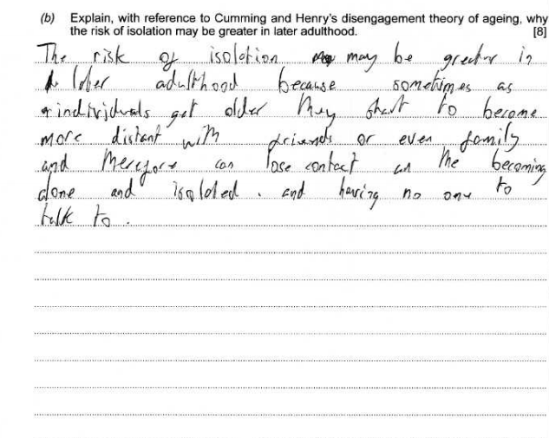
Question 4 (b) Candidate answer

Slide 9
Question 4 (b) Candidate answer with examiner’s comments
A limited response, demonstrating little or no explanation of why the risk of isolation may be greater in later adulthood.
The candidate has failed to make reference to Cumming and Henry’s disengagement theory in their initial response and has not acknowledged that it is natural and acceptable to withdraw from society. The candidate makes one point – that, in later adulthood, individuals may distance themselves from friends and family – but fails to acknowledge the reasons why. In expanding this answer, they could have commented on these reasons, such as family moving away for jobs, friends/partners passing away. Further reasons could have included: less likely to travel, technology, retirement, ill-health, and less mobile.
1 mark awarded – band 1

Slide 10
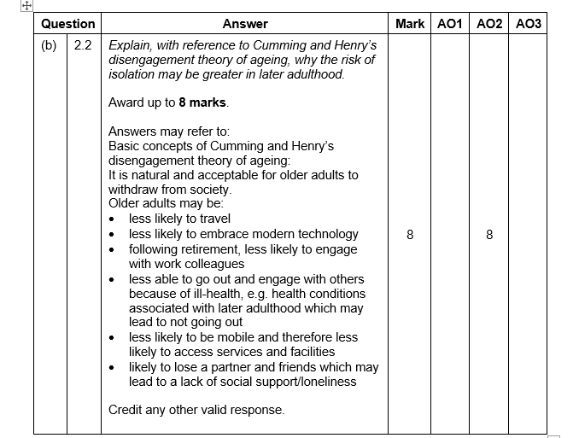
Question 4 (b) Mark scheme

Slide 11
Question 6 (b)
(b) The ‘Change4Life’ initiative is based on the behavioural change approach. The medical approach is another way of promoting health and well-being.
Contrast the medical approach with the behavioural change approach. [6]

Slide 12
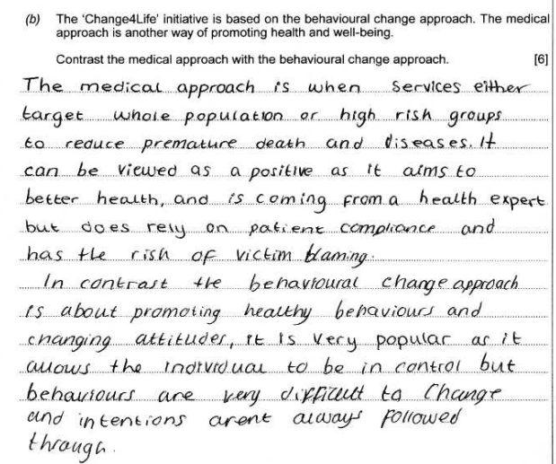
Question 6 (b) Candidate answer

Slide 13
Question 6 (b) Candidate answer with examiner’s comments
A very good response which contrasts a range of features of the medical/behavioural change approaches of promoting health and well-being, and demonstrates detailed knowledge and understanding of the differences between the two approaches.
The candidate has correctly applied the command verb ‘contrast’ to focus on their answer by citing the differences between the two approaches. The candidate has correctly described the medical approach target group as whole population or high-risk groups and expert-led. The answer then correctly outlines the strengths and weaknesses of the approach briefly, such as relying on patient compliance. This illustrates a detailed knowledge and understanding of the differences between the approaches as they go on to contrast with the behavioural change approach, noting it is about healthy behaviours and changing attitudes. Again, they note the strengths and appropriate weakness that behaviours can be difficult to change. Good use of terminology applied.
5 marks – band 3

Slide 14
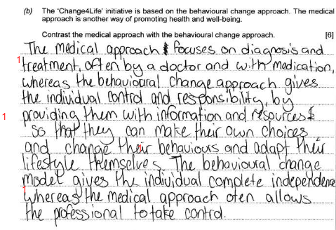
Question 6 (b) Candidate answer

Slide 15
Question 6 (b) Candidate answer with examiner’s comments
A good response which contrasts some features of the medical/behavioural change approaches of promoting health and well-being which demonstrates some knowledge and understanding of the differences between the two approaches.
The candidate has understood the command verb ‘contrast’ and attempts to provide a response that focuses on the differences between both approaches. The candidate has correctly understood that the behavioural change approach gives the individual responsibility for their own health and requires the provision of information and resources to target an individual’s needs. It correctly notes that individuals make their own choices to adapt their lifestyle accordingly. Their contrasting answer is considerably weaker for the medical approach buy gains a mark for correctly noting that a health professional such as a ‘doctor’ would be involved (although the correct terminology, ‘GP’ or ‘general practitioner’, should be used instead of ‘doctor’). They failed to note that the approach is not individualised but aimed at whole population or target group, e.g. screening, vaccination. It is used to prevent ill-health and reduce effects.
4 marks – band 2

Slide 16
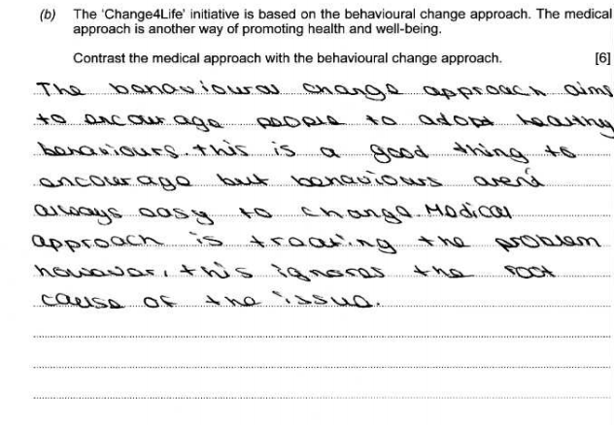
Question 6 (b) Candidate answer

Slide 17
Question 6 (b) Candidate answer with examiner’s comments
A basic response, lacking in detail, which contrasts only limited features of the medical/behavioral change approaches of promoting health and well-being, and demonstrates little knowledge and understanding of the differences between the two approaches.
The candidate correctly acknowledges that the behavioural change approach aims to encourage individuals to adopt healthy behaviours and a basic disadvantage of this approach. Appropriate terminology is not used, and the candidate fails to note the individual's interest in and responsibility for their own health, the importance of making an informed choice, and providing information to target individuals in need. In contrasting the candidate fails to note that the medical approach depends on health professionals, (for example, screening or immunisation) and that success depends on population participation and is often costly.
1 mark – band 1

Slide 18
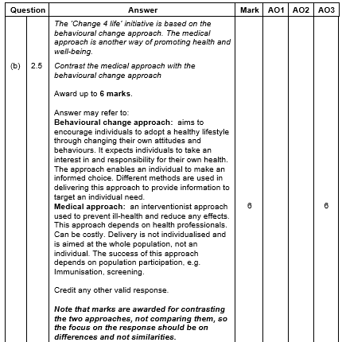
Question 6 (b) Mark scheme

Slide 19
Question 1 (c)
Susan and Mary have disclosed to the CAHMS team that they are feeling anxious about Wren’s diagnosis and the support that may be available to them.
Consider, with reference to Rogers’ humanistic theory, how Susan and Mary may be supported to help Wren. [7]

Slide 20
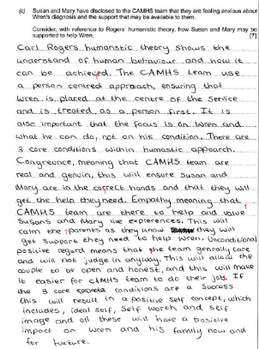
Question 1 (c) Candidate answer

Slide 21
Question 1 (c) Candidate answer with examiner’s comments
A good response that shows some knowledge and understanding of Roger’s humanistic theory and considers how Susan and Mary may be supported to help Wren.
The candidate has correctly understood the question and applied their answer to how Susan and Mary may be supported. They have demonstrated a good understanding of Carl Rogers’ theory throughout and have clearly put the parents as the experts in the situation. They correctly note that the CAMHS team can use a person-centered approach although incorrectly apply this to Wren. They correctly state the core conditions, with congruence ensuring that Susan and Mary are getting the help they need, and empathy to understand the situation and value Susan and Mary’s life experience. Unconditional positive regard is noted correctly as providing a non-judgmental approach, allowing the couple to be open and honest, enabling provision of support. Finally the candidate concludes with the result of positive self-worth and self image.
6 marks – band 2

Slide 22
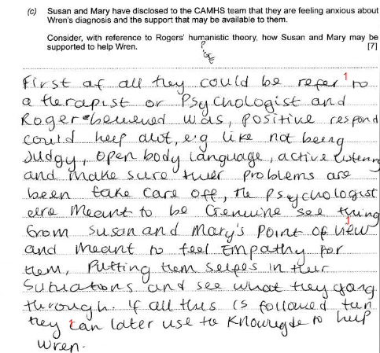
Question 1 (c) Candidate answer

Slide 23
Question 1 (c) Candidate answer with examiner’s comments
A basic response that shows little knowledge and understanding of Roger’s humanistic theory. Some consideration is made to how Susan and Mary may be supported to help Wren.
The candidate has made reference to the theory and has applied their answer correctly to Susan and Mary. The candidate has recognised that the parents could be referred to for support and this was a positive and they would be shown a non-judgmental approach and that things would be seen from their point of view. The candidate recognises empathy by trying to understand their situation. They could have explained the theory at the start as a person-centred approach and identified the importance of unconditional positive regard.
3 marks – band 1

Slide 24
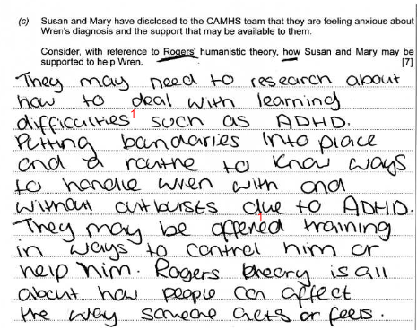
Question 1 (c) Candidate answer

Slide 25
Question 1 (c) Candidate answer with examiner’s comments
A basic response that shows little knowledge and understanding of Roger’s humanistic theory. Some consideration is made to how Susan and Mary may be supported to help Wren.
The candidate applies their response to Susan and Mary but only makes brief reference to Rogers’ humanistic theory and the response lacks health and social care terminology. They recognise that research would provide support to deal with Wren’s learning difficulty and they acknowledge that techniques such as training would support Susan and Mary to help Wren. However, they do not identify the key features of the approach, including unconditional positive regard, non-judgmental approach, person-centered, and showing empathy.
2 marks – band 1

Slide 26
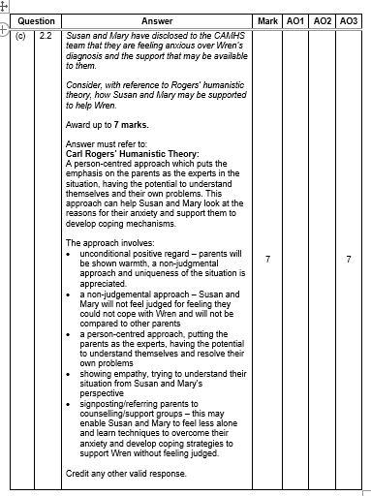
Question 1 (c) Mark scheme

