Slide 1
Exam Walk-Through
Level 2 Health and Social Care: Principles and Contexts – Unit 1 5972UB0-1
Notes:
Hello.
This is a walk-through of the Level 2 Health and Social Care: Principles and Contexts Unit 1 examination paper from January 2020.

Slide 2
What you should have in front of you:
A copy of the exam paper
A pen, pencil, ruler
A highlighter/at least three different coloured highlighters
A watch
Post-It notes
Notes:
In front of you, you should have:
A copy of the exam paper
A pen and pencil
A highlighter pen, which will help you identify key points in the question
A watch to help you keep an eye on the time
And Post-It notes – in case you want to make any notes or jot down questions to ask your teacher

Slide 3
What this exam paper is all about:
This paper is 1 hour, 30 minutes long.
It is testing your knowledge of health and social care principles and contexts.
The paper is made up of eight questions.
The question types vary.
The paper will assess AO1, AO2 and AO3.
The total mark for this paper is 80.
All question papers for Health and Social Care: Principles and Contexts have the same layout as this one.
Notes:
This exam paper is from the January 2020 series.
It is testing the content you will have been taught for Level 2 Health and Social Care: Principles and Contexts.
The exam is 1 hour and 30 minutes long.
The paper is made up of 8 questions.
The question types vary.
The paper will assess AO1, AO2 and AO3.
The total mark for this paper is 80.

Slide 4
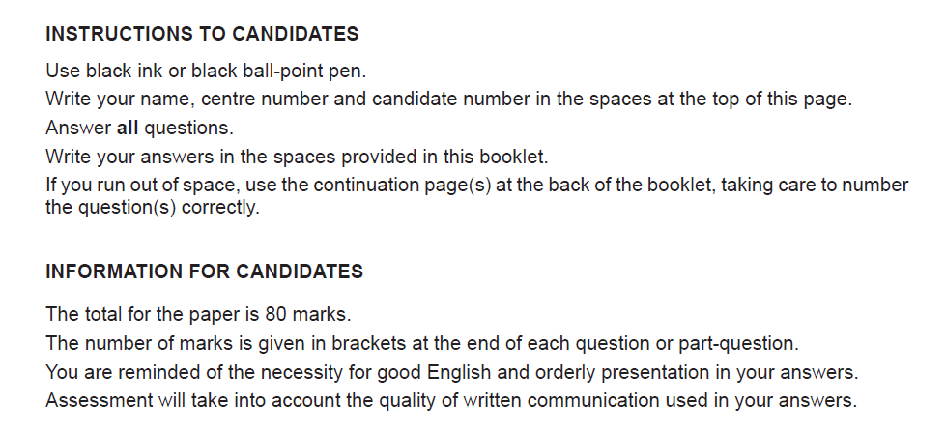
What should I do first?
1. Read the front cover of the exam paper.
2. Make sure your name and candidate number are on your answer booklet.
Notes:
First of all, read the instructions on the front cover of the exam paper.
Read the Instructions to Candidates section and the Information to Candidates section.
Write your name and candidate number in the correct section of the booklet.

Slide 5
General points on exam technique
Read through the whole question before starting to answer. This will help you understand what is required of you.
Use a highlighter to pick out key words.
Look at the command words and the number of marks available for each question, they will help you decide how much detail is needed.
If a word is bold, it is important.
Keep your exam paper open at the double page spread, do not fold it in half.
Read your answers to check they make sense.
Notes:
Read slide

Slide 6
How do I tackle Question 1?
Question 1
Skills being tested:
AO1 – demonstrate knowledge and understanding
Approach:
Read question 1 and highlight key words/command verbs.
Look at the table.
Check the number of marks for each part of the question so you spend your time appropriately.
Think carefully about your answer.
Tick the correct answers in the spaces provided on the table.
Notes:
Read slide

Slide 7
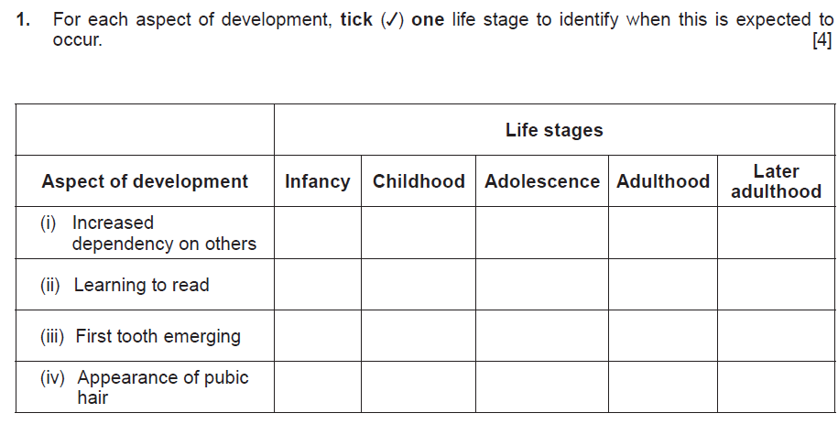
Question 1, AO1
Command word here is ‘Identify’ – provide brief facts or examples.
If you make a mistake and put the tick in the wrong box clearly cross it out so the examiner knows which one to mark.
Many learners get this wrong as they rush and don’t read the question carefully.
Notes:
Read out the question.
Command word here is ‘Identify’ – provide brief facts or examples.
If you make a mistake and put the tick in the wrong box, clearly cross it out so the examiner knows which one to mark.
Many learners get this wrong as they rush and don’t read the question carefully.

Slide 8
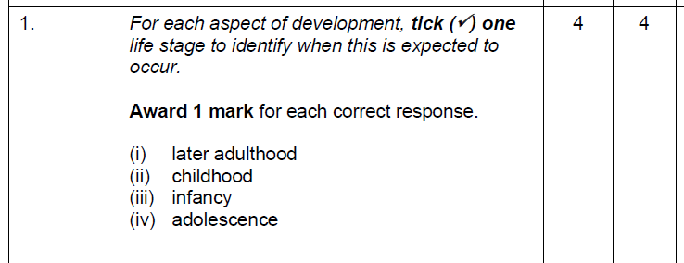
Question 1 AO1 mark scheme
What we are looking for here is evidence that you can demonstrate your knowledge of key physical, intellectual, emotional and social aspects that affect growth and development across the lifespan of individuals.
Notes:
This is the mark scheme for question 1.
What we are looking for here is evidence that you can demonstrate your knowledge of key physical, intellectual, emotional and social aspects that affect growth and development across the lifespan of individuals.

Slide 9
How do I tackle Question 2?
Question 2
Skills being tested:
AO1 – demonstrate knowledge and understanding
AO2 – apply knowledge and understanding of health and social care principles and contexts
Approach:
Read question 2 (a)(b) and (c).
Highlight key words/command verbs.
Check the number of marks for each part of the question so you spend your time appropriately.
Think carefully about your answer.
The number of lines available indicates the length of the required response.
Notes:
Read slide

Slide 10
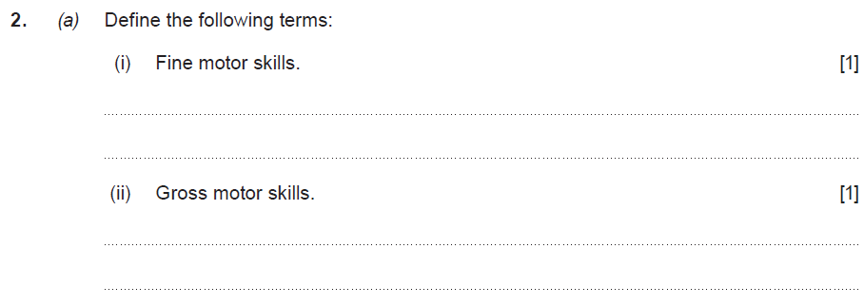
Question 2 (a), AO1
The command word here is ‘Define’ – give the exact meaning of. Do not use examples here as that is asked for in the next part of the question: (b).
Notes:
Read the question.
The command word here is ‘Define’ – give the exact meaning of. Do not use examples here as that is asked for in the next part of the question: (b).

Slide 11
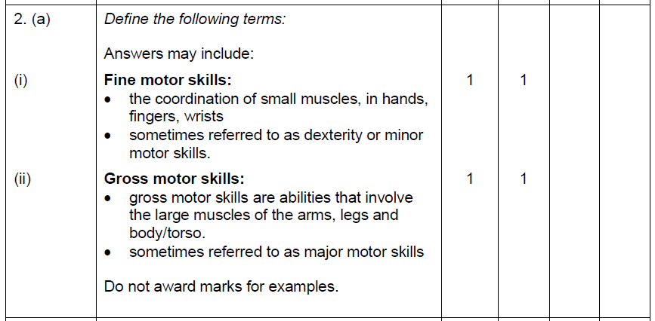
Question 2 (a) AO1 mark scheme
What we are looking for here is evidence that you can demonstrate your knowledge of physical aspects of development.
Notes:
Here is the mark scheme for question 2.
What we are looking for here is evidence that you can demonstrate your knowledge of physical aspects of development.

Slide 12
Question 2 (b), AO1
This part of the question requires two examples. Make sure you read the question as two examples are being asked for but only for one type of motor skill.
Notes:
Read the question.
This part of the question requires two examples. Make sure you read the question as two examples are being asked for but only for one type of motor skill.

Slide 13
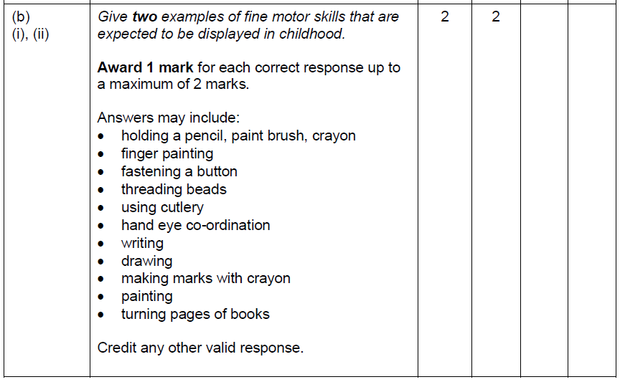
Question 2 (b) AO1 mark scheme
What we are looking for here is evidence that you can demonstrate your knowledge of fine motor skills in childhood.
Notes:
This is the mark scheme for question 2 (b).
What we are looking for here is evidence that you can demonstrate your knowledge of fine motor skills in childhood.

Slide 14
Question 2 (c), AO2
Command word here is ‘Describe’ – provide characteristics/main features or a brief account.
Read the statement carefully, then the question. Underline key words to help you.
Notes:
Read the question.
Command word here is ‘Describe’ – provide characteristics/main features or a brief account.
Read the statement carefully, then the question. Underline key words to help you.

Slide 15
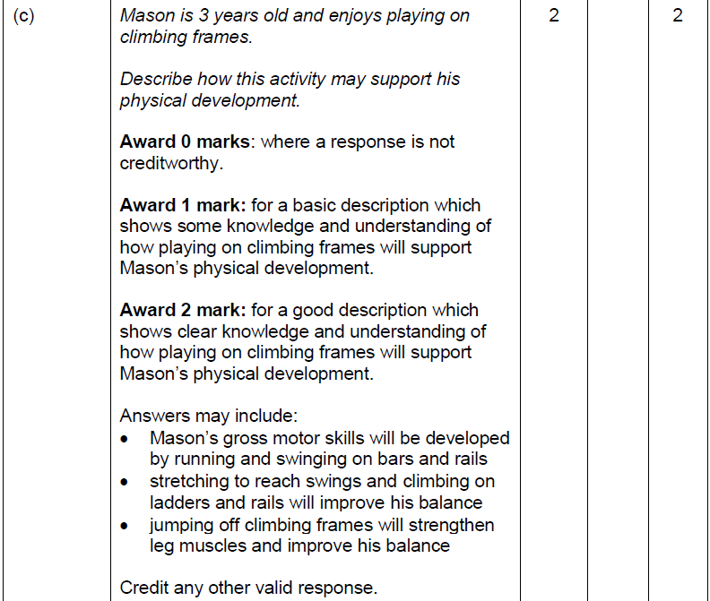
Question 2 (c) AO2 mark scheme
What we are looking for here is evidence that you can demonstrate your knowledge of physical development in childhood.
Notes:
Here is the mark scheme for question 2 (c).
What we are looking for here is evidence that you can demonstrate your knowledge of physical development in childhood.

Slide 16
How do I tackle Question 3?
Question
Skills being tested:
AO1 – demonstrate knowledge and understanding
AO2 – apply knowledge and understanding of health and social care principles and contexts
Approach:
Read question 3 (a) and (b).
Highlight key words/command verbs.
Check the number of marks for each part of the question so you spend your time appropriately.
Think carefully about your answer.
The number of lines available indicates the length of the required response.
Part (b) requires some extended writing and is a high tariff question; therefore, you will need to plan your answer.
Notes:
Read slide.

Slide 17
Question 3 (a), AO1
The command word here is ‘Define’ – give the exact meaning of.
Notes:
Read the question.
The command word here is ‘Define’ – give the exact meaning of.

Slide 18
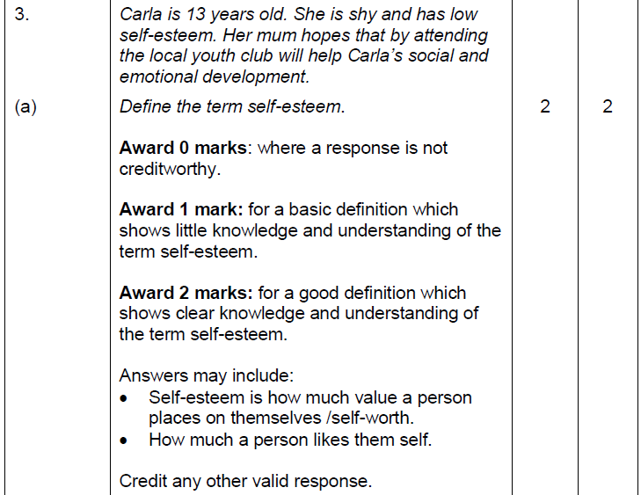
Question 3 (a) AO1 mark scheme
What we are looking for here is evidence that you can demonstrate your knowledge and understanding of the term self-esteem. You will have learnt this as part of the topic on self-concept.
Notes:
Here is the mark scheme for question 3 (a).
What we are looking for here is evidence that you can demonstrate your knowledge and understanding of the term self-esteem. You will have learnt this as part of the topic on self-concept.

Slide 19
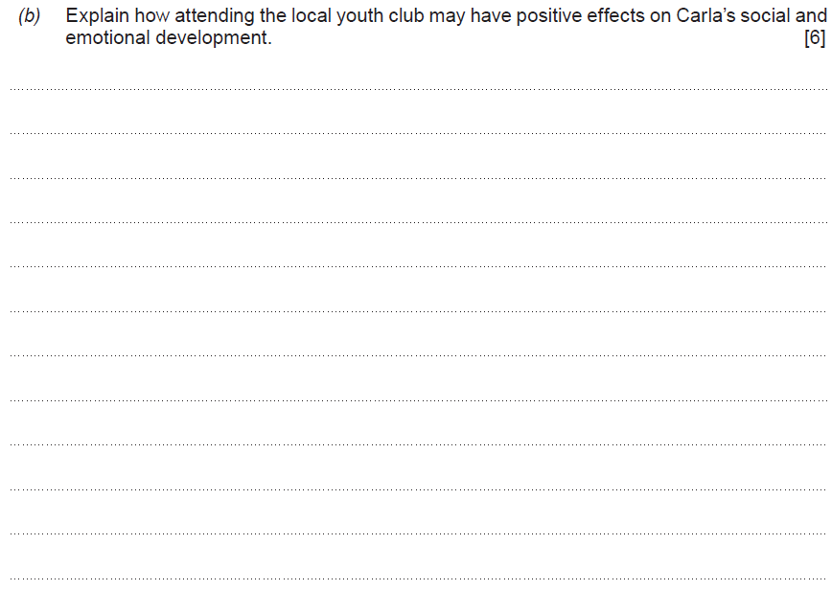
Question 3 (b), AO2
This question has multiple lines. The command word is ‘explain’ so extended writing is now needed.
Explain – provide details and reasons why and how something is the way it is.
You will need to refer to both social and emotional development in your answer.
Notes:
Read the question.
This question has multiple lines. The command word is ‘explain’ so extended writing is now needed.
Explain – provide details and reasons why and how something is the way it is.
You will need to refer to both social and emotional development in your answer.

Slide 20
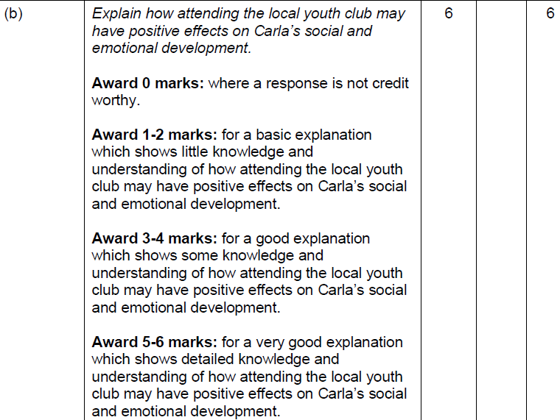
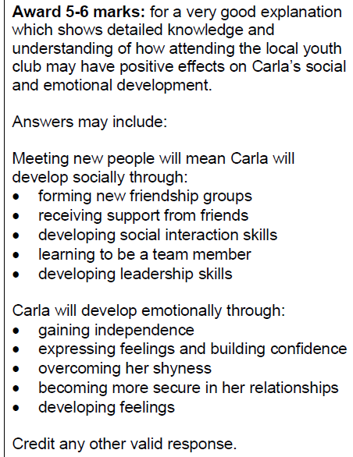
Question 3 (b) AO2 mark scheme
What we are looking for here is evidence that you can demonstrate your knowledge and understanding of both social and emotional development and relate your answer to Carla. This is a banded mark scheme – so you need to make a judgement on your response before awarding a mark.
Notes:
Here is the mark scheme for question 3 (b).
What we are looking for here is evidence that you can demonstrate your knowledge and understanding of both social and emotional development and relate your answer to Carla. This is a banded mark scheme – so you need to make a judgement on your response before awarding a mark.

Slide 21
How do I tackle Question 4?
Question 4
Skills being tested:
AO1 – demonstrate knowledge and understanding
AO2 – apply knowledge and understanding of health and social care principles and contexts
Approach:
Read question 4 (a) and (b).
Highlight key words/command verbs.
Check the number of marks for each part of the question so you spend your time appropriately.
Think carefully about your answer.
The number of lines available indicates the length of the required response.
Part (b) requires some extended writing and is a high tariff question; therefore, you will need to plan your answer.
Notes:
Read slide.

Slide 22
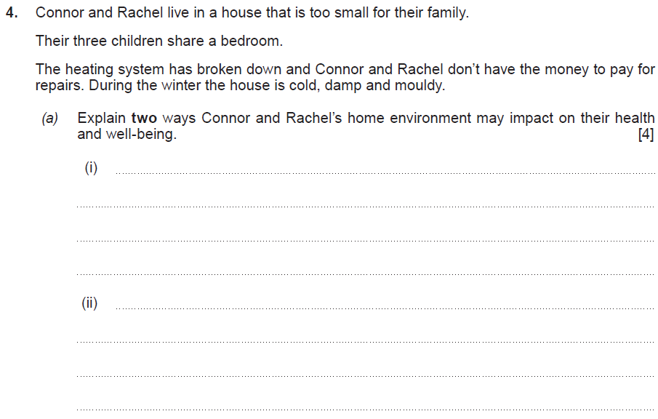
Question 4 (a), AO2
Read through the information carefully before answering the question. This is called the rider. Use your highlighter pen to identify key words in the rider before writing your answer.
The question is asking for ‘two ways’.
Notes:
Read the question.
Read through the information carefully before answering the question. This is called the rider. Use your highlighter pen to identify key words in the rider before writing your answer.
The question is asking for ‘two ways’.

Slide 23
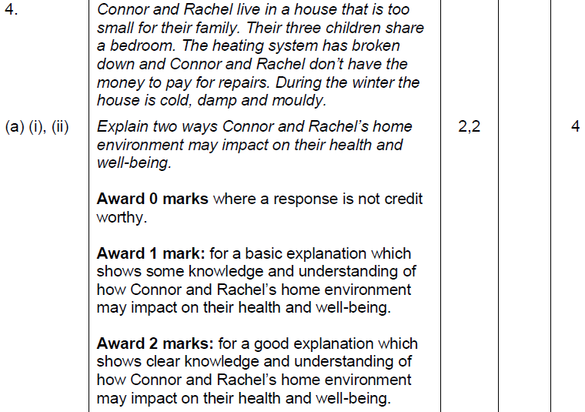
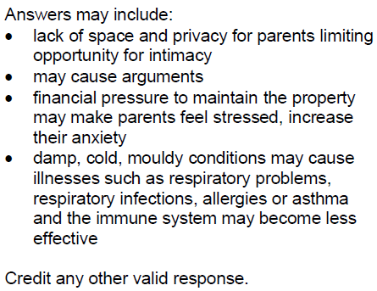
Question 4 (a) AO2 mark scheme
What we are looking for here is evidence that you can demonstrate your knowledge and understanding of the influence of life factors – home environment – on health and well-being.
Notes:
Here is the mark scheme for question 4 (a).
What we are looking for here is evidence that you can demonstrate your knowledge and understanding of the influence of life factors – home environment – on health and well-being.

Slide 24
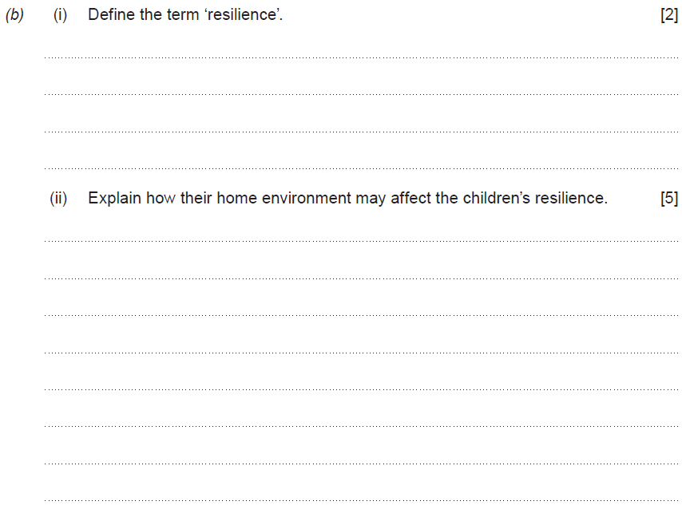
Question 4 (b), AO1 and AO2
You will need to understand the meaning of the term ‘resilience’ in order to answer this question.
This question has multiple lines. The command word is ‘explain’ so extended writing is now needed.
Explain – provide details and reasons why and how something is the way it is.
Notes:
Read the question.
You will need to understand the meaning of the term ‘resilience’ in order to answer this question.
This question has multiple lines. The command word is ‘Explain’ so extended writing is now needed.
Explain – provide details and reasons why and how something is the way it is.

Slide 25
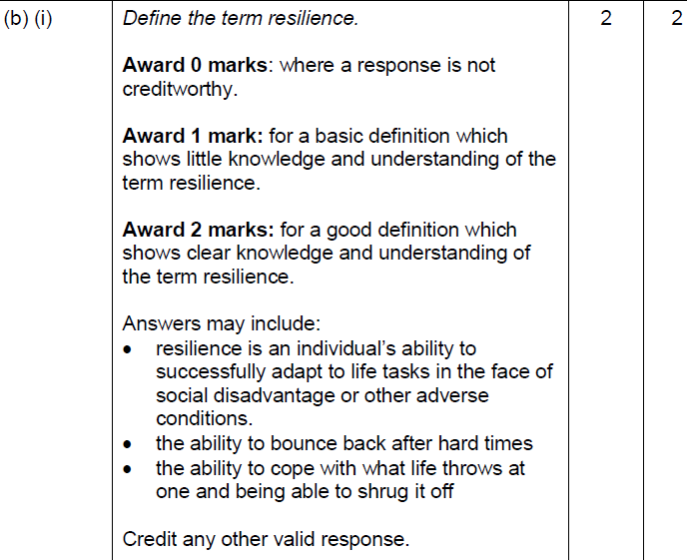
Question 4 (b) (i) AO1 mark scheme
This is a banded mark scheme – so you need to make a judgement on your response before awarding a mark.
Notes:
Here is the mark scheme for question 4 (b )(i).
This is a banded mark scheme – so you need to make a judgement on your response before awarding a mark.

Slide 26
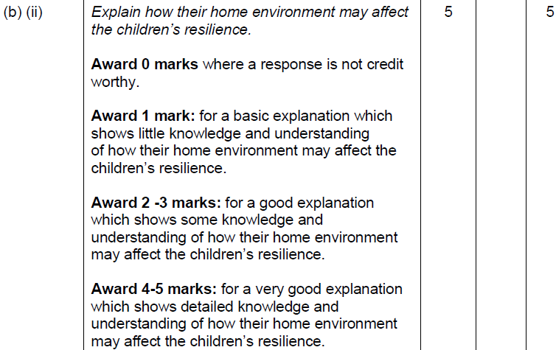
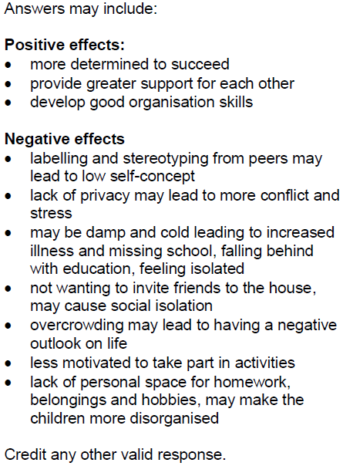
Question 4 (b) (ii) AO2 mark scheme
What we are looking for here is evidence that you can demonstrate your knowledge and understanding of both positive and negative effects on the children’s resilience.
Look at your answers and underline anything that is in these lists.
Notes:
Here is the mark scheme for question 4 (b)(ii).
What we are looking for here is evidence that you can demonstrate your knowledge and understanding of both positive and negative effects on the children’s resilience.
Look at your answers and underline anything that is in these lists.

Slide 27
How do I tackle Question 5?
Question 5
Skills being tested:
AO1 – demonstrate knowledge and understanding
AO2 – apply knowledge and understanding of health and social care principles and contexts
Approach:
Read question 5 (a), (b) and (c).
Highlight key words/command verbs.
Check the number of marks for each part of the question so you spend your time appropriately.
Think carefully about your answer.
The number of lines available indicates the length of the required response
Notes:
Read slide.

Slide 28
Question 5 (a), AO1
You will need to understand the term ‘ACEs’. You will find this and other subject terminology in the ‘Glossary of terms’. It is important that you use these sector-related terms in your work.
Reading the question carefully and underlining key words will help you understand what you are being asked. The command word is ‘Describe’ which means provide main features. It is important to remember that you are not being asked for an example here – that is part (b).
Notes:
Read the question.
Reading the question carefully and underlining key words will help you understand what you are being asked.
You will need to understand the term ‘ACEs’. You will find this and other subject terminology in the ‘Glossary of Terms’. It is important that you use these sector-related terms in your work.
The command word is ‘Describe’ which means provide main features. It is important to remember that you are not being asked for an example here – that is part (b).

Slide 29
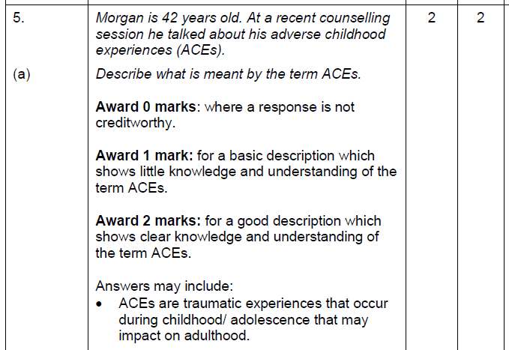
Question 5 (a) AO1 mark scheme
What we are looking for here is evidence that you can demonstrate your knowledge and understanding of ACEs.
Notes:
Here is the mark scheme for question 5 (a).
What we are looking for here is evidence that you can demonstrate your knowledge and understanding of ACEs.

Slide 30
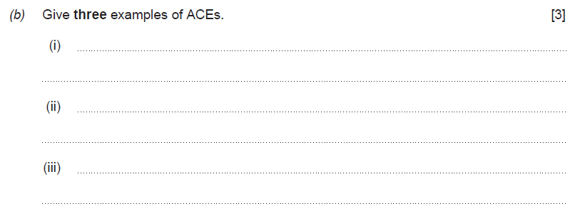
Question 5 (b), AO1
This part of the question requires three examples.
Make sure that each example you give is different .
Notes:
Read the question.
This part of the question requires three examples. Make sure that each example you give is different .

Slide 31
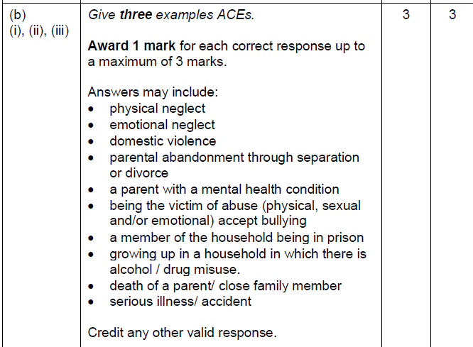
Question 5 (b) AO1 mark scheme
What we are looking for here is evidence that you can demonstrate your knowledge and understanding of ACEs by using examples.
Notes:
Here is the mark scheme for question 5 (b).
What we are looking for here is evidence that you can demonstrate your knowledge and understanding of ACEs by using examples.

Slide 32
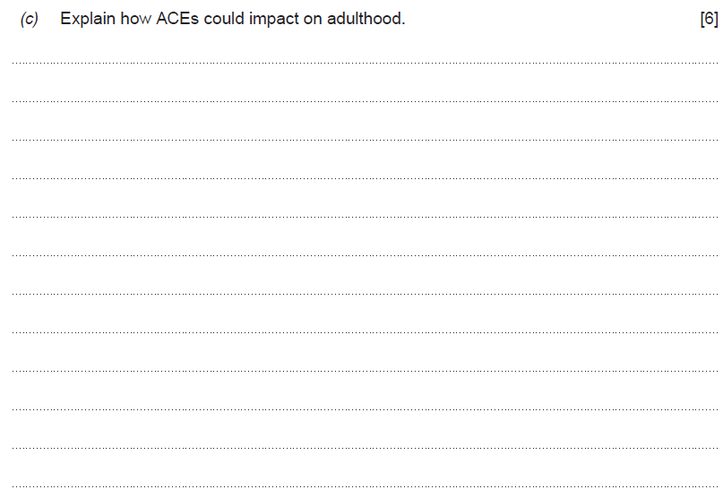
Question 5 (c), AO2
Key word here is ‘Impact’. Here, you are demonstrating your knowledge of ACEs but also applying your knowledge to show you understand the impact that they have.
The command word here is ‘Explain’ so extended writing is now needed.
Explain – provide details and reasons why and how something is the way it is.
Notes:
Read the question.
The command word here is ‘Explain’ so extended writing is now needed.
Explain – provide details and reasons why and how something is the way it is.
Key word here is ‘Impact’. Here, you are demonstrating your knowledge of ACEs but also applying your knowledge to show you understand the impact that they have.

Slide 33
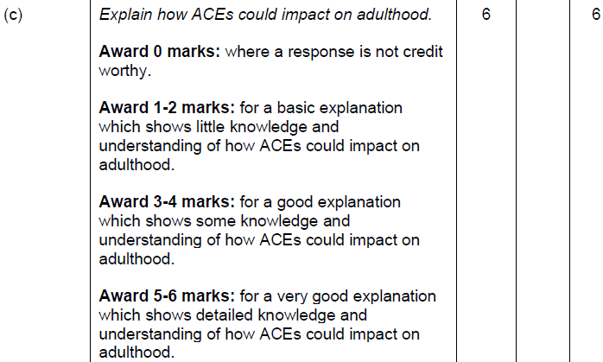
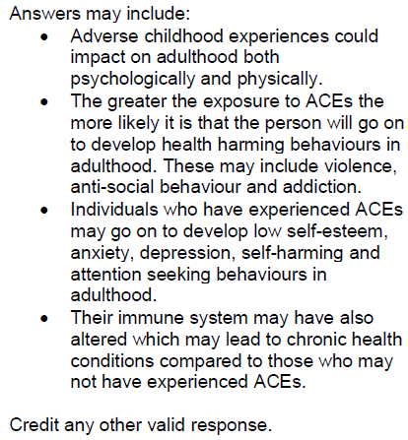
Question 5 (c) AO2 mark scheme
Look at your answers and underline anything that is in this list.
This is a banded mark scheme – so you need to make a judgement on your response before awarding a mark.
Notes:
Here is the mark scheme for question 5 (c).
Look at your answers and underline anything that is in this list.
This is a banded mark scheme – so you need to make a judgement on your response before awarding a mark.

Slide 34
How do I tackle Question 6?
Question 6
Skills being tested:
AO1 – demonstrate knowledge and understanding
AO2 – apply knowledge and understanding of health and social care principles and contexts
Approach:
Read question 6 (a), (b) and (c).
Highlight key words/command verbs.
Check the number of marks for each part of the question so you spend your time appropriately.
Think carefully about your answer.
The number of lines available indicates the length of the required response.
Notes:
Read slide

Slide 35
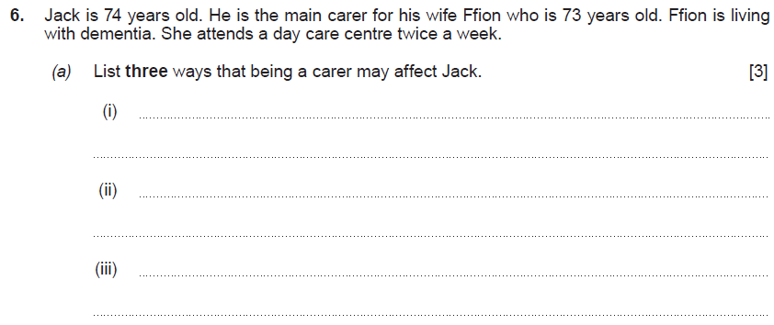
Question 6 (a), AO1
Command word here is ‘List’ – provide brief facts and examples. Your answer must relate to how being a carer affects Jack.
Notes:
Read the question.
Command word here is ‘List’ – provide brief facts and examples. Your answer must relate to how being a carer affects Jack.

Slide 36
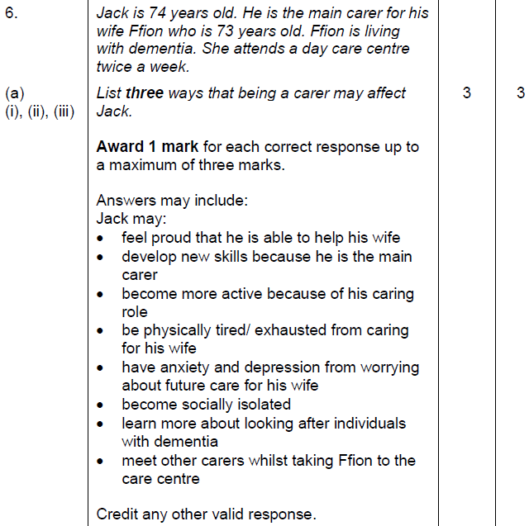
Question 6 (a) AO1 mark scheme
Award yourself a mark for each correct response.
Notes:
Here is the mark scheme for question 6 (a).
Award yourself a mark for each correct response.

Slide 37
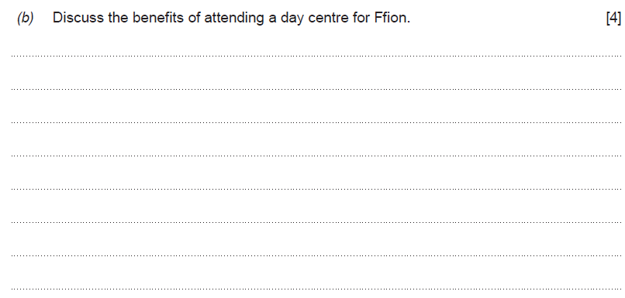
Question 6 (b), AO3
Command word here is ‘Discuss’ – examine an issue in detail/in a structured way, taking into account different ideas.
It is important here to discuss several benefits to Ffion.
Notes:
Read the question.
Command word here is ‘Discuss’ – examine an issue in detail/in a structured way, taking into account different ideas.
It is important here to discuss several benefits to Ffion.

Slide 38
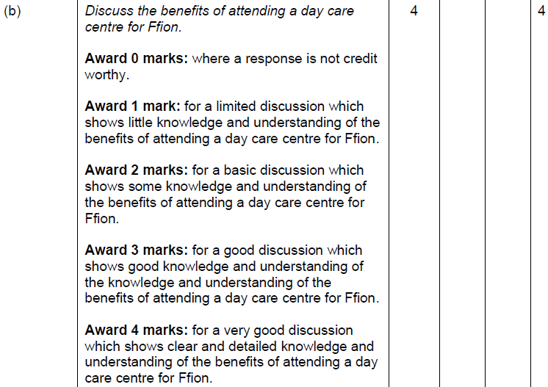
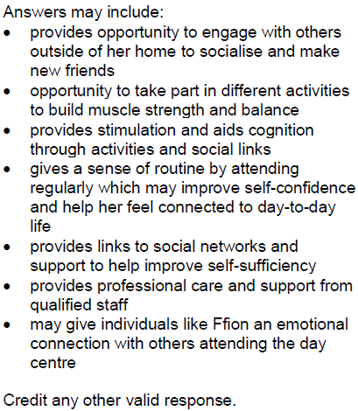
Question 6 (b) AO3 mark scheme
This is a banded mark scheme – so you need to make a judgement on your response before awarding a mark.
Notes:
Here is the mark scheme for question 6 (b).
This is a banded mark scheme – so you need to make a judgement on your response before awarding a mark.

Slide 39
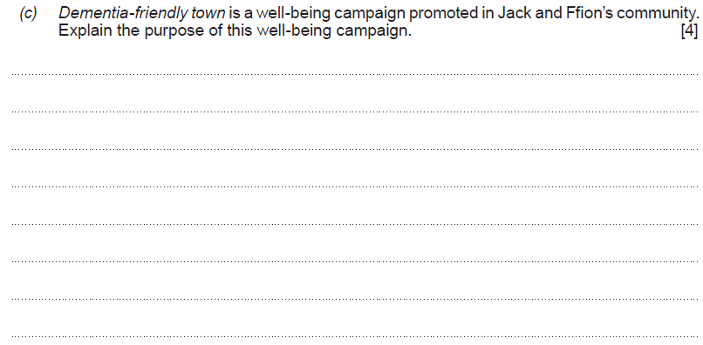
Question 6 (c), AO2
Explain – provide details and reasons why and how something is the way it is.
Keyword here is ‘purpose’ – the reason for which something exists.
Notes:
Read the question.
Explain – provide details and reasons why and how something is the way it is.
Keyword here is ‘purpose’ – the reason for which something exists.

Slide 40
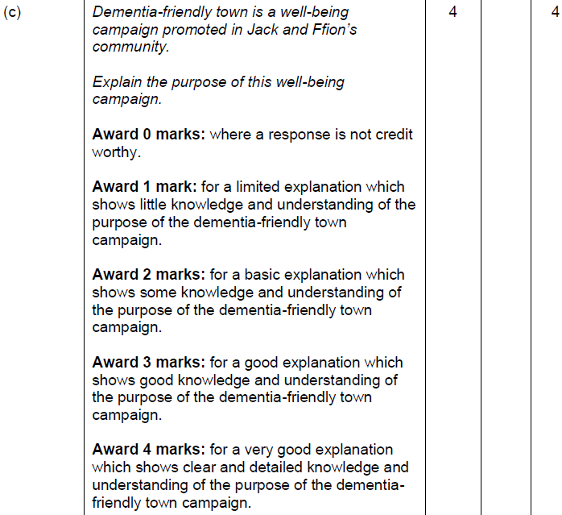
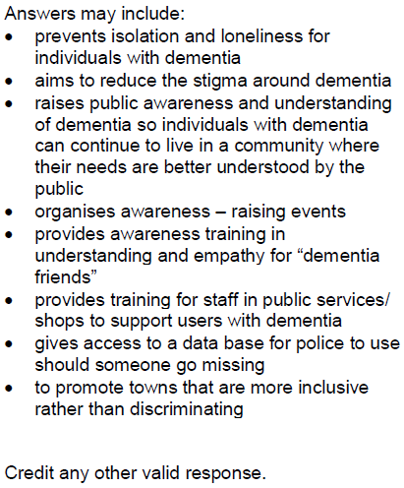
Question 6 (c) AO2 mark scheme
This is a banded mark scheme – so you need to make a judgement on your response before awarding a mark.
Notes:
Here is the mark scheme for question 6 (c)
This is a banded mark scheme – so you need to make a judgement on your response before awarding a mark.

Slide 41
How do I tackle Question 7?
Question 7
Skills being tested
AO1 – demonstrate knowledge and understanding
AO3 – analyse and reflect on all aspects of health and social care principles and contexts
Approach:
Read question 7 (a) and (b).
Highlight key words/command verbs.
Check the number of marks for each part of the question so you spend your time appropriately.
Think carefully about your answer.
The number of lines available indicates the length of the required response.
Notes:
Read slide

Slide 42
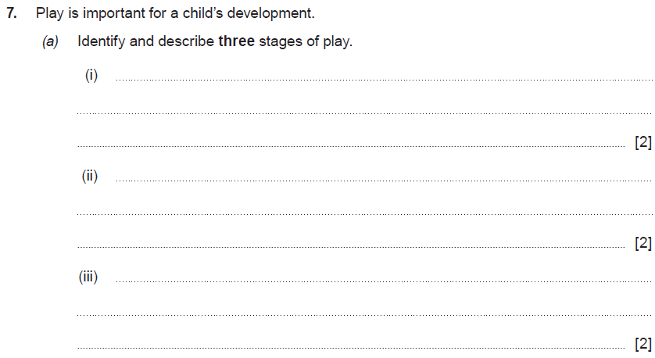
Question 7 (a), AO1
There are two command words in this question – ‘Identify’ and ‘describe’.
The question is asking you to ‘Identify’ – name the three stages of play; and then ‘describe’ – provide the main features of each stage.
Notes:
Read the question.
There are two command words in this question – ‘identify’ and ‘describe’.
The question is asking you to ‘identify’ – name the three stages of play; and then ‘describe’ – provide the main features of each stage.

Slide 43
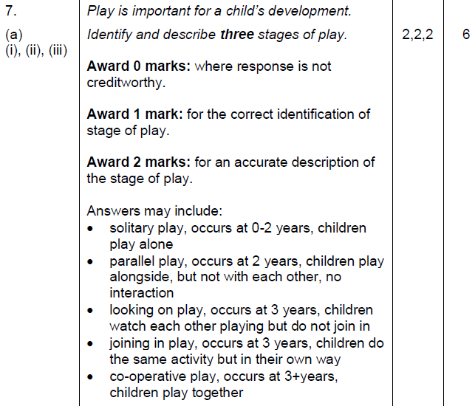
Question 7 (a) AO1 mark scheme
You will need to award yourself 1 mark for each stage of play that you have correctly identified and then another mark for an accurate description of the stage of play. There are 6 marks in total for this question.
Notes:
Here is the mark scheme for question 7 (c).
You will need to award yourself 1 mark for each stage of play that you have correctly identified and then another mark for an accurate description of the stage of play. There are 6 marks in total for this question.

Slide 44
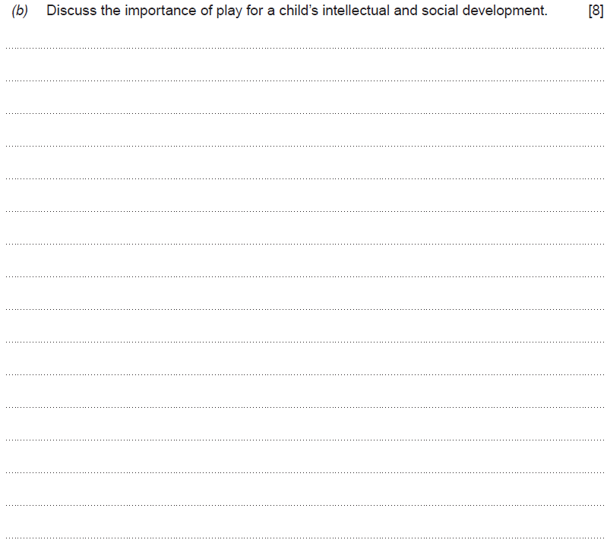
Question 7 (b), AO3
The command word here is ‘Discuss’ – examine an issue in detail/in a structured way, taking into account different ideas.
Take care not to repeat yourself in your answer. A good quality discussion that addresses both intellectual and social development is required to gain marks in the higher mark bands.
Notes:
Read the question.
The command word here is ‘Discuss’ – examine an issue in detail/in a structured way, taking into account different ideas.
Take care not to repeat yourself in your answer. A good quality discussion that addresses both intellectual and social development is required to gain marks in the higher mark bands.

Slide 45
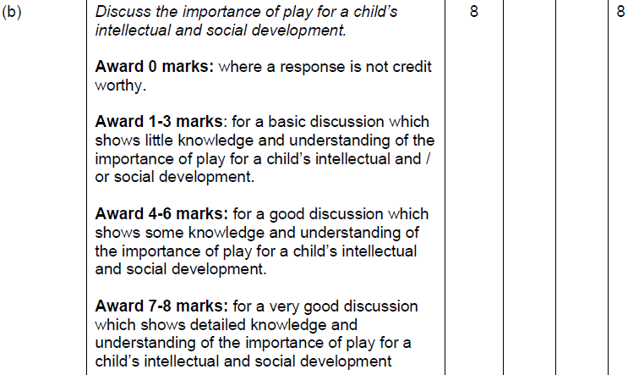
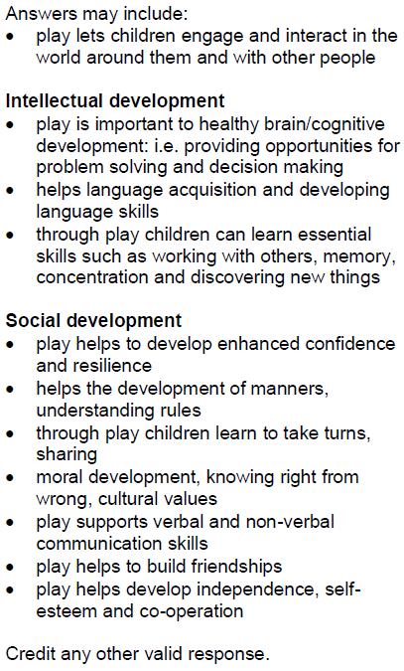
Question 7 (b) AO3 mark scheme
Look at your answers and underline anything that is in these lists.
This is a banded mark scheme – so you need to make a judgement on your response before awarding a mark.
Notes:
Here is the mark scheme for question 7 (b).
Look at your answers and underline anything that is in these lists.
This is a banded mark scheme – so you need to make a judgement on your response before awarding a mark.

Slide 46
How do I tackle Question 8?
Question 8
Skills being tested:
AO1 – demonstrate knowledge and understanding
AO2 – apply knowledge and understanding of health and social care principles and contexts
AO3 – analyse and reflect on all aspects of health and social care principles and contexts
Approach:
Read question 8 (a), (b) and (c).
Highlight key words/command verbs.
Check the number of marks for each part of the question so you spend your time appropriately.
Think carefully about your answer.
The number of lines available indicates the length of the required response.
Notes:
Read slide

Slide 47
Question 8 (a), AO1
Current campaigns are an important area of learning.
Notes:
Read the question.
Current campaigns are an important area of learning.

Slide 48
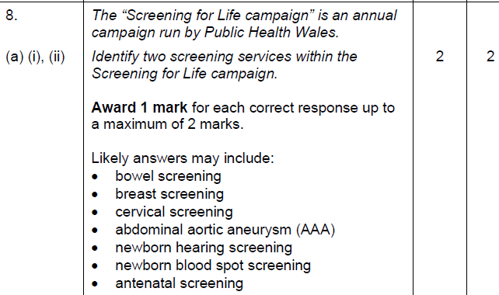
Question 8 (a) AO1 mark scheme
Award yourself 1 mark for each correctly identified screening service.
What we are looking for here is evidence that you can demonstrate your knowledge and understanding of screening services.
Notes:
Here is the mark scheme for question 8 (a).
Award yourself 1 mark for each correctly identified screening service.
What we are looking for here is evidence that you can demonstrate your knowledge and understanding of screening services.

Slide 49
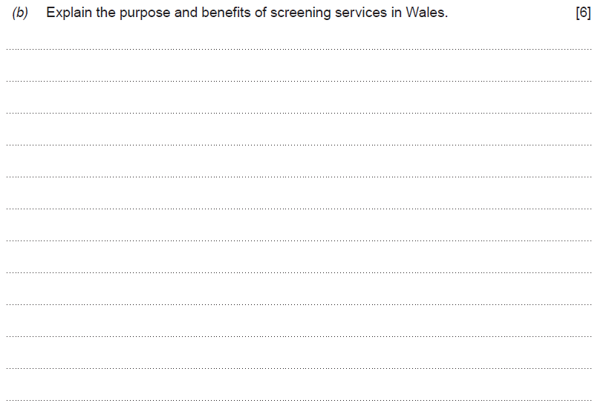
Question 8 (b), AO2
The command word here is ‘Explain’ – provide details and reasons for how and why something is the way it is.
Important key words are ‘purpose’ and ‘benefits’. Underlining these words may help you when writing your answer.
Notes:
Read the question.
The command word here is ‘Explain’ – provide details and reasons for how and why something is the way it is.
Important key words are ‘purpose’ and ‘benefits’. Underlining these words may help you when writing your answer.

Slide 50
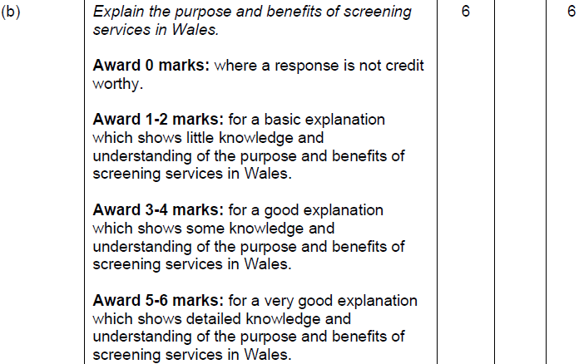
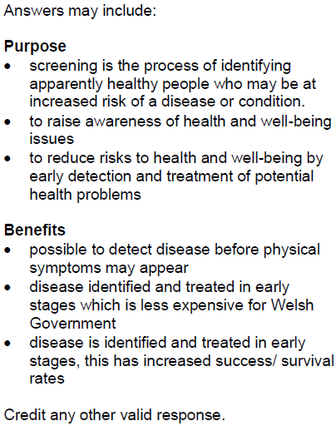
Question 8 (b) AO2 mark scheme
This is a banded mark scheme – so you need to make a judgement on your response before awarding a mark.
Notes:
Here is the mark scheme for question 8 (b).
This is a banded mark scheme – so you need to make a judgement on your response before awarding a mark.

Slide 51
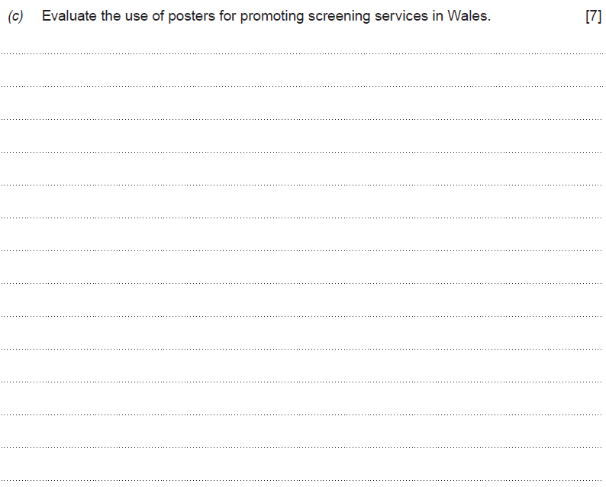
Question 8 (c), AO3
The command word here is ‘Evaluate’ – make a judgement by weighing up evidence to come to a conclusion.
Notes:
Read the question.
The command word here is ‘Evaluate’ – make a judgement by weighing up evidence to come to a conclusion.

Slide 52
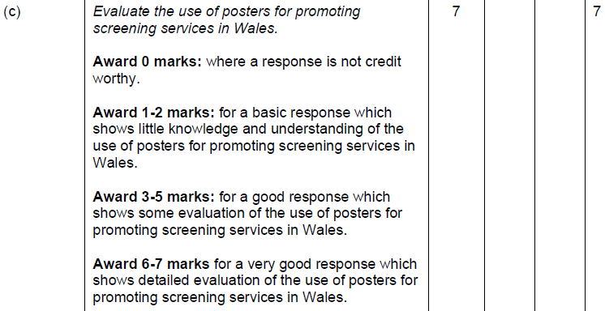
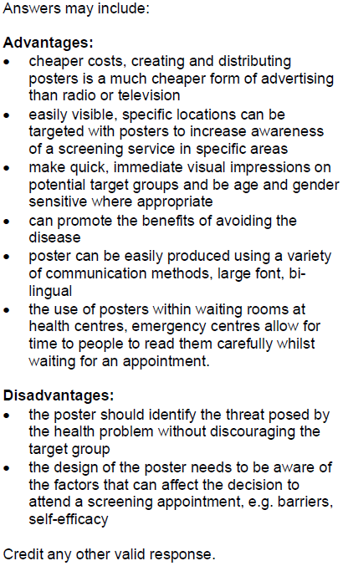
Question 8 (c) AO3 mark scheme
This is a banded mark scheme – so you need to make a judgement on your response before awarding a mark. Underline any answers in the lists you had included.
Notes:
Here is the mark scheme for question 8 (c).
This is a banded mark scheme – so you need to make a judgement on your response before awarding a mark.
Underline any answers in the lists you had included.

Slide 53
How did you do?
Here are the grade boundaries for this paper:
Notes:
Well done – you have made it to the end of the paper.
You should now be able to give yourself a mark out of 80.

Slide 54
Any questions?
Do you have any further questions about this exam?
If so, write them on a Post-It note and stick it to the front of your paper to give to your teacher.
Notes:
Read the slide.

