Slide 1
Level 2 Health and Social Care:
Principles and Contexts
Unit 1: Promoting health and well-being throughout the life stages

Slide 2
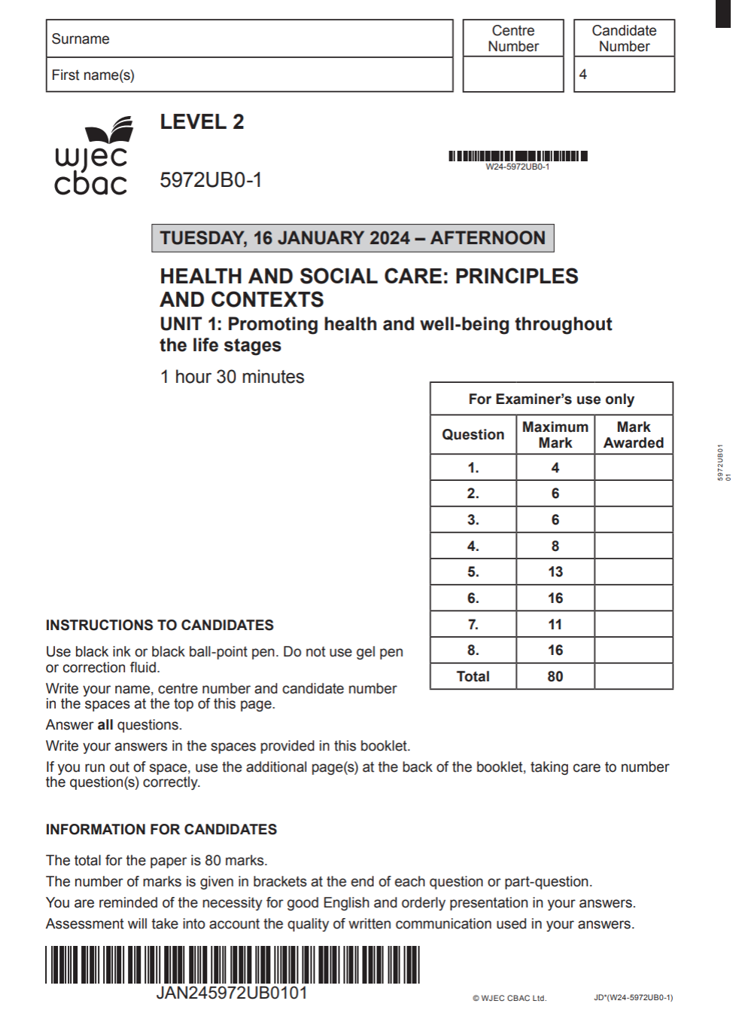

Unit 1: Promoting health and well-being throughout the life stages
Online examination review (OER)

Slide 3
General points on exam technique
Read through the whole question before starting to answer. This will help you understand what is required of you.
Use a highlighter to pick out key words.
Look at the command words and the number of marks available for each question, they will help you decide how much detail is needed.
If a word is bold, it is important.
Keep your exam paper open at the double page spread, do not fold it in half.
Read your answers to check they make sense.

Slide 4
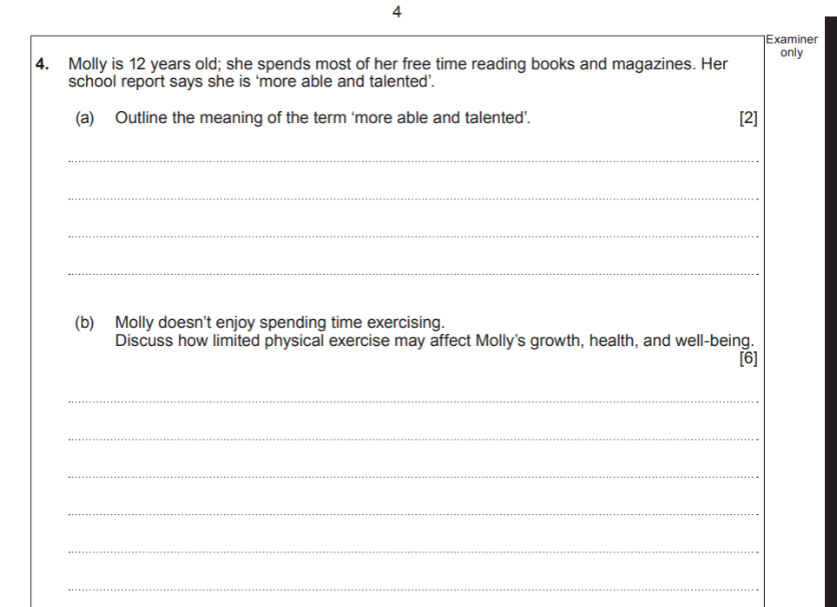
Question 4

Slide 5
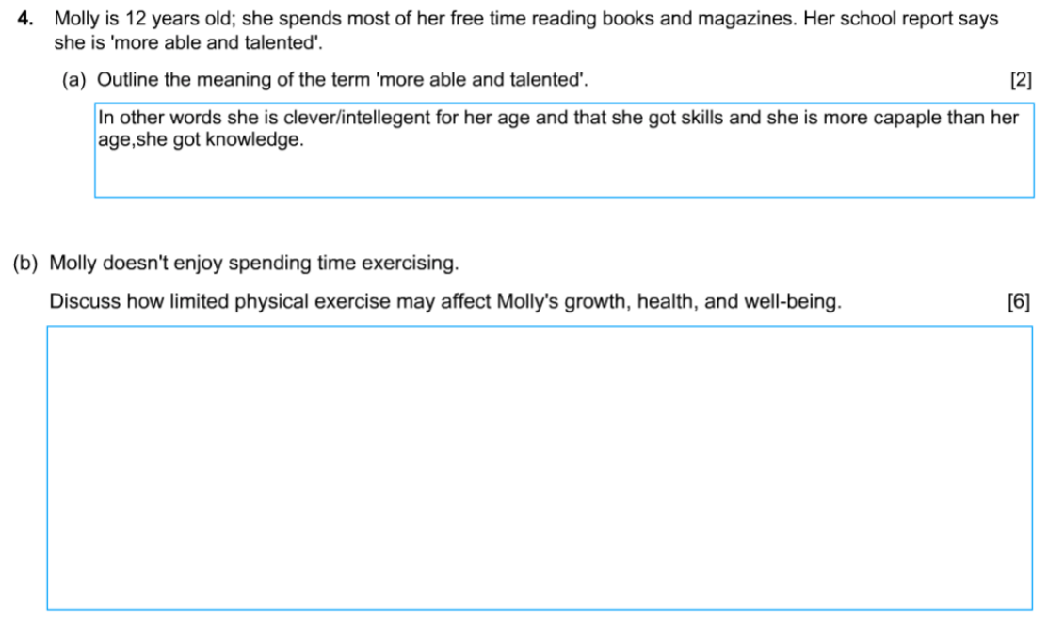
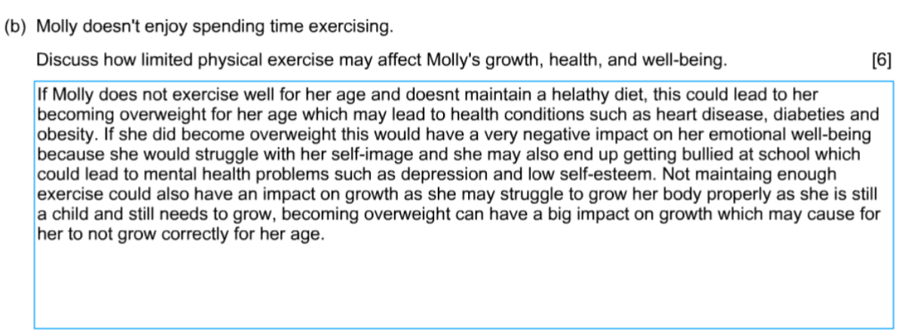
Question 4, candidate 1 response

Slide 6
Question 4,candidate 1 response with examiner’s comments
The candidate was awarded 2
marks. Correctly outlining Molly is more
intelligent/ capable than her age.
The candidate was awarded 4 marks.
The response is good, discussing how
limited activity can lead to
weight related issues and self image.
The response is repetitive and lacks
positive effects, preventing access to the
top mark band.
Total marks awarded
(a) 2/2 and (b) 4/6

Slide 7
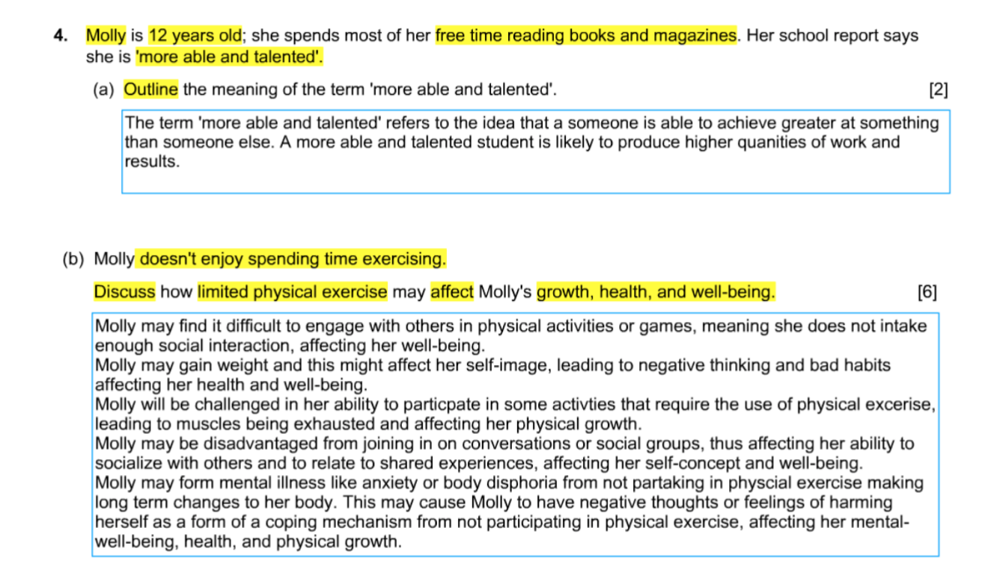
Question 4, candidate 2 response

Slide 8
Question 4,candidate 2 response with examiner’s comments
The candidate was awarded 2
marks. The response demonstrates
clear understanding of the term
‘more able and talented’.
Good exam technique to underline or
highlight the key words in the question.
But still needs to read carefully first!
The candidate was awarded the top
mark band for a detailed discussion of
social , physical and mental health
effects. Good use of subject language.
The response requires the addition
of a positive effect to be awarded
full marks
Total marks awarded
(a) 2/2 and (b) 5/6

Slide 9
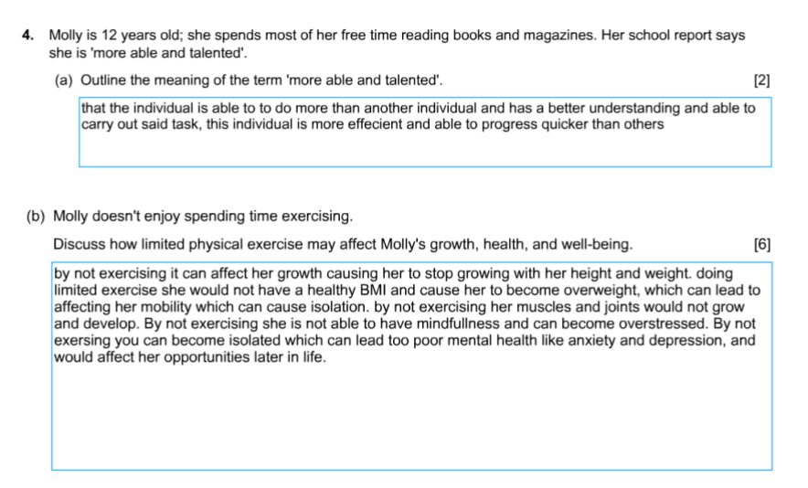
Question 4, candidate 3 response

Slide 10
Question 4,candidate 3 response with examiner’s comments
The candidate was awarded 2
marks. The response demonstrates
an outline of the term
‘more able and talented’.
The candidate was awarded the top
mark band for a detailed discussion of
social , physical and mental health
effects. Some use of subject language.
The response requires the addition
of a positive effect to be awarded
full marks.
Total marks awarded
(a) 2/2 and (b) 5/6

Slide 11
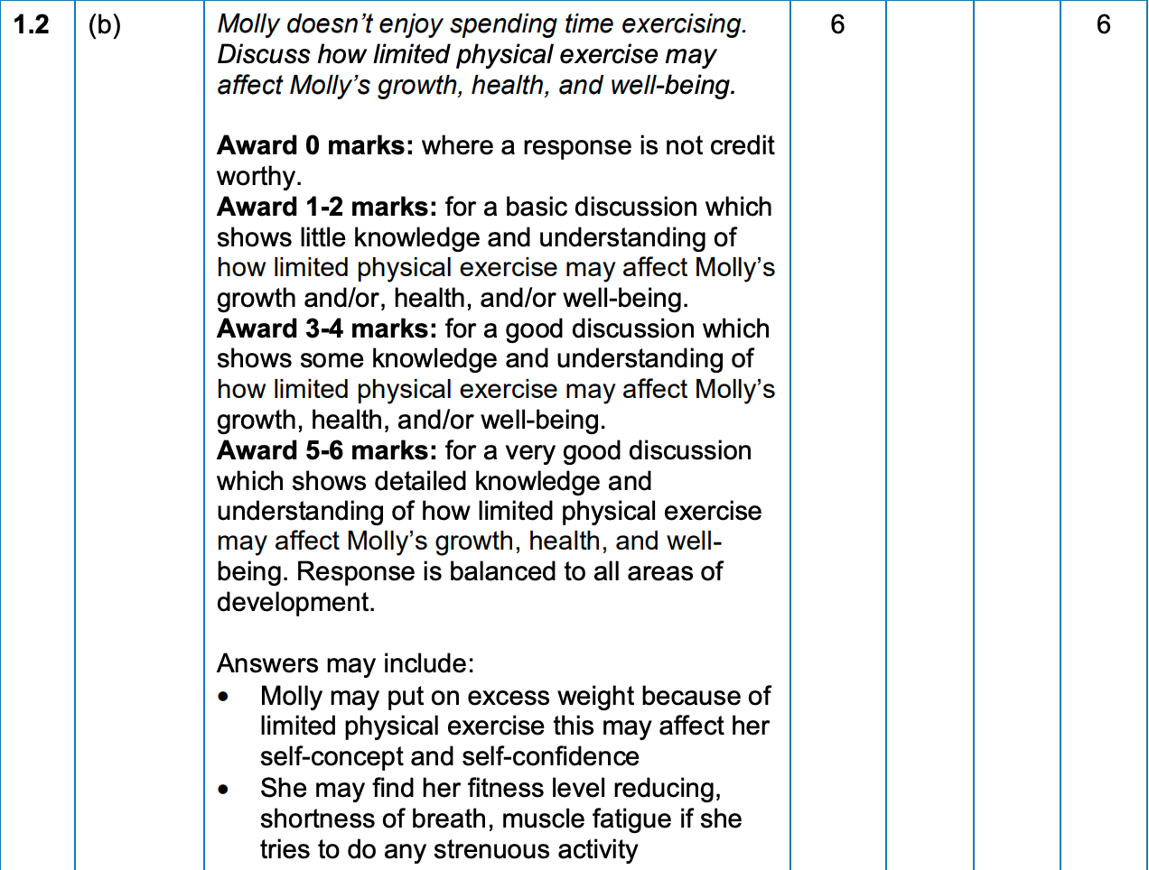
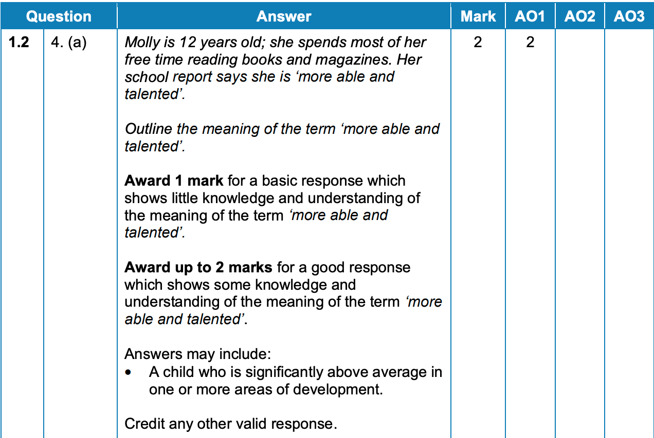
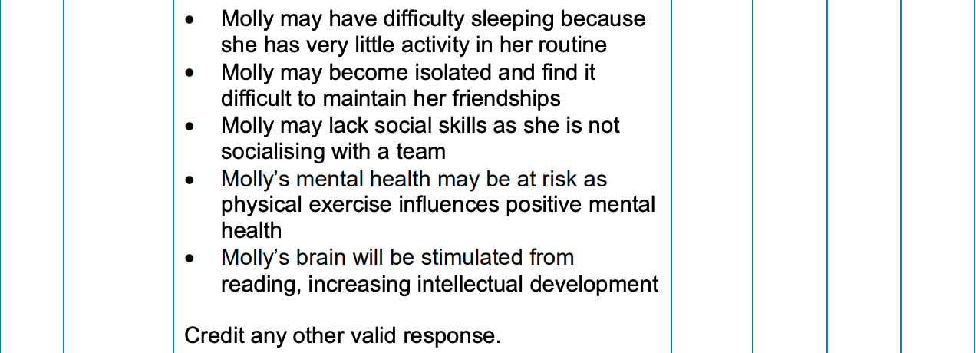
Question 4, mark scheme

Slide 12
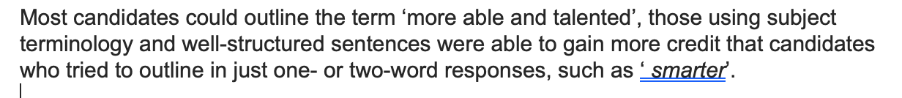
Principal Examiner Comments on question 4 (a), (b)
(b) There were a variety of responses to this question. The most common focus was on obesity and depression, which limited marks to the bottom/ lower middle mark band.
Candidates who understood the command word gave detailed discussion with a range of both positive and negative effects on Molly’s growth, health and well-being. These responses were awarded top mark band.

Slide 13
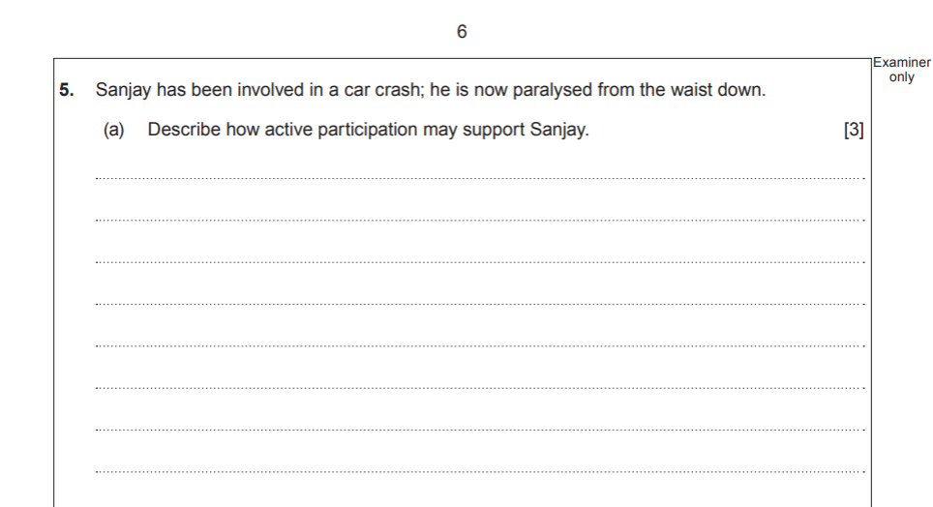
Question 5

Slide 14
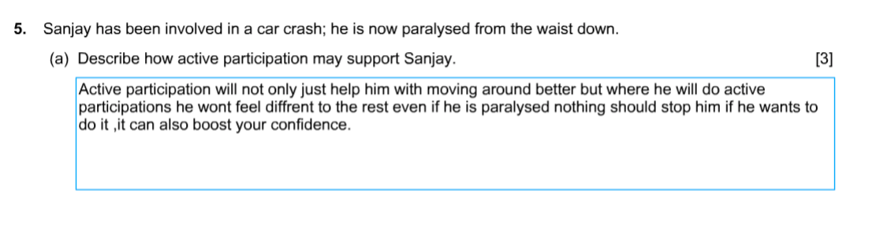
Question 5, candidate 1 response

Slide 15
Question 5,candidate 1 response with examiner’s comments
The candidate was awarded 0 marks.
There is no description of active participation.
The response is describing the
importance of being active.
Total marks awarded
0/3

Slide 16
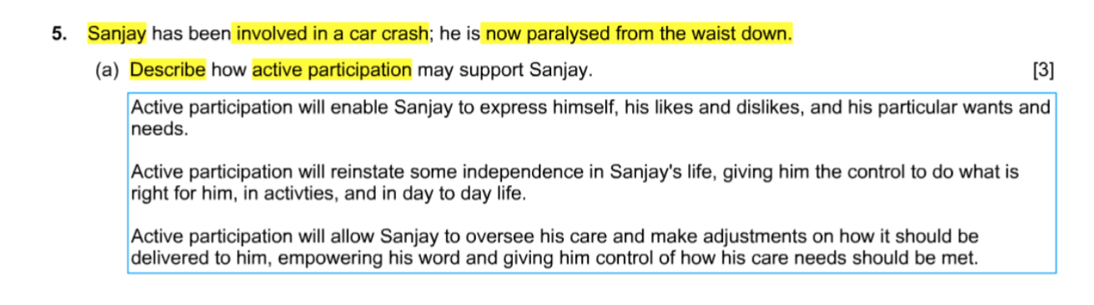
Question 5, candidate 2 response

Slide 17
Question 5,candidate 2 response with examiner’s comments
The candidate was awarded the full 3 marks
for a very good, detailed description
using subject terminology.
Total marks awarded
3/3

Slide 18
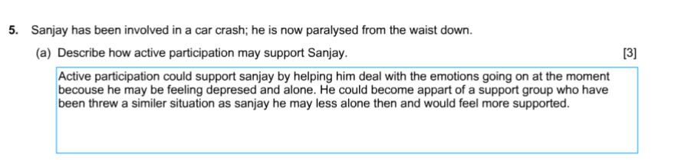
Question 5, candidate 3 response

Slide 19
Question 5,candidate 3 response with examiner’s comments
The candidate was awarded 0 marks
The response shows no knowledge of active
participation.
Possibly the candidate has misread the question
and is suggesting the benefit of joining a
support group.
Total marks awarded
0/3

Slide 20
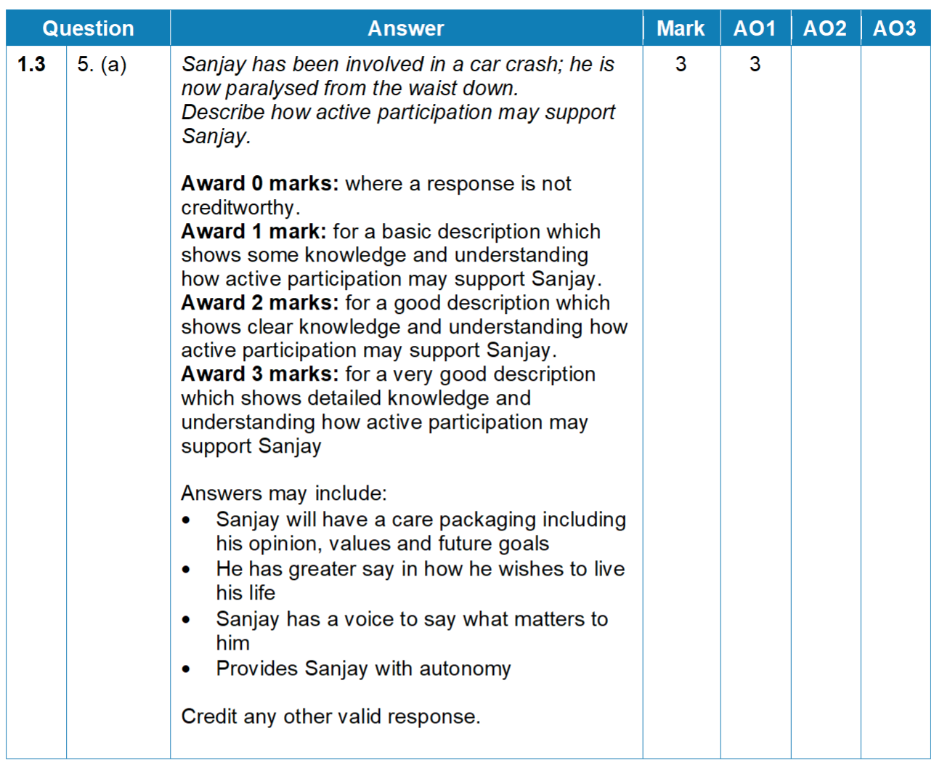
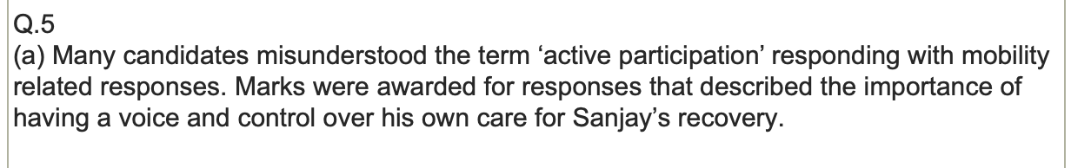
Question 5, mark scheme
Principal Examiner comments for this question

Slide 21
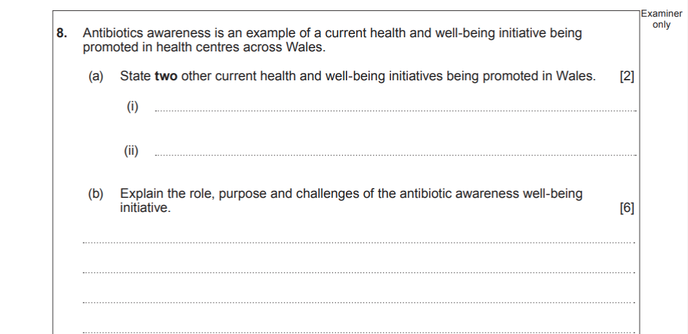
Question 8

Slide 22
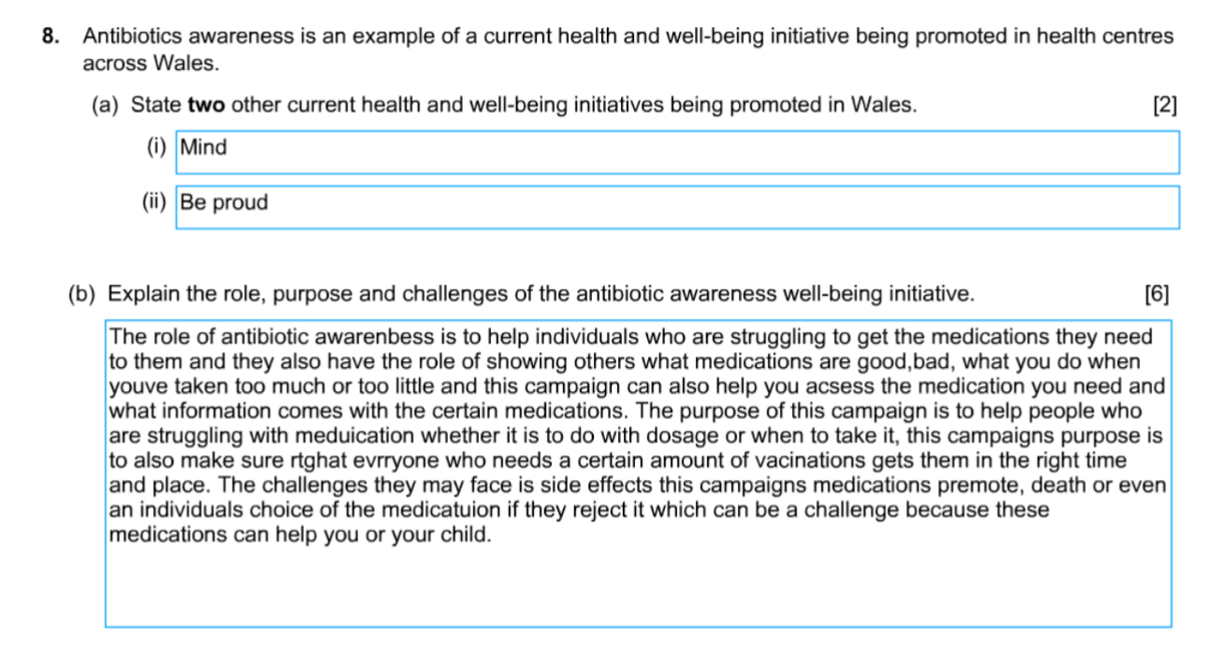
Question 8, candidate 1 response

Slide 23
Question 8,candidate 1 response with examiner’s comments
The candidate was awarded 0
marks. MIND is a charity, not
well-being initiative.
Be proud, not recognised.
The candidate was awarded 0
marks. No explanation was given
for role, purpose and challenges of
The antibiotics awareness campaign.
Total marks awarded
(a) 0/2 and (b) 0/6

Slide 24
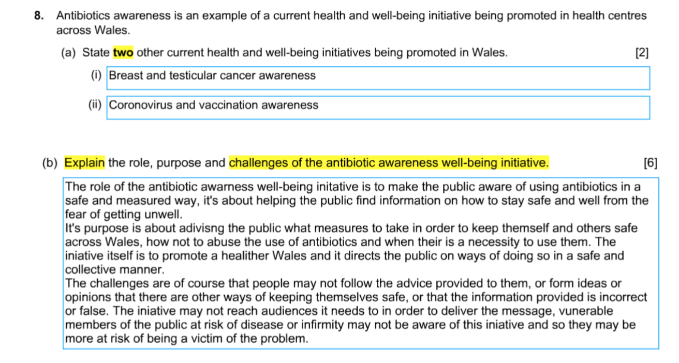
Question 8, candidate 2 response
Good use of highlighter to focus on the key words

Slide 25
Question 8,candidate 2 response with examiner’s comments
The candidate was awarded 2 marks for
clearly stating two different
well-being initiatives
The candidate was awarded 5 marks.
A well-structured response addressing
the full demands of the question.
A range of challenges such as:
the cost involved of producing
the initiatives, would have gained
full marks.
Total marks awarded
(a) 2/2 and (b) 5/6

Slide 26
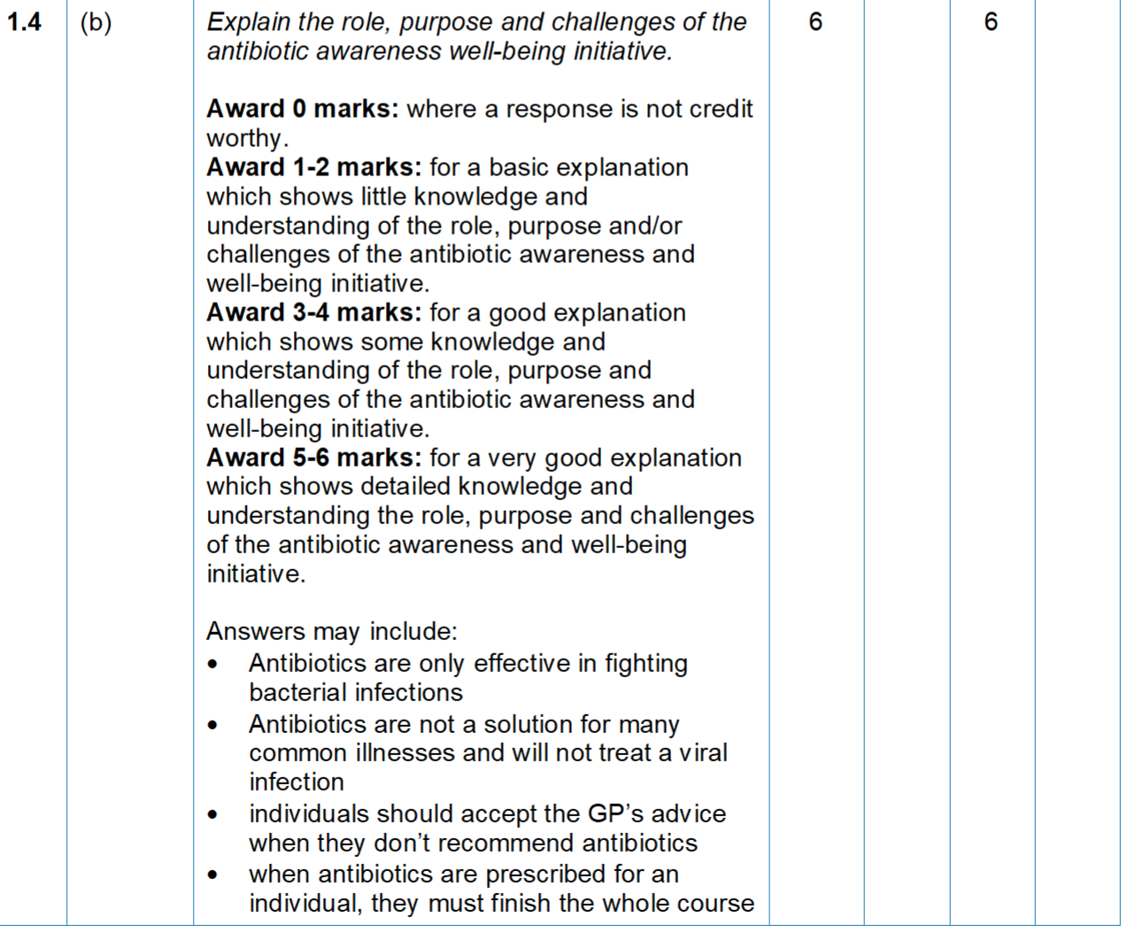
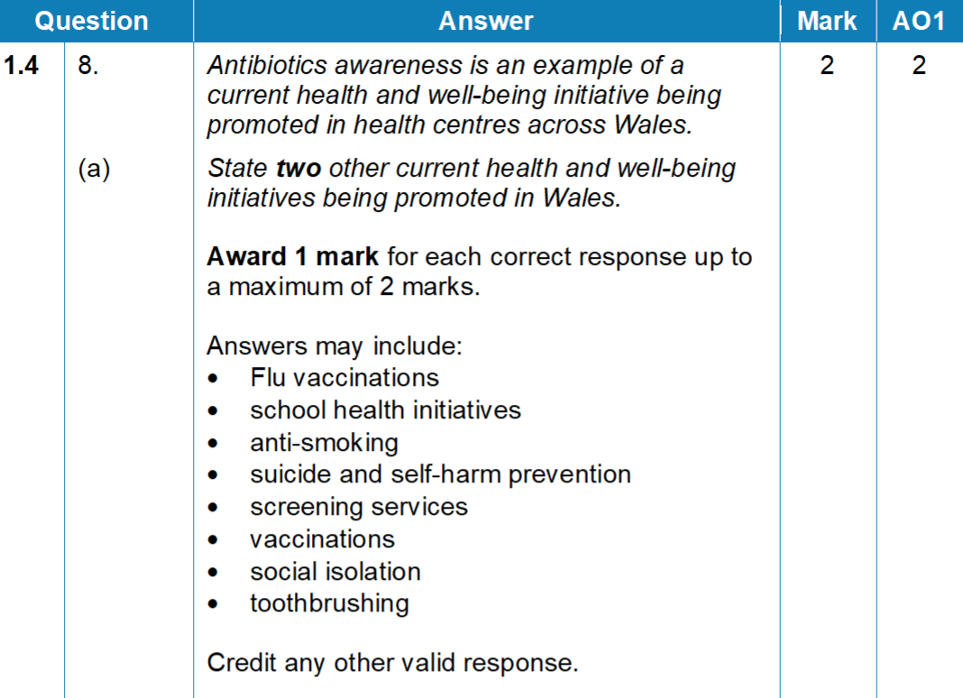
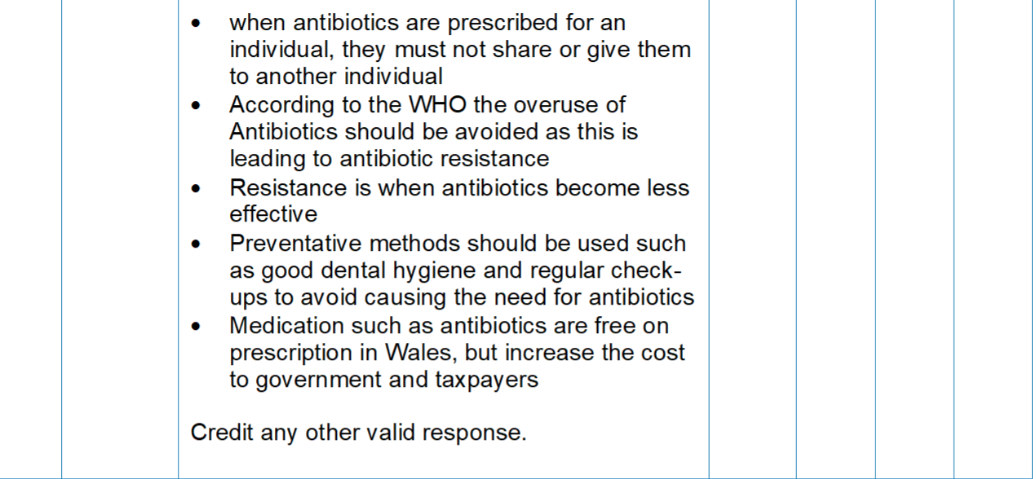
Question 8, mark scheme
New health and well-being initiatives are regularly introduced, but best place to start your learning is with the ones listed in the specification for this course.

Slide 27
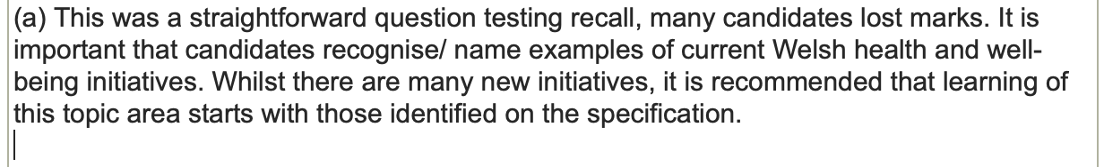
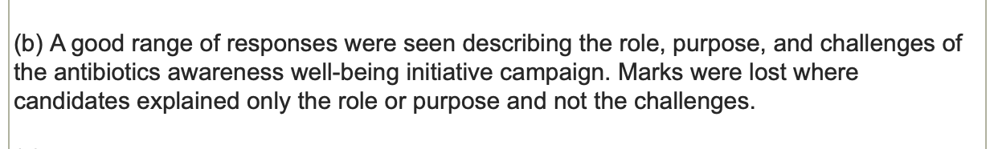
Principal Examiner comments for this question

Slide 28
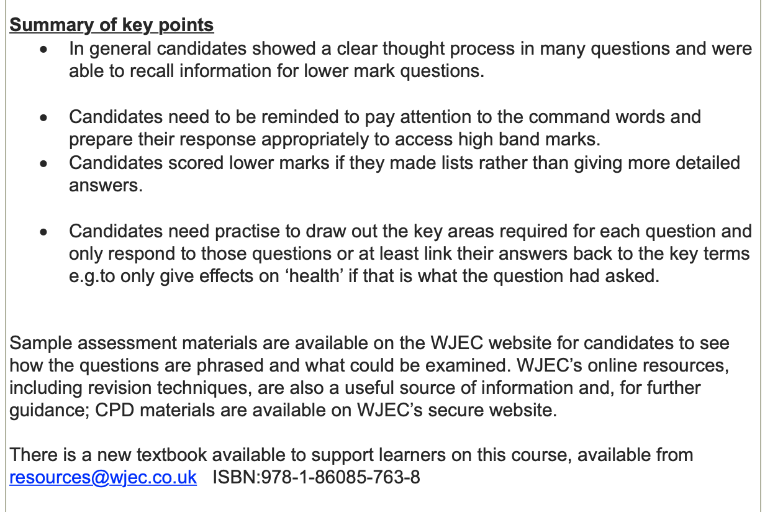
Principal Examiner Summary for the Winter 2024 Examination

Slide 29


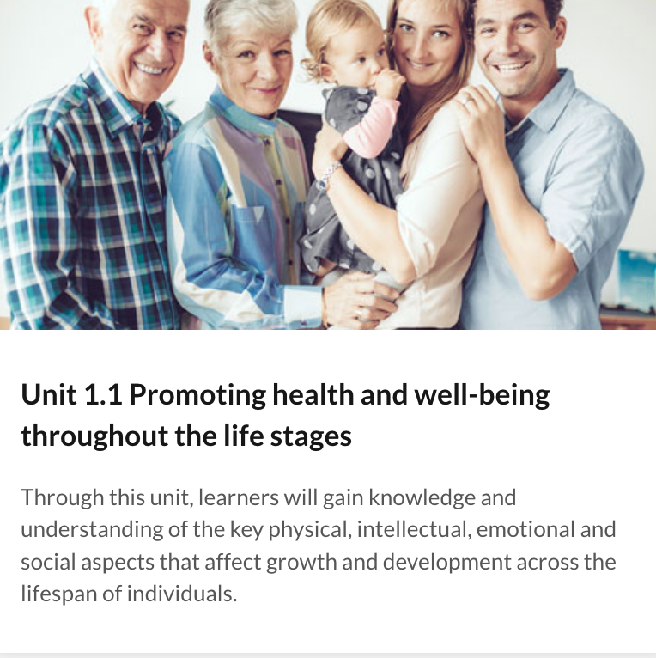
Visit wjec.co.uk for more resources for this qualification
New text-book to support learners

